Slide 1
ΑΝΑΝΕΩΣΙΜΕΣ ΠΗΓΕΣ ΕΝΕΡΓΕΙΑΣ
ΔΙΑΛΕΞΗ 10α
ΓΕΩΘΕΡΜΙΑ

Slide 4
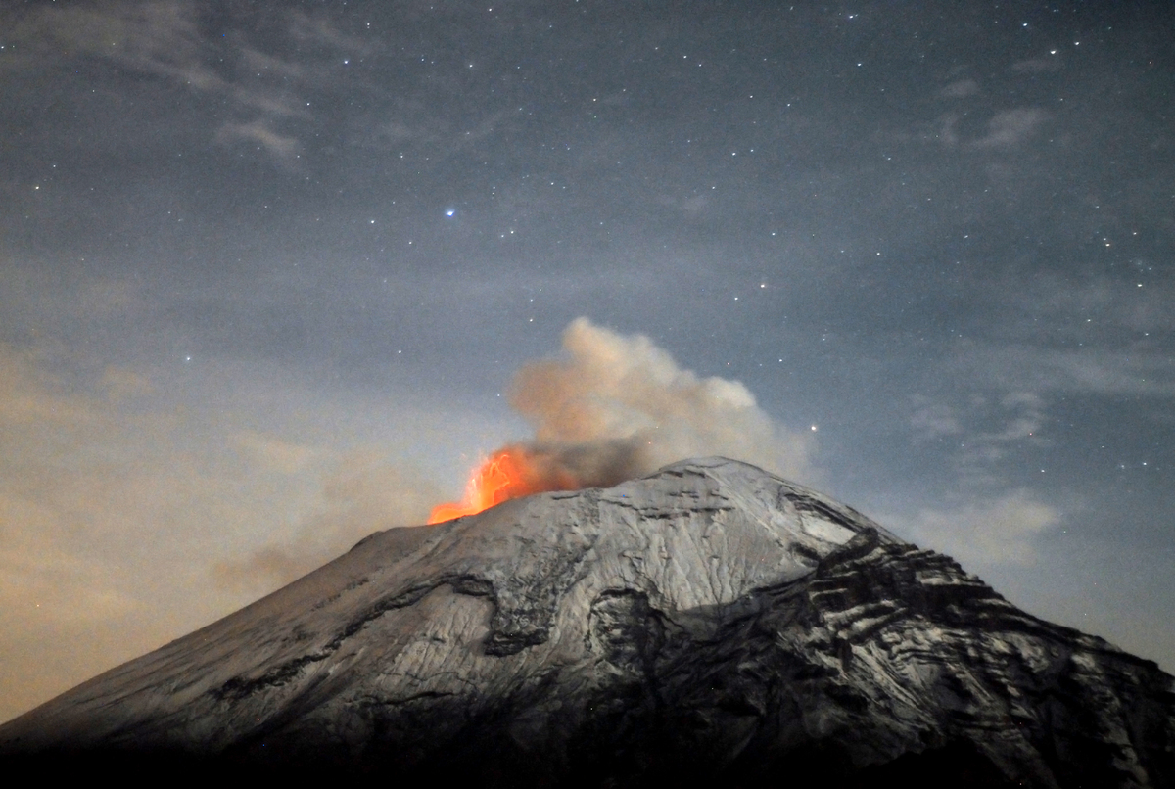
ΓΕΩΘΕΡΜΙΑ
ΘΕΡΜΟΤΗΤΑ ΣΤΟ ΥΠΕΔΑΦΟΣ
ΚΑΤΑΛΛΗΛΗ ΓΙΑ:
ΘΕΡΜΑΝΣΗ &
ΗΛΕΚΤΡΟΠΑΡΑΓΩΓΗ
ΜΕΣΩ ΤΟΥ ΑΤΜΟΥ, ΟΠΩΣ ΜΕ ΤΗΝ ΣΥΜΒΑΤΙΚΗ ΗΛΕΚΤΡΟΠΑΡΑΓΩΓΗ

Slide 5
ΓΕΩΘΕΡΜΙΑ : πώς γίνεται αντιληπτή στην επιφάνεια της Γης

Slide 6
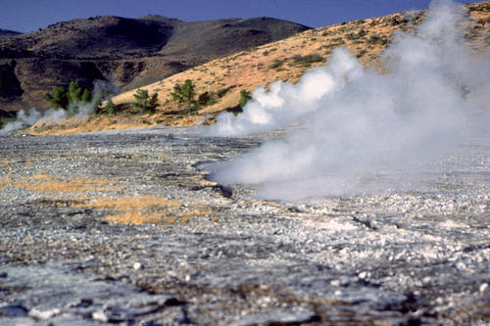
ΘΕΡΜΕΣ ΠΗΓΕΣ

Slide 7
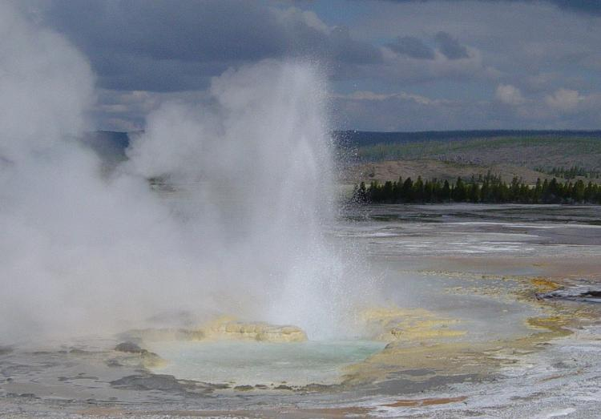
GEYSERS
Notes:
A geyser is a type of hot spring that erupts periodically, ejecting a column of hot water and steam into the air. The name geyser comes from Geysir, the name of an erupting spring at Haukadalur, Iceland; that name, in turn, comes from the Icelandic verb gjósa, "to gush".
The formation of geysers requires a favourable hydrogeology which exists in only a few places on Earth, and so they are fairly rare phenomena. About 1000 exist worldwide, with about half of these in Yellowstone National Park, USA (Glennon, J.A. 2005). Geyser eruptive activity may change or cease due to ongoing mineral deposition within the geyser plumbing, exchange of functions with nearby hot springs, earthquake influences, and human intervention (Bryan, T.S. 1995).

Slide 8
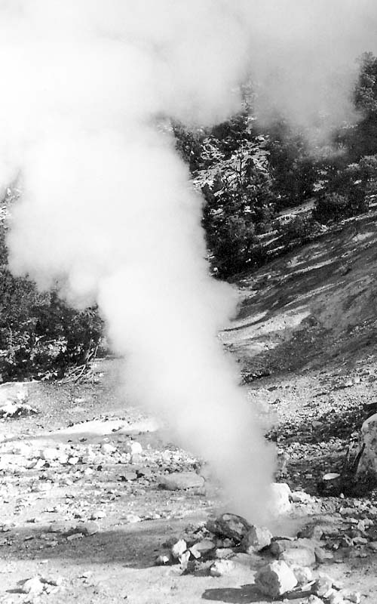
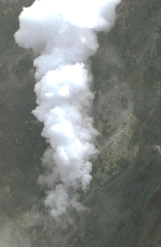
Fumaroles
Clay Diablo Fumarole (CA)
White Island Fumarole
New Zealand
Notes:
CDF is a fumarole in the Casa Diablo area, near the intersection of U.S. Highway 395 and State Highway 203. Vent temperature is measured a few times each year, has remained fairly stable between 92 and 94 degrees, and is the hottest of the 5 fumaroles that are monitored in the Long Valley caldera. Gas chemistry has been collected on several occasions (Farrar and others, 1985). Vent gas temperature and chemistry of CDF are monitored because changes in characteristics of CDF may indicate a change in the volcanic system.
This is an especially large fumarole on the inner wall of the central crater. Image the sound of a large roaring jet engine, and you get an impression of the noise it produces. Together with the steam, the smell of foul eggs (caused by sulphur) and because it's not the only fumarole in the crater, a view in the crater is like looking in hell's kitchen. - Christian Treber Copyrights information on the above image Location: Central Crater, White Island, New Zealand

Slide 9
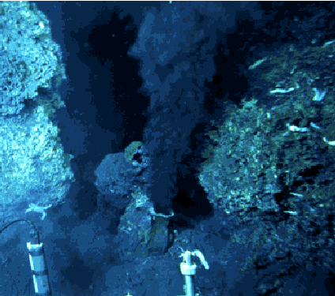
Ωκεανός-Γεωθερμική ατμίδα
Υπέρθερμη πηγή στον πυθμένα του ωκεανού όπου υπάρχουν ηφαιστειακά ρήγματα.
Υποστηρίζουν πλούσια ζωή στον γύρω χώρο.
Notes:
It's called a 'black smoker.' It's a super-heated vent found deep in the oceans and seas of the world where volcanic ridges are found. Miraculously, life thrives in these vents and one of them produces incredible amounts of hydrogen.

Slide 10
Αίτνα

Slide 11
Έκρηξη ηφαιστείου

Slide 12
Έκρηξη ηφαιστείου

Slide 13
ΝΙΣΥΡΟΣ – Ο ΚΡΑΤΗΡΑΣ ΤΟΥ ΗΦΑΙΣΤΕΙΟΥ

Slide 14
Νίσυρος

Slide 15
Νίσυρος

Slide 16
Νίσυρος: Επιφανειακές θερμοκρασίες

Slide 17
ΤΟ ΕΣΩΤΕΡΙΚΟ ΤΗΣ ΓΗΣ

Slide 18
Το εσωτερικό της Γης

Slide 19
Το εσωτερικό δυναμό της Γης
Notes:
Image from Mr. P. Chisholm's grade 10 class, Cornwall, Ontario, original source unknown.
This is only our observations - we think that the magnetic field is produced by what is called a self-generating dynamo.
The essentials of the idea are that:
The outer core is liquid Fe/Ni - conductive
At 20 degrees C, electrical conductivity of pure Fe ~ 107 W-1m-1
Estimate at core temperatures (~3000 degrees C?) and Pressures (> 150 Gpa) ~ 3.5 X 105 W-1m-1 - still a very good conductor (better than graphite).
Self generating dynamos can be made in the laboratory with conducting fluid metals (Mercury)
The outer core is also very hot - convecting, fluid is moving
What is Convection? Bouyancy driven motion - e.g. hot material is less dense and thus must rise. Essentially, convection occurs when heat cannot dissipate sufficiently quickly - thermal expansion occurs - density decreases - bouyancy force exceeds viscous resistance.

Slide 20
Θεωρία των τεκτονικών πλακών

Slide 21
ΤΕΚΤΟΝΙΚΕΣ ΠΛΑΚΕΣ
Notes:
In 1947, seismologists on the U.S. research ship Atlantis found that the sediment layer on the floor of the Atlantic was much thinner than originally thought. Scientists had previously believed that the oceans have existed for at least 4 billion years, so therefore the sediment layer should have been very thick. Why then was there so little accumulation of sedimentary rock and debris on the ocean floor? The answer to this question, which came after further exploration, would prove to be vital to advancing the concept of plate tectonics.

Slide 22
Συχνότητα σεισμών

Slide 23
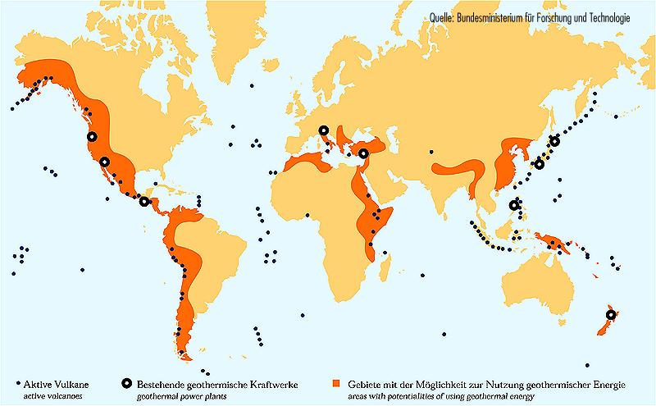
ΓΕΩΘΕΡΜΙΚΕΣ ΠΕΡΙΟΧΕΣ

Slide 24
Τι οδηγεί τις γεωτεκτονικές πλάκες
Notes:
Left: Conceptual drawing of assumed convection cells in the mantle (see text). Below a depth of about 700 km, the descending slab begins to soften and flow, losing its form. Below: Sketch showing convection cells commonly seen in boiling water or soup. This analogy, however, does not take into account the huge differences in the size and the flow rates of these cells.
The tectonic plates do not randomly drift or wander about the Earth's surface; they are driven by definite yet unseen forces. Although scientists can neither precisely describe nor fully understand the forces, most believe that the relatively shallow forces driving the lithospheric plates are coupled with forces originating much deeper in the Earth.
What drives the plates?
From seismic and other geophysical evidence and laboratory experiments, scientists generally agree with Harry Hess' theory that the plate-driving force is the slow movement of hot, softened mantle that lies below the rigid plates. This idea was first considered in the 1930s by Arthur Holmes, the English geologist who later influenced Harry Hess' thinking about seafloor spreading. Holmes speculated that the circular motion of the mantle carried the continents along in much the same way as a conveyor belt. However, at the time that Wegener proposed his theory of continental drift, most scientists still believed the Earth was a solid, motionless body. We now know better. As J. Tuzo Wilson eloquently stated in 1968, "The earth, instead of appearing as an inert statue, is a living, mobile thing." Both the Earth's surface and its interior are in motion. Below the lithospheric plates, at some depth the mantle is partially molten and can flow, albeit slowly, in response to steady forces applied for long periods of time. Just as a solid metal like steel, when exposed to heat and pressure, can be softened and take different shapes, so too can solid rock in the mantle when subjected to heat and pressure in the Earth's interior over millions of years.

Slide 25
Η κίνηση των τεκτονικών πλακών

Slide 26
ΓΕΩΛΟΓΙΚΗ ΠΡΟΪΣΤΟΡΙΑ

Slide 27
Γεωλογικές μετακινήσεις

Slide 28
Αποκλίνουσες/συγκλίνουσες/παράλληλα κινούμενες ζώνες
Notes:
Scientists now have a fairly good understanding of how the plates move and how such movements relate to earthquake activity. Most movement occurs along narrow zones between plates where the results of plate-tectonic forces are most evident.
There are four types of plate boundaries:
Divergent boundaries -- where new crust is generated as the plates pull away from each other.
Convergent boundaries -- where crust is destroyed as one plate dives under another.
Transform boundaries -- where crust is neither produced nor destroyed as the plates slide horizontally past each other.
Plate boundary zones -- broad belts in which boundaries are not well defined and the effects of plate interaction are unclear.

Slide 29
Κίνηση πλακών – Ωκεάνεια και Ηπειρωτική σύκλιση
Notes:
Off the coast of South America along the Peru-Chile trench, the oceanic Nazca Plate is pushing into and being subducted under the continental part of the South American Plate. In turn, the overriding South American Plate is being lifted up, creating the towering Andes mountains, the backbone of the continent. Strong, destructive earthquakes and the rapid uplift of mountain ranges are common in this region. Even though the Nazca Plate as a whole is sinking smoothly and continuously into the trench, the deepest part of the subducting plate breaks into smaller pieces that become locked in place for long periods of time before suddenly moving to generate large earthquakes. Such earthquakes are often accompanied by uplift of the land by as much as a few meters.

Slide 30
Κίνηση πλακών – Ωκεάνεια-Ωκεάνεια σύγκλιση
Notes:
Subduction processes in oceanic-oceanic plate convergence also result in the formation of volcanoes. Over millions of years, the erupted lava and volcanic debris pile up on the ocean floor until a submarine volcano rises above sea level to form an island volcano. Such volcanoes are typically strung out in chains called island arcs. As the name implies, volcanic island arcs, which closely parallel the trenches, are generally curved. The trenches are the key to understanding how island arcs such as the Marianas and the Aleutian Islands have formed and why they experience numerous strong earthquakes. Magmas that form island arcs are produced by the partial melting of the descending plate and/or the overlying oceanic lithosphere. The descending plate also provides a source of stress as the two plates interact, leading to frequent moderate to strong earthquakes.

Slide 31
Κίνηση πλακών – Ηπειρωτική-Ηπειρωτική σύγκλιση

Slide 32
Μεσο-ωκεάνεια Ράχη
Notes:
A theoretical model of the formation of magnetic striping. New oceanic crust forming continuously at the crest of the mid-ocean ridge cools and becomes increasingly older as it moves away from the ridge crest with seafloor spreading (see text): a. the spreading ridge about 5 million years ago; b. about 2 to 3 million years ago; and c. present-day. Early in the 20th century, paleomagnetists (those who study the Earth's ancient magnetic field) -- such as Bernard Brunhes in France (in 1906) and Motonari Matuyama in Japan (in the 1920s) -- recognized that rocks generally belong to two groups according to their magnetic properties. One group has so-called normal polarity, characterized by the magnetic minerals in the rock having the same polarity as that of the Earth's present magnetic field. This would result in the north end of the rock's "compass needle" pointing toward magnetic north. The other group, however, has reversed polarity, indicated by a polarity alignment opposite to that of the Earth's present magnetic field. In this case, the north end of the rock's compass needle would point south. How could this be? This answer lies in the magnetite in volcanic rock. Grains of magnetite -- behaving like little magnets -- can align themselves with the orientation of the Earth's magnetic field. When magma (molten rock containing minerals and gases) cools to form solid volcanic rock, the alignment of the magnetite grains is "locked in," recording the Earth's magnetic orientation or polarity (normal or reversed) at the time of cooling.

Slide 33
Μεσο-ωκεάνεια Ράχη
Notes:
Computer-generated detailed topographic map of a segment of the Mid-Oceanic Ridge. "Warm" colors (yellow to red) indicate the ridge rising above the seafloor, and the "cool" colors (green to blue) represent lower elevations. This image (at latitude 9° north) is of a small part of the East Pacific Rise. (Imagery courtesy of Stacey Tighe, University of Rhode Island.)
In the 1950s, oceanic exploration greatly expanded. Data gathered by oceanographic surveys conducted by many nations led to the discovery that a great mountain range on the ocean floor virtually encircled the Earth. Called the global mid-ocean ridge, this immense submarine mountain chain -- more than 50,000 kilometers (km) long and, in places, more than 800 km across -- zig-zags between the continents, winding its way around the globe like the seam on a baseball. Rising an average of about 4,500 meters(m) above the sea floor, the mid-ocean ridge overshadows all the mountains in the United States except for Mount McKinley (Denali) in Alaska (6,194 m). Though hidden beneath the ocean surface, the global mid-ocean ridge system is the most prominent topographic feature on the surface of our planet.

Slide 34
Ισλανδία : Μεσο-Ατλαντικό ρήγμα

Slide 35
Ισλανδία – Επιφανειακή φωτογράφιση ρήγματος
Notes:
Aerial view of the area around Thingvellir, Iceland, showing a fissure zone (in shadow) that is the on-land exposure of the Mid-Atlantic Ridge. Right of the fissure, the North American Plate is pulling westward away from the Eurasian Plate (left of the fissure). Large building (near top) marks the site of Lögberg, Iceland's first parliament, founded in the year A.D. 930. (Photograph by Oddur Sigurdsson, National Energy Authority, Iceland.)

Slide 36
Ιμαλάϊα
Notes:
Above: The collision between the Indian and Eurasian plates has pushed up the Himalayas and the Tibetan Plateau. Below: Cartoon cross sections showing the meeting of these two plates before and after their collision. The reference points (small squares) show the amount of uplift of an imaginary point in the Earth's crust during this mountain-building process.

Slide 37
Κίνηση Ινδικής χερσονήσου

Slide 38
Η ΓΕΩΘΕΡΜΙΑ
Μιά ανανεώσιμη πηγή ενέργειας γιά παραγωγή:
Θερμότητας
Ηλεκτρισμού

Slide 39
Τι είναι η Γεωθερμία
Η Γεωθερμία είναι μιά ανανεώσιμη πηγή ενέργειας που προέρχεται από το έδαφος της Γης. Η θερμότητα έρχεται κοντά στην επιφάνεια με θερμική αγωγή και διείσδυση μάγματος στον φλοιό. Υπόγεια νερά θερμαίνονται και σχηματίζουν θερμές πηγές και πίδακες. Γιά την εκμετάλλευση της γεωθερμίας ανοίγονται γεωτρήσεις ή χρησιμοποιούνται εναλλάκτες θερμότητας.
Η αβαθής γεωθερμία μπορεί να χρησιμοποιηθεί με γεωθερμικές αντλίες θερμότητας. Γιά την εκμετάλλευση θερμών πετρωμάτων, μάγματος και γεωθερμικών ταμιευτήρων υπό πίεση, απαιτείται περαιτέρω έρευνα και ανάπτυξη.
Γιά την παραγωγή ηλεκτρισμού ή/και θερμού νερού σε θερμοκρασίες από 150ºC μέχρι 370^{ο}C, το νερό προσάγεται από τον υπόγειο ταμιευτήρα στην επιφάνεια μέσω γεωτρήσεων, και το διφασικό (ατμός+νερό) ρευστό εκτονώνεται σε ειδικές συσκευές με μείωση της πίεσης. Ο ατμός διαχωρίζεται από την υγρή φάση και οδηγείται σε ατμοστροβίλους, όπου εκτονώνεται σε στροβίλους και περιστρέφει ηλεκτρικές γεννήτριες. Το χρησιμοποιηθέν γεωθερμικό ρευστό (αλμόλοιπο) επαναεισάγεται στον ταμιευτήρα (σε άλλο, περιφερειακό σημείο) γιά να διατηρηθεί η πίεση σταθερή.
Γιά εφαρμογές άμεσης χρήσης, το γεωθερμικό ρευστό οδηγείται σε εναλλάκτες θερμότητας και στην συνέχεια επαναεισάγεται στο έδαφος. Με τον τρόπο αυτό μπορούν να θερμανθούν οικίες, θερμοκήπια, εγκαταστάσεις ξήρανσης κλπ.

Slide 40
γεωθερμία – τα 5 επίπεδα ανάλυσης
τεχνολογία ανακάλυψης
ανάπτυξη οργάνων και τεχνικών
γεωφυσικές και γεωχημικές μέθοδοι
τεχνολογία γεώτρησης
από την τεχνολογία γεωτρήσεων πετρελαίου
τεχνολογία ταμιευτήρα (υδροθερμικού & ξηρού θερμού πετρώματος)
παραγωγικότητα & βιωσιμότητα
προσομοίωση ταμιευτήρα
φυσική ταμιευτήρα
χημεία ταμιευτήρα
μελέτη πεδίου
τεχνολογία μετατροπής
μετατροπή ξηρού ατμού
εκτόνωση ατμού
διπλού κύκλου
υγρά ψύξης
τσιμέντο ως υλικό πλήρωσης γεώτρησης
σωληνώσεις εναλλάκτη θερμότητας
μείγμα αμμωνίας νερού – θερμοφυσικές ιδιότητες
περιβάλλον
περιβαλλοντικές επιπτώσεις, υγεία, ασφάλεια

Slide 41
Γεωθερμικό σύστημα: Σχηματική παράσταση

Slide 42
ΓΕΩΘΕΡΜΙΚΟΣ ΤΑΜΙΕΥΤΗΡΑΣ
ΓΕΩΤΡΗΣΗ ΠΑΡΑΓΩΓΗΣ
ΕΡΕΥΝΗΤΙΚΗ
ΓΕΩΤΡΗΣΗ

Slide 43
εξαγωγή θερμότητας
Με μια γεώτρηση – για ήπια ρευστά
Με δύο γεωτρήσεις (για επαναεισαγωγή για την περίπτωση επιβεβαρυμένων ρευστών)

Slide 44
ΓΕΩΘΕΡΜΙΚΗ ΕΡΕΥΝΑ
ΜΕΤΡΗΣΕΙΣ :
ΣΕΙΣΜΙΚΟΤΗΤΑΣ
ΒΑΡΥΤΗΤΑΣ
ΑΓΩΓΙΜΟΤΗΤΑΣ του εδάφους

Slide 45
Μετρήσεις σεισμικότητας
Με συνεχή γραμμή τα ανακλώμενα κύματα
Με διακεκομένη γραμμή τα κύματα που διεισδύουν σε μεγαλύτερο βάθος.
Notes:
An active seismic survey.

Slide 46
Μετρήσεις Βαρύτητας
Σχηματική παράσταση μετρήσεων του συντελεστή βαρύτητας, με την υπόθεση ότι βαθύτερα στρώματα είναι πιο πυκνά, με μεγαλύτερο συντελεστή.

Slide 47
Μετρήσεις ηλεκτρικής αγωγιμότητας
Ηλεκτρικό ρεύμα διοχετεύεται στα Α & Β και μετράται η διαφορά τάσης στα Μ και Ν. Όσο μεγαλύτερη η απόσταση μεταξύ Α και Β, τόσο μεγαλύτερο το βάθος της μέτρησης.

Slide 48
ΓΕΩΛΟΓΙΚΗ ΚΑΙ ΥΔΡΟΓΕΩΛΟΓΙΚΗ ΕΡΕΥΝΑ
ΕΝΤΟΠΙΣΜΟΣ ΤΗΣ ΘΕΣΗΣ ΚΑΙ ΤΗΣ ΕΚΤΑΣΗΣ ΠΕΡΙΟΧΩΝ ΓΙΑ ΜΕΛΕΤΗ.
ΠΡΟΣΔΙΟΡΙΣΜΟΣ ΤΗΣ ΘΕΣΗΣ ΤΩΝ ΕΡΕΥΝΗΤΙΚΩΝ ΚΑΙ ΠΑΡΑΓΩΓΙΚΩΝ ΓΕΩΤΡΗΣΕΩΝ
ΠΡΩΤΗ ΜΟΝΤΕΛΟΠΟΙΗΣΗ ΤΟΥ ΓΕΩΘΕΡΜΙΚΟΥ ΣΥΣΤΗΜΑΤΟΣ ΚΑΙ ΑΞΙΟΛΟΓΗΣΗ ΤΟΥ ΔΥΝΑΜΙΚΟΥ ΤΟΥ ΤΑΜΙΕΥΤΗΡΑ
ΣΥΜΒΟΛΗ ΣΤΗ ΦΑΣΗ ΤΗΣ ΠΑΡΑΓΩΓΗΣ ΒΟΗΘΩΝΤΑΣ ΤΟΝ ΜΗΧΑΝΙΚΟ ΠΑΡΑΓΩΓΗΣ ΚΑΙ ΤΟΝ ΜΗΧΑΝΙΚΟ ΤΟΥ ΤΑΜΙΕΥΤΗΡΑ.
Notes:
Geological and hydrogeological studies are the starting point of any exploration programme, and their basic function is that of identifying the location and extension of the areas worth investigating in greater detail and of recommending the most suitable exploration methods for these areas. Geological and hydrogeological studies have an important role in all subsequent phases of geothermal research, right up to the siting of exploratory and producing boreholes. They also provide the background information for interpreting the data obtained with the other exploration methods and, finally, for constructing a realistic model of the geothermal system and assessing the potential of the resource. The information obtained from the geological and hydrogeological studies may also be used in the production phase, providing valuable information for the reservoir and production engineers. The duration and cost of exploration can be appreciably reduced by a good exploration programme and an efficient coordination of the research.

Slide 49
ΓΕΩΦΥΣΙΚΗ ΕΡΕΥΝΑ
ΠΡΟΣΔΙΟΡΙΣΜΟΣ ΤΩΝ ΦΥΣΙΚΩΝ ΠΑΡΑΜΕΤΡΩΝ ΤΩΝ ΒΑΘΕΩΝ ΓΕΩΛΟΓΙΚΩΝ ΣΧΗΜΑΤΙΣΜΩΝ, ΟΠΩΣ:
ΘΕΡΜΟΚΡΑΣΙΑ
ΗΛΕΚΤΡΙΚΗ ΑΓΩΓΙΜΟΤΗΤΑ
ΤΑΧΥΤΗΤΑ ΔΙΑΔΟΣΗΣ ΣΕΙΣΜΙΚΩΝ ΚΥΜΑΤΩΝ
ΠΥΚΝΟΤΗΤΑ
ΜΑΓΝΗΤΙΚΕΣ ΙΔΙΟΤΗΤΕΣ
Notes:
Geophysical surveys are directed at obtaining indirectly, from the surface or from depth intervals close to the surface, the physical parameters of deep geological formations. These physical parameters include:
temperature (thermal survey)
electrical conductivity (electrical and electromagnetic methods)
propagation velocity of elastic waves (seismic survey)
density (gravity survey)
magnetic susceptibility (magnetic survey).

Slide 50
ΓΕΩΧΗΜΙΚΗ ΕΡΕΥΝΑ
ΔΕΙΓΜΑΤΟΛΗΨΙΑ ΑΠΟ ΠΗΓΕΣ, ΓΕΩΤΡΗΣΕΙΣ
ΧΗΜΙΚΗ ΚΑΙ ΙΣΟΤΟΠΙΚΗ ΑΝΑΛΥΣΗ
ΝΕΡΟ ή ΝΕΡΟ-ΑΤΜΟΣ ?
ΘΕΡΜΟΚΡΑΣΙΑ ΤΑΜΙΕΥΤΗΡΑ
ΠΡΟΕΛΕΥΣΗ ΝΕΡΟΥ ΑΝΑΠΛΗΡΩΣΗΣ ΤΑΜΙΕΥΤΗΡΑ
ΑΛΛΑΓΕΣ ΣΤΗΝ ΣΥΣΤΑΣΗ ΤΩΝ ΡΕΥΣΤΩΝ
ΔΙΑΒΡΩΣΗ ΣΩΛΗΝΩΣΕΩΝ
ΕΝΑΠΟΘΕΣΗ ΑΛΑΤΩΝ ΣΕ ΣΩΛΗΝΩΣΕΙΣ
Notes:
Geochemical surveys (including isotope geochemistry) are a useful means of determining whether the geothermal system is water- or vapour-dominated, of estimating the minimum temperature expected at depth, of estimating the homogeneity of the water supply, of inferring the chemical characteristics of the deep fluid, and of determining the source of recharge water. Valuable information can also be obtained on the type of problems that are likely to arise during the re-injection phase and plant utilization (e.g. changes in fluid composition, corrosion and scaling on pipes and plant installations, environmental impact) and how to avoid or combat them. The geochemical survey consists of sampling and chemical and/or isotope analyses of the water and gas from geothermal manifestations (hot springs, fumaroles, etc.) or wells in the study area. As the geochemical survey provides useful data for planning exploration and its cost is relatively low compared to other more sophisticated methods, such as the geophysical surveys, the geochemical techniques should be utilised as much as possible before proceeding with other more expensive methodologies.

Slide 51
ΘΕΡΜΙΚΕΣ ΤΕΧΝΙΚΕΣ
ΓΙΑ ΤΗΝ ΕΚΤΙΜΗΣΗ ΤΗΣ ΘΕΡΜΟΚΡΑΣΙΑΣ ΣΤΟ ΕΠΑΝΩ ΜΕΡΟΣ ΤΟΥ ΤΑΜΙΕΥΤΗΡΑ
ΜΕΤΡΗΣΗ ΘΕΡΜΟΚΡΑΣΙΩΝ
ΠΡΟΣΔΙΟΡΙΣΜΟΣ ΓΕΩΘΕΡΜΙΚΩΝ ΚΛΙΣΕΩΝ
ΠΡΟΣΔΙΟΡΙΣΜΟΣ ΕΠΙΦΑΝΕΙΑΚΗΣ ΘΕΡΜΙΚΗΣ ΡΟΗΣ
Notes:
Thermal techniques (temperature measurements, determination of geothermal gradient and terrestrial heat flow) can often provide a good approximation of the temperature at the top of the reservoir.

Slide 52
ΓΕΩΤΡΗΣΕΙΣ
ΕΙΝΑΙ Η ΤΕΛΙΚΗ ΦΑΣΗ ΤΗΣ ΓΕΩΘΕΡΜΙΚΗΣ ΕΡΕΥΝΑΣ
ΚΑΘΟΡΙΖΕΙ ΤΑ ΧΑΡΑΚΤΗΡΙΣΤΙΚΑ ΤΟΥ ΤΑΜΙΕΥΤΗΡΑ ΚΑΙ ΤΟ ΔΥΝΑΜΙΚΟ ΤΟΥ
Ο ΠΡΟΣΔΙΟΡΙΣΜΟΣ ΤΗΣ ΘΕΣΗΣ ΤΗΣ ΕΡΕΥΝΗΤΙΚΗΣ ΓΕΩΤΡΗΣΗΣ ΕΙΝΑΙ ΜΙΑ ΠΟΛΥ ΕΥΑΙΣΘΗΤΗ ΔΙΑΔΙΚΑΣΙΑ
Notes:
Drilling of exploratory wells represents the final phase of any geothermal exploration programme and is the only means of determining the real characteristics of the geothermal reservoir and thus of assessing its potential (Combs and Muffler, 1973). The data provided by exploratory wells should be capable of verifying all the hypotheses and models elaborated from the results of surface exploration and of confirming that the reservoir is productive and that it contains enough fluids of adequate characteristics for the utilization for which it is intended. Siting of the exploratory wells is therefore a very delicate operation.

Slide 53
γεωτρύπανο

Slide 54
ΓΕΩΘΕΡΜΙΑ ΣΤΗΝ ΕΥΡΩΠΗ

Slide 55
Κατάταξη Γεωθερμικών Πηγών
Χαμηλής ενθαλπίας < 90 ^{ο}C
Μέσης ενθαλπίας 90 – 150 ^{ο}C
Υψηλής ενθαλπίας > 150 ^{ο}C
Ενθαλπία είναι ένα μέτρο της συνολικής ενέργειας ενός θερμοδυναμικού συστήματος. Συμπεριλαμβάνει την εσωτερική ενέργεια του συστήματος και το θερμοδυναμικό δυναμικό, καθώς και τον όγκο και την πίεση
Η ενθαλπία ομογενούς συστήματος ορίζεται : H = U + p * V
H η ενθαλπία του συστήματος
U η εσωτερική ενέργεια του συστήματος
p η πίεση του συστήματος
V ο όγκος του συστήματος

Slide 56
Διάγραμμα ενθαλπίας και πίεσης γιά νερό και ατμό
ΠΕΡΙΟΧΕΣ
Μία φάση : Νερό
Δύο φάσεις : Νερό & ατμός
Δύο φάσεις : Υπέρθερμος ατμός (> 100 ^{ο}C)

Slide 57
Χρήσεις Γεωθερμίας- Διάγραμμα Lindal

Slide 58
Γεωθερμία
Ευρώπη
Ηλεκτρισμός (2013) 6 TWh
EU-28 (πρόβλεψη 2020) ... ... ... 11 TWh
Δυναμικό στην Ευρώπη (2030) 174 TWh
Notes:
Γεωθερμικό Δυναμικό
The production of geothermal electricity in the EU in 2013 is ... ... 6 TWh
The NREAPs forecast a production in the EU-28 of... ... ... ca. 11 TWh in 2020
The total European geothermal electricity potential in 2030 is ... ... 174 TWh
The economic potential grows to more than ... ... ... 4000 TWh in 2050
By integrating existing data in the EU-28 and defining a new methodology based on existing systems outside Europe, the GeoElec project has assessed the economic potential for geothermal electricity using a Levelised Cost of Energy (LCoE) value of less than 150 €/MWh in 2030 and less than 100 €/MWh in 2050.
The results show:
The production of geothermal electricity in the EU in 2013 is 6 TWh
The NREAPs forecast a production in the EU-28 of ca. 11 TWh in 2020
The total European geothermal electricity potential in 2030 is 174 TWh
The economic potential grows to more than 4000 TWh in 2050
Economics and Finance Innovative financing mechanisms are required for geothermal as expenditure and risk are concentrated in the first stages of project development, and EGS is an emerging technology.
The GeoElec project shows that:
Support schemes are crucial to compensate for market failures
Financing mechanisms need to take the specificities of geothermal technologies into account • A European Geothermal Risk Insurance Fund (EGRIF) should be established
Cost assessment to design support schemes for renewables should be holistic and include all system costs and externalities
Regulation and Public Acceptance Regulatory barriers that can cause delays and increase costs for geothermal electricity projects still exist and have to be removed. The environmental impact of all infrastructure projects should be rightly considered, and environmental regulations are important tools for the development of geothermal electricity. Such sustainable development, coupled with open dialogue and clear information will enable public acceptance.
Recommendations for Geothermal Electricity in Europe
Τhe GeoElec project recommends:
The establishment of National Committees on Geothermal to increase awareness and create conditions for development
A European EGS flagship programme, providing affordable electricity and contributing to European competitiveness
The establishment of an EGRIF, creating the financial conditions for development
The creation of Education and Training networks, developing a future workforce
Support for a sector which will be able to employ more than 100,000 people by 2030.

Slide 59
Γεωθερμία στην Ελλάδα

Slide 60
Γεωθερμικό τόξο Αιγαίου: Νίσυρος, Σαντορίνη, Μήλος, Σουσάκι Κορινθίας
Notes:
http://volcano.und.nodak.edu/vwdocs/volc_images/europe_west_asia/greece.html

Slide 61
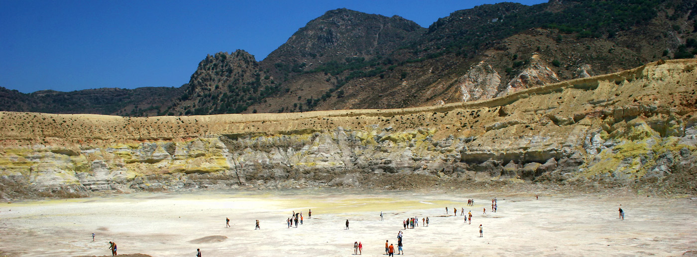
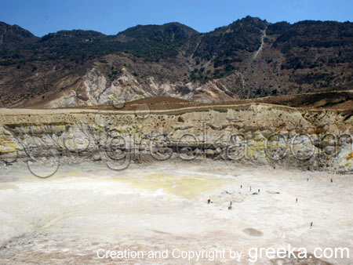
ΝΙΣΥΡΟΣ – Ο ΚΡΑΤΗΡΑΣ ΤΟΥ ΗΦΑΙΣΤΕΙΟΥ
Notes:
Two distinct hydrothermal aquifers are present beneath the Lakki plain: (a) a deep aquifer, characterized by temperatures higher than 290°C and chloride-rich fluids: and (b) a shallow aquifer, with a chloride content close to that of sea water and temperatures in the range 170-255°C. The vapor phase boiled from the shallow aquifer feeds the fumarolic vents in the southern half of the Lakki plain and its liquid phase flows northeast and southwest, contributing to the thermal springs located along the northern and southern coasts of the island.

Slide 62
Γεωθερμικός ταμιευτήρας

Slide 63
Γεωθερμία με μικρό θερμοκλινές

Slide 64
Γεωθερμία με μεγάλο θερμοκλινές

Slide 65
Γεωθερμία με πολύ μεγάλο θερμοκλινές

Slide 66
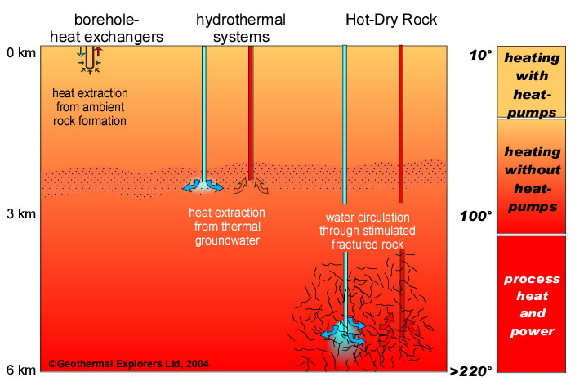
ΤΥΠΟΙ ΓΕΩΘΕΡΜΙΚΩΝ ΠΗΓΩΝ
ΥΔΡΟΘΕΡΜΙΚΕΣ ΠΗΓΕΣ
ΓΕΩ-ΠΙΕΣΤΙΚΕΣ ΠΗΓΕΣ
ΠΗΓΕΣ ΘΕΡΜΩΝ, ΞΗΡΩΝ ΠΕΤΡΩΜΑΤΩΝ
ΠΗΓΕΣ ΜΑΓΜΑΤΟΣ

Slide 67
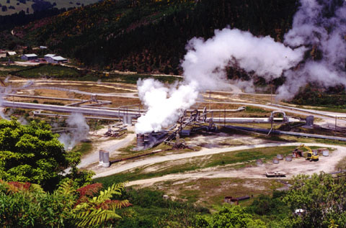
ΥΔΡΟΘΕΡΜΙΚΕΣ ΠΗΓΕΣ
Notes:
Hydrothermal Hydrothermal, or hot water, resources arise, when hot water and/or steam is formed in fractured or porous rock at shallow to moderate depths (100m to 4.5km) as a result of either the intrusion in the earth’s crust of molten magma from the earth’s interior, or the deep circulation of water through a fault or fracture [2]. High temperature hydrothermal resources, with temperatures from 180 ° C to over 350 ° C, are usually heated by hot molten rock. While low temperature resources, with temperatures from 100 ° C to 180 ° C, can be produced by either process [1]
Hydrothermal resources come in the form of either steam or hot water depending on the temperatures and pressures involved. High grade resources are usually used for electricity generation, while low grade resources are used in direct heating applications.

Slide 68
ΓΕΩΠΙΕΣΤΙΚΕΣ ΠΗΓΕΣ
ΠΗΓΕΣ ΜΕ ΘΕΡΜΟ, ΥΨΗΛΗΣ ΑΛΑΤΟΤΗΤΑΣ ΡΕΥΣΤΟ, ΚΟΡΕΣΜΕΝΟ ΜΕ ΜΕΘΑΝΙΟ
ΒΡΙΣΚΟΝΤΑΙ ΣΕ ΜΕΓΑΛΟ ΒΑΘΟΣ ΚΑΙ ΥΠΟ ΜΕΓΑΛΗ ΠΙΕΣΗ
ΠΑΓΙΔΕΥΜΕΝΕΣ ΣΕ ΒΑΘΗ 3-6km
ΘΕΡΜΟΚΡΑΣΙΕΣ 90-200 ^{ο}C
Notes:
Geopressured Geopressured geothermal resources consist of hot brine saturated with methane, found in large, deep aquifers under high pressure. The water and methane is trapped in sedimentary formations at a depth of about 3km-6km [2]. The temperature of the water is in the range of 90 ° C- 200 ° C. Three forms of energy can be obtained from geopressured resources: thermal energy, hydraulic energy from the high pressure and chemical energy from burning the dissolved methane gas. The major region of geopressured reservoirs discovered to date is in the northern Gulf of Mexico.

Slide 69
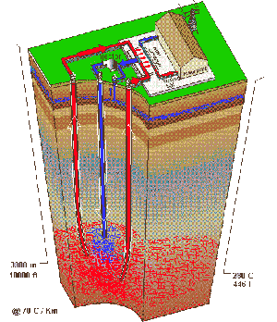
ΠΗΓΕΣ ΘΕΡΜΩΝ, ΞΗΡΩΝ ΠΕΤΡΩΜΑΤΩΝ
ΘΕΡΜΟΙ ΓΕΩΛΟΓΙΚΟΙ ΣΧΗΜΑΤΙΣΜΟΙ
ΠΟΥ Δ Ε Ν ΠΕΡΙΕΧΟΥΝ
ΝΕΡΟ
Notes:
Hot Dry Rock Hot dry rock (HDR) is a heated geological formation formed in the same way as hydrothermal resources, but containing no water as the aquifers or fractures required to conduct water to the surface are not present. This resource is virtually limitless and is more accessible than hydrothermal resources. The geological profile of Australia is such that there is a large potential for hot dry rock technologies to be used for energy production in the eastern states of Australia. Figure six is a false colour map of Australia showing the relative potential of HDR techologies. Red indicates greatest potential, blue the least.

Slide 70
ΠΗΓΕΣ ΜΑΓΜΑΤΟΣ
Η ΜΕΓΑΛΥΤΕΡΗ – εν δυνάμει - ΓΕΩΘΕΡΜΙΚΗ ΠΗΓΗ
ΠΕΤΡΩΜΑΤΑ ΥΠΟ ΤΗΞΗ ΣΕ ΒΑΘΗ 3 – 10 km ΚΑΙ ΔΥΣΚΟΛΑ ΠΡΟΣΒΑΣΙΜΑ.
ΘΕΡΜΟΚΡΑΣΙΕΣ ΑΠΟ 700 - 1200 ºC.
ΔΕΝ ΕΧΕΙ ΕΞΕΡΕΥΝΗΘΕΙ ΜΕΧΡΙ ΣΗΜΕΡΑ.
Notes:
Magma Magma, the largest geothermal resource, is molten rock found at depths of 3km-10km and deeper, and therefore not easily accessible. It has a temperature which ranges from 700 - 1,200 ° C. The resource has not been well explored to date.

Slide 71
Γεωθερμία- Βασική ιδέα εκμετάλλευσης

Slide 72
ΓΕΩΘΕΡΜΙΚΗ ΕΝΕΡΓΕΙΑ: ΧΡΗΣΕΙΣ
ΑΜΕΣΗ ΧΡΗΣΗ ΘΕΡΜΟΤΗΤΑΣ
ΠΑΡΑΓΩΓΗ ΗΛΕΚΤΡΙΣΜΟΥ
ΞΗΡΟΣ ΑΤΜΟΣ
ΕΚΤΟΝΟΥΜΕΝΟΣ ΑΤΜΟΣ
ΣΥΣΤΗΜΑΤΑ ΔΙΠΛΟΥ ΚΥΚΛΟΥ
ΓΙΑ ΦΟΡΤΙΟ ΒΑΣΗΣ
ΓΙΑ ΦΟΡΤΙΟ ΑΙΧΜΗΣ
Notes:
Electricity generation High temperature geothermal resources can be used for electricity production. There is currently over 8GW of installed geothermal electricity generation capacity worldwide (see Table 1). There are a number of energy conversion technologies, which use the geothermal resource. These include dry steam, flash steam and binary cycle systems.
Geothermal electricity can be used for base load power, as well as for peak load demand as required. In many parts of world, geothermal electricity is competitive with conventional energy sources.

Slide 73
ΠΑΡΑΓΩΓΗ ΗΛΕΚΤΡΙΣΜΟΥ

Slide 74
ΓΕΩΤΡΗΣΗ

Slide 75
ΓΕΩΤΡΗΣΗ ΚΑΙ ΕΚΤΟΝΩΣΗ

Slide 76
Γεωθερμία-Σταθμός ηλεκτροπαραγωγής

Slide 77
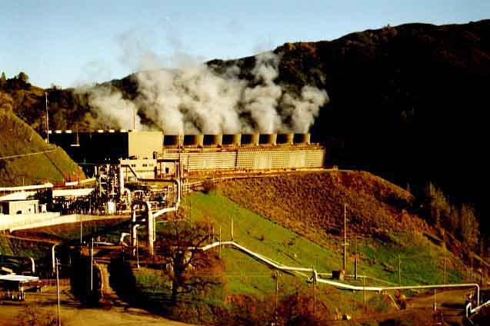
Σταθμός Geysers, California

Slide 78
Γεωθερμία – Σταθμός ηλεκτροπαραγωγής

Slide 79
Γεωθερμία – Σταθμός ηλεκτροπαραγωγής

Slide 80
ξηρού ατμού (δεν υπάρχει η υγρή φάση)

Slide 81
με εκτόνωση ατμού

Slide 82
Συστήματα Διπλού Κύκλου
πρωτεύον κύκλωμα γιά μεταφορά γεωθερμικού ρευστού στον εναλλάκτη
δευτερεύον κύκλωμα γιά μεταφορά θερμότητας στην εκμετάλλευση

Slide 83
διπλού κύκλου (πρωτεύον και δευτερεύον κύκλωμα)

Slide 84
ΔΙΦΑΣΙΚΟΣ ΣΤΑΘΜΟΣ

Slide 85
Southampton: Τηλεθέρμανση

Slide 86
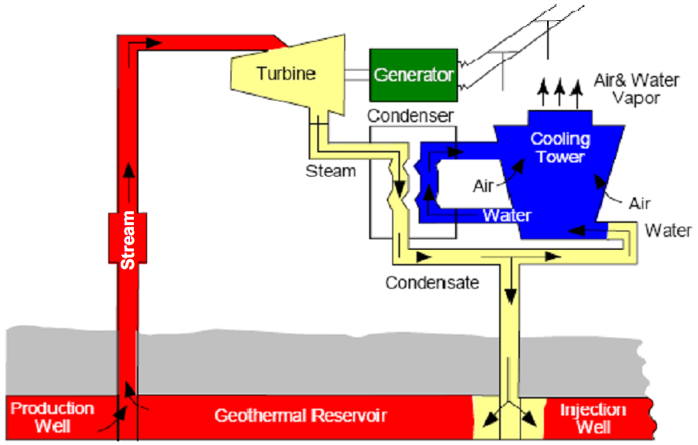
Παραγωγή ηλεκτρισμού από ταμιευτήρα γεωθερμίας
Notes:
Electricity production from stream reservoir

Slide 87
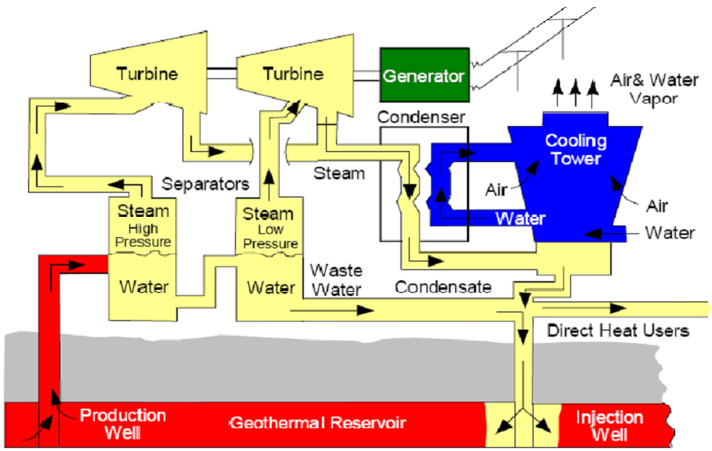
Παραγωγή ηλεκτρισμού από ταμιευτήρα ζεστού νερού
Notes:
Electricity production from hot water reservoir

Slide 88
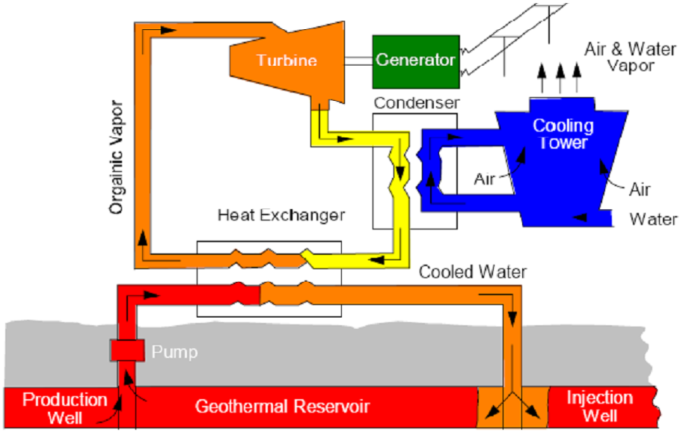
Παραγωγή ηλεκτρισμού από ταμιευτήρα μέσης ενθαλπίας
Notes:
Electricity production from middle enthalpy reservoir

Slide 89
Άμεση Χρήση Γεωθερμίας
Γεωθερμικοί ταμιευτήρες χαμηλής έως μέσης θερμοκρασίας,
20 ºC to 150 ºC ,
προσφέρουν άμεση θερμότητα γιά:
κτίρια,
βιομηχανίες και
άλλες εμπορικές χρήσεις.
Η ενεργειακή αυτή πηγή χρησιμοποιείται γιά θέρμανση
σπιτιών,
γραφείων,
θερμοκηπίων,
ιχθυοτροφείων,
μονάδων επεξεργασίας τροφίμων, και
άλλων εφαρμογών.

Slide 90
ΓΕΩΘΕΡΜΙΑ ΓΙΑ ΘΕΡΜΑΝΣΗ ΔΡΟΜΩΝ

Slide 91
ΠΟΛΙΧΝΙΤΟΣ – ΓΕΩΘΕΡΜΙΚΑ ΘΕΡΜΟΚΗΠΙΑ

Slide 92
ΤΕΛΟΣ

