Slide 1
ΕΝΕΡΓΕΙΑΚΗ ΠΟΛΙΤΙΚΗ ΚΑΙ ΔΙΑΧΕΙΡΙΣΗ - ΛΗΨΗ ΑΠΟΦΑΣΕΩΝ
ΔΙΑΛΕΞΗ Νο 06
ΕΝΕΡΓΕΙΑΚΕΣ ΤΕΧΝΟΛΟΓΙΕΣ

Slide 4
Κοσμική ακτινοβολία – η αρχή
Notes:
Origin of the cosmic background radiation
About 100,000 years after the Big Bang, the temperature of the Universe had dropped sufficiently for electrons and protons to combine into hydrogen atoms, p + e --> H. From this time onwards, radiation was effectively unable to interact with the background gas; it has propagated freely ever since, while constantly losing energy because its wavelength is stretched by the expansion of the Universe. Originally, the radiation temperature was about 3000 degrees Kelvin, whereas today it has fallen to only 3K.
Observers detecting this radiation today are able to see the Universe at a very early stage on what is known as the `surface of last scattering'. Photons in the cosmic microwave background have been travelling towards us for over ten billion years, and have covered a distance of about a million billion billion miles. The Origin of Fluctuations in the CBR
There are a variety of competing theories for the origin of large-scale structure and the fluctuations in the cosmic microwave background radiation. These models fall into two categories: (1) causal topological defect models, such as cosmic strings and textures, or (2) inflationary scenarios.
Following subtraction of the dipole anisotropy and components of the detected emission arising from dust (thermal emission), hot gas (free-free emission), and charged particles interacting with magnetic fields (synchrotron emission) in the Milky Way Galaxy, the cosmic microwave background (CMB) anisotropy can be seen. CMB anisotropy tiny fluctuations in the sky brightness at a level of a part in one hundred thousand was first detected by the COBE DMR instrument. The CMB radiation is a remnant of the Big Bang, and the fluctuations are the imprint of density contrast in the early Universe (see slide 24 caption). This image represents the anisotropy detected in data collected during the first two years of DMR operation. Ultimately the DMR was operated for four years. See slide 19 caption for information about map smoothing and projection.
24
This image combines data from the DIRBE obtained at infrared wavelengths of 100, 140 and 240 µm - the longest wavelengths measured by this instrument. The sky brightness at these wavelengths is represented respectively by blue, green, and red colors in the image. This image shows where there is more material (appears brighter) and where this material is coldest (appears redder). The plane of the Milky Way Galaxy lies horizontally across the middle of the image with the Galactic center at the center. Most of the infrared radiation seen in this image originates from cold dust (approximately 20 K, or 20 degrees Centigrade above absolute zero) located in clouds of gas and dust between the stars in the Milky Way Galaxy. The wispy-looking dust features are called "infrared cirrus." The region of the Orion Nebula with active star formation approximately 1,500 light years distance from the Sun appears on the right of the image below the plane of the Milky Way. Neighboring galaxies, the Large and Small Magellanic Clouds, appear as faint "blobs" below and slightly to the right of the Galactic center. Much of the picture appears to be the same color, indicating that there is not a large variation in the dust temperature. Because the brightness of the Solar System and Galaxy tends to decrease with increasing wavelength, these long wavelength DIRBE measurements are particularly valuable for searching for the cosmic infrared background.

Slide 5
Η ΔΟΜΗ ΤΟΥ ΕΝΕΡΓΕΙΑΚΟΥ ΣΥΣΤΗΜΑΤΟΣ
ΠΗΓΕΣ | ΤΕΧΝΟΛΟΓΙΑ ΜΕΤΑΤΡΟΠΗΣ | ΦΟΡΕΑΣ (νόμισμα) | ΤΕΧΝΟΛΟΓΙΑ ΔΙΑΝΟΜΗΣ-ΜΕΤΑΦΟΡΑΣ | ΤΕΧΝΟΛΟ-ΓΙΑ ΧΡΗΣΗΣ | ΥΠΗΡΕΣΙΕΣ
Πετρέλαιο | Διυλιστήρια | Βενζίνη | Τρένο,τάνκερ | Λέβητας | Θέρμανση
Φυσικό αέριο | Γεωτρήσεις | Πετρέλαιο | Αγωγοί | Λάμπα | Φωτισμός
ΑΝΘΡΑΚΑΣ | Ορυχεία | Φυσικό αέριο | Ηλεκτρικές γραμμές | Αιρ Κοντίσιον | Ψύξη
Ηλιακή | Συλλέκτες | Ηλεκτρισμός |  | Τηλέφωνο | Επικοινωνίες
Αιολική | Ανεμογεννήτριες | Θερμότητα |  | Αυτοκίνητο Τρένο, | Μεταφορές
Υδροηλεκτρ. | Φράγματα | Υδρογόνο |  | Κουζίνα | Μαγείρεμα
Γεωθερμία | Γεωθερμικοί σταθμοί
Βιομάζα | Σταθμοί καύσης, πυρόλυσης
Ουράνιο | Ορυχεία

Slide 6
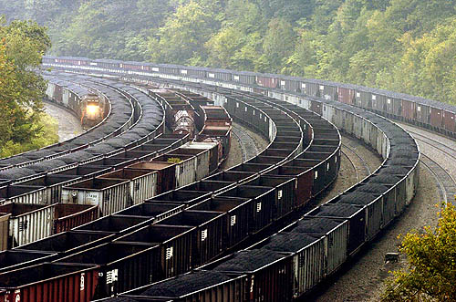
ΣΤΑΔΙΑ
ΕΞΟΡΥΞΗ
ΠΡΟΕΤΟΙΜΑΣΙΑ (ΠΑΡΑΓΩΓΗ ΟΜΟΓΕΝΟΠΟΙΗΜΕΝΗΣ ΠΡΩΤΗΣ ΥΛΗΣ)
ΠΑΡΑΓΩΓΗ ΘΕΡΜΟΤΗΤΑΣ
ΠΑΡΑΓΩΓΗ ΜΗΧΑΝΙΚΗΣ ΕΝΕΡΓΕΙΑΣ
ΠΑΡΑΓΩΓΗ ΗΛΕΚΤΡΙΣΜΟΥ

Slide 7
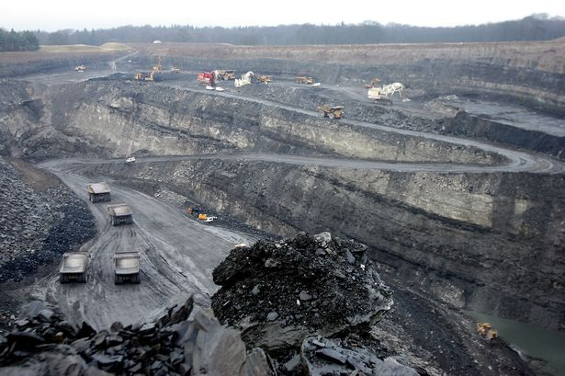
ΕΠΙΦΑΝΕΙΑΚΗ ΕΞΟΡΥΞΗ ΛΙΓΝΙΤΗ

Slide 8
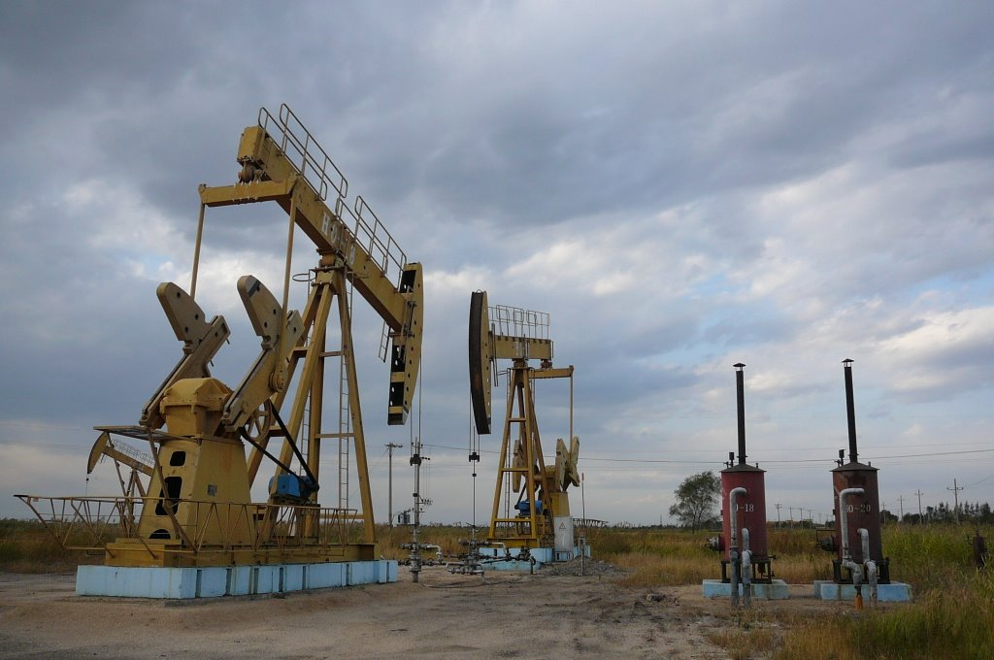
ΠΕΤΡΕΛΑΙΟ

Slide 9
ΠΛΩΤΗ ΠΛΑΤΦΟΡΜΑ ΕΞΟΡΥΞΗΣ ΠΕΤΡΕΛΑΙΟΥ

Slide 10
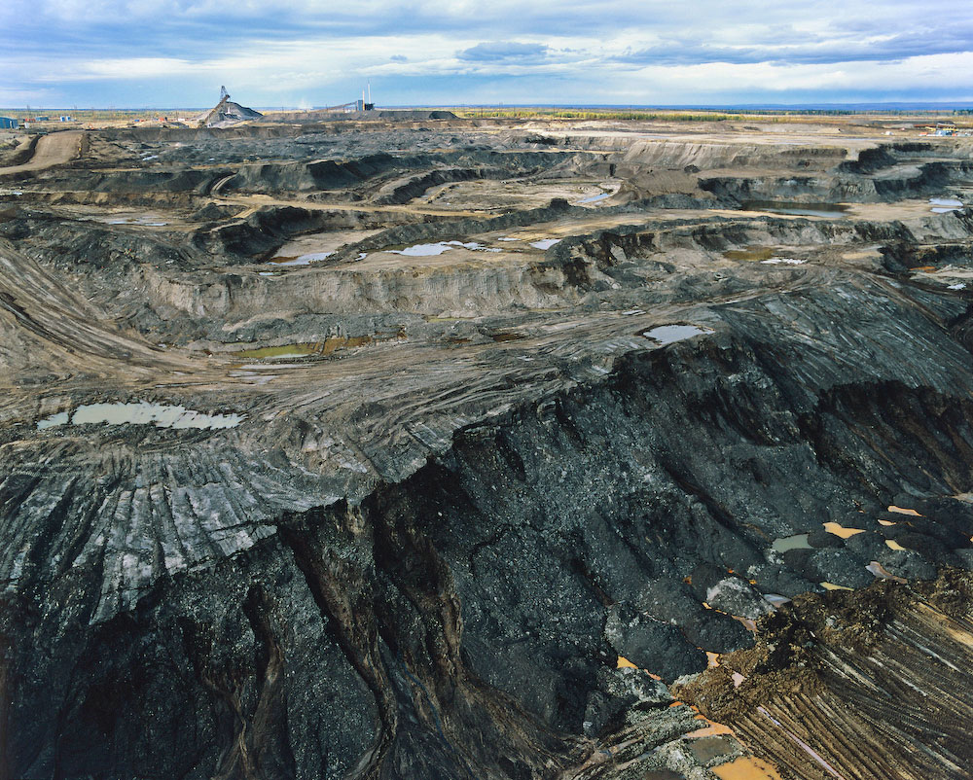
Alberta tar sands

Slide 11
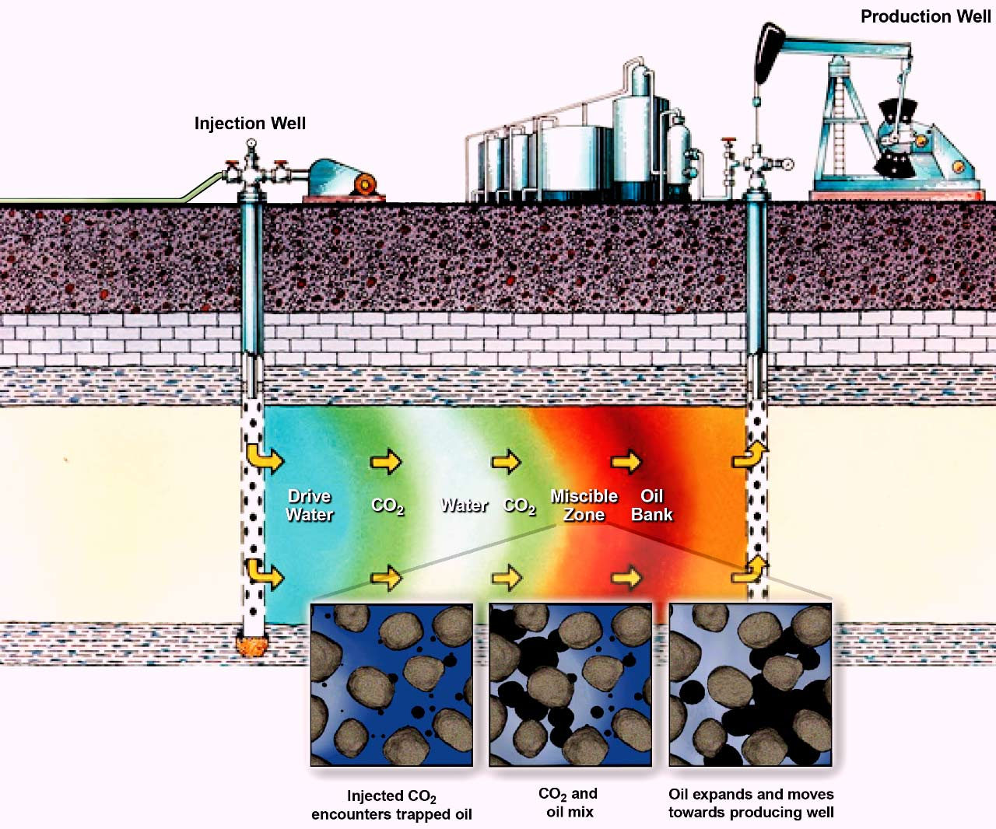
ΠΟΡΩΔΕΣ ΠΕΤΡΩΜΑ ΜΕ ΠΕΤΡΕΛΑΙΟ

Slide 12
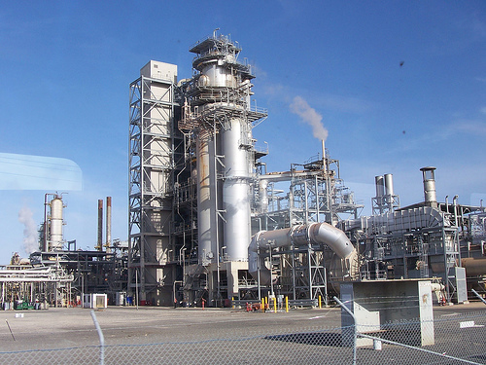
Oil Refinery
Notes:
PHOTO CAPTION: Arak Oil Refinery in Iran, which is one of the world's largest oil producers. It supplies China with approximately 15 percent of the oil the Asian powerhouse imports, which gives it extraordinary political leverage despite U.S. efforts to isolated it.

Slide 13
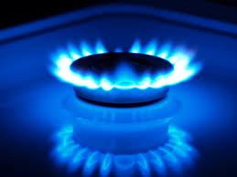
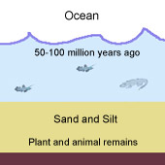
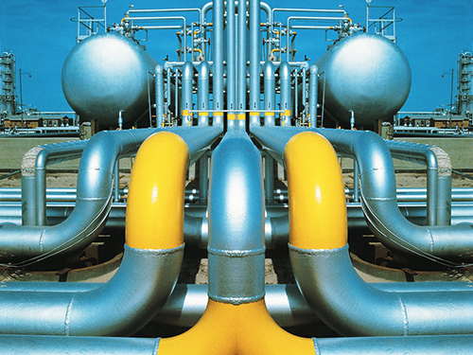
ΤΟ ΦΥΣΙΚΟ ΑΕΡΙΟ

Slide 14
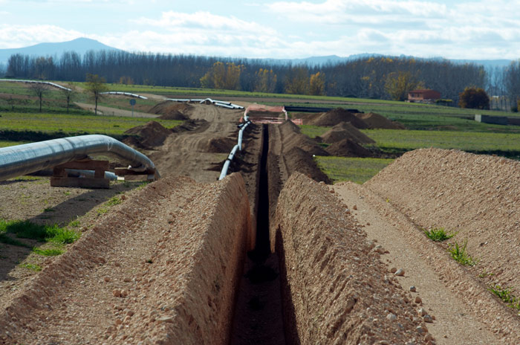
Το φυσικό αέριο – κατασκευή αγωγού

Slide 15
ΤΟ ΦΥΣΙΚΟ ΑΕΡΙΟ ΣΤΗΝ ΕΥΡΩΠΗ

Slide 16
ΡΕΒΥΘΟΥΣΑ: ΣΤΑΘΜΟΣ ΑΠΟΘΗΚΕΥΣΗΣ

Slide 17
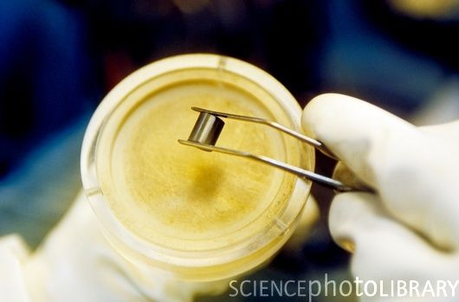
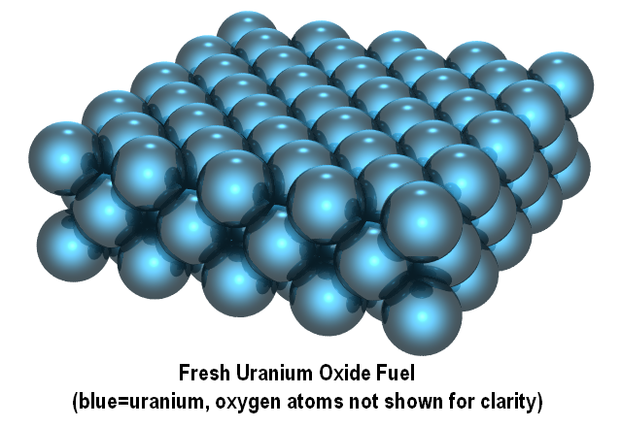
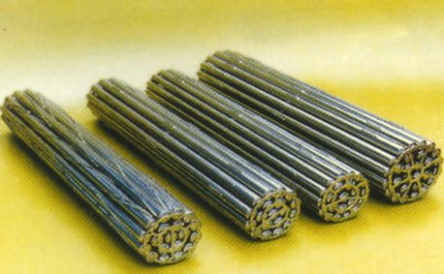
ΠΥΡΗΝΙΚΑ ΚΑΥΣΙΜΑ

Slide 18
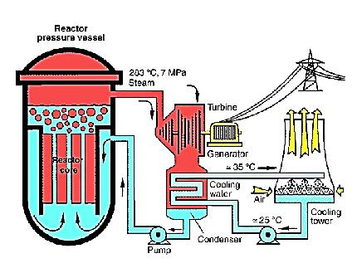
Πυρηνικός αντιδραστήρας

Slide 19
Υαλοποίηση πυρηνικών αποβλήτων

Slide 20
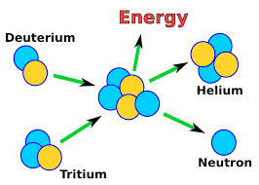
ΣΥΝΤΗΞΗ

Slide 21
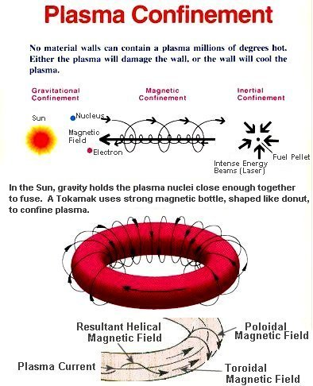
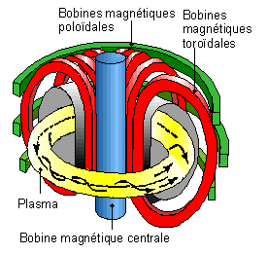
Σύντηξη – συγκράτηση πλάσματος

Slide 22
Ενεργειακή μετατροπή σε θερμικό σταθμό
ΧΗΜΙΚΗ ΕΝΕΡΓΕΙΑ ΚΑΥΣΙΜΟΥ
ΛΕΒΗΤΑΣ
ΘΕΡΜΙΚΗ ΕΝΕΡΓΕΙΑ
ΣΤΡΟΒΙΛΟΣ
ΜΗΧΑΝΙΚΗ ΕΝΕΡΓΕΙΑ
ΓΕΝΝΗΤΡΙΑ
ΗΛΕΚΤΡΙΣΜΟΣ
ΚΑΛΥΨΗ ΑΝΑΓΚΩΝ

Slide 23
ΜΗΧΑΝΕΣ
I. ΘΕΡΜΙΚΑ
ΑΤΜΟΥ
ΠΑΛΙΝΔΡΟΜΙΚΕΣ
ΣΤΡΟΒΙΛΟΙ
ΜΗΧΑΝΕΣ ΕΣΩΤΕΡΙΚΗΣ ΚΑΥΣΗΣ
ΜΗΧΑΝΕΣ ΕΞΩΤΕΡΙΚΗΣ ΚΑΥΣΗΣ
ΑΕΡΙΟΣΤΡΟΒΙΛΟΜΗΧΑΝΕΣ
ΙΙ. ΥΔΡΟΗΛΕΚΤΡΙΚΑ
ΙΙΙ. ΑΙΟΛΙΚΕΣ ΜΗΧΑΝΕΣ
IV. ΑΜΕΣΗΣ ΜΕΤΑΤΡΟΠΗΣ
ΚΥΤΤΑΡΑ ΚΑΥΣΙΜΟΥ
ΦΩΤΟΒΟΛΤΑΪΚΑ

Slide 24
ΑΠΟΔΟΣΗ ΜΕΤΑΤΡΟΠΗΣ
ΠΕΤΡΕΛΑΙΟ 26.6 %
ΚΑΡΒΟΥΝΟ 32.5 %
ΕΛΑΦΡΟΥ ΥΔΑΤΟΣ 24.9 %
ΗΛΙΑΚΟΣ ΣΥΛΛΕΚΤΗΣ 2.4 %
ΣΥΜΠΑΡΑΓΩΓΗ 50 %

Slide 25
ΑΕΡΙΟΣΤΡΟΒΙΛΟΣ

Slide 26
Τυπικοί αεριοστρόβιλοι αεροπλάνων
Notes:
When you go to an airport and see the commercial jets there, you can't help but notice the huge engines that power them. Most commercial jets are powered by turbofan engines, and turbofans are one example of a general class of engines called gas turbine engines.
There are many different kinds of turbines:
You have probably heard of a steam turbine. Most power plants use coal, natural gas, oil or a nuclear reactor to create steam. The steam runs through a huge and very carefully designed multi-stage turbine to spin an output shaft that drives the plant's generator.
Hydroelectric dams use water turbines in the same way to generate power. The turbines used in a hydroelectric plant look completely different from a steam turbine because water is so much denser (and slower moving) than steam, but it is the same principle.
Wind turbines, also known as wind mills, use the wind as their motive force. A wind turbine looks nothing like a steam turbine or a water turbine because wind is slow moving and very light, but again, the principle is the same.
A gas turbine is an extension of the same concept. In a gas turbine, a pressurized gas spins the turbine. In all modern gas turbine engines, the engine produces its own pressurized gas, and it does this by burning something like propane, natural gas, kerosene or jet fuel. The heat that comes from burning the fuel expands air, and the high-speed rush of this hot air spins the turbine.
Advantages and Disadvantages So why does the M-1 tank use a 1,500 horsepower gas turbine engine instead of a diesel engine? It turns out that there are two big advantages of the turbine over the diesel:
Gas turbine engines have a great power-to-weight ratio compared to reciprocating engines. That is, the amount of power you get out of the engine compared to the weight of the engine itself is very good.
Gas turbine engines are smaller than their reciprocating counterparts of the same power.
The main disadvantage of gas turbines is that, compared to a reciprocating engine of the same size, they are expensive. Because they spin at such high speeds and because of the high operating temperatures, designing and manufacturing gas turbines is a tough problem from both the engineering and materials standpoint. Gas turbines also tend to use more fuel when they are idling, and they prefer a constant rather than a fluctuating load. That makes gas turbines great for things like transcontinental jet aircraft and power plants, but explains why you don't have one under the hood of your car.

Slide 27
ΣΤΡΟΒΙΛΟΣ-ΓΕΝΝΗΤΡΙΑ

Slide 28
ΣΤΡΟΒΙΛΟΣ 2 ΣΤΑΔΙΩΝ

Slide 29
Μηχανή εσωτερικής καύσης

Slide 30
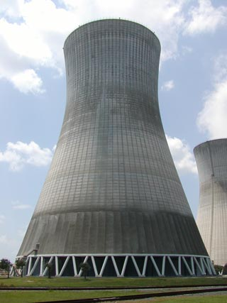
Πύργος ψύξης (εσωτερικό)
Notes:
An Introduction to Cooling Tower Drift In the cooling tower, hot water is sprayed over contact media called fill as air is drawn counter current or cross current to the water stream. As the water is sprayed and evaporated, a large distribution of droplet sizes is created. A portion of these droplets will become entrained in the exit air stream and leave the cooling tower. These droplets are referred to as drift. These drift droplets and the solids they contain will be deposited downwind of the cooling tower. Significant emission and deposition can lead to icing, transformer shorts, environmental degradation, and environmental non-compliance. Inertial impaction devices called drift eliminators are used to control the emission of these drift droplets. High efficiency drift eliminators of modern design can potentially control the drift to less than 0.0005 % of the cooling tower circulating water flow. These drift eliminators are able to capture nearly 100% of the droplets which are larger than 10 microns in diameter. However, large droplets up to 1000 microns may still be generated by cooling towers. The sources of these droplets include:
Gaps in the drift eliminators - The drift eliminators must be installed around cooling tower structural members. This is usually accomplished by cutting the drift eliminator to fit. The cut portion of the drift eliminator does not have the same particle capture characteristics as the unaltered drift eliminator. Any gap left between the drift eliminator and the structural member or wall is also a source of uncontrolled emission. Typically air seals are installed to prevent drift from passing the drift eliminator between the drift eliminator and the wall.
Variations in local air velocities - Modern drift eliminators are designed for a fairly wide range of air velocities. If the local velocity is not within the design band, the drift rate may be increased.
Re-entrainment of collected drift - Cooling tower structural members, the surface of the fan stack and the cooling tower fan blades collect drift droplets. Water accumulated on these surfaces can be re-entrained in the air. Since these surfaces are downstream of the drift eliminators, the droplet size is determined by the entrainment process and the local velocity. The local air velocity must be greater than the settling velocity in order for emission to occur. Re-entrainment from the drift eliminators can also occur although this is usually caused by overloading due to a malfunction of the cooling tower water distribution system.
Emission from such sources may comprise most of the mass of the drift emitted by cooling towers. Cooling towers with high efficiency drift eliminators are able to achieve their low drift rates because the emission of drift through the drift eliminators is actually much lower than the nominal rate. Since the generation of the larger drift droplets is a function of the details of the cooling tower design as well as the quality of the installation of the drift eliminators, the prediction of the size distribution of the drift for a cooling tower yet to be built is subject to great uncertainty

Slide 31
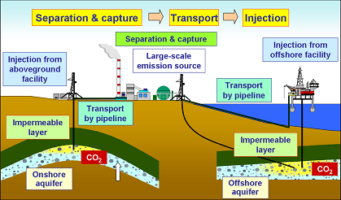
ΚΑΤΑΚΡΑΤΗΣΗ CO₂

Slide 32
ΑΠΟΜΑΚΡΥΝΣΗ CO₂
Notes:
DIRECT INJECTION INVOLVES THE CAPTURE, SEPARATION, TRANSPORT, AND INJECTION OF CARBON DIOXIDE INTO THE DEEP SEA
"At great depths, CO2 is denser than sea water, and it may be possible to store it on the bottom as liquid or deposits of icy hydrates," Bishop explains. "At depths easy to reach with pipes, CO2 is buoyant; it has to be diluted and dispersed so it will dissolve."
What happens to carbon dioxide introduced into the ocean in this way may soon be field-tested in Hawaii. Over a two-week period researchers plan to inject 40 to 60 metric tons of pure liquid CO2 over 2,500 feet deep in the ocean near the Big Island.
One variable they will be measuring is acidity. Water and carbon dioxide form carbonic acid, "but once diluted in sea water, carbonic acid is not the dominant chemical species," Bishop says, "because of seawater's high alkalinity and buffering capacity." If calcium carbonate sediments are involved, acidity is even less. "Think of Tums," he suggests.

Slide 33
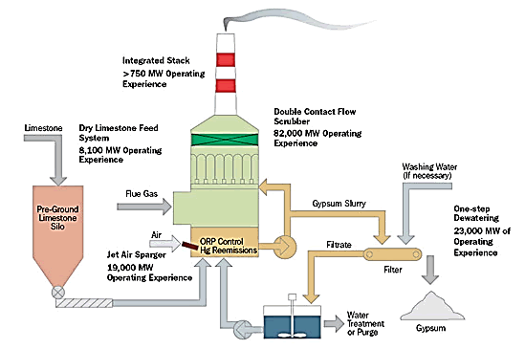
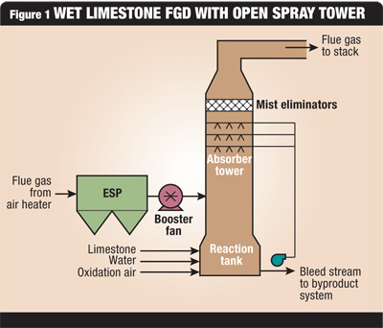
Θερμικός σταθμός με επεξεργασία καυσαερίων

Slide 34
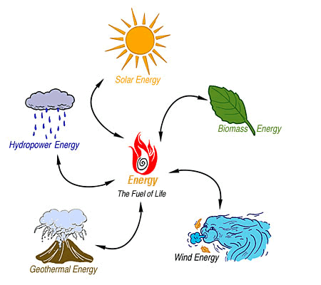
ΑΝΑΝΕΩΣΙΜΕΣ ΠΗΓΕΣ ΕΝΕΡΓΕΙΑΣ ΚΑΙ ΤΕΧΝΟΛΟΓΙΑ

Slide 35
ΑΝΑΝΕΩΣΙΜΕΣ ΠΗΓΕΣ ΕΝΕΡΓΕΙΑΣ
ΓΕΩΘΕΡΜΙΑ
ΚΥΜΑΤΙΚΗ
ΗΛΙΑΚΗ
ΒΙΟΜΑΖΑ
ΑΙΟΛΙΚΗ
ΥΔΡΑΥΛΙΚΗ ΕΝΕΡΓΕΙΑ

Slide 36
Γεωθερμική γεώτρηση

Slide 37
Εναλλάκτης γεωθερμικής θερμότητας

Slide 38
Γεωθερμικός σταθμός

Slide 39
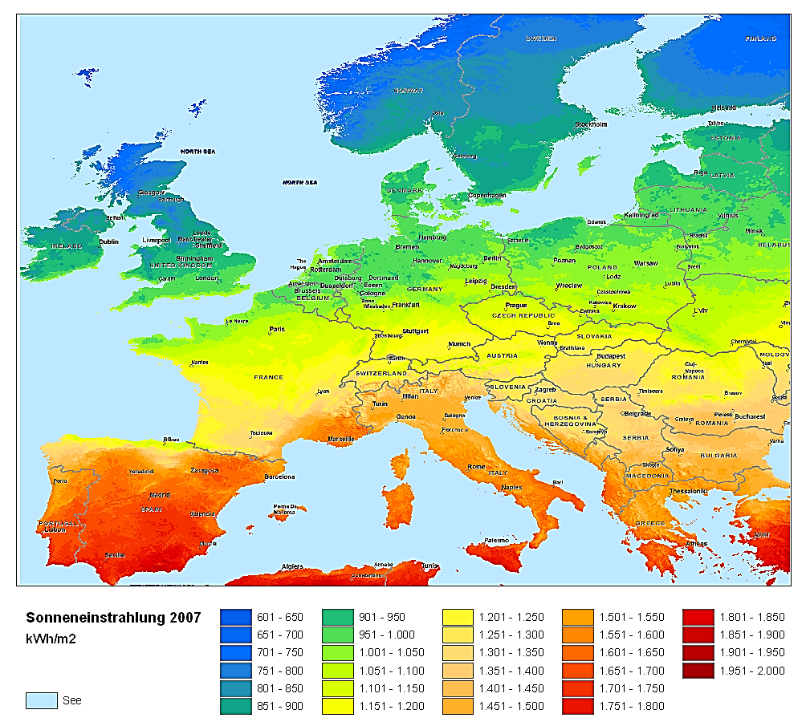
Ηλιακή ενέργεια

Slide 40
McDonnell Douglas (currently Boeing) SD system

Slide 41
Ηλιακό σύστημα παραγωγής με φωτοβολταϊκά

Slide 42
Συγκεντρωτικό ηλιακό κάτοπτρο

Slide 43
Ηλιακός θερμικός σταθμός

Slide 44
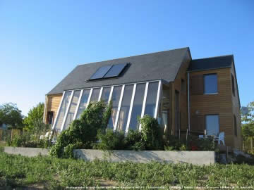
ΗΛΙΑΚΟ ΣΠΙΤΙ

Slide 45
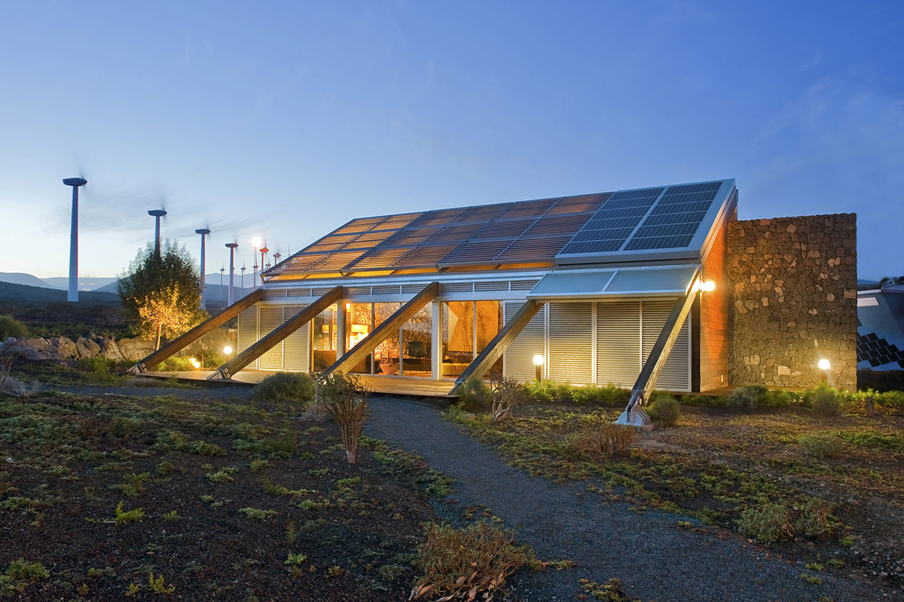
ΒΙΟΚΛΙΜΑΤΙΚΟ ΣΠΙΤΙ - ΤΕΝΕΡΙΦΗ

Slide 46
ΒΙΟΚΛΙΜΑΤΙΚΟ ΣΠΙΤΙ -

Slide 47
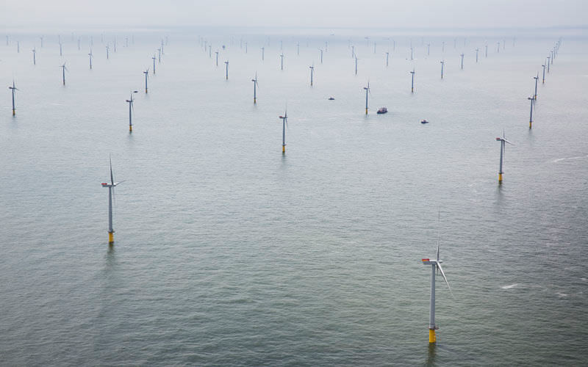
Ανεμογεννήτρια 1650 W

Slide 48
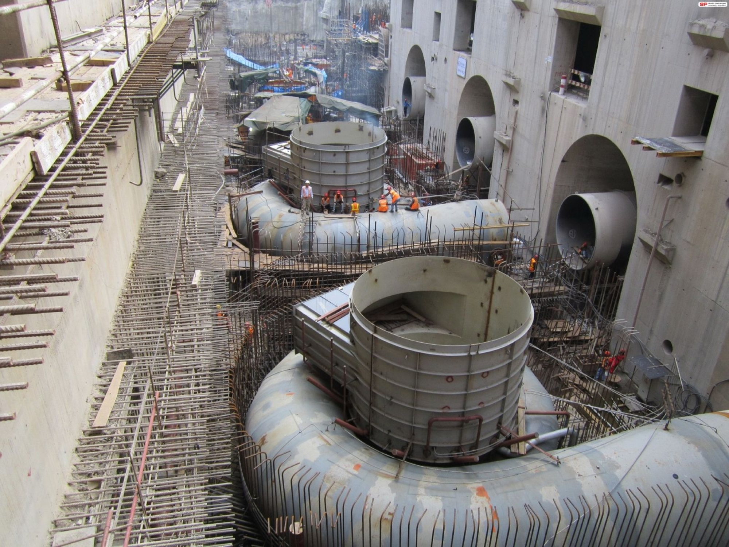
Υδροηλεκτρική ενέργεια

Slide 49
Κατάντη του φράγματος

Slide 50
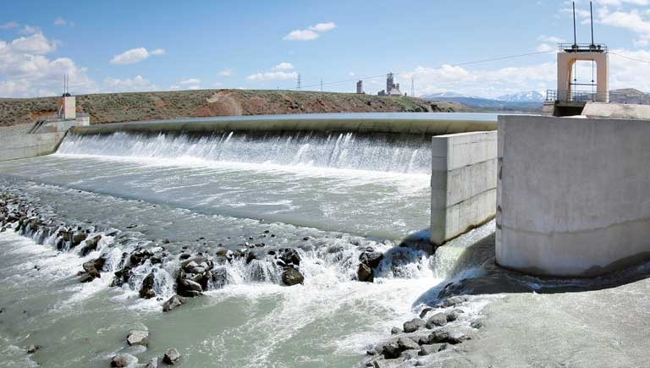
Υδροηλεκτρικό φράγμα

Slide 51
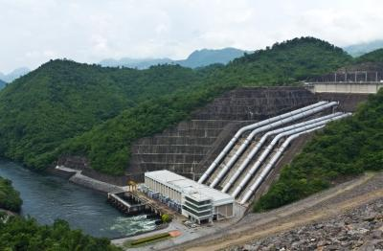
Φράγμα, αγωγοί, σταθμός, κατάντη ποταμού

Slide 52
Κυματικός σταθμός

Slide 53
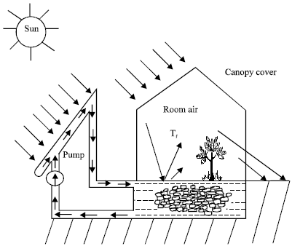
ΑΠΟΘΗΚΕΥΣΗ ΕΝΕΡΓΕΙΑΣ
Υλικά αλλαγής φάσης
Νερό
Βότσαλα
Υδραυλική ενέργεια
Μπαταρία
Περιστρεφόμενος σφόνδυλος
Υδρογόνο (με ηλεκτρόλυση)

Slide 54
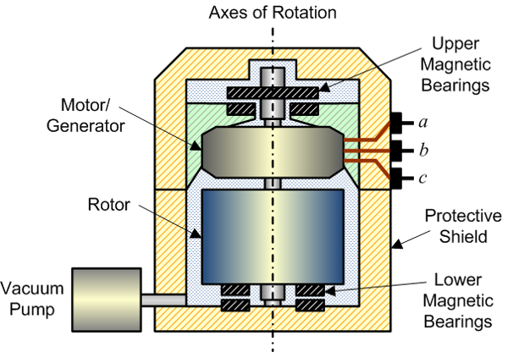
Fly-wheel γιά αποθήκευση ενέργειας
Notes:
A Flywheel Energy Storage System consists of a rotating cylinder (rim) suspended on magnetic bearings in a vacuum and connected to a motor/generator. The motor/generator transforms electrical energy into stored kinetic energy by spinning a 150-pound composite rim up to a speed of 700 meters per second. The flywheel is able to spin for extended periods with great efficiency, because friction and drag are virtually eliminated by employing magnetic bearings and a vacuum system.
When the product is called upon to produce electricity (see flywheel in action), the spinning flywheel drives the motor/generator, that instantaneously converts the kinetic energy into electrical energy. This conversion continues, and the flywheel slows, until it is "discharged.«
Flywheel in Action Follow the flywheel through its three modes of operation: 1. Flywheel Charge Mode
AC power is supplied to the Flywheel Controller
Controller powers up the Flywheel to full speed within one hour
2. Flywheel Float Mode 3. Flywheel Discharge Mode

Slide 55
κυψέλη καυσίμου

Slide 56
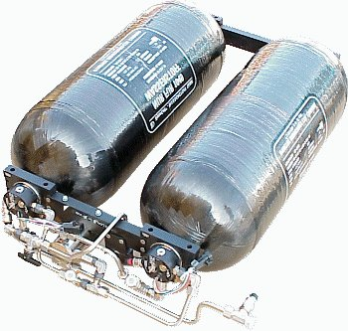
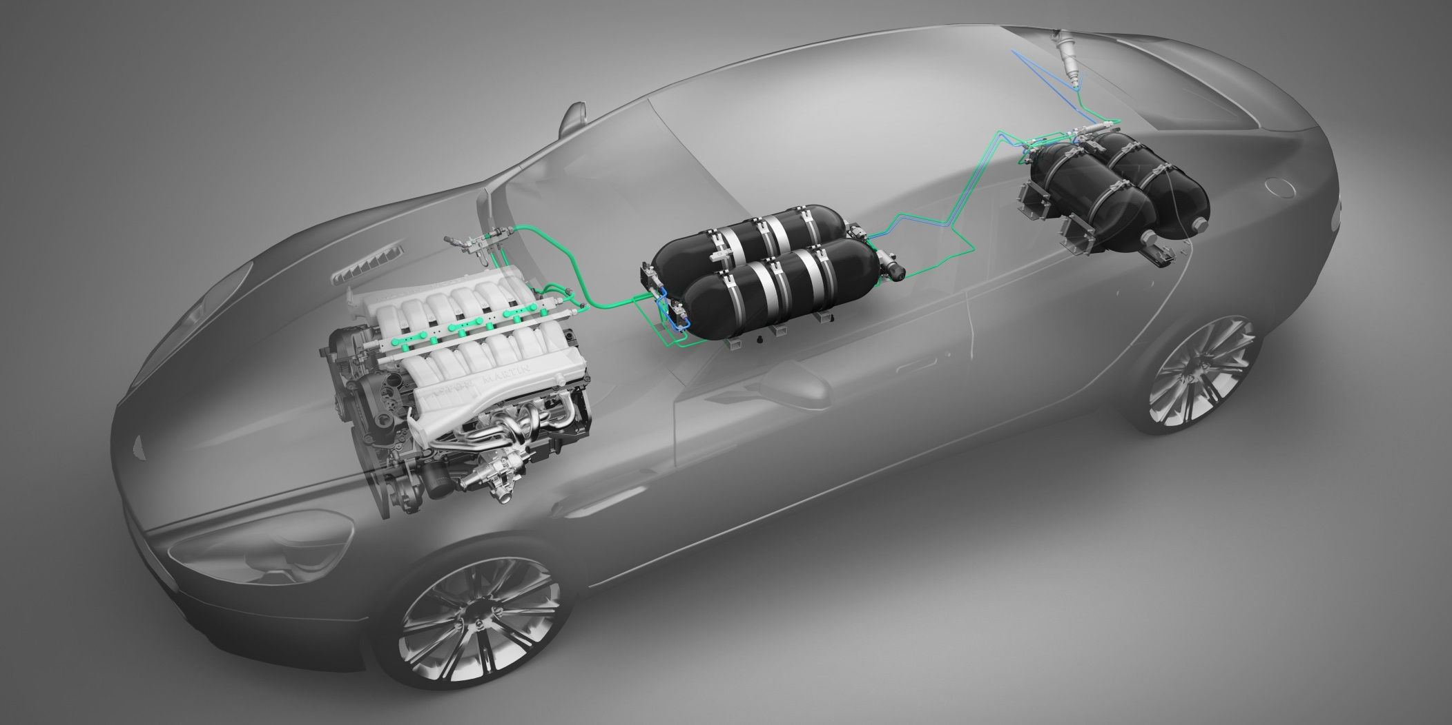
Κυψέλη καυσίμου για φορητές συσκευές
Notes:
Μια μικρή κυψέλη καυσίμου της Toshiba θα μπορούσε να αντικαταστήσει τις μπαταρίες στις φορητές ηλεκτρονικές συσκευές από το 2005. Η κυψέλη χρησιμοποιεί μεθανόλη και μπορεί να τροφοδοτήσει ένα mp3 player για 20 ώρες, με μόλις 2ml καυσίμου.
Παρόμοιες κυψέλες καυσίμου που λειτουργούν με υδρογόνο, με μεθάνιο ή μεθανόλη αναμένεται να κάνουν από του χρόνου την εμφάνισή τους και σε φορητούς υπολογιστές. Η NEC έχει ήδη παρουσιάσει έναν πειραματικό φορητό με ενσωματωμένη κυψέλη.
Οι κυψέλες καυσίμου είναι ηλεκτρομηχανικές συσκευές στις οποίες η ενέργεια από χημικές αντιδράσεις μετατρέπεται απευθείας σε ηλεκτρισμό. Τα παραπροϊόντα είναι μόνο διοξείδιο του άνθρακα και νερό, καθιστώντας τις κυψέλες καυσίμου πιο φιλικές για το περιβάλλον.
Το πρωτότυπο που παρουσίασε η Toshiba στην Ιαπωνία έχει μέγεθος 2,2 επί 4,5 εκατοστά και ζυγίζει 8,5 γραμμάρια. «Είναι αρκετά μικρή ώστε να ενσωματωθεί σε ασύρματα ακουστικά για κινητά τηλέφωνα, αλλά αρκετά αποδοτική ώστε να τροφοδοτεί ένα mp3 player για 20 ώρες με ένα και μόνο γέμισμα με δύο χιλιοστόλιτρα μεθανόλης υψηλής συγκέντρωσης» δήλωσε εκπρόσωπος της εταιρείας στο Γαλλικό Πρακτορείο Ειδήσεων.
Η κυψέλη αναμένεται να περάσει στην παραγωγή το 2005, η τιμή της όμως δεν έχει ακόμα καθοριστεί.

Slide 57
Κοσμική ακτινοβολία – ΤΟ ΤΕΛΟΣ
Notes:
Origin of the cosmic background radiation
About 100,000 years after the Big Bang, the temperature of the Universe had dropped sufficiently for electrons and protons to combine into hydrogen atoms, p + e --> H. From this time onwards, radiation was effectively unable to interact with the background gas; it has propagated freely ever since, while constantly losing energy because its wavelength is stretched by the expansion of the Universe. Originally, the radiation temperature was about 3000 degrees Kelvin, whereas today it has fallen to only 3K.
Observers detecting this radiation today are able to see the Universe at a very early stage on what is known as the `surface of last scattering'. Photons in the cosmic microwave background have been travelling towards us for over ten billion years, and have covered a distance of about a million billion billion miles. The Origin of Fluctuations in the CBR
There are a variety of competing theories for the origin of large-scale structure and the fluctuations in the cosmic microwave background radiation. These models fall into two categories: (1) causal topological defect models, such as cosmic strings and textures, or (2) inflationary scenarios.

