Slide 1
Διαδραστική σχεδίαση (Interaction Design)
Ενότητα 1: Εισαγωγή
Μόδεστος Σταυράκης
Τμήμα Μηχανικών Σχεδίασης Προϊόντων και Συστημάτων

Slide 2
Άδειες Χρήσης
Το παρόν εκπαιδευτικό υλικό υπόκειται σε άδειες χρήσης Creative Commons.
Για εκπαιδευτικό υλικό, όπως εικόνες, που υπόκειται σε άλλου τύπου άδειας χρήσης, η άδεια χρήσης αναφέρεται ρητώς.

Slide 3
Χρηματοδότηση
Το παρόν εκπαιδευτικό υλικό έχει αναπτυχθεί στα πλαίσια του εκπαιδευτικού έργου του διδάσκοντα.
Το έργο «Ανοικτά Ακαδημαϊκά Μαθήματα στο Πανεπιστήμιο Αιγαίου» έχει χρηματοδοτήσει μόνο τη αναδιαμόρφωση του εκπαιδευτικού υλικού.
Το έργο υλοποιείται στο πλαίσιο του Επιχειρησιακού Προγράμματος «Εκπαίδευση και Δια Βίου Μάθηση» και συγχρηματοδοτείται από την Ευρωπαϊκή Ένωση (Ευρωπαϊκό Κοινωνικό Ταμείο) και από εθνικούς πόρους.

Slide 4
Interaction Design
Introduction

Slide 5
Interaction Design
Introduction - Week 1

Slide 6
What you will learn:
What is the aim of today’s lecture:
Introduction to the course,
Teaching and Learning Strategies,
History of Interaction Design,
Course content and other topics that we will cover,
Introduction to theories of interaction,
Interaction design definitions,
In class discussion
Examples

Slide 7
What you will learn:
Other topics include:
What interaction design is and how it relates to human-computer interaction and other fields.
Explain the relationship between the user experience and usability.
Describe what and who is involved in the process of interaction design.
Enable you to evaluate an interactive product and explain what is good and bad about it in terms of the goals and core principles of interaction design.

Slide 8
Interaction Design
Course Content - Week 1

Slide 9
Topics Covered 1/3
Week 1 - Introduction :: Introduction to Interaction Design, What is Interaction Design?
Week 2 - Theories of Interaction :: Introduction to the most fundamental theories and methods of interaction design
Week 3 - Researching for Interaction :: Understanding the problem space, Conceptual models of interaction, interface metaphors, interaction paradigms, theories, models and frameworks .
Week 4 - Understanding Users :: Cognition and Cognitive Frameworks, Mental Models, Information Processing.
Week 5 - Social Interaction :: Social, Face to face conversations, Remote conversations, Telepresence, Co-presence, Emergent social phenomena.

Slide 10
Topics Covered 2/3
Week 6 - Emotional Interaction :: Emotions and the User Experience, Expressive/Frustrating interfaces, Persuasive technologies and behavioural change, Anthropomorphism and zoomorphism, Models of emotion.
Week 7 - Interfaces :: Interface types, Natural User Interfaces.
Week 8 - Data Gathering :: Data Recording, Interviews Questionnaires, Observation.
Week 9 - Data analysis, Interpretation and presentation :: Qualitative and Quantitative analysis, Tools to support data analysis, Presenting Findings.
Week 10 - The process of Interaction Design :: What is involved in interaction design, Practical Issues.

Slide 11
Topics Covered 3/3
Week 11 - Requirements :: What, How and why?, What are requirements, how to gather, analyse, interpret and present requirements.
Week 12 - Design Prototyping and Construction :: Prototyping and Construction, Concept Design, Physical Design, Use of Scenarios, Use Prototypes, Design Support.
Week 13 - Evaluation :: Types of evaluation, Evaluation Frameworks, Evaluation case studies.

Slide 12
Introduction to the course
What is the aim of the course:
In this course, you will learn how to design artifacts that bring people joy, rather than frustration.
Focus on learning about designing for interaction and experience rather than for the artifact or software alone.

Slide 13
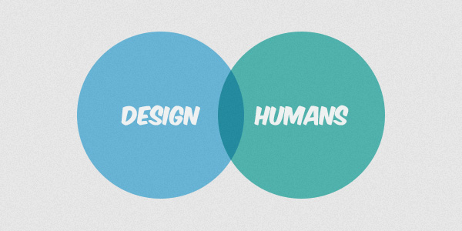
Introduction to the course
The main goal of this course is helping you build human-centered design skills, so that you have the principles and methods to trigger pleasurable experiences by designing physical or digital products.
FOR

Slide 14
What you will learn
You'll learn:
How to conduct fieldwork with people to help you get design ideas.
How to make paper prototypes and low-fidelity mock-ups that are interactive -- and how to use these designs to get feedback from other stakeholders like your teammates, clients, and users.
Principles of visual design so that you can effectively organize and present information.
Principles of perception and cognition that inform effective interaction design.

Slide 15
What you will learn
You'll learn
How to perform and analyse controlled experiments with people, in situ or online,
To understand interaction design methodologies and apply interaction design methods,
Experiment with software and hardware.

Slide 16
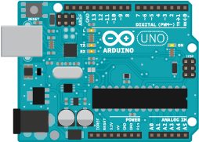
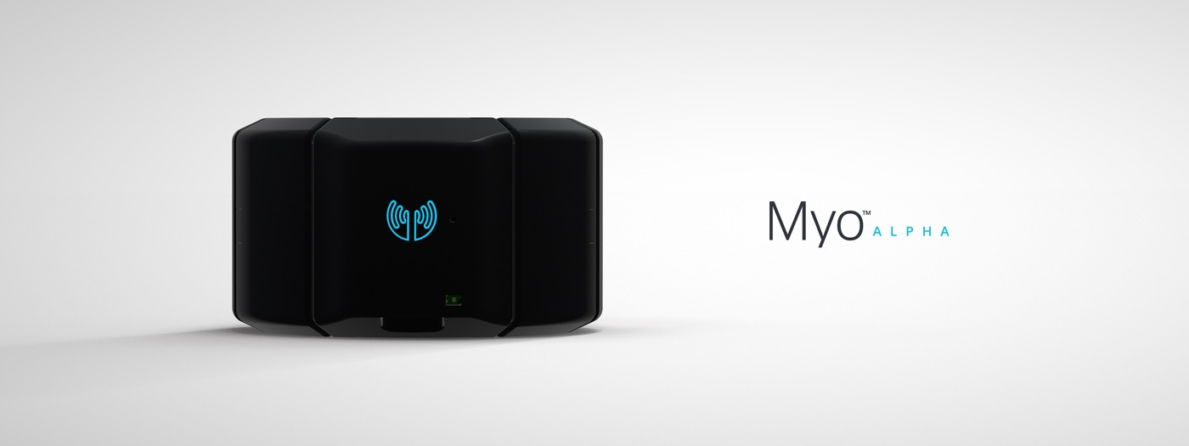
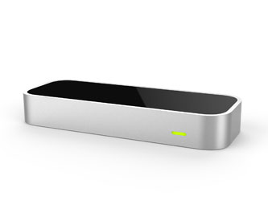
What you will learn
Software
Axure RP, InVision, Balsamiq Mockups, OmniGraffle, Indigo Studio, Google Draw.
Hardware / Platforms

Slide 17
Keywords
Interaction
Design
User experience design
Human computer interaction
User Interface
Usability

