Slide 1
Digital Technology in Shipping:
a brief overview
State of the art digital shipping technologies and applications
maritime communications and bridge systems
e-procurement, bunkering and e-chartering platforms (i.e. Q88)
single window applications (i.e. NACCS)
shipping e-marketplaces (inttra.com, shipserv.com)
Process/market innovations in shipping, in the e-shipping era

Slide 2
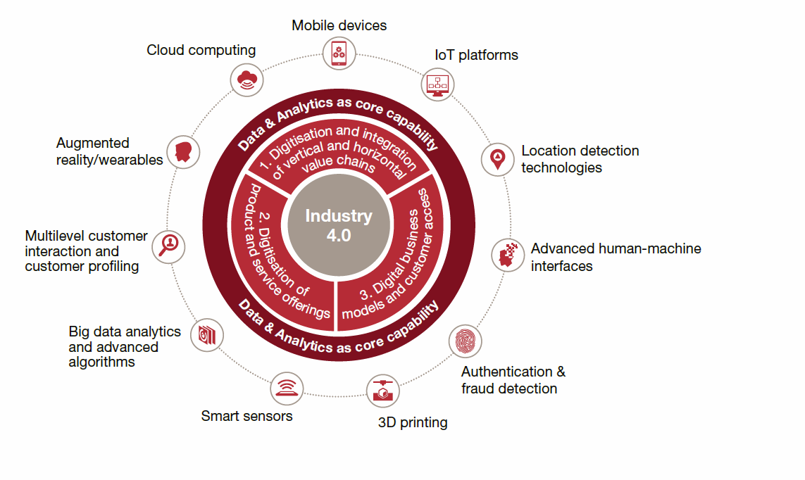
Industry 4.0

Slide 3
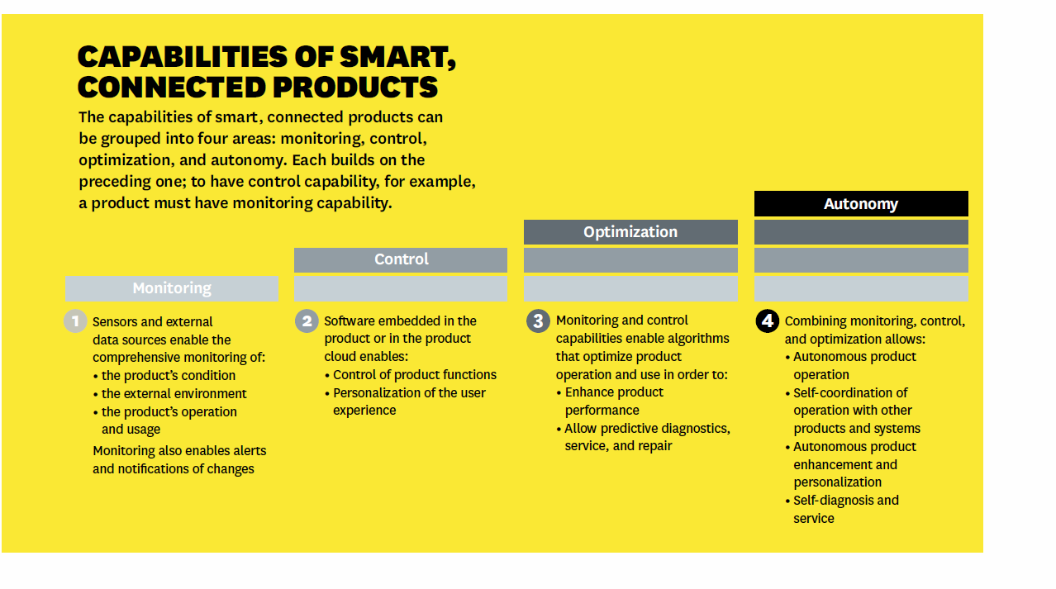
Smart Systems

Slide 4
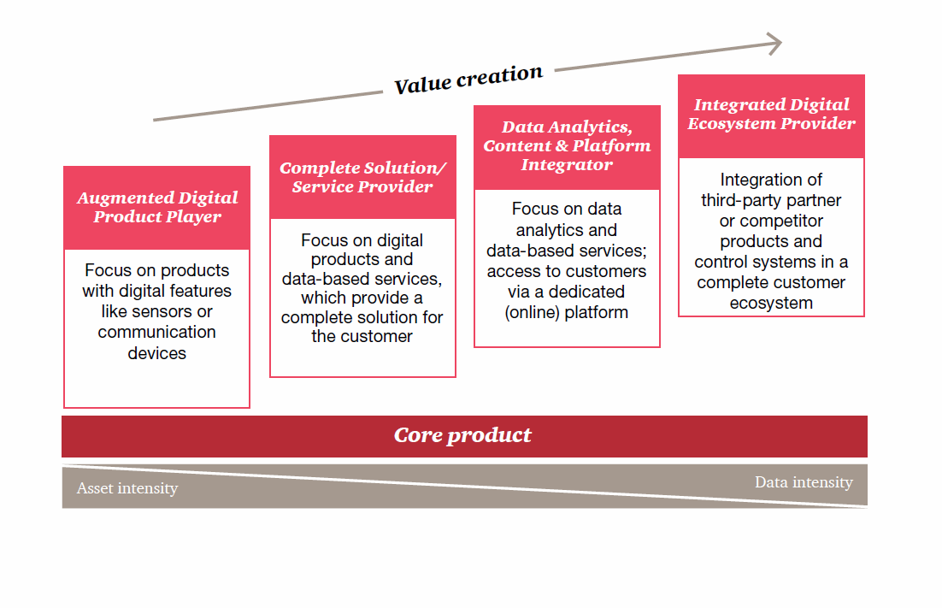
Digitalization and Value Creation

Slide 5
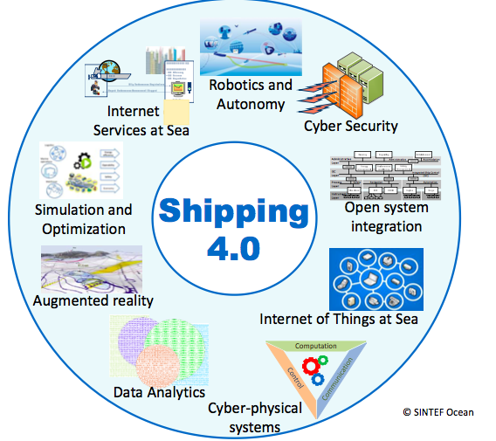
Shipping 4.0: the new era
A collection of digital shipping technologies and applications for ship design, operations and shipping management
Robotics and automation
Augmented reality
Design and Simulation
Big data analytics
AI applications
Blockchain
Cyber security

Slide 6
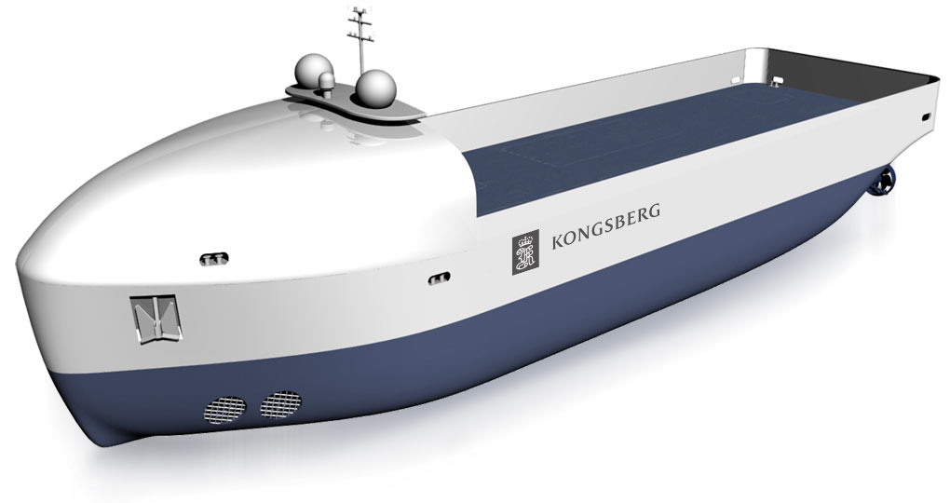
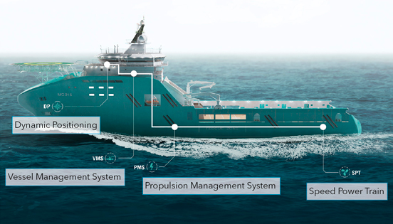
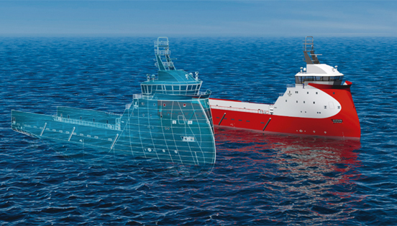
The European Case
The Rolls-Royce Advanced Autonomous Waterborne Applications Project
Kongsberg Autonomous Ship Activities
Massterly joint venture with Wilhelmsen
Maersk Digital- a Range of Applications
SINTEF Ocean (OSP Platform)

Slide 7
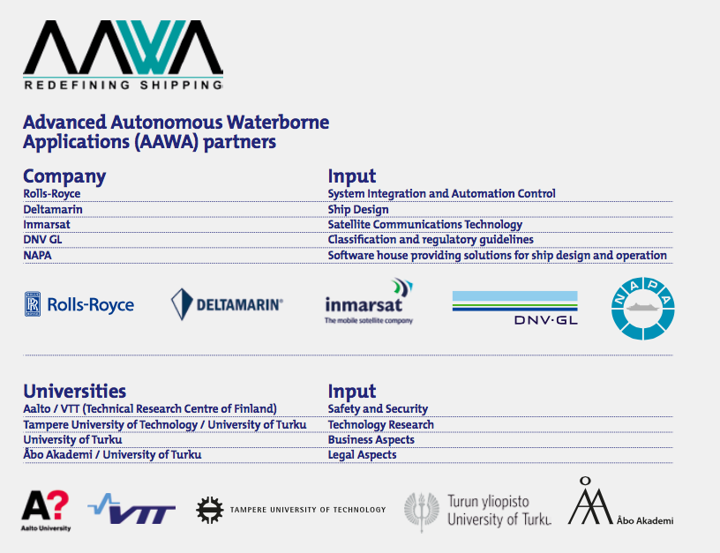

Slide 8
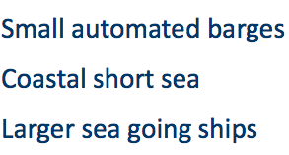
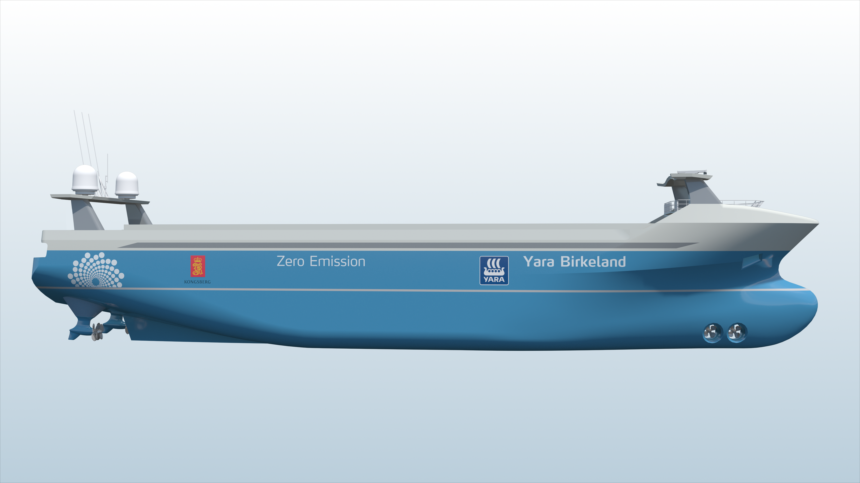

Slide 9
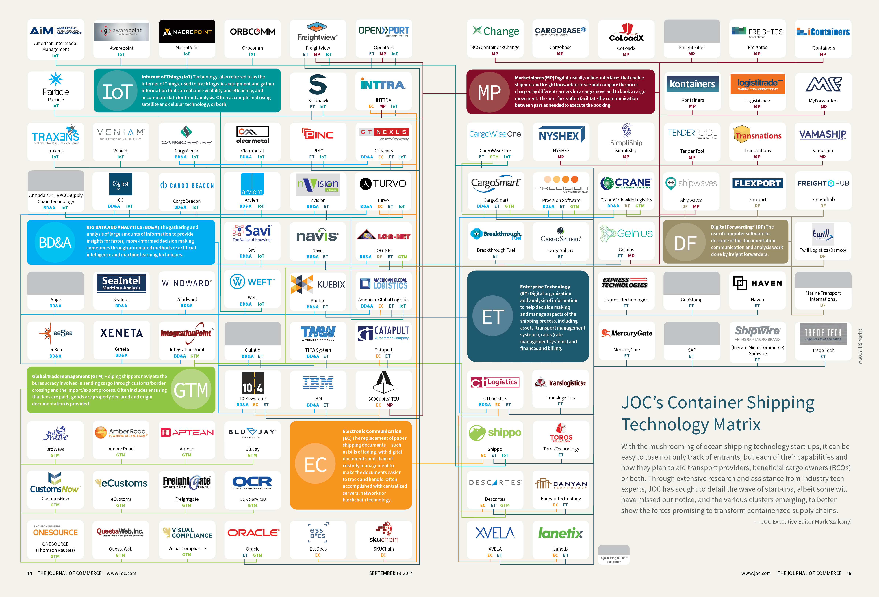
Digital Apps Ecosystem

Slide 10
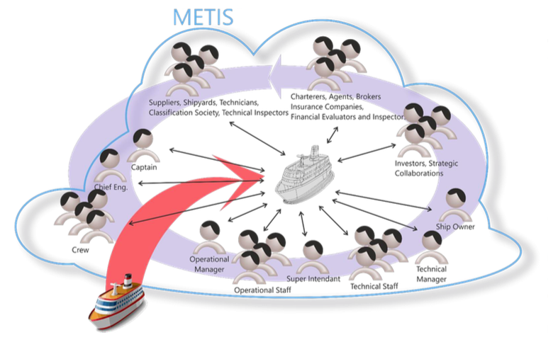
AI Platform
NLP Personal Digital Assistants: METIS

Slide 11
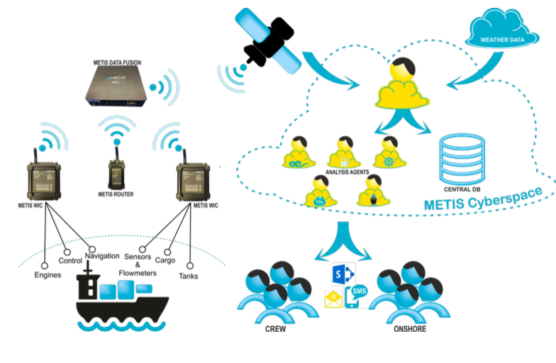

Slide 12
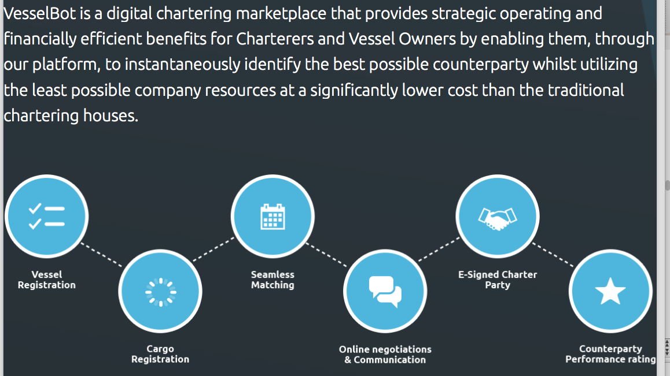
E-Chartering Marketplace: VesselBot

Slide 13
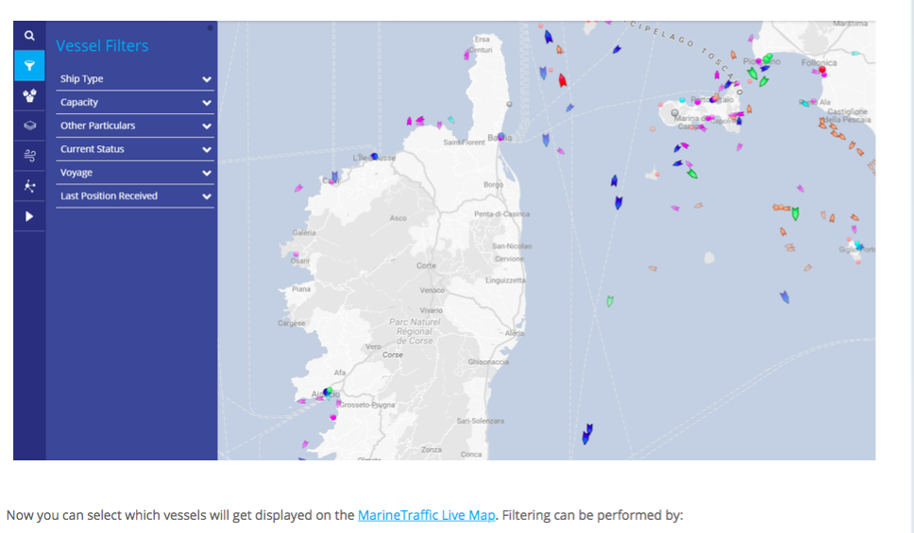
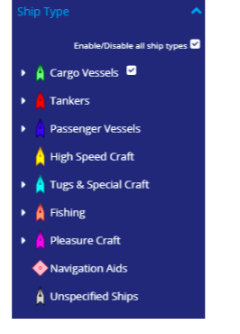
AIS Data Platform: MarineTraffic

Slide 14
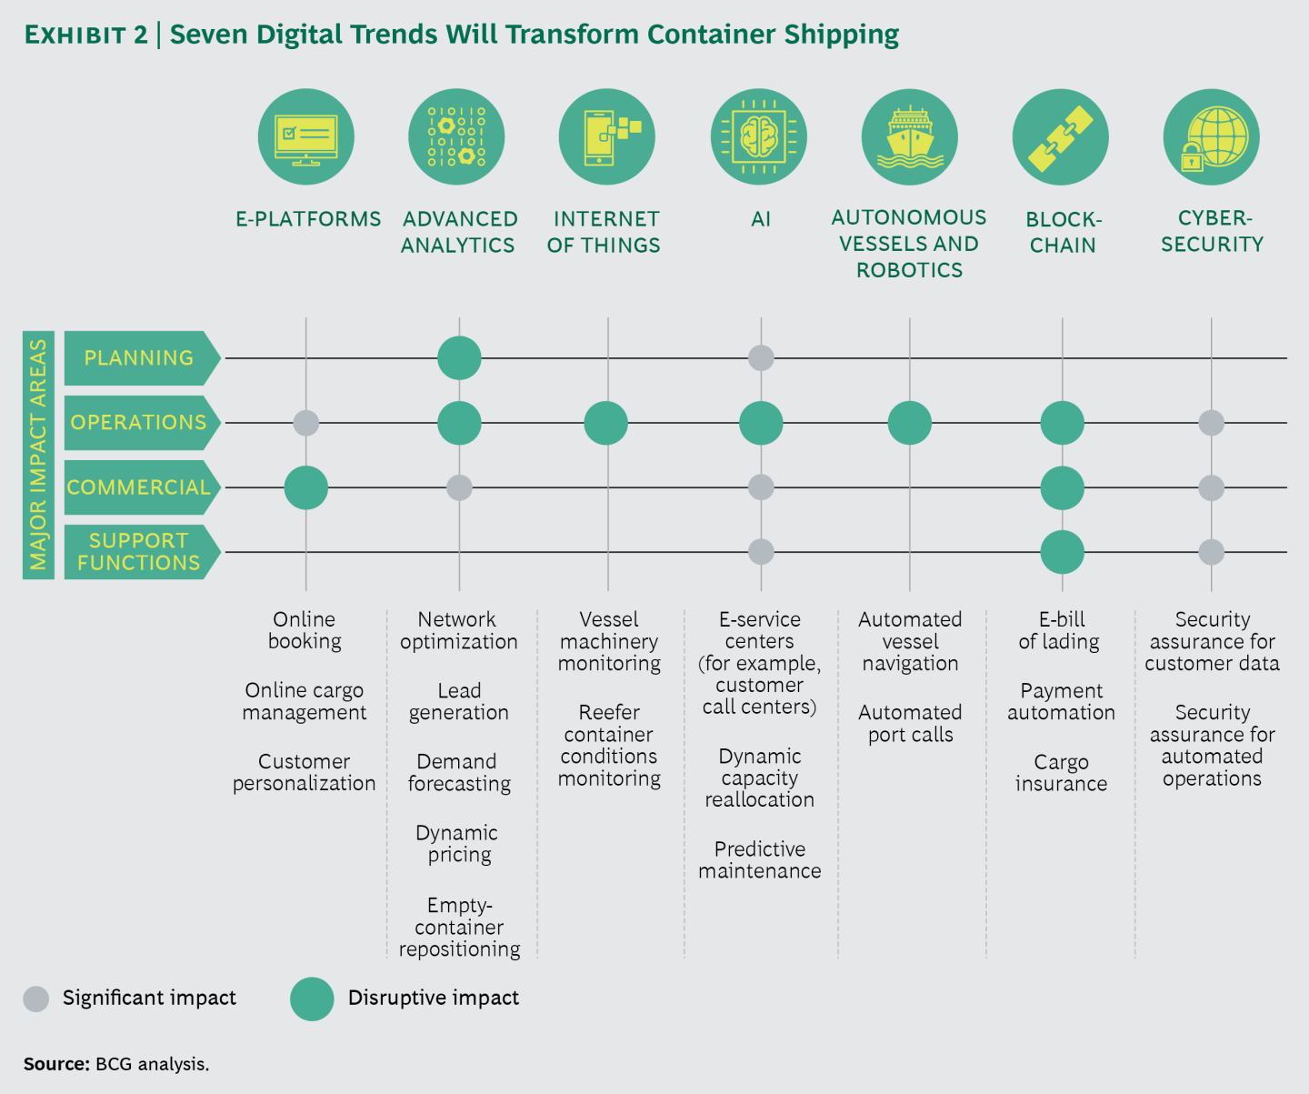
Shipping Digitalization and Disruptive Impact

Slide 15
Shipping Digitalization Case #1

Slide 16
Shipping Digitalization Case #2

Slide 17
Shipping Digitalization Case #3

Slide 18
Shipping Digitalization Case #3

Slide 19
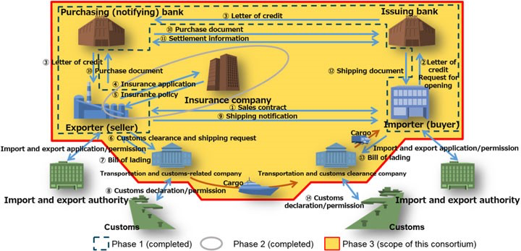
Trade data sharing platform using blockchain technology
Shipping Digitalization Case #4

Slide 20
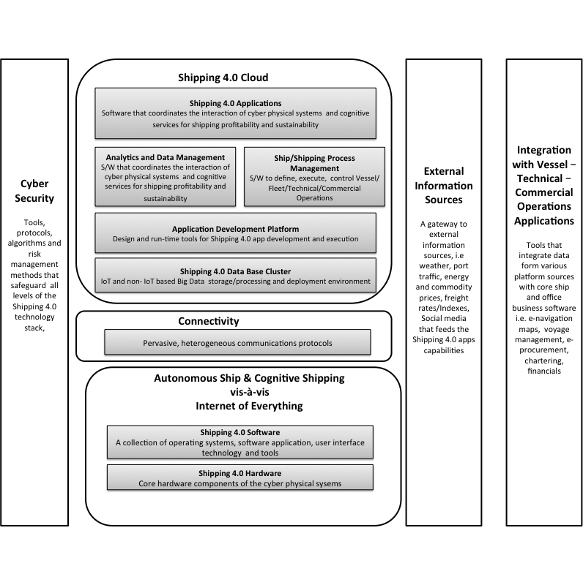
Shipping 4.0 Technology Stack (based on Porter and Heppelmann, 2014)

Slide 21
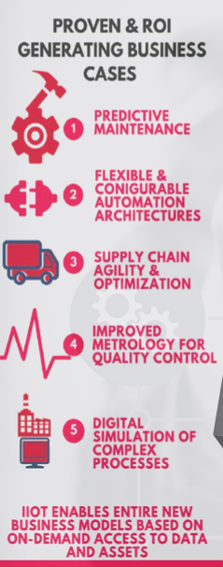
Big data: defined in terms of "the x Vs": volume, velocity, variety, veracity, value
Volume – the quantity of data relative to the
ability to store and manage it
Velocity – the speed of calculation needed to
query the data relative to the rate of change of the data
Variety – a measure of the number of different
formats the data exists in (e.g. text, audio, video, blogs etc)
Veracity – that addresses the inherent trustworthiness of data
Value -select the attributes and factors that are most likely that predict outcomes that matter most to businesses
advanced tools, software, and systems are required to capture, store, manage, and analyze the data sets, all in a timeframe that preserves the intrinsic value of the data
“techniques and technologies that make handling data at extreme scale affordable”

Slide 22
From DSS to BI to BDA

Slide 23
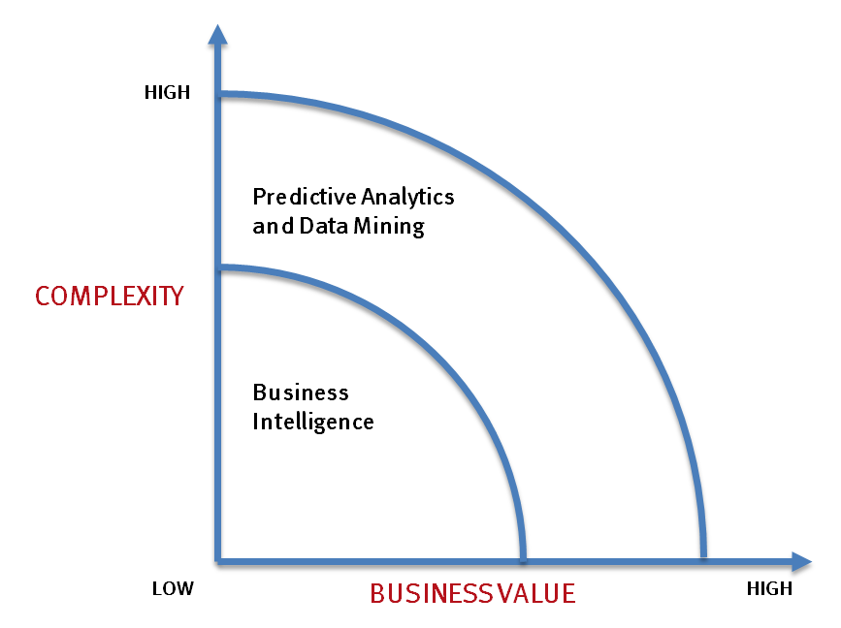
Big Data Drivers
- Optimizations and predictive analytics
- Complex statistical analysis
- All types of data, and many sources
- Very large datasets
- More of a real-time
- Ad-hoc querying and reporting
- Data mining techniques
- Structured data, typical sources
- Small to mid-size datasets

Slide 24
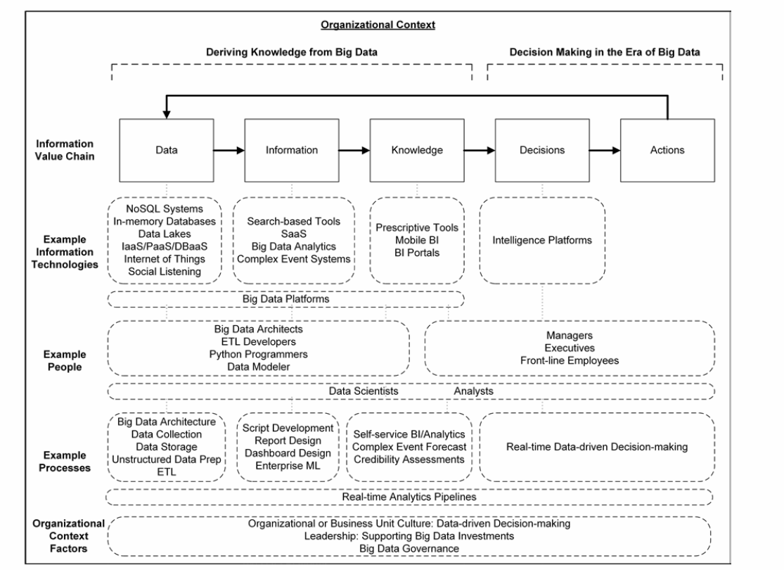
Abbaci et al. (2016)

Slide 25
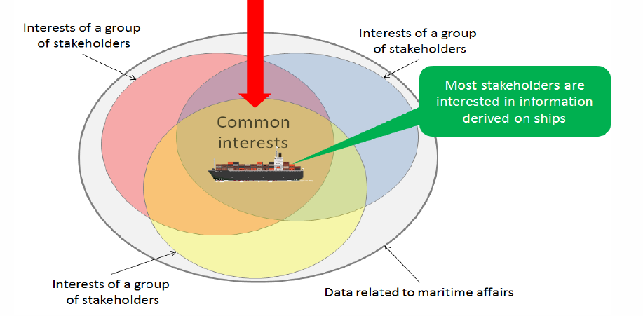
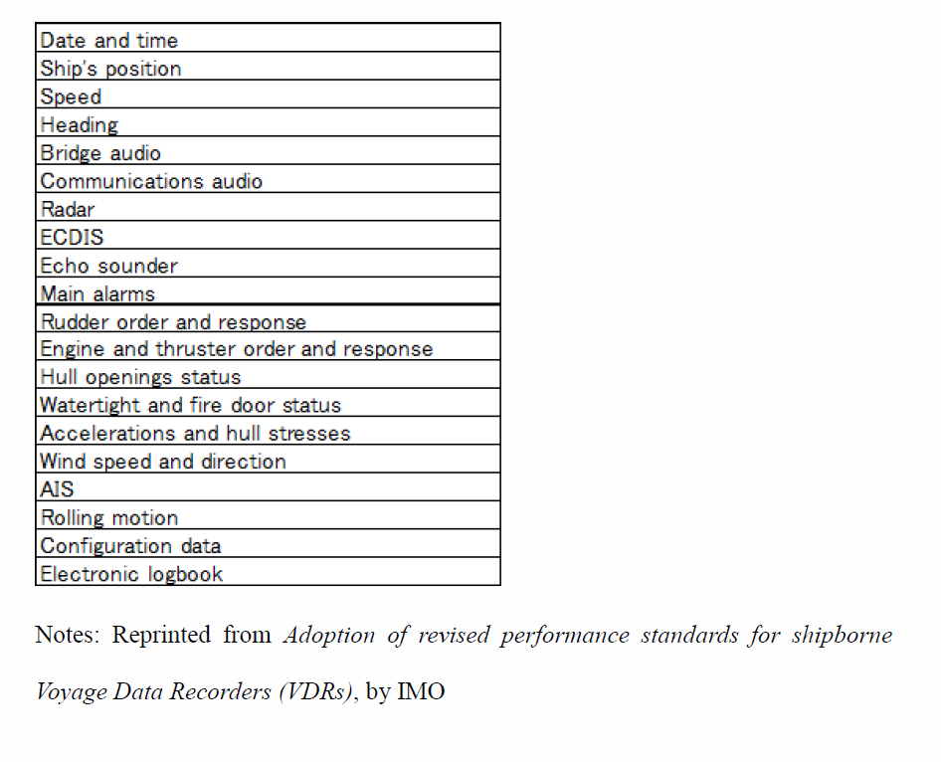
Maritime Big Data

Slide 26
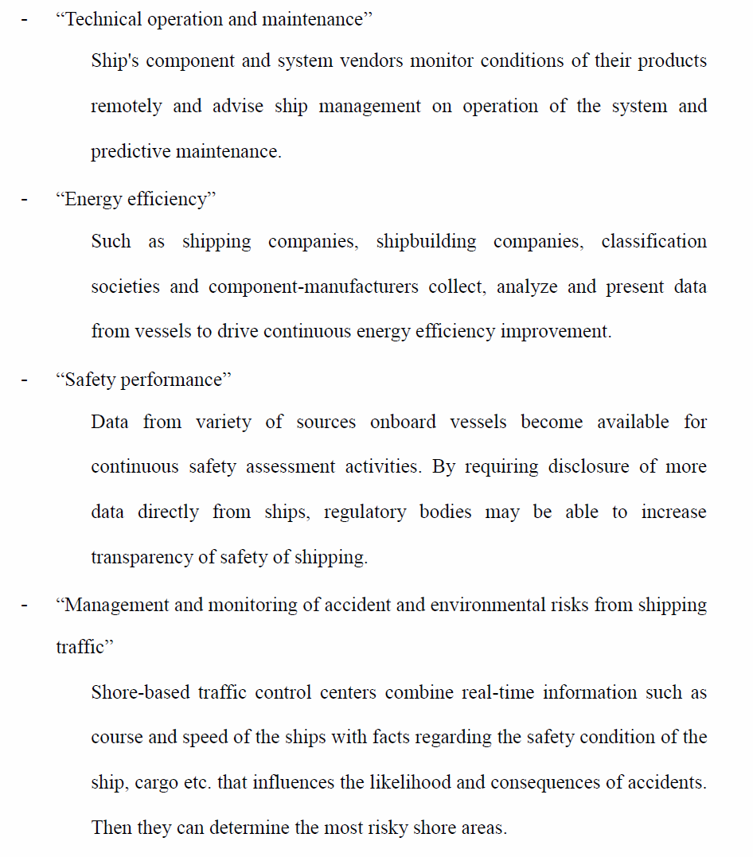
DNV-GL: Maritime Big Data Areas

Slide 27
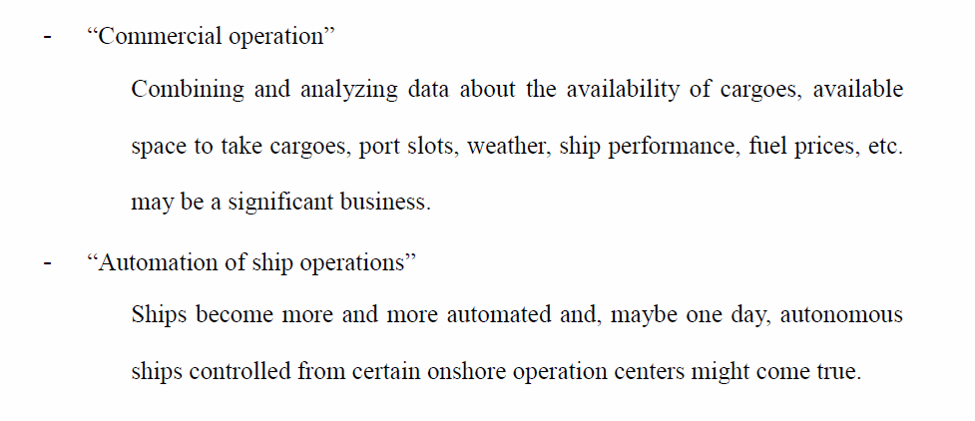
DNV-GL: Maritime Big Data Areas

Slide 28
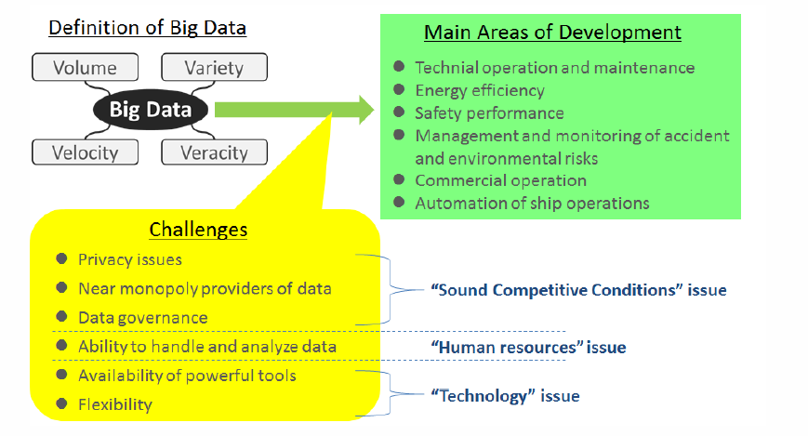
DNV-GL: Maritime Big Data Issues

Slide 29
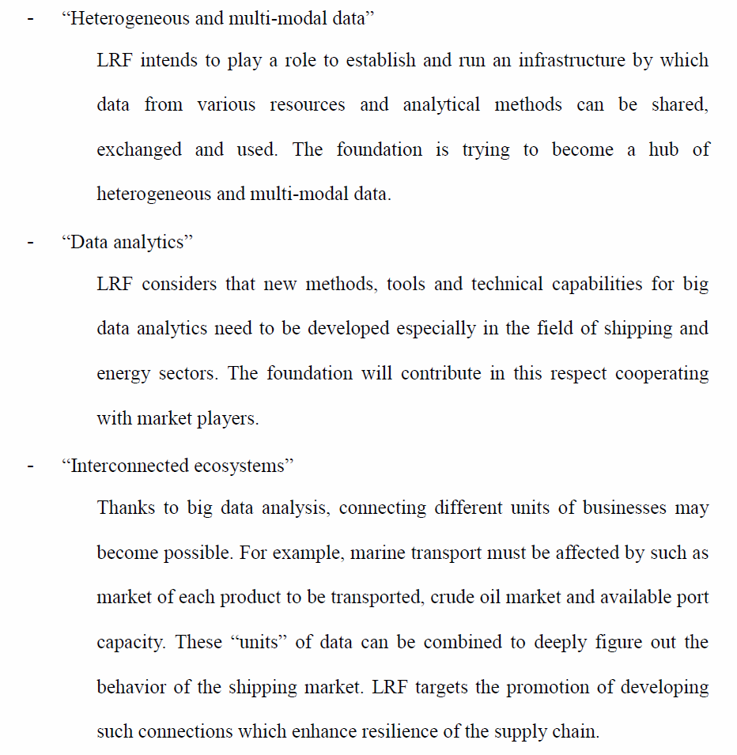
LRF: Maritime Big Data Opportunities

Slide 30
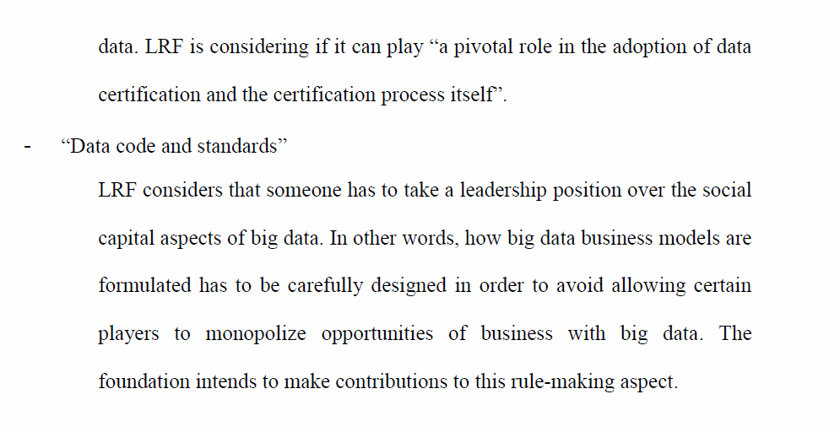
LRF: Maritime Big Data Opportunities

Slide 31
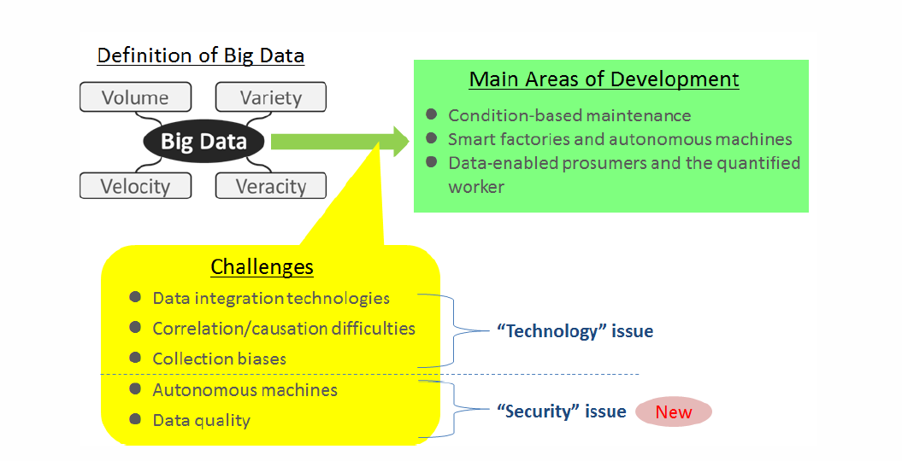
LRF: Maritime Big Data Issues

Slide 32
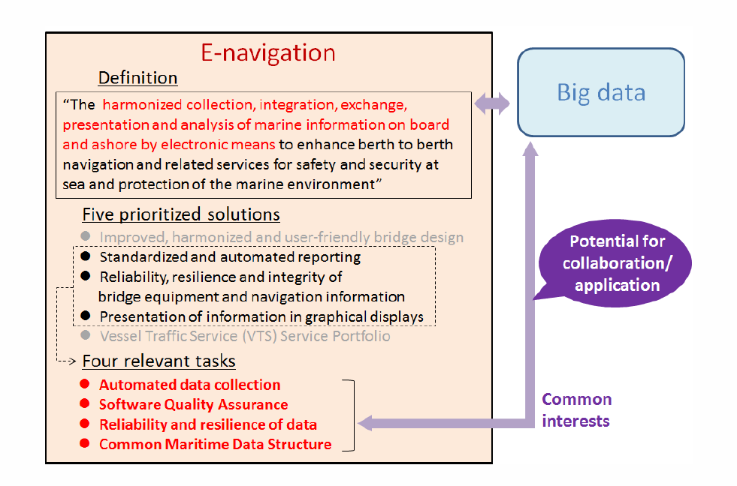
IMO e-Navigation: Synergies for Maritime Big Data

Slide 33
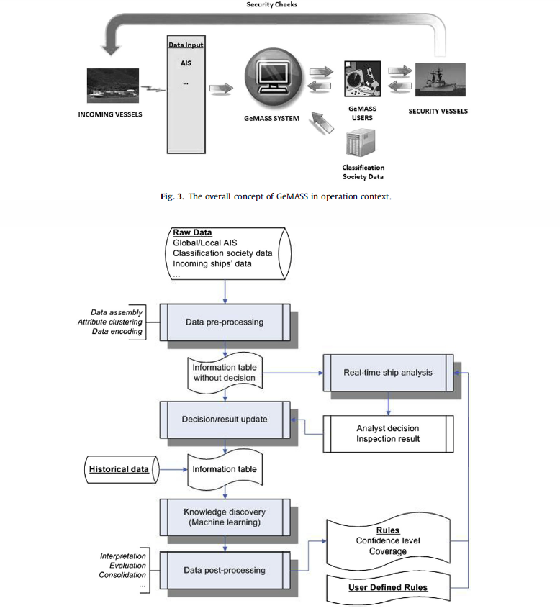
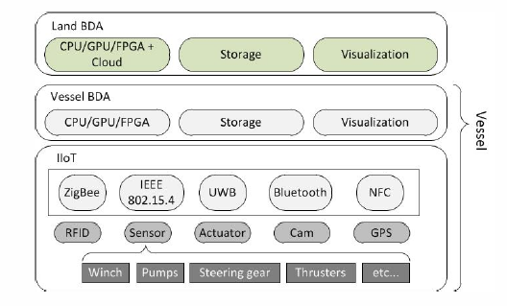
The Maritime Big Data Business Case
Big Data Technology for the Maritime Industry
ship health monitoring (predictive maintenance) applications
energy consumption/efficiency monitoring
emissions/environmental impact monitoring platforms
safety and security platforms for critical incidents /piracy monitoring
Vessel Tracking/Anomaly Detection Scenario

Slide 34
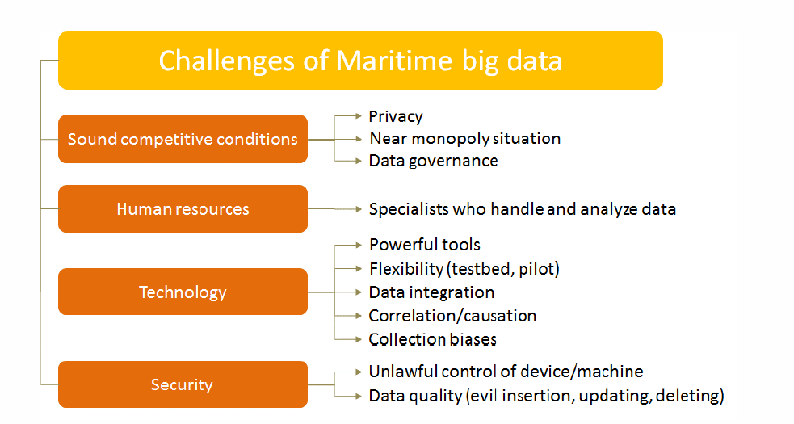
The Maritime Big Data Business Case

Slide 35
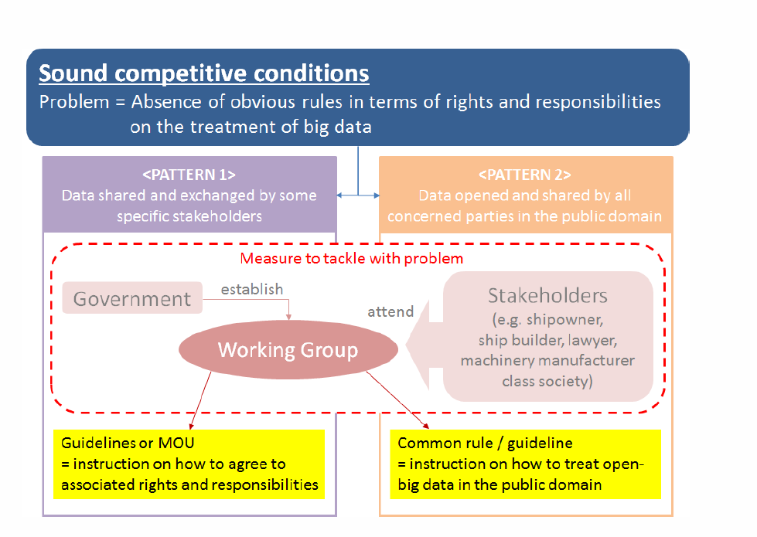
The Maritime Big Data Business Case

Slide 36
The Maritime Big Data Business Case

Slide 37
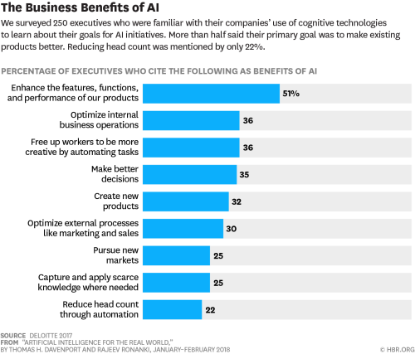

Slide 38
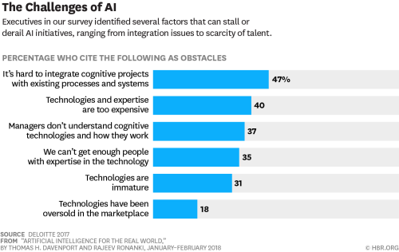

Slide 39
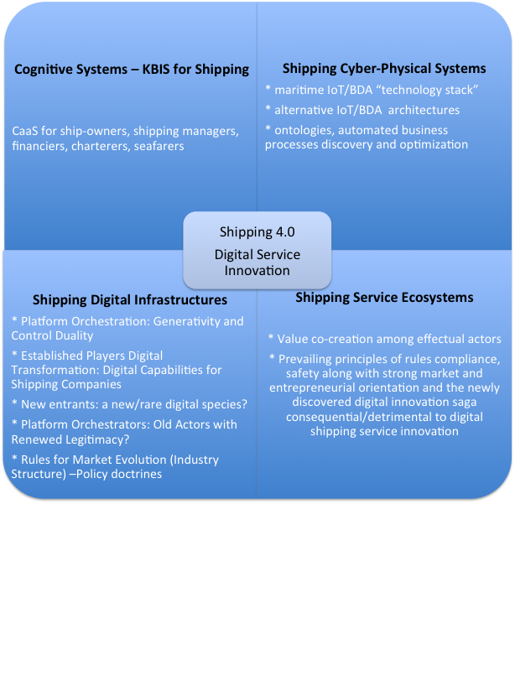
Shipping 4.0 vis-a-vis Digital Service Innovation

Slide 40
Shipping Digitalization Use Cases
New Operational problems- ship management applications (technical operations)
Ship Equipment and Conditions Monitoring
Predictive Maintenance
Environmental Regulations Compliance
Navigation and Situation awareness
Energy Consumption Monitoring

Slide 41
Shipping Digitalization Use Cases
New tactical problems- (commercial operations)
Asset Optimization
Fleet Planning
Service Planning
Chartering

Slide 42
Shipping Digitalization Use Cases
Strategic management applications of analytics technology:
investments appraisal and portfolio management
shipping markets monitoring/prediction and positioning or exit determination
Strategy and Policy Problems
Incumbent Players Digital Strategies
New entrants
Digital Platform Orchestrators
Example: Asset play, fleet mix and ship prices problems for autonomous ships variations
Market equilibrium for digital entrants, shipping incumbents

Slide 43
Shipping Digital Technology and IS theory:
Digitalization is more than new ICT
Using information systems effectively requires an understanding of the organization, management, and information technology shaping the systems. An information system creates value for the firm as an organizational and management solution to challenges posed by the environment.
Notes:
These three themes (management, organizations, and technology) will reappear throughout the book. Understanding the interaction among these factors and information systems is known as information system literacy. Knowing how to optimize the relationship between technology, organizations, and management is the purpose of this book and course.

Slide 44
Technology dimension of information systems
Computer hardware and software
Data management technology
Networking and telecommunications technology
Networks, Cloud, IoT
IT infrastructure: platforms, development environments, design, computational techniques
Notes:
Information technology is at the heart of information systems. Although organization and management are important too, it’s the technology that enables the systems and the organizations and managers who use the technology.
The distinction between the Internet and intranets and extranets has to do with their scope. Intranets are private networks used by corporations and extranets are similar except that they are directed at external users (such as customers and suppliers). In contrast, the Internet connects millions of different networks across the globe. Students may not immediately understand this distinction.

Slide 45
How information systems are transforming business
“Every business is digital business”
Strategic business objectives of information systems
Operational excellence
New products, services, and business models
Customer and supplier engagement
Improved decision making
Competitive advantage
Survival

Slide 46
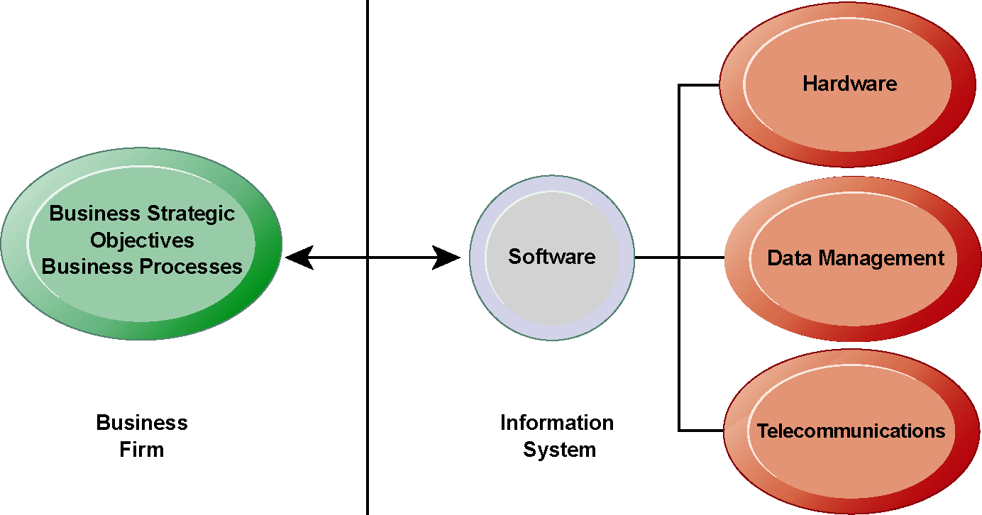
The Interdependence Between Organizations and Information Technology
The Role of Information Systems in (Shipping) Business Today
There is a growing interdependence between a firm’s information systems and its business capabilities. Changes in strategy, rules, and business processes increasingly require changes in hardware, software, databases, and telecommunications. Typically, what the organization
would like to do depends on what its systems will permit it to do.

Slide 47
Contemporary Approaches to Information Systems
Technical approach
Management approach
Sociotechnical systems

Slide 48
Change firm structure- Flattening organizations
Separating work from location
Reorganizing work-flows
Increasing flexibility
Redefining organizational boundaries
Restructure existing industries
Create new industries

Slide 49
Strategic information systems
Information technology is becoming a commodity ---
Advances are easily replicated
…many firms overspend on information systems and the systems themselves are becoming utilities like electricity or the railroads…

Slide 50
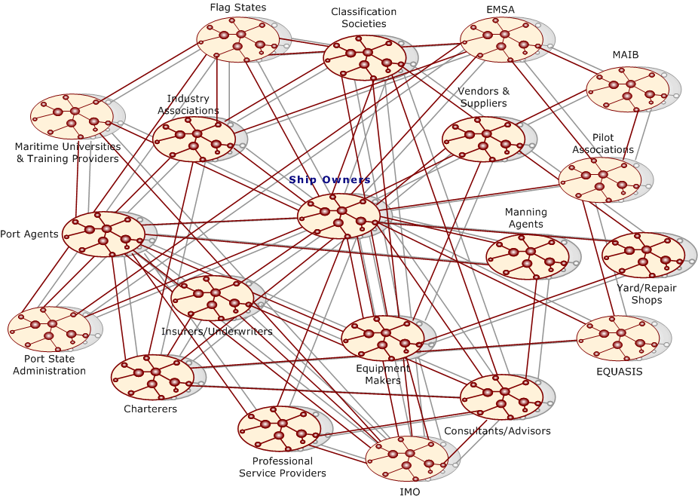
Digital Shipping Business Management

Slide 51
Digitalization Management

Slide 52
The role of digital technology in
shipping strategy and innovation
shift of focus
from technical and commercial operations automation and
decision making support
to real time transparency and autonomous shipping
affordances of digitalization on the shipping company
beyond increasing efficiency, safety and rules compliance
towards new business models
cost-leadership, strategic differentiation and competitive advantage or business sustainability, also new digital markets creation

Slide 53
Digital Transformation of the Shipping sector
Addressing shipping digitalization with a scholarly, business and technical manner
Define in formal and harmonized manner the contemporary digitalization phenomena
Classify/Map Shipping 4.0 technologies to Strategic, Tactical, Operational Problems
Analyze the role and impact on shipping management activities
Extend the research inquiry to more units of analysis
New (updated) reference theories, techniques and tools

Slide 54
Digital Transformation of the Shipping sector
A synthesized Information Systems, Innovation Management, and Maritime Business Management disciplinary mode
the technological foundations of the shipping digitalization process towards a pluralist creation of use cases, in diverse organizational settings (i.e. AI systems for process automation, insight and action, engagement?)
a multitude of digitalization outcomes (applications, business models, entrepreneurial strategies)
the determinant factors for the innovative potential actualization
Shipping Digitalization vis a vis New Methodologies
Transaction Cost Theory, RBV
Analytics/OR/Digitalization Mgt, AI techniques

Slide 55
The role of digital technology in
shipping strategy and innovation
affordances of digitalization and shipping innovation
“value co-creation of novel offerings through the recombination of digital and/or physical components and solution/service providers”.
shifting the locus of control
toward supra-organizational forms, i.e. alliances, partnerships, business networks, platforms and digital infrastructures
the changing nature and attributes of the contemporary shipping firm
the organizing logic and governance mechanisms

Slide 56
The role of digital technology in
shipping business operation and innovation
affordances of digitalization and shipping innovation
“exploitation” through incremental improvements supported by new technology
“exploration” with larger, strategic digital technology projects
combine new digital technologies with legacy systems
a digital technology portfolio management (programme management)
“innovation process” ideation, experimentation, acceleration

Slide 57
The role of digital technology in
Shipping business operation and innovation
enabling factors of digitalization and shipping innovation
Digital innovation capabilities
Governance, Leadership
Quality/Market/Innovation orientation
Resourcing
Network and Collaboration orientation
Culture

Slide 58
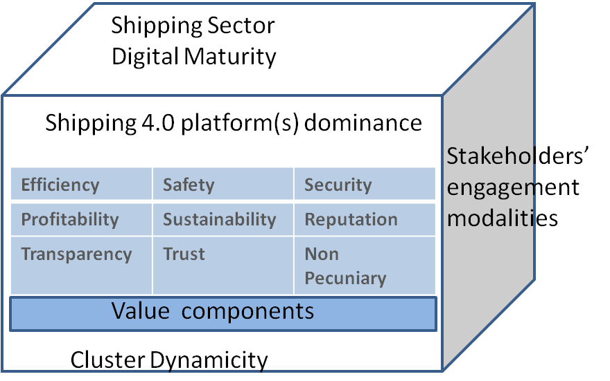
The role of digital technology in
shipping business operation and innovation
affordances of digitalization and shipping innovation
digital innovation engagement modes/dynamics
porterian maritime cluster,
shipping sub-sector,
Shipping 4.0 platform(s),
actors’ engagement properties

Slide 59
The role of digital technology in
Shipping business operation and innovation
enabling factors of digitalization and shipping innovation
Digital innovation capabilities
Governance, Leadership
Quality/Market/Innovation orientation
Resourcing
Network and Collaboration orientation
Culture

Slide 60
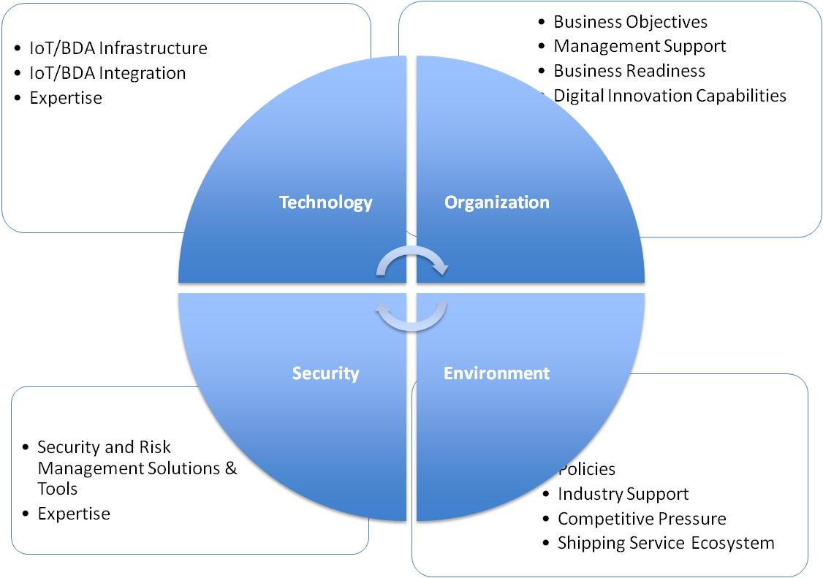
Shipping Digitalization Technology Acceptance Factors (adapted from Ching at al, 2016)

Slide 61
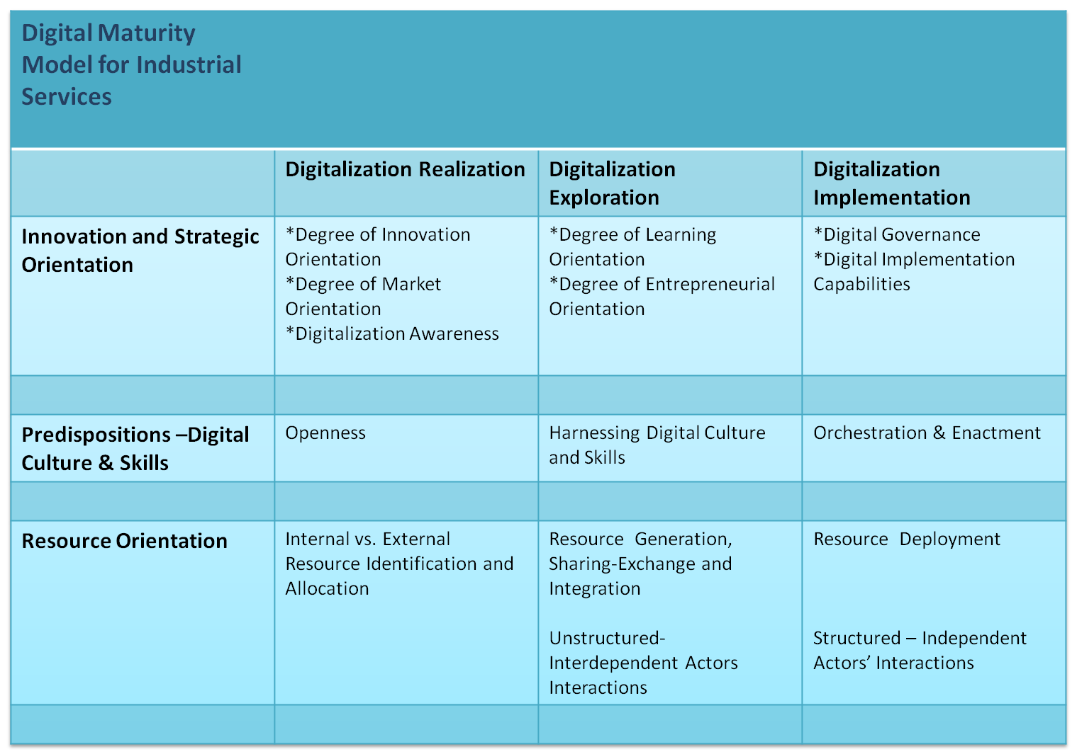
Digitalization Stages and Factors

Slide 62
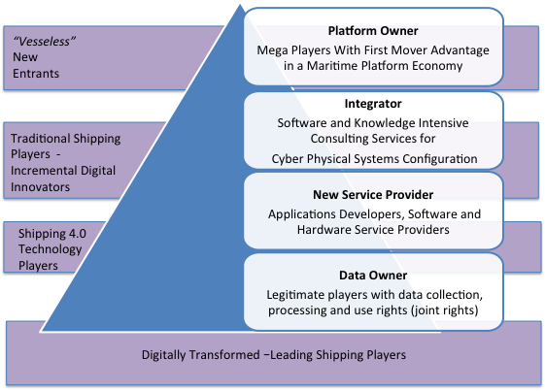
Digitalization Business Models

