Slide 1
Πανεπιστήμιο Αιγαίου

Slide 2
Άδειες Χρήσης
Το παρόν εκπαιδευτικό υλικό υπόκειται σε άδειες χρήσης Creative Commons.
Για εκπαιδευτικό υλικό, όπως εικόνες, που υπόκειται σε άλλου τύπου άδειας χρήσης, η άδεια χρήσης αναφέρεται ρητώς.

Slide 3
Χρηματοδότηση
Το παρόν εκπαιδευτικό υλικό έχει αναπτυχθεί στα πλαίσια του εκπαιδευτικού έργου του διδάσκοντα.
Το έργο «Ανοικτά Ακαδημαϊκά Μαθήματα στο Πανεπιστήμιο Αιγαίου» έχει χρηματοδοτήσει μόνο τη αναδιαμόρφωση του εκπαιδευτικού υλικού.
Το έργο υλοποιείται στο πλαίσιο του Επιχειρησιακού Προγράμματος «Εκπαίδευση και Δια Βίου Μάθηση» και συγχρηματοδοτείται από την Ευρωπαϊκή Ένωση (Ευρωπαϊκό Κοινωνικό Ταμείο) και από εθνικούς πόρους.

Slide 4
1. Ecosystem Characterization
Often difficult to perform because
Ecosystem no longer there?
Boundaries?
Climate changes?
Biotic interactions?

Slide 5
2. Stressor characteristics and evaluation of relevant effects
Chemical properties?
Toxicity?
Usually evaluate from published data
May do own tests but expensive → only do if absolutely necessary

Slide 6
3. Exposure analysis
Determine environmental concentration
Difficult → end of pipe →biotransformation → media heterogeneity → now how much toxic stuff is there?
Non-point sources can be even more difficult
Where to measure?
When to measure?

Slide 7
4. Ecological response analysis
Most difficult stage of ERA because as test system becomes more environmentally realistic the ability to accurately predict effects decreases
Can use
Toxicity data
Microcosms
Field data/observations
Etc.

Slide 8
5. Stressor/response analysis
Analogous to dose/response but using single species toxicity to extrapolate to population/community level responses
Have to take other (natural) stressors into account

Slide 9
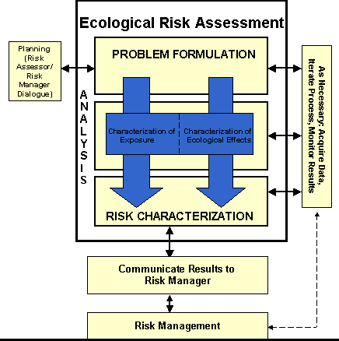
Risk Characterization
Final stage of an ERA
Combines ecological effect and environmental concentration to provide likelihood of effects given distribution of stressor within ecosystem
Composed of two parts:

Slide 10
1. Risk estimation
Integration
Integrate exposure with toxicity
Use quotient method of estimating environmental risk
Uncertainty analysis – how much confidence (certainty) in data/information
Can have formal mathematical analysis or informal “best guess” analysis

Slide 11
Quotient Method
Quotient = Expected environmental concentration
Concentration producing an unacceptable environmental effect
Quotient | Risk
>1 | Potential of high risk
~1 | Potential risk
<< 1 | Low risk

Slide 12
2. Risk description
Ecological risk summary
“what are the potential effects and do I believe them?
Interpretation of ecological significance
“how big a problem is this really going to be”

Slide 13
Discussion between Risk Assessor and Risk Manager
Report from risk assessor to risk manager
Risk manager may take information and perform a risk/benefit analysis

Slide 14
Discussion between Risk Assessor and Risk Manager
Report from risk assessor to risk manager
Risk manager may take information and perform a risk/benefit analysis→ is the economic benefit worth the environmental cost?
Report may generate multiple vituperative displays of acrimony among interested parties

Slide 15
Risk Management
Manage risk taking environmental, social, economic effects into account
Management usually implemented in the form of policy and legislation

Slide 16
Monitor Results
Usually need to implement an on-going monitoring plan to determine if management objectives are being met
Often not performed as extensively as necessary until a problem arises

