Slide 1
Inducing changes on landscapes

Slide 2
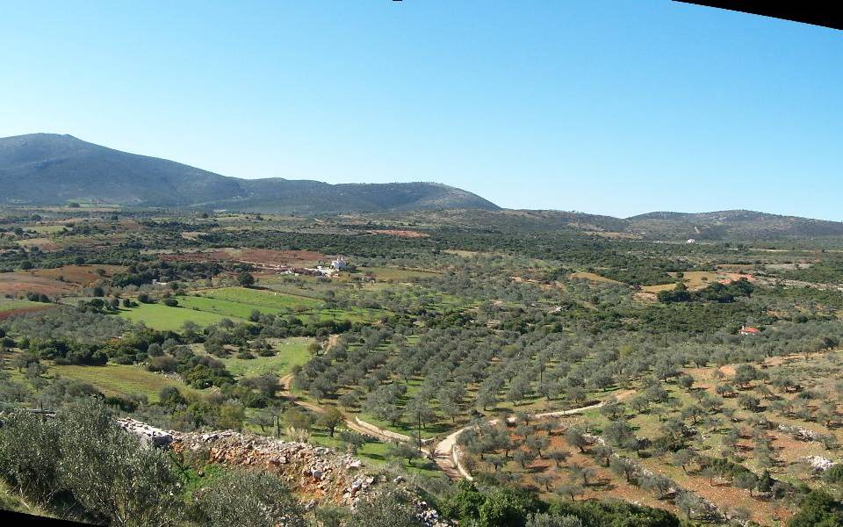
Talkin’ landscapes

Slide 3
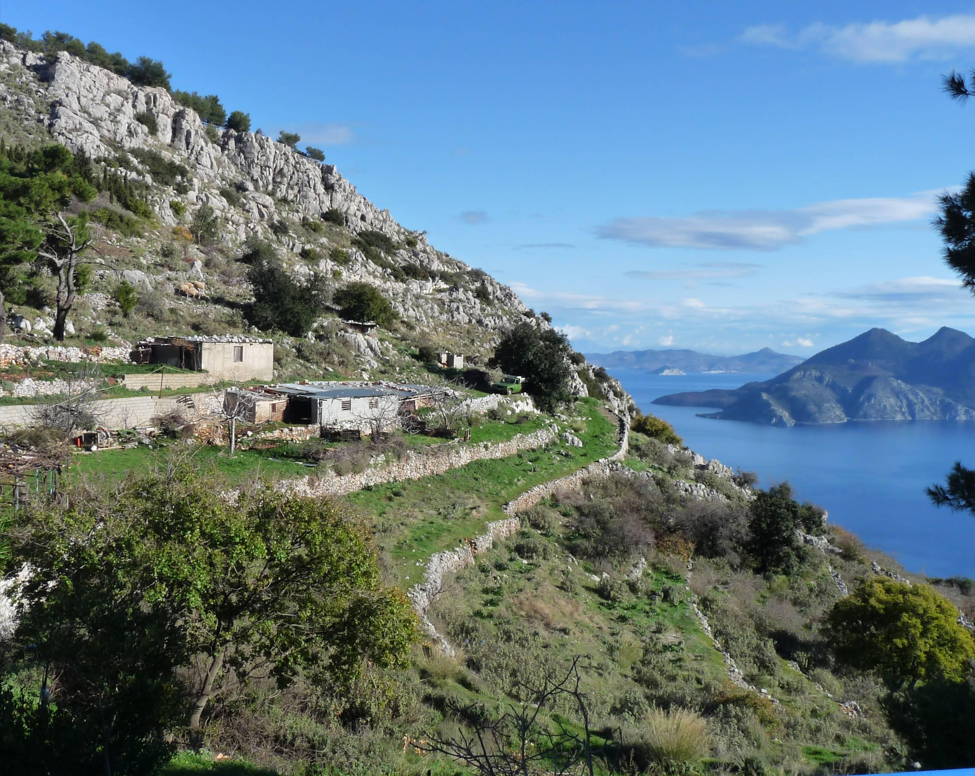
Talkin’ landscapes

Slide 4
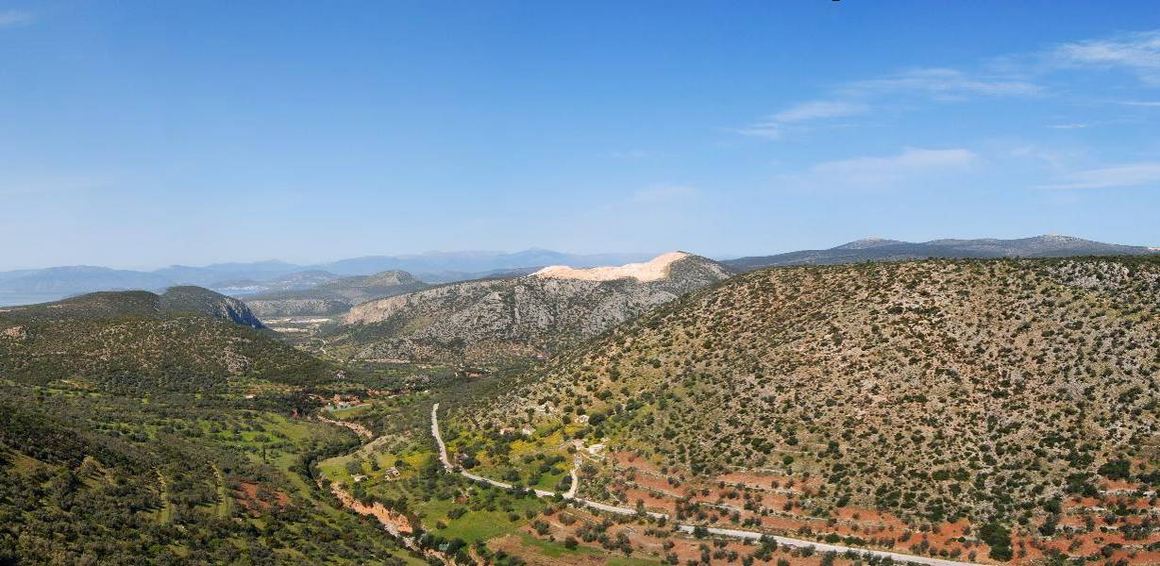
Talkin’ landscapes

Slide 5
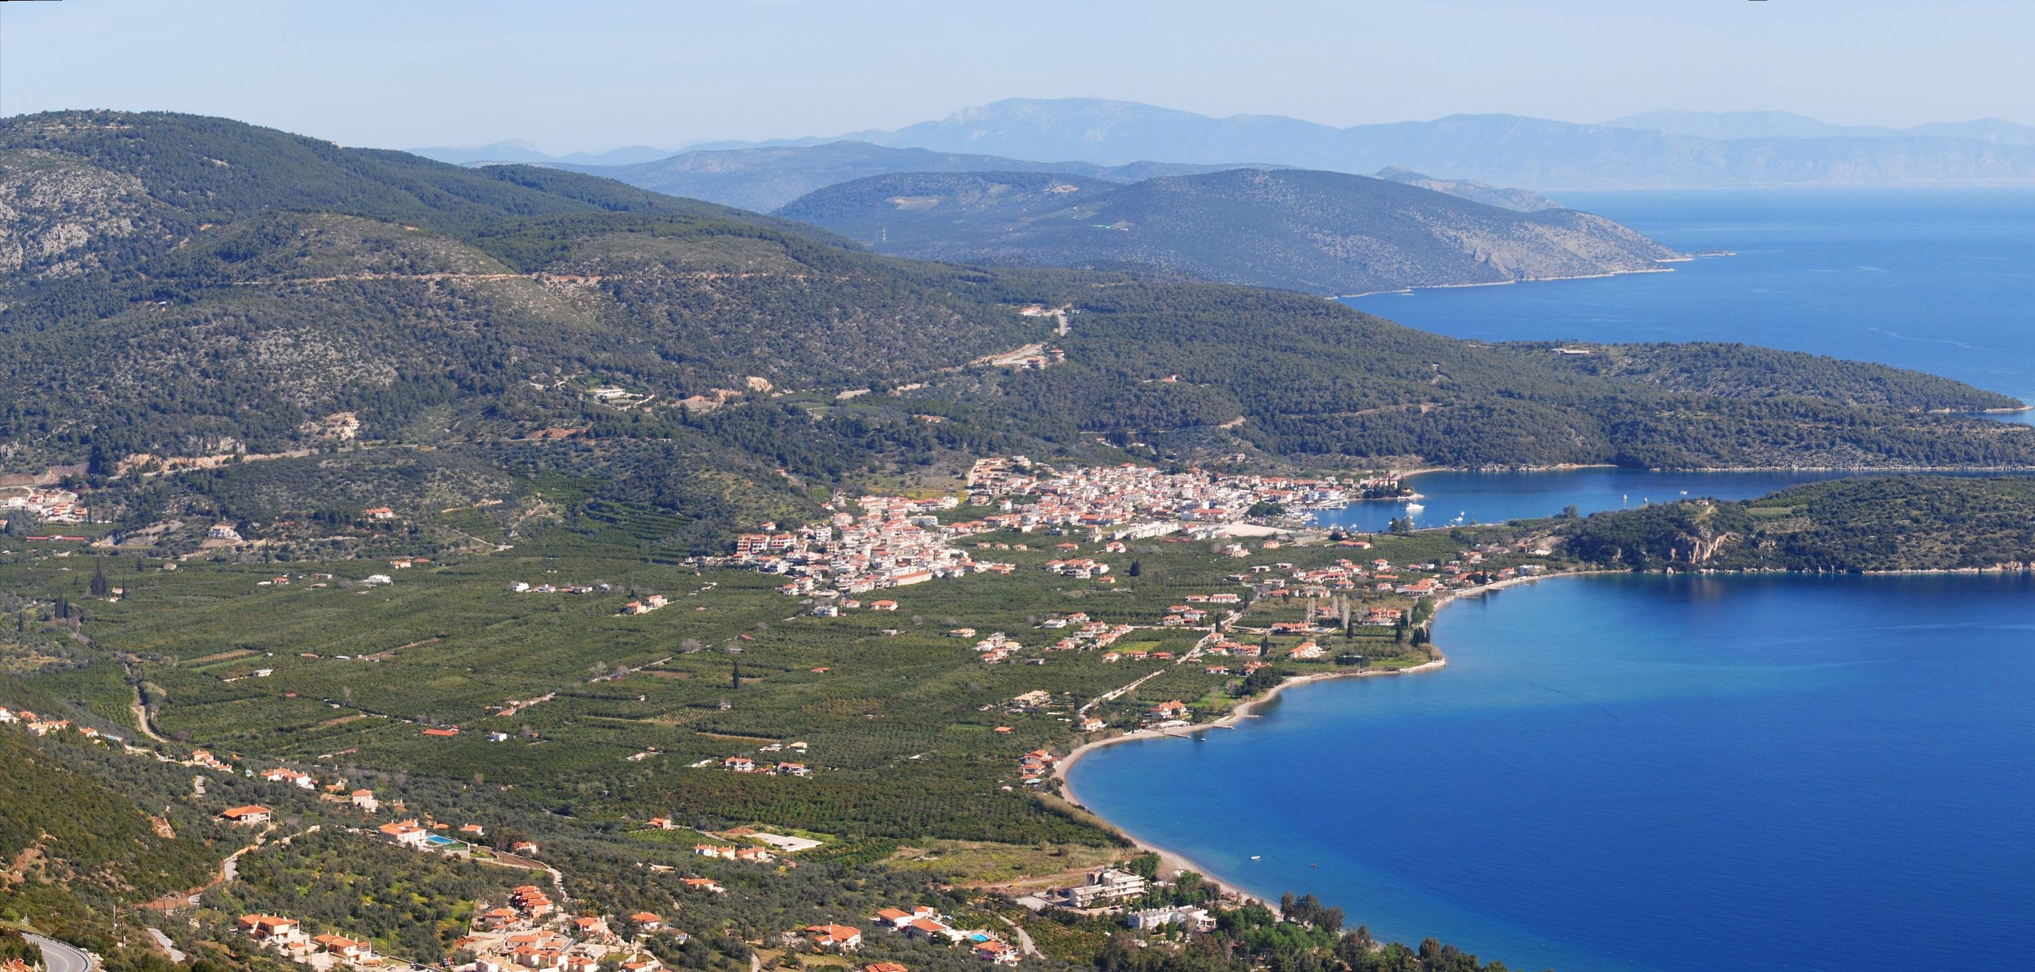
Talkin’ landscapes

Slide 6
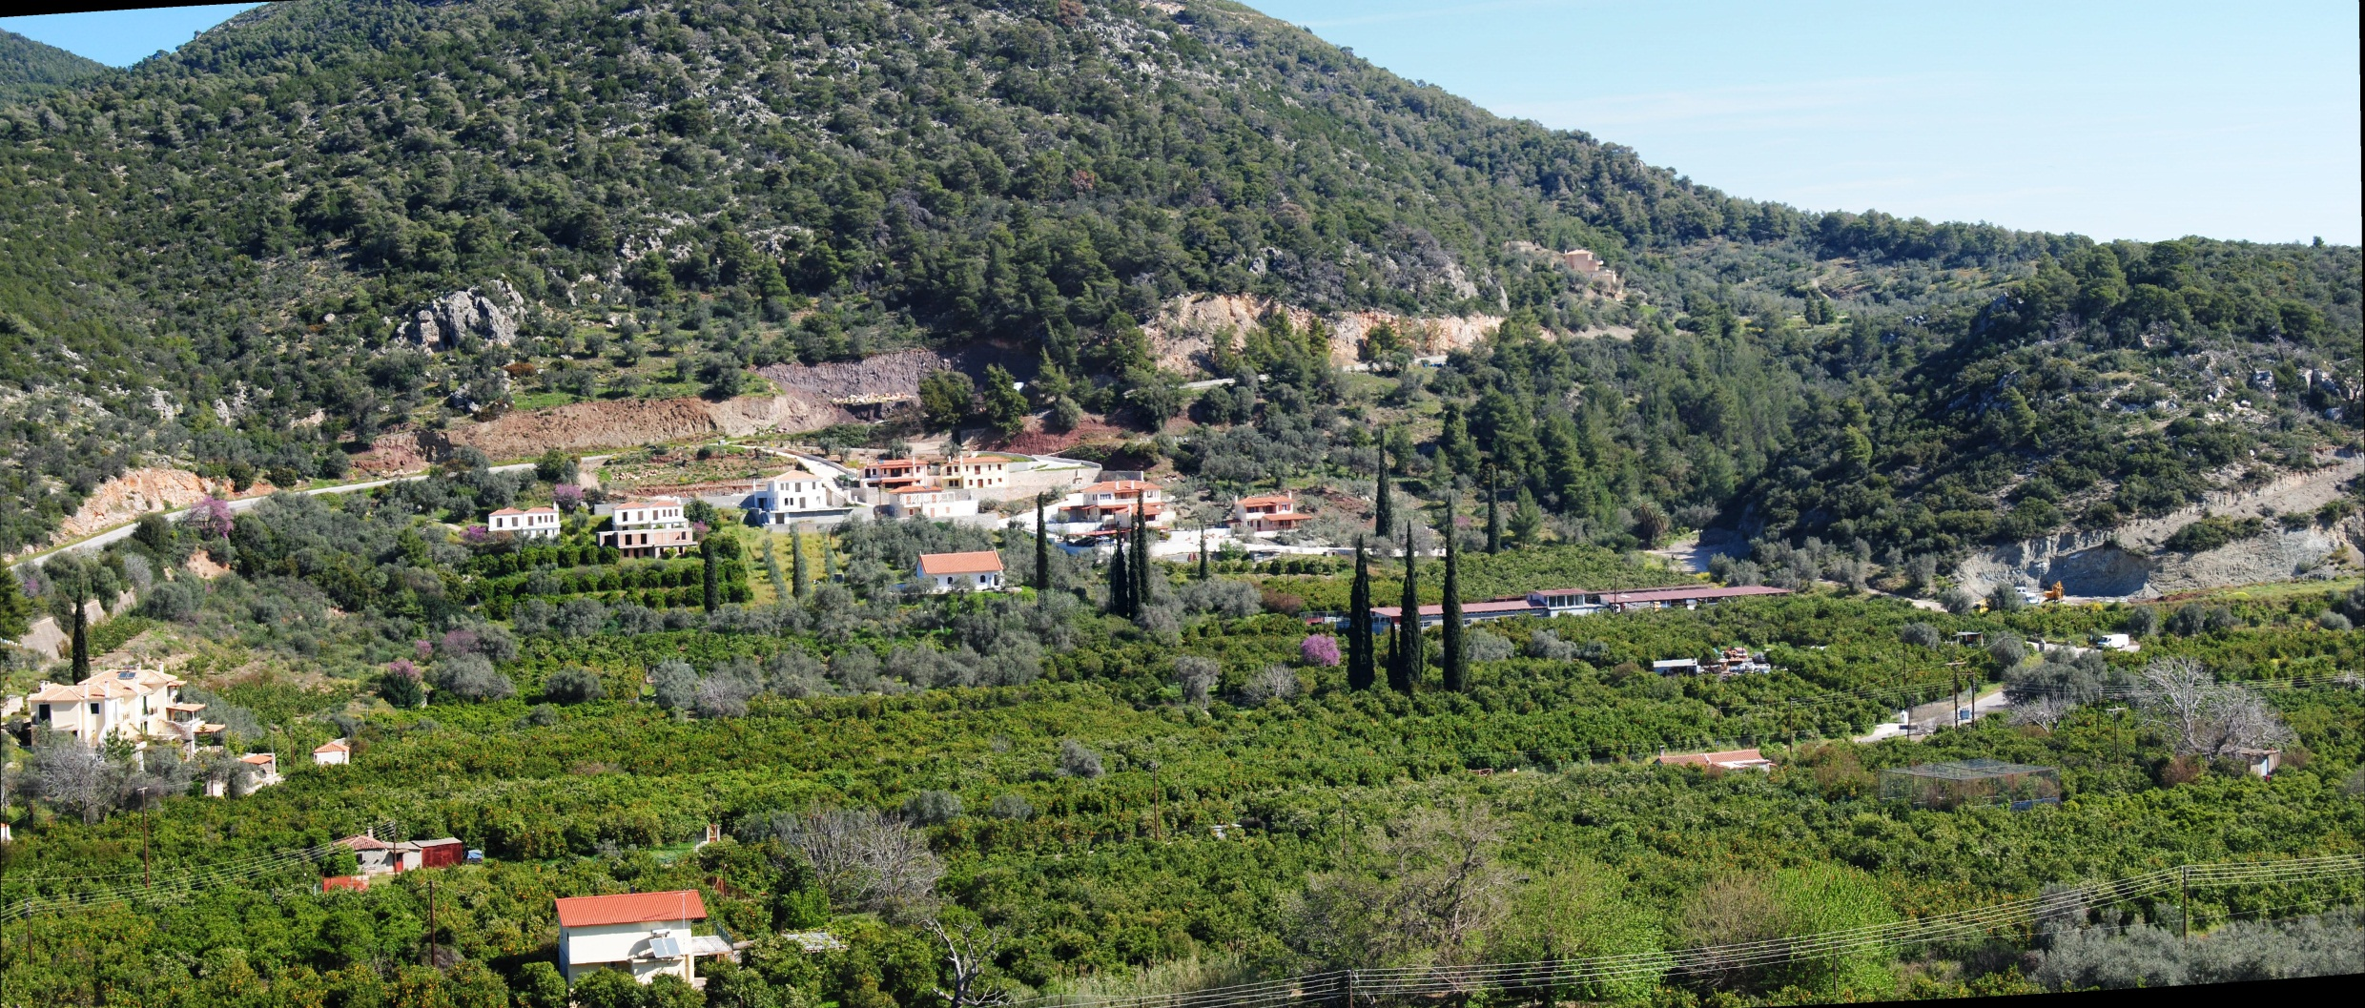
Talkin’ landscapes

Slide 7
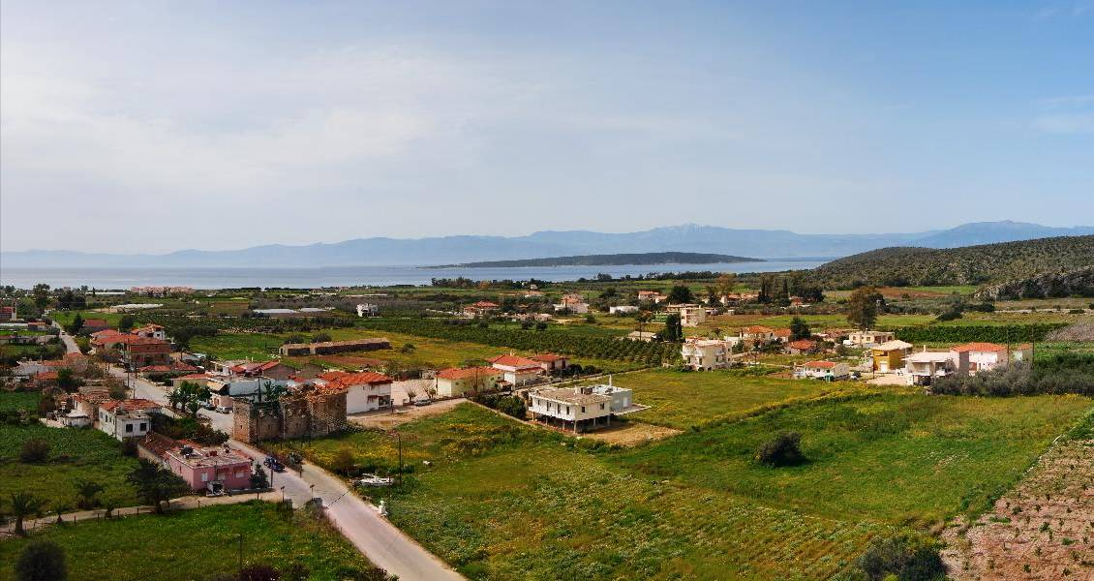
Talkin’ landscapes

Slide 8
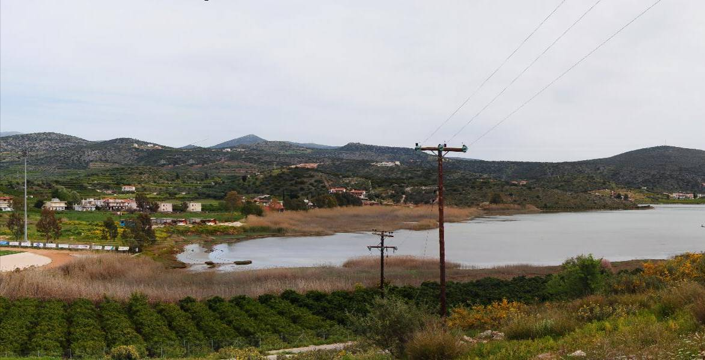
Talkin’ landscapes

Slide 9
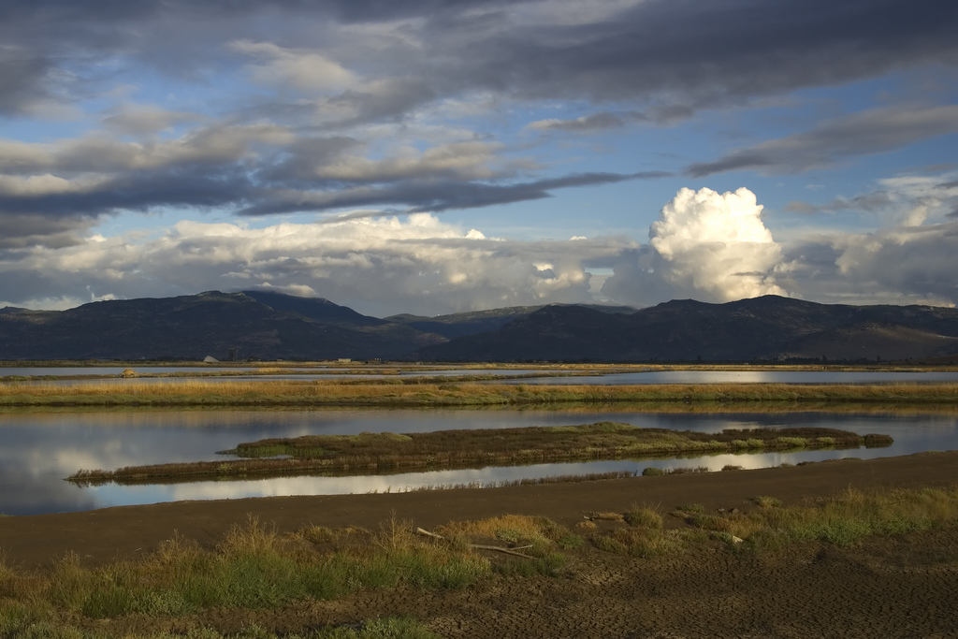
Talkin’ landscapes
Notes:
Αλυκή λέσβος

Slide 10
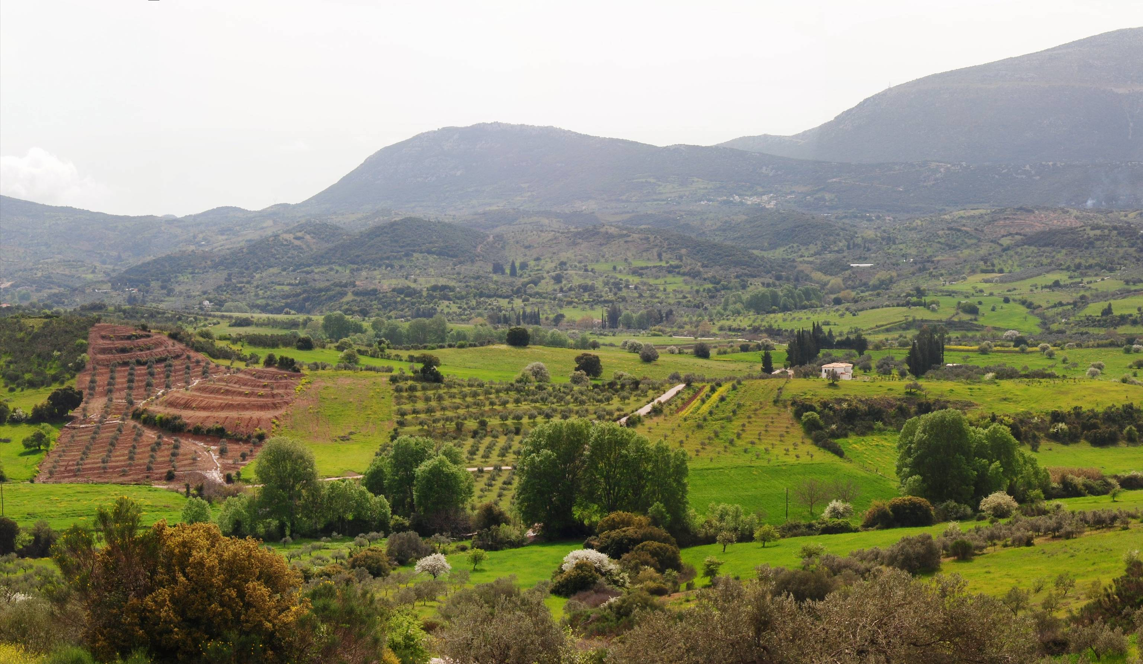
Talkin’ landscapes

Slide 11
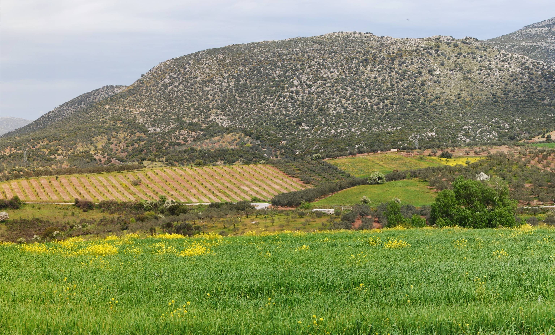
Talkin’ landscapes

Slide 12
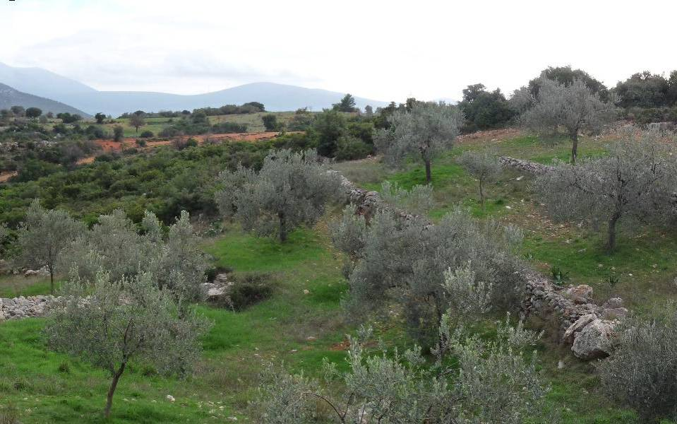
Talkin’ landscapes

Slide 13
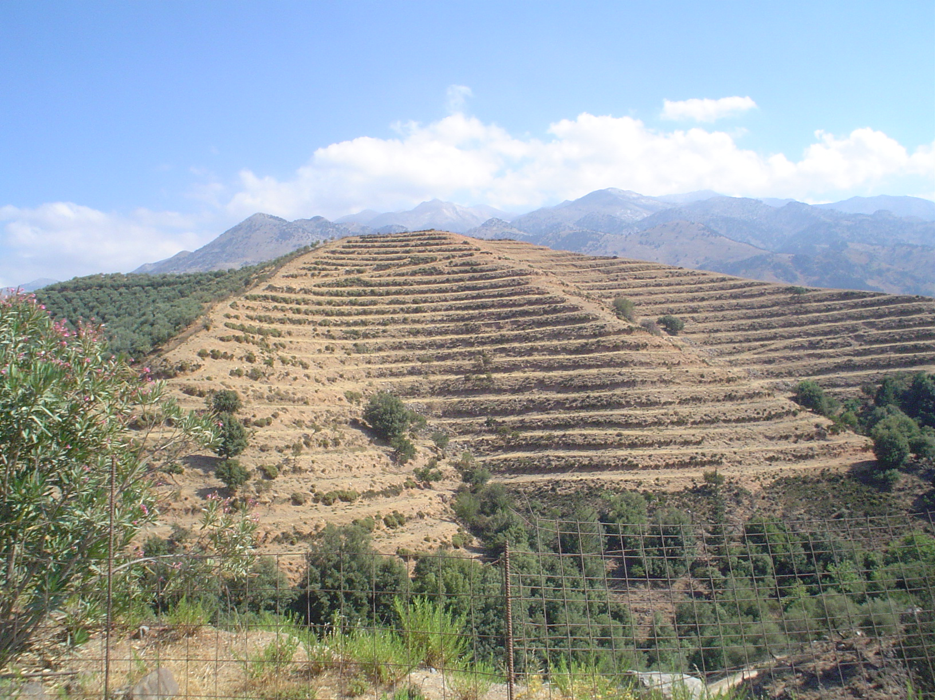
Talkin’ landscapes

Slide 14
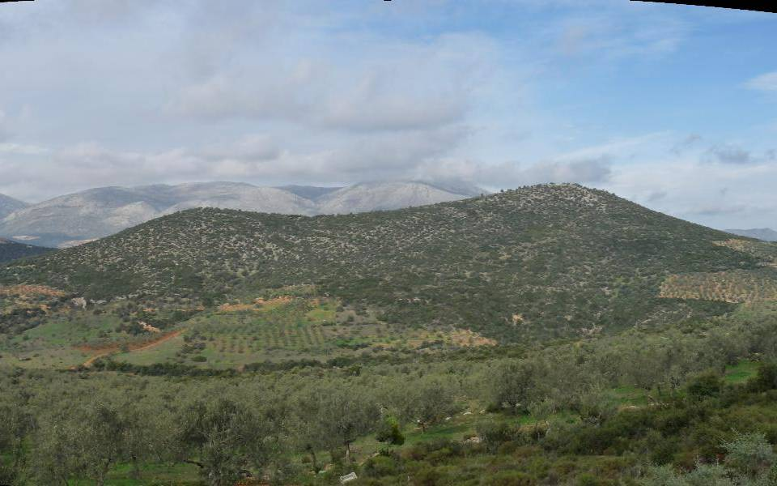
Talkin’ landscapes

Slide 15
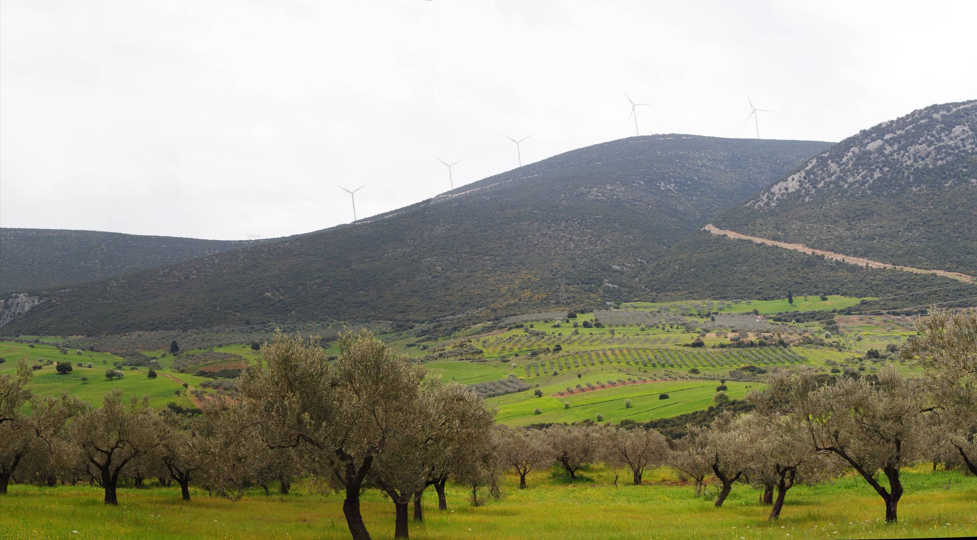
Talkin’ landscapes

Slide 16
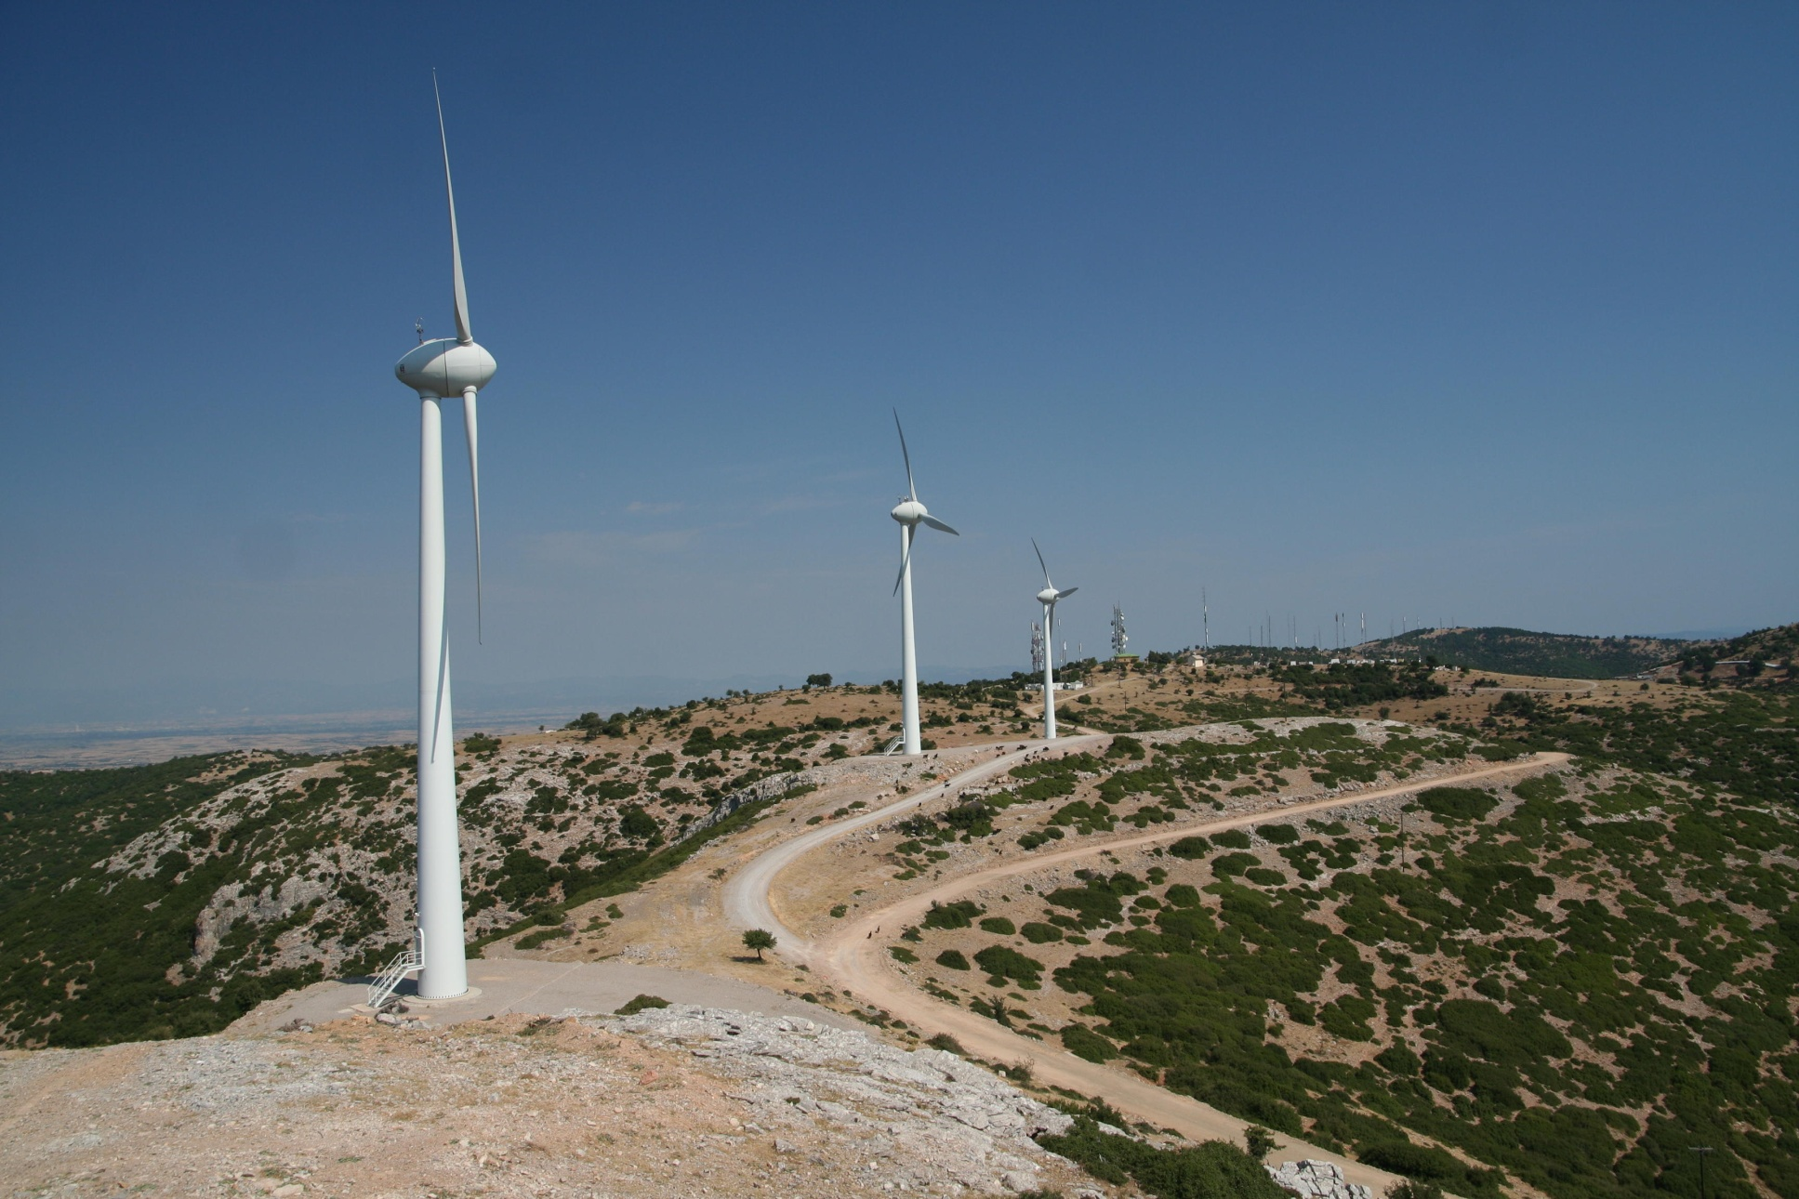
Talkin’ landscapes

Slide 17
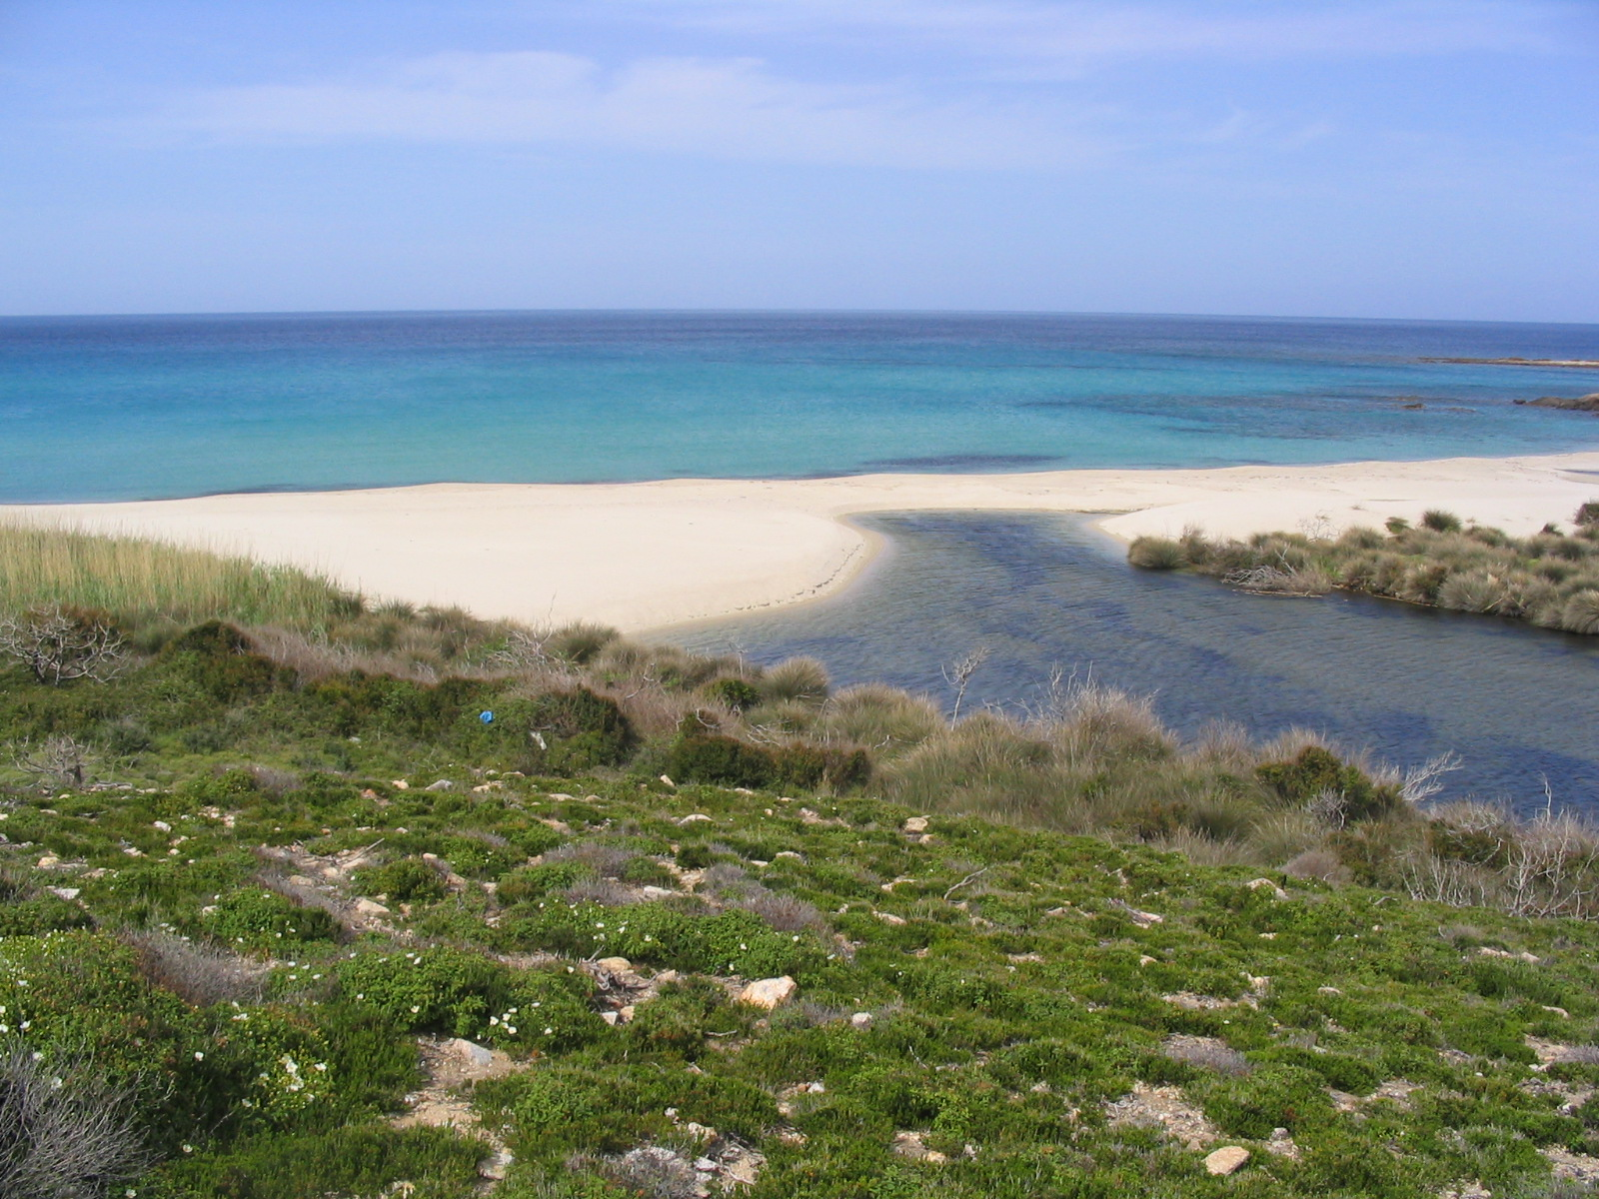
Talkin’ landscapes

Slide 18
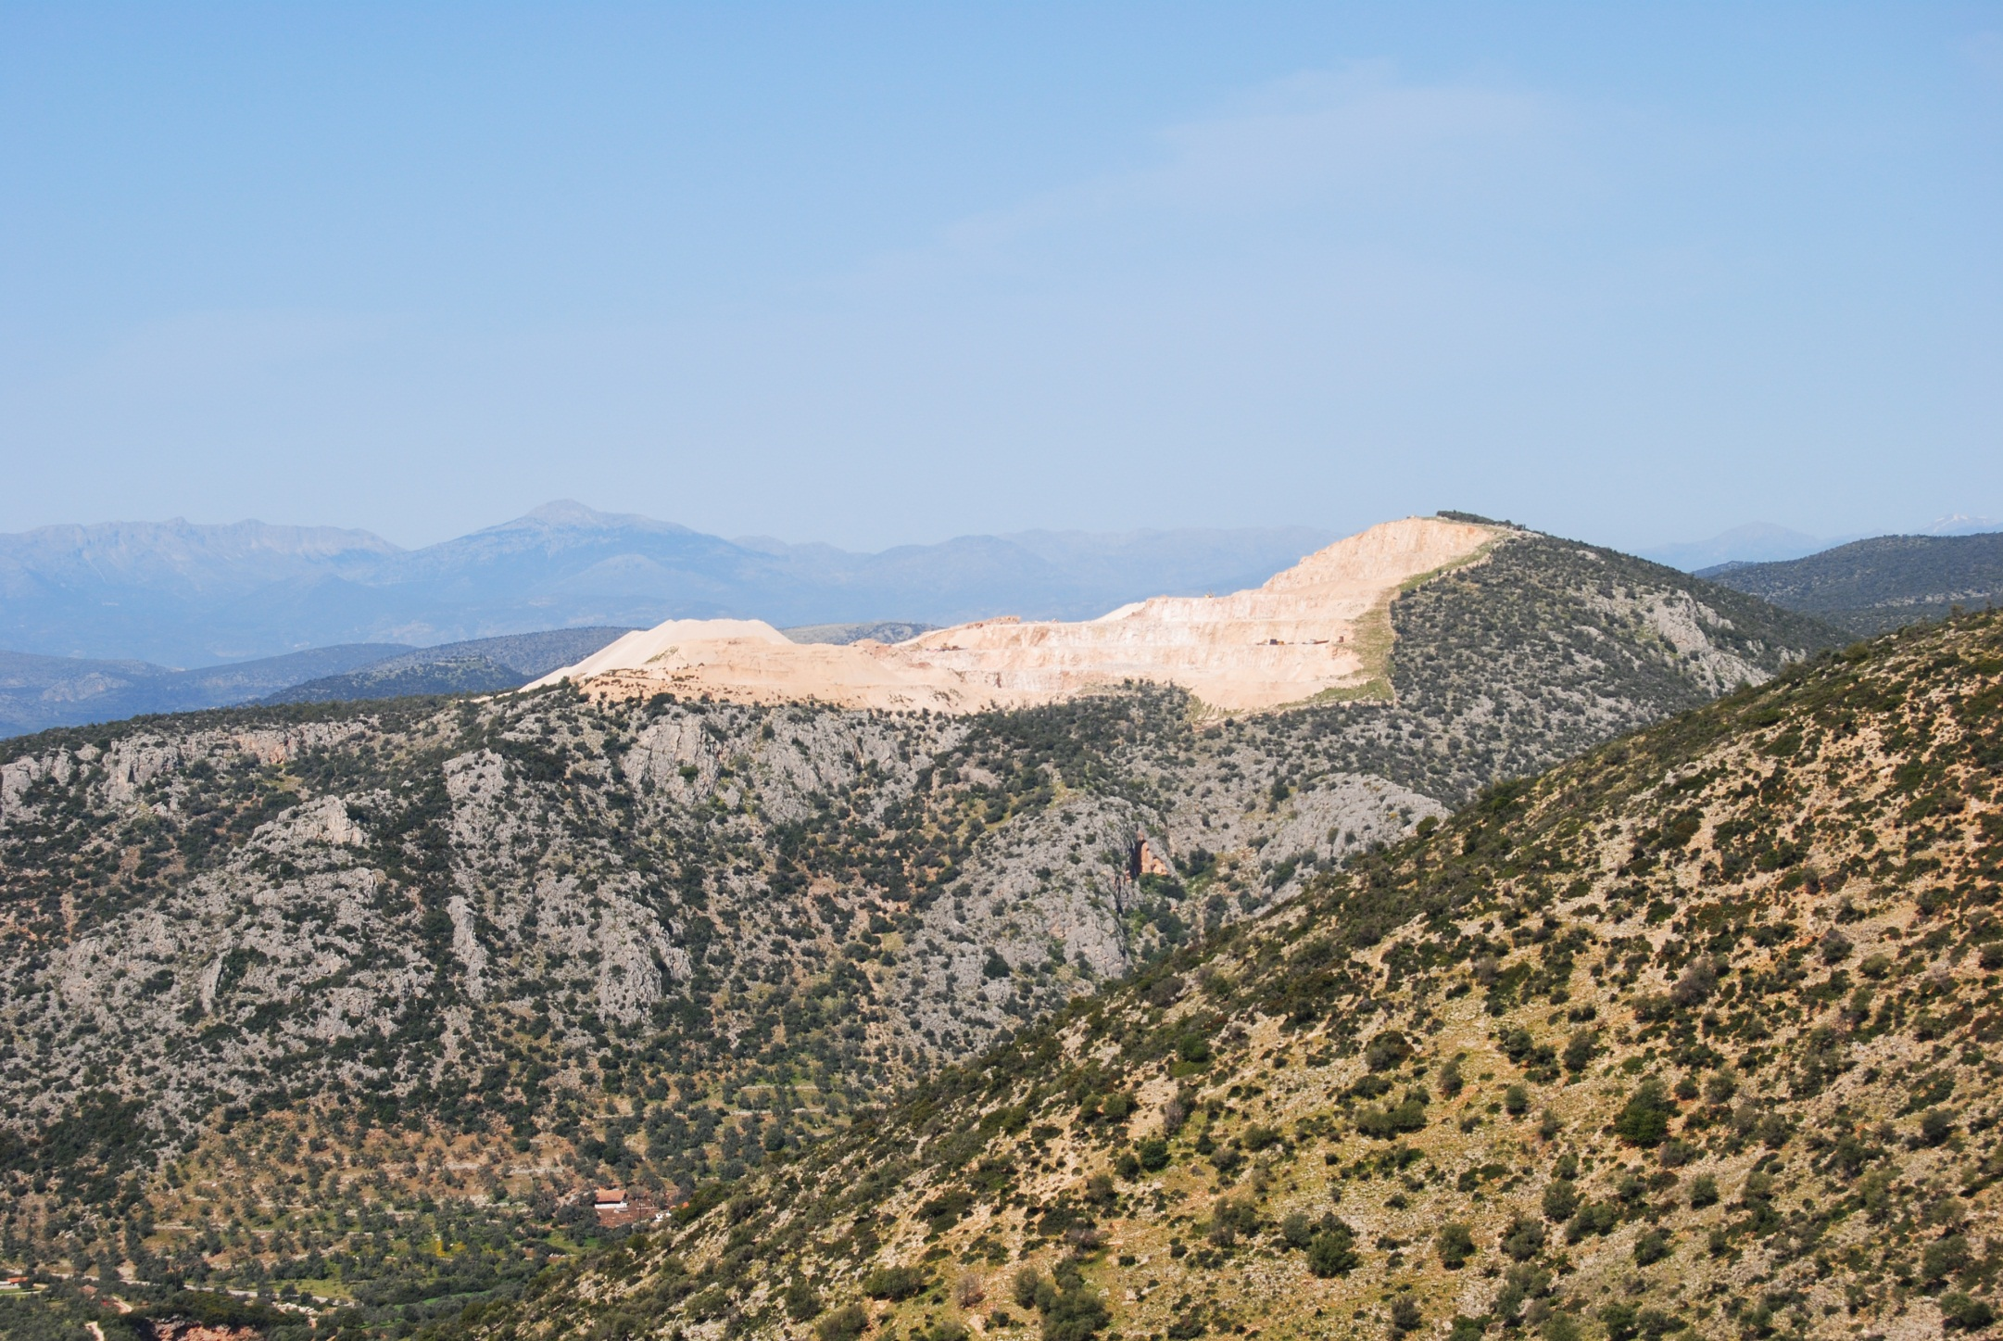
Talkin’ landscapes

Slide 19
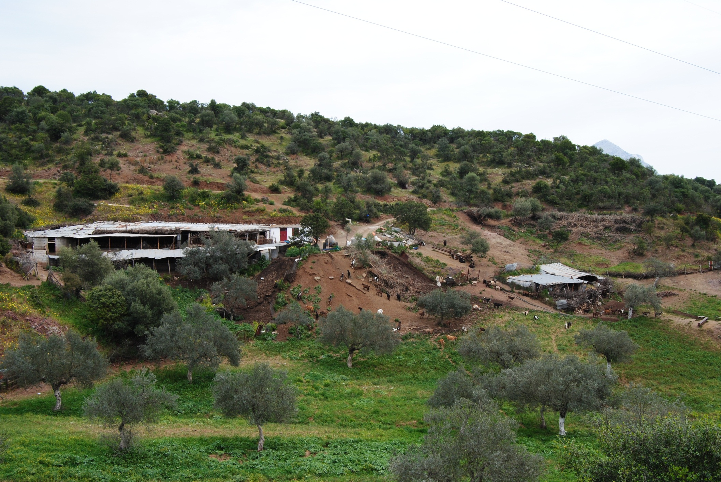
Talkin’ landscapes

Slide 20
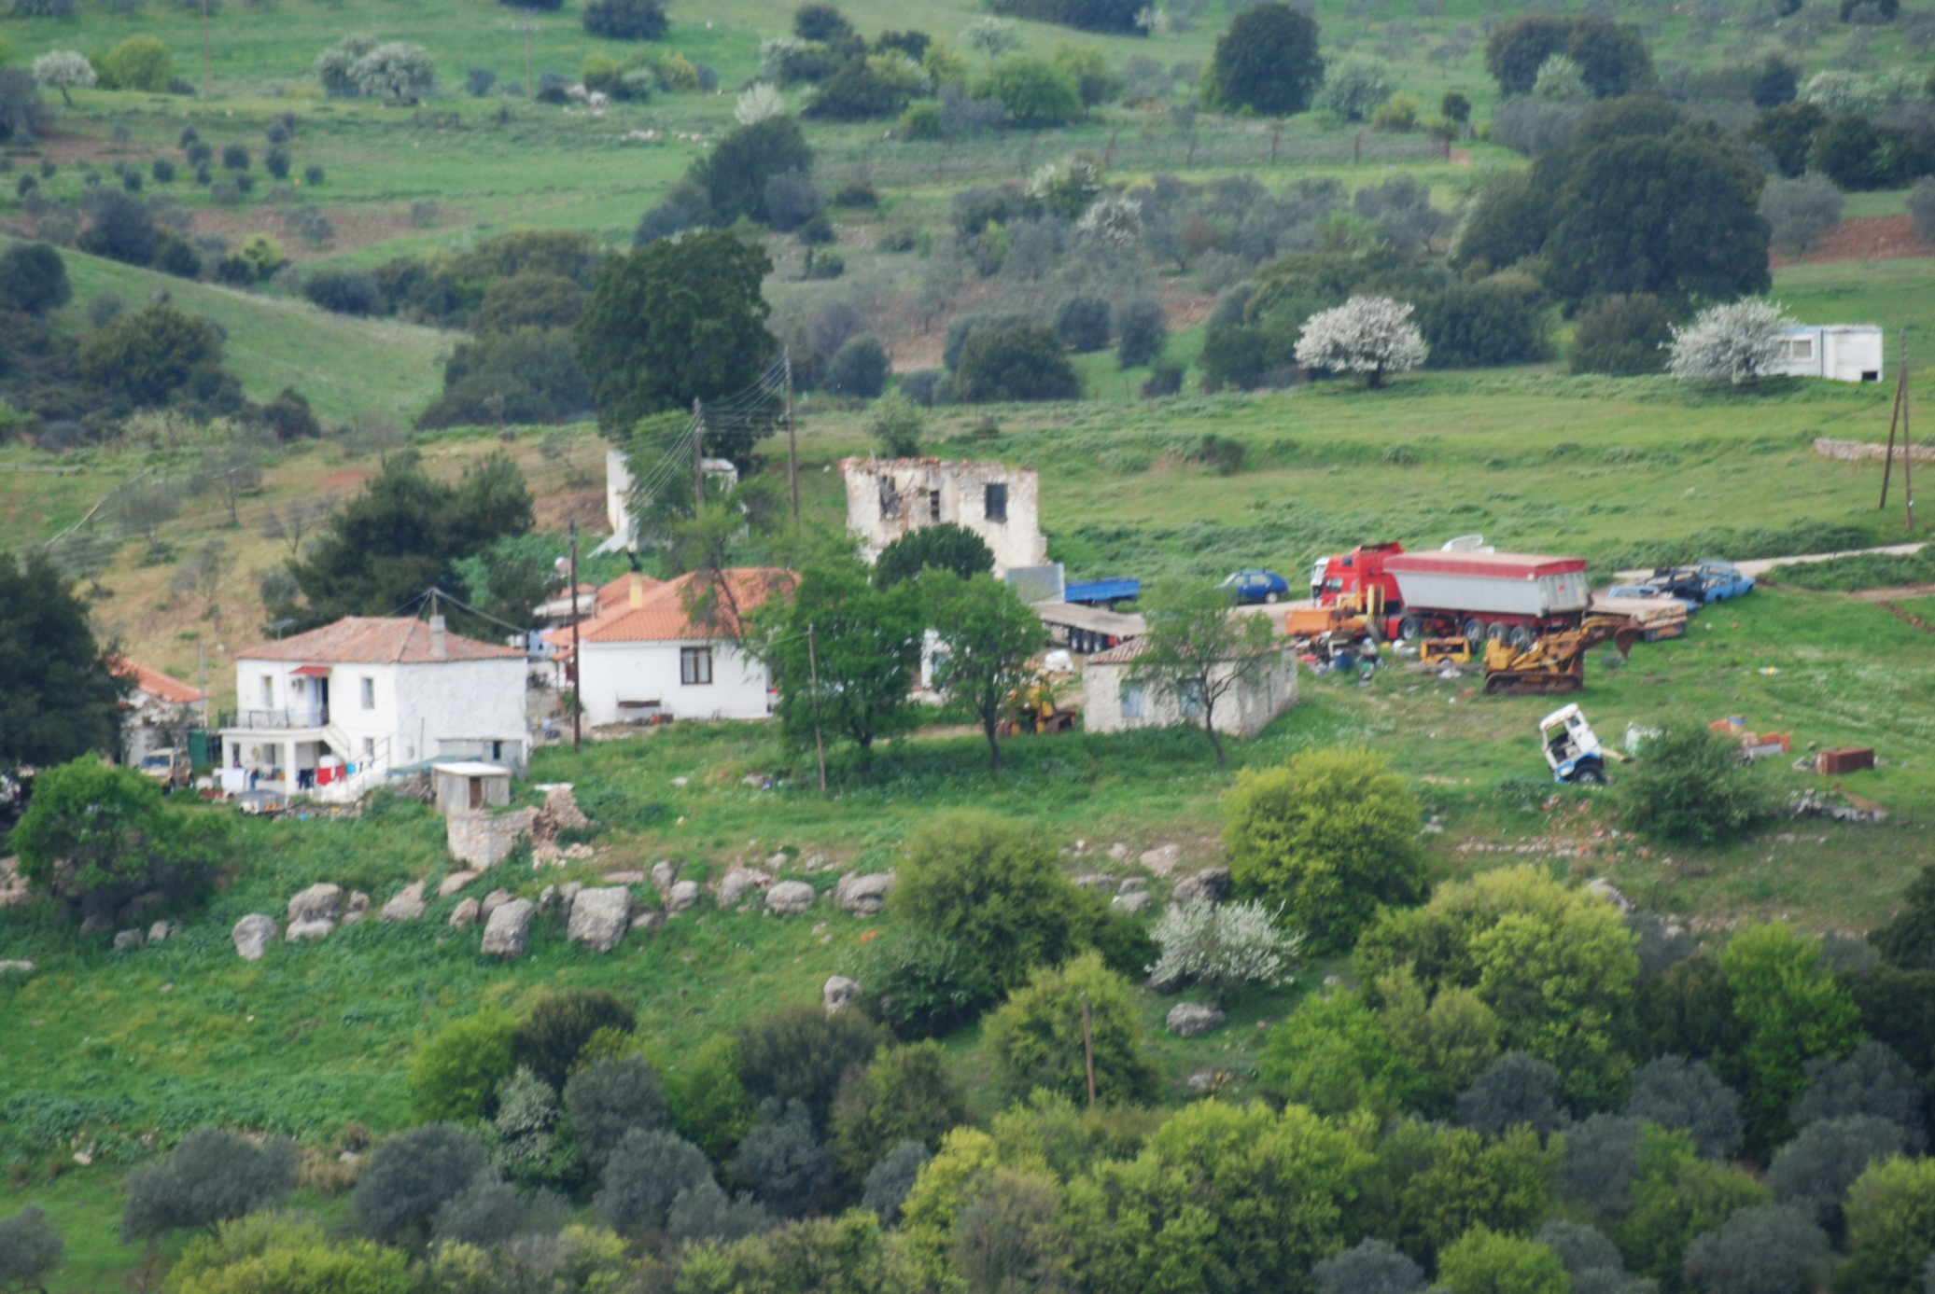
Talkin’ landscapes

Slide 21
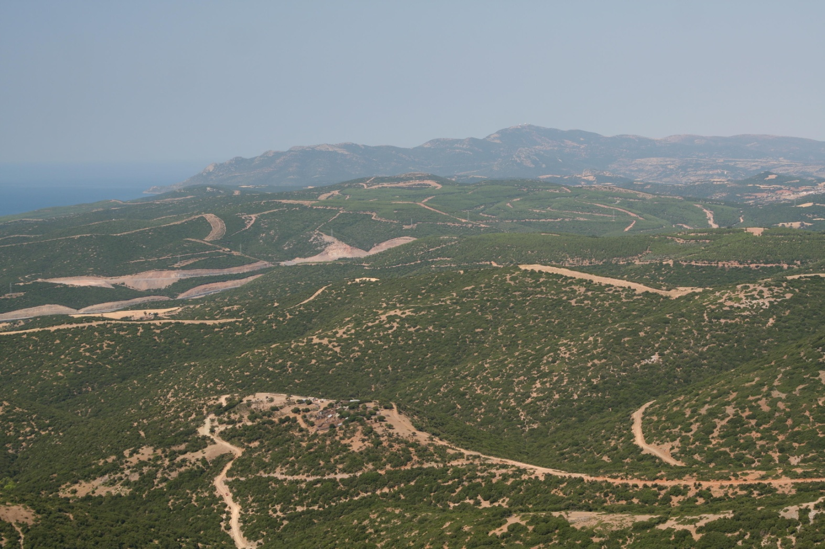
Talkin’ landscapes

Slide 22
Impacts on landscapes
Three basic understandings:
Landscape conservation vs Landscape ecology
Land cover vs Land use
Sustainability and resilience (the critical factors)

Slide 24
Impacts on landscapes
Two main types of impacts on landscapes:
1. Impacts on the character of the landscape
2. Impacts on the functions of the landscape

Slide 26
Impacts on landscapes
Impacts on the character of the landscape:
1. Visual / aesthetic
2. Cultural / historical
3. Subjective – matter of perception

Slide 27
Impacts on landscapes
Impacts on the function of the landscape:
1. Ecology / biodiversity
2. Ecosystem services
3. Economic
4. Generally objective – can be assessed based on scientific facts

Slide 28
Impacts on landscapes
Impacts may be:
1. Direct: directly caused by a specific action/policy
2. Indirect: driven by an action/policy but not directly caused by it
3. Induced: seemingly irrelevant to an action/policy but actually fostered or promoted by it

Slide 29
Understanding Policy impacts
Exercise 1: Map policy impacts against this matrix
For the following actions / policies:
Corridor / Highway / road construction
Agricultural support policies
Tourism development
Renewable energy development
Impact | Landscape Character | Landscape function
Direct
Indirect
Induced

Slide 30
Understanding Policy impacts
Exercise results:
Presentation
Discussion of findings
Grouping of Impacts
Mapping policy interrelations

Slide 31
Landscape character
 | DIRECT | INDIRECT / INDUCED
R.E.S. | Visual (actual installations) L:oss of vegetation Changes in relief Sound landscape | Long term access driving change in uses Loss of traditional RES systems
M. Tourism | Visual (mass tourism – construction) | Abandonment of other landscapes Cultural change Change of local identity Preservation of local history
2nd homes | Dispersed or condensed development Revitalization of traditional structures | Fragmentation of landscape
Alt. tourism | Preservation of cultural landscape | Restoring of the place Commodification of landscape Loss of values
Agri subsidies | Visual (changes in crops) Land-use changes | Loss of Biodiv. (homogeneous landscape) Farmers identity (strenghtening or loss – depending) Monocultures Uneven regional development patterns Construction of farming infrastructures Restriction of freedom in farmers choice
Roads | Visual (actual installations) L:oss of vegetation Changes in relief Sound landscape Quarries / depositories Dust pollution | Soundscape Land-use changes cross roads Physical barriers Tourism development – knowledge of place Landmarks (traffic servicing stations)
Understanding Policy impacts

Slide 32
Understanding Policy impacts
Landscape Function
 | DIRECT | INDIRECT / INDUCED
R.E.S. | Fragmentation, disturbance (windfarms only) Economic gain Soil erosion (winfarms only) Soil sealing (PV only) Loss of agricultural land (PV only) | Economic loss (devaluation of land, loss of tourism prospects) Increased access leading to: wildfires, increased grazing, poaching (loss of vegetation/biodiv)
Mass tourism | Economic income Loss of biod Income – Employment | Attraction of investors
2nd homes | Revitalization of local economy | Land-values higher Large scale recreation infrastructures
Alt. tourism | Protection of the environemnt Enhanced econ activity | Extension of ecosystem services Differentiated employment
Agri subsidies | Economic (production increased) | Loss of water (agri consumption / irrigation) Increase of employment (lowlands) Desertion (uplands) Soil erosion Corruption (subsidy management system)
Roads |  | Economic +/- Loss of biodiv. Fragmentation Land-use Access Land resources used Soil erosion Prevention of wildfires land-value +/- Increased employment - different jobs (expert temporary) Growth of networks

Slide 33
Understanding Policy impacts
Landscape Function
IMPACT | POLICY RESPONS

Slide 34
Understanding Policy impacts
Exercise 2: Identifying drivers and changing policies
For each group of indirect or induced impacts mapped and analyzed, identify the main drivers behind it.
And then revisit policy:
How should the policy have been better designed in the first place
What accompanying policy measures should be taken to ameliorate impacts on landscapes

Slide 35
Understanding Policy impacts
Exercise results:
Presentation
Discussion of findings
Identifying main groups of necessary accompanying policy measures

Slide 42
Talkin’ landscapes

Slide 43
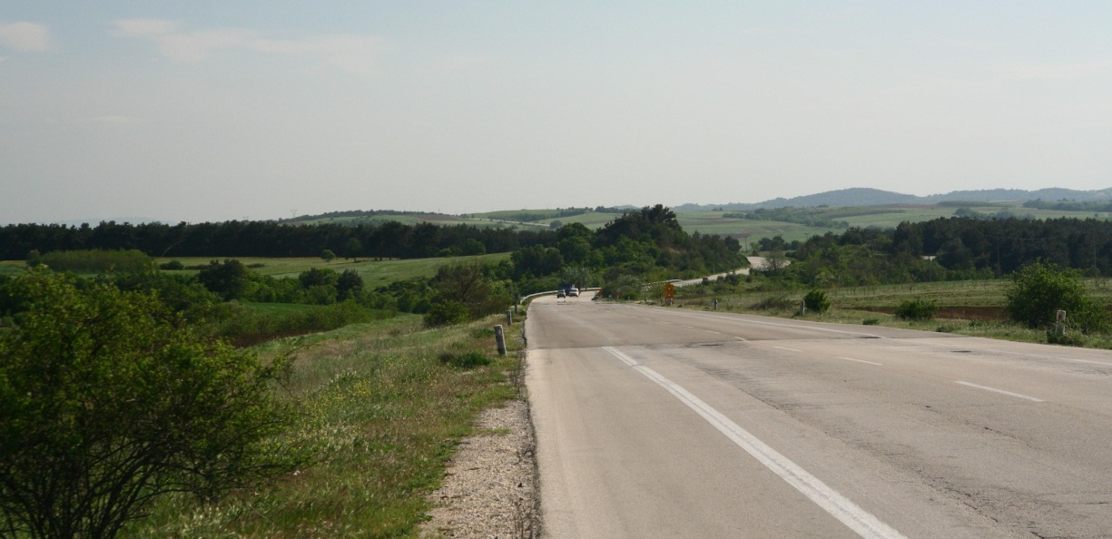
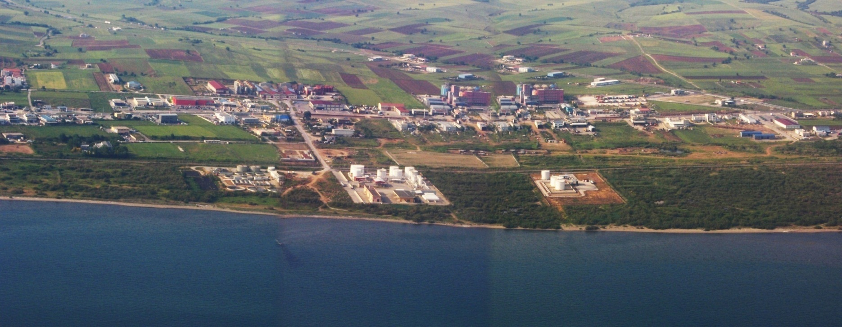
Talkin’ landscapes

Slide 44
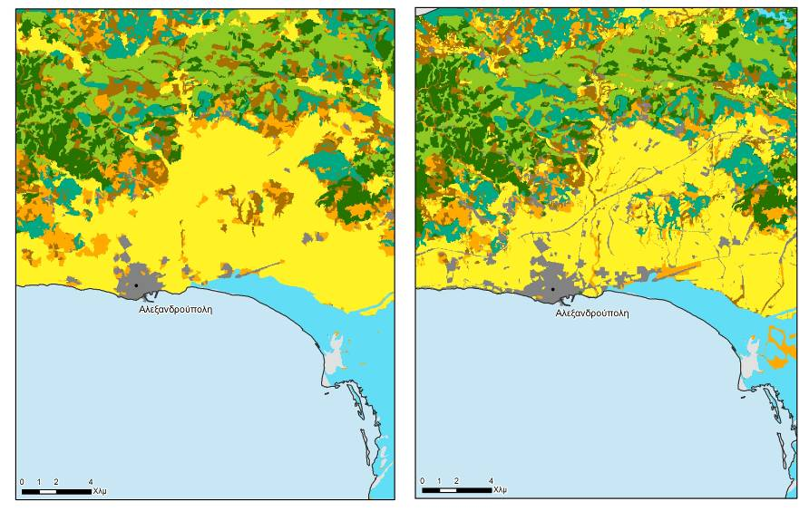
Revisiting landscapes

Slide 45
Revisiting landscapes

Slide 46
Revisiting landscapes

