Slide 1
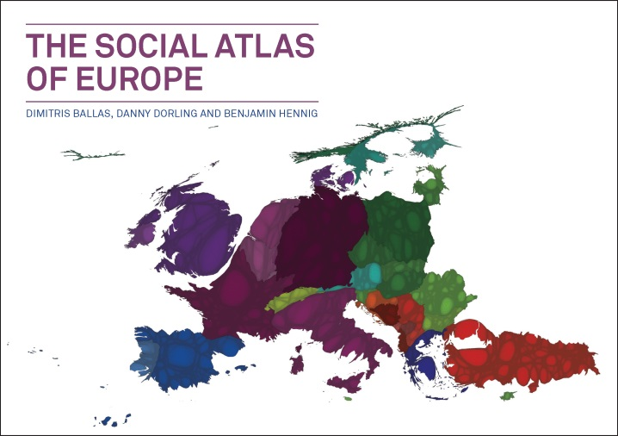

Slide 2
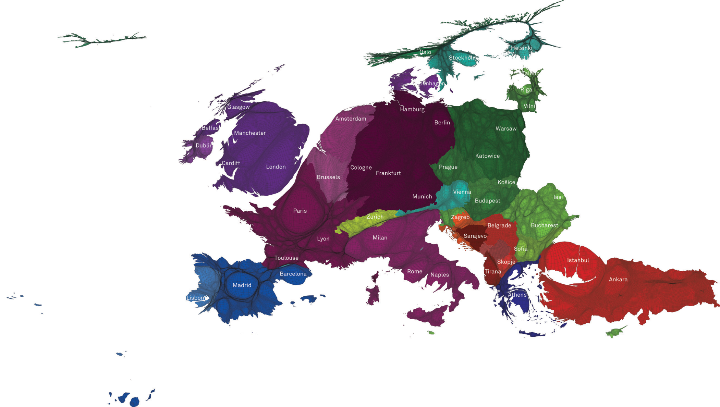

Slide 3
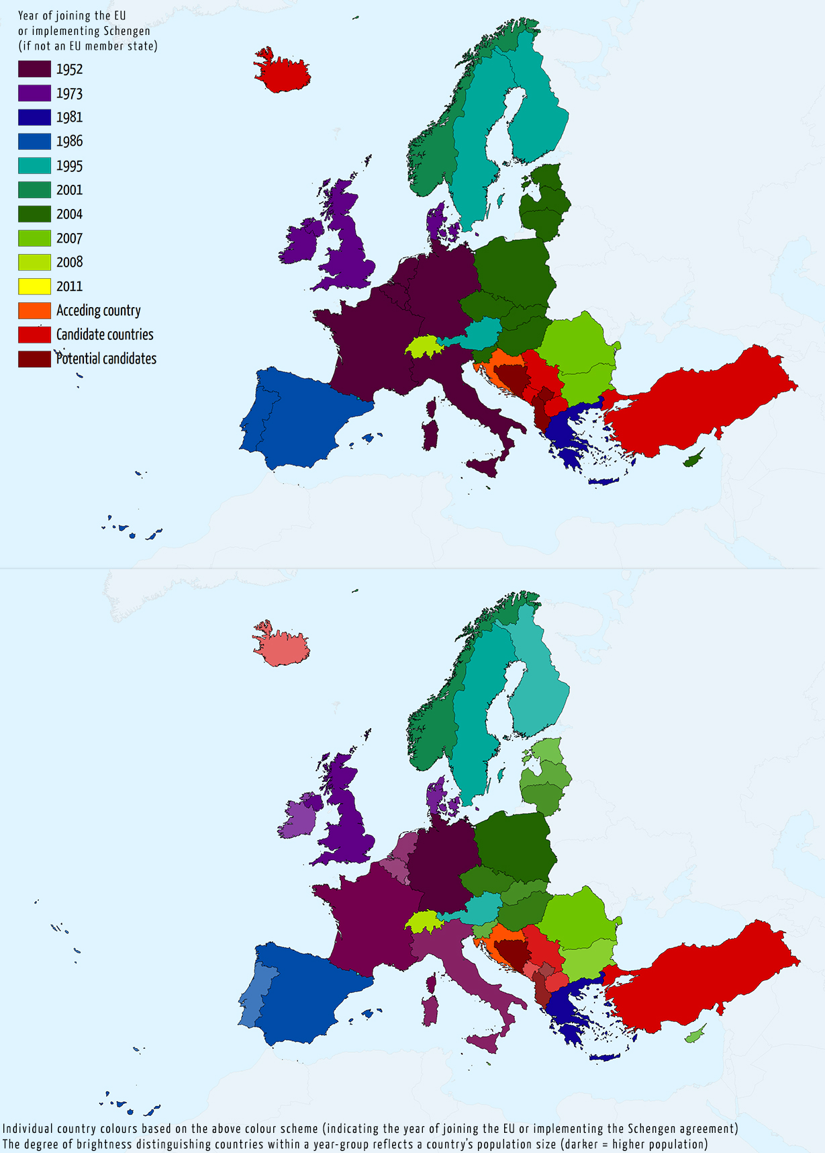

Slide 6
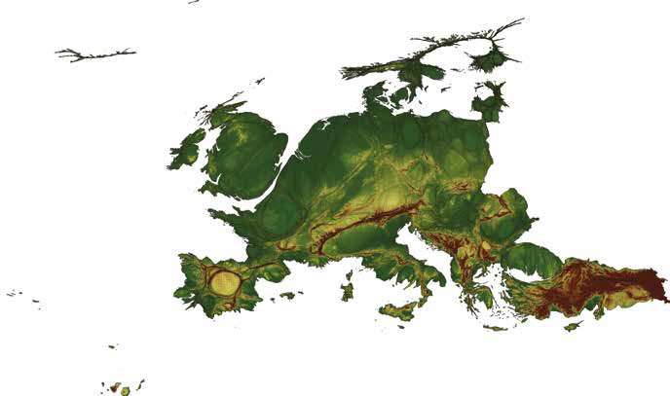
Gridded population cartogram representation
of the topography of Europe

Slide 7
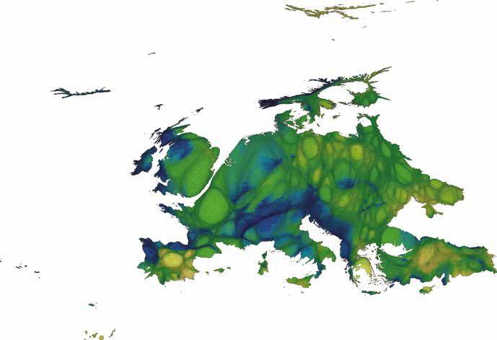
Annual precipitation

Slide 8
The EU has delivered half a century of peace, stability, and prosperity, helped raise living standards and launched a single European currency, the euro and is progressively building a single Europe-wide market in which people, goods, services, and capital move among Member States as freely as within one country
European Commission, 2012a

Slide 9
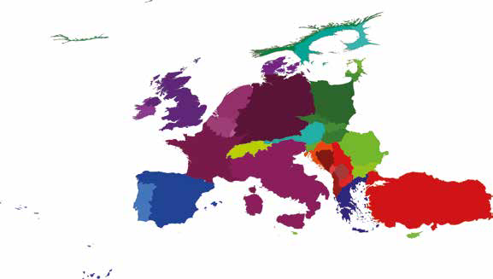
Can the death penalty be justified? Never

Slide 10
Article 2 Right to life
1. Everyone has the right to life.
2. No one shall be condemned to the death penalty, or executed.
Charter of Fundamental Rights of the European Union, 2007/C 303/01

Slide 11
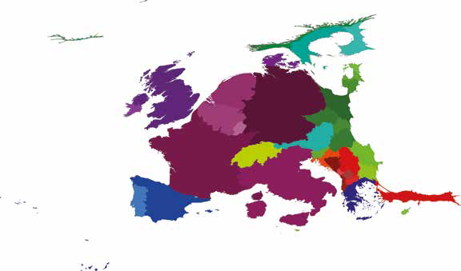
MAP 2.009 – WHICH GEOGRAPHIC GROUP DO YOU FEEL YOU BELONG TO MOST? Distribution of people who feel that they belong most to Europe

Slide 12
Europe is a thought that needs to become a feeling.
Bono, addressing delegates at the European People’s Party Congress in Dublin, 7 March 2014 (RTE, 2014)

Slide 13
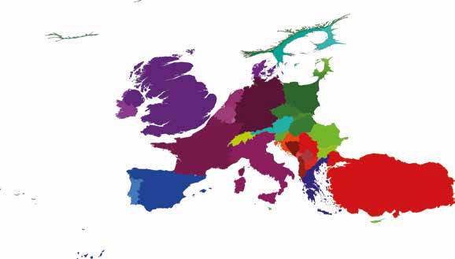
MAP 2.010 – ARE YOU AFRAID OF LOSING YOUR NATIONAL IDENTITY/CULTURE? Distribution of people who feel ‘very much afraid’ of losing their national identity/culture

Slide 14
People learn how to appreciate peace. Croatian people know that the European Union is the guarantee for that peace.
Drazen Gregurevic, Deputy Mayor of Zadar, Croatia, the 28th member of the EU as of 1 July 2013 (BBC News,2013a)

Slide 15
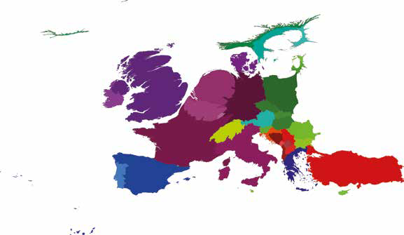
MAP 2.011 – TAKING ALL THINGS TOGETHER, HOW HAPPY ARE YOU? Distribution of Europeans who consider themselves ‘very happy’

Slide 16
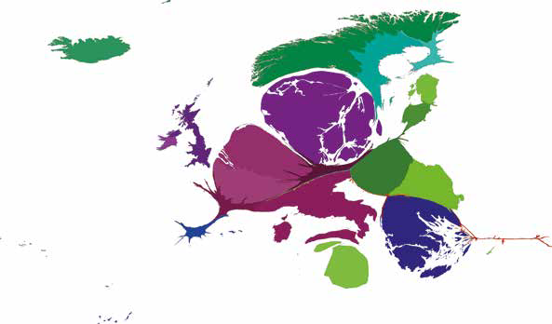
MAP 2.015 – TOTAL VOTES RECEIVED,
EUROVISION SONG CONTEST 2013

Slide 17
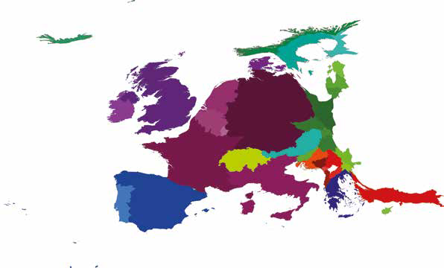
MAP 3.024 – POPULATION BORN OUTSIDE
THE COUNTRY OF RESIDENCE, 2010

Slide 18
For a century from around the middle of the 19th century, Europe’s dominant experience was mainly to send people to other continents, not to receive migrants. Only in the last half century has the net movement reversed, and since the 1980s another radical change has occurred: Greece, southern Italy, Spain and Portugal, which through most of the 20th century were regions of rural depopulation and emigration to northern Europe, the Americas and Australia, have become regions of return migration and of immigration from eastern Europe and other continents.
Warnes et al, 2004, p 311

Slide 19
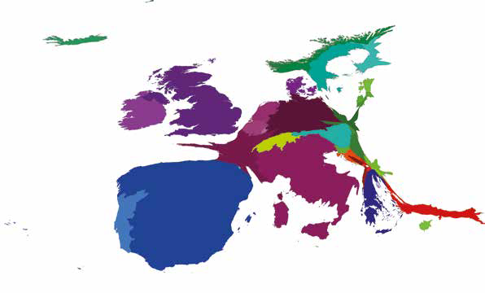
MAP 3.025 – POPULATION BORN OUTSIDE THE
COUNTRY OF RESIDENCE,INCREASE 2000–10

Slide 20
Is it not the case that without immigrants, the women in your country would grow moustaches, because you would have ended up marrying your first cousins?
Bulgarian TV interview question to Nigel Farage, leader of the UK Independence Party, broadcast by Channel 4 (YouTube, 2013)

Slide 21
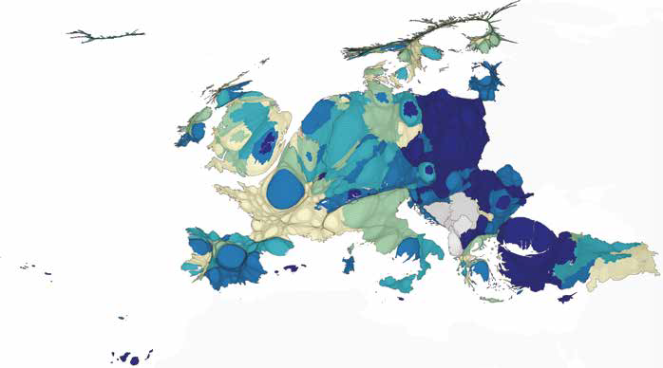
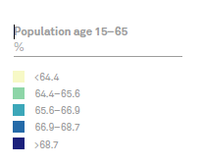
MAP 3.020 – POPULATION AGED 15–65
AS A PERCENTAGE OF TOTAL POPULATION, BY REGION

Slide 22
“In all EU member states, the proportion of older people has increased in recent decades, because of a combination of low fertility and longer life expectancy. However, there are some variations between countries and time periods in the contributions of these factors.”
Rechel et al, 2013, p 1312

Slide 23
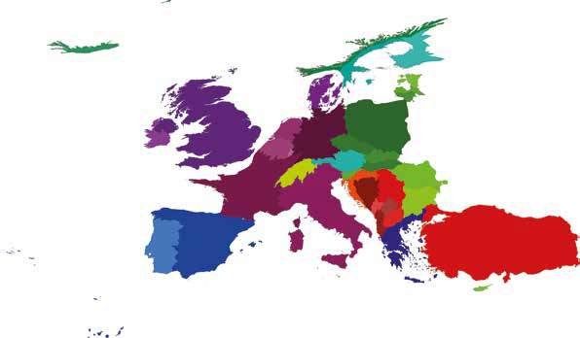
MAP 4.028 – POPULATION WITH, AT MOST,
PRIMARY EDUCATIONAL ATTAINMENT

Slide 24
Around one in seven children leave school or training early and this has an impact on individuals, society and economies... Early leavers from education and training and tertiary educational attainment are headline indicators for the Europe 2020 strategy. European Commission, 2013c

Slide 25
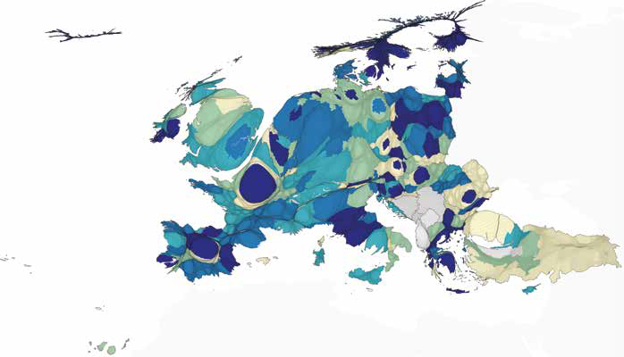
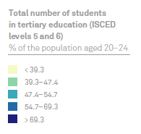
MAP 4.033 – TOTAL NUMBER OF STUDENTS IN TERTIARY
EDUCATION, AS A PERCENTAGE OF THE POPULATION
AGED 20–24 YEARS, BY NUTS 2 REGIONS, 2010

Slide 26
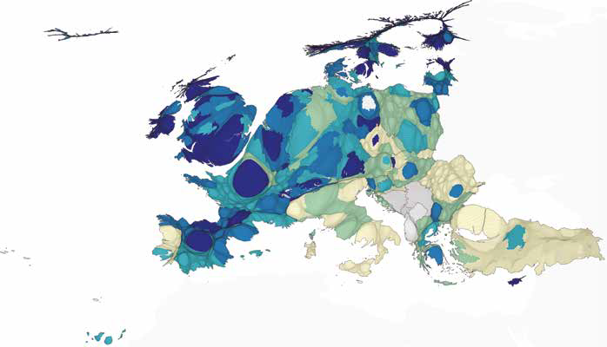
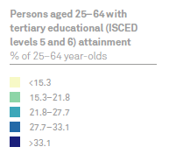
MAP 4.034 – PEOPLE AGED 25–64 YEARS WITH TERTIARY
EDUCATIONAL ATTAINMENT, BY NUTS 2 REGIONS, 2010

Slide 27
All European citizens should benefit from high quality education and training – irrespective of where they live. It is time to deliver on the commitments which have been made. Tackling geographic inequality in education is a pre-requisite for balanced regional development and social cohesion. The European Structural Funds can and should be used to help address inequalities.
Androulla Vassiliou, European Commissioner for Education, Culture, Multilingualism and Youth,cited in a press release (European Commission, 2012c)

Slide 28
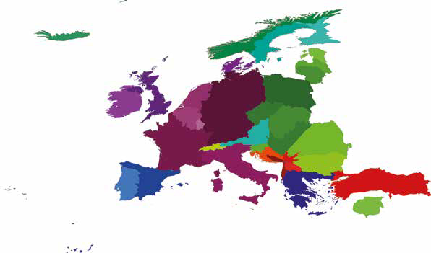
MAP 4.032 – STUDENT MOBILITY: NUMBERS OF OUTGOING STUDENTS

Slide 29
Until recently, a UK student on a European campus could bank on modest celebrity status. They were a rare breed, and sightings at the library, lecture hall or bar caused quite a stir. But that’s all changing. Although full-time UK students are still fairly unusual at universities throughout Europe, more and more are heading beyond the Channel for their degree.
Moore, 2014

Slide 30
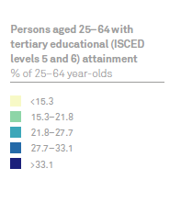
MAP 4.034 – PEOPLE AGED 25–64 YEARS WITH TERTIARY
EDUCATIONAL ATTAINMENT, BY NUTS 2 REGIONS, 2010

Slide 31
The UK’s young unemployed could form a dole queue stretching from London to Edinburgh, research by MPs and the Commons library has calculated. As MPs prepare to launch a new cross-party group dealing with youth unemployment, the figures suggest that out-of-work 16- to 24-year-olds could stand in a line that extends for 434 miles. This is equivalent to an area the size of Leeds, assuming each young person has 0.75 metres (2.5 feet) square to stand in.
Rowena Mason, political correspondent for The Guardian (Mason, R., 2014)

Slide 32
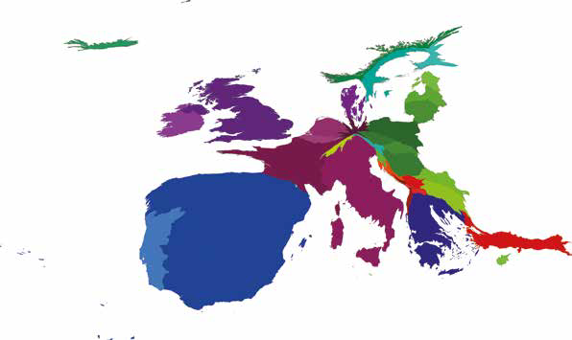
MAP 5.040 – NUMBERS OF UNEMPLOYED
PEOPLE: INCREASE BETWEEN 2007 AND 2012

Slide 33
Without work, educated young people lose their skills. Unable to enter training programs because of public expenditure cuts, they cannot obtain the skills which would underpin recovery should it occur. Out of work and out of school, they face lives of idle desperation in which criminality beckons as a false exit from destitution.
Weeks, 2013

Slide 34
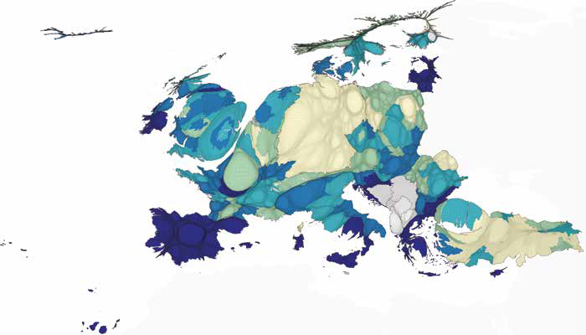
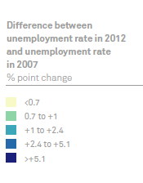
MAP 5.046 – UNEMPLOYMENT RATES BY REGION:
CHANGE BETWEEN 2007 AND 2012

Slide 35
Agriculture represents 10% of the European Union total GDP, and it plays an essential role in the European culture and environmental protection. Indeed, agriculture occupies a great part of the territory and helps maintain the lifestyle and economy of many rural areas.
Food and Water Watch Europe, 2014

Slide 36
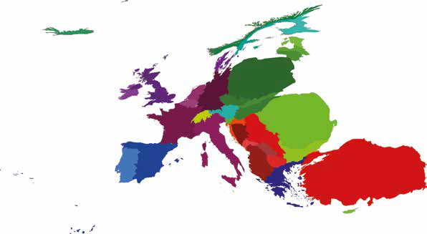
MAP 6.048 – PEOPLE WORKING IN
AGRICULTURE

Slide 37
Europe needs its real economy now more than ever to underpin the recovery of economic growth and jobs and it needs to reindustrialise for the 21st century. Immediate action should contribute to revert the current downward trend and to promote the re-industrialisation of Europe. Currently industry accounts for about 16% of EU GDP. Therefore, the European Commission has set its goal that industry’s share of GDP should be around 20% by 2020.
European Commission, 2014a

Slide 38
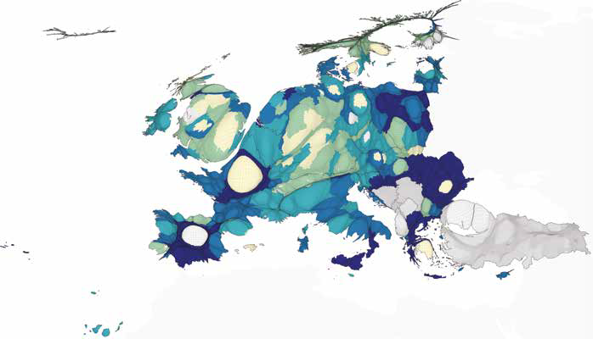
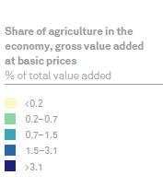
MAP 6.060 – SHARE OF AGRICULTURE IN THE ECONOMY,
BY NUTS 2 REGIONS (% of gross value added at basic prices)

Slide 39
… value added generated by agriculture 2010 was EUR 145.3 billion [in the EU27], and this was 2.3 % lower than it had been in 2005 (down from EUR 148.7 billion); during this period value added was volatile, peaking at EUR 156.5 billion in 2007 and falling as low as EUR 131.3 billion in 2009. Agriculture’s contribution to the value added of the whole economy fell from 1.5% in 2005 to 1.2% in 2009 before picking up to 1.3% in 2010.
European Commission, 2013d, p. 150

Slide 40
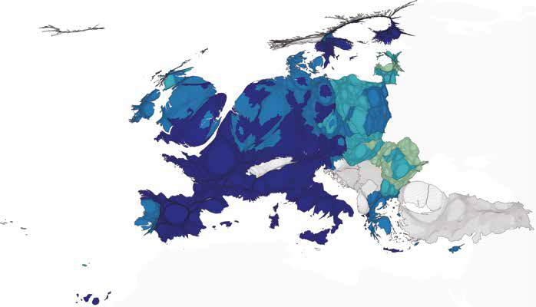
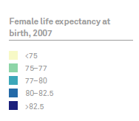
MAP 7.065 – FEMALE LIFE EXPECTANCY AT BIRTH, 2007

Slide 41
The EU has an enviably high life expectancy. In 2007, life expectancy at birth stood at 79 years in the EU compared to an average global expectancy of only 67 (UN). Outside Europe, only 6 countries in the world (Japan, Australia, Israel, Canada, New Zealand and Singapore) have a higher life expectancy.
European Commission, 2010, p 73

Slide 42
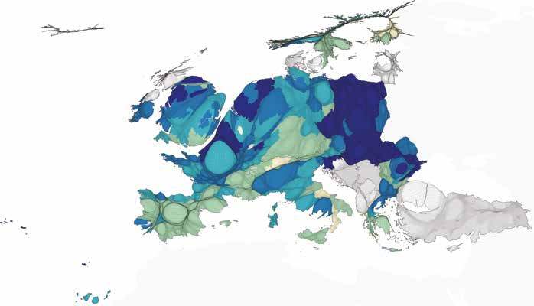
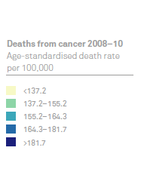
MAP 7.072 – DEATHS DUE TO CANCER
Age-standardised mortality rate per 100,000 inhabitants,
three years average (2008–10)

Slide 43
How can we prioritize the health needs of those that need health care the most? The answer is by going beyond needs and ensuring the right to health to everyone on this planet.
Beracochea et al, 2011, p 4 (emphasis in original)

Slide 44
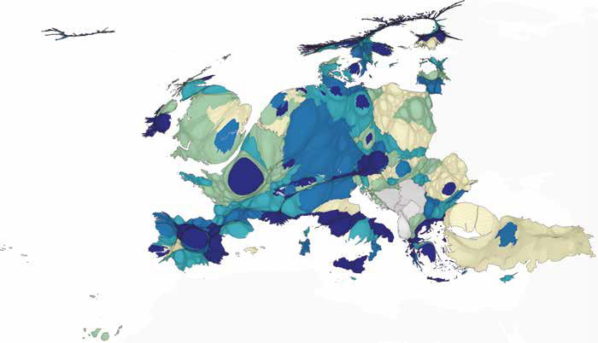
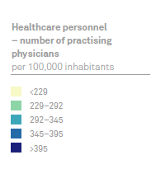
MAP 7.076 – NUMBER OF PRACTISING PHYSICIANS
(PER 100,000 INHABITANTS) BY NUTS 2 REGIONS

Slide 45
Among at least the longer standing EU Member States, there is a common model or approach to health care provision based on social solidarity and universal coverage.
Mossialos et al, 2010, p 1

Slide 46
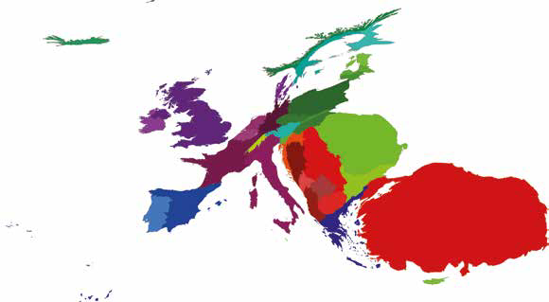
MAP 8.084 – ARMY RULE: IS IT A GOOD POLITICAL SYSTEM?
Distribution of Europeans agreeing that army rule is a very good political
system

Slide 47
At 57, the thrice-married mother of-three has long been a ubiquitous presence on the political landscape of Greece, a defining figure who began as the iconic ‘voice of the Polytechnic’ during the 1973 students’ revolt against the military dictatorship … Damanaki, who would spend seven months in prison after the regime crushed the rebellion, still bears the scars of that time. Memories of days spent in solitary confinement in a darkened cell at Athens’s notorious military police headquarters return to haunt her.
Smith, 2010, on Maria Damanaki, European Commissioner for Maritime Affairs and Fisheries

Slide 48
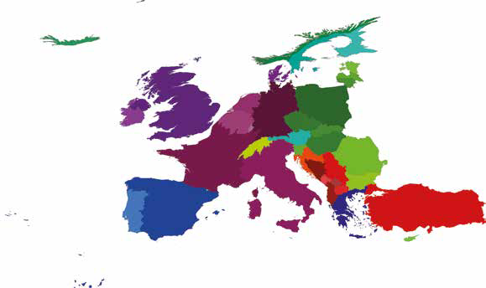
MAP 8.085 – HOW INTERESTED ARE YOU IN POLITICS?
Distribution of Europeans who are ‘not at all interested’ in politics

Slide 49
You don’t have to listen to my political point of view. But it’s not that I’m not voting out of apathy. I’m not voting out of absolute indifference and weariness and exhaustion from the lies, treachery, deceit of the political class that has been going on for generations now and which has now reached fever pitch where you have a disenfranchised, disillusioned, despondent underclass that are not being represented by that political system, so voting for it is tacit complicity with that system and that’s not something I’m offering up.
Russell Brand, interviewed by Jeremy Paxman, 27 October 2013 (Corrente, 2013)

Slide 50
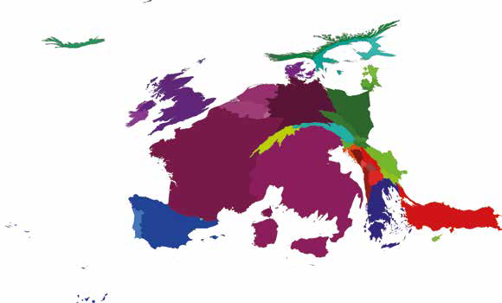
MAP 8.090 – HAVE YOU EVER OCCUPIED BUILDINGS/FACTORIES?
Distribution of Europeans who have taken part in an occupation of
buildings/factories

Slide 51
In the fall of 2011, the Occupy movement occupied the western media headlines for weeks. Photos showed activists – so-called Occupiers – and their tents on squares in major cities like New York, London,Tel Aviv and Amsterdam. Occupy was hot. What makes this movement so newsworthy?
Van Stekelenburg, 2012, p 224

Slide 52
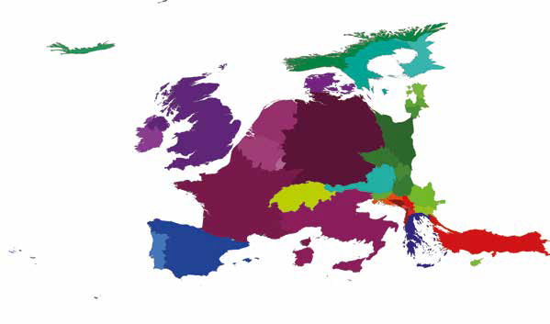
MAP 9.094 – GROSS DOMESTIC PRODUCT, 2012

Slide 53
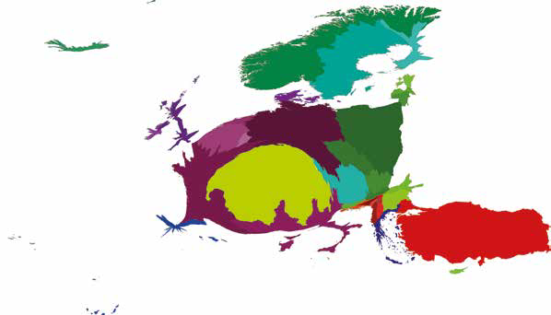
MAP 9.095 – GROSS DOMESTIC PRODUCT INCREASE,
2007–12 (Constant 2005 US$)

Slide 54
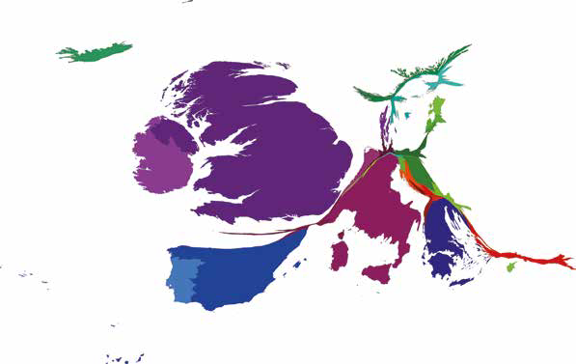
MAP 9.096 – GROSS DOMESTIC PRODUCT DECLINE,
2007–12 (Constant 2005 US$)

Slide 55
British workers’ wages have suffered one of the biggest falls across Europe, according to House of Commons figures. The average hourly wage has fallen by 5.5% since 2010 – even more than austerity-hit Spain, which has seen a 3.3% drop in the same period.
(Sky News, 2013)

Slide 56
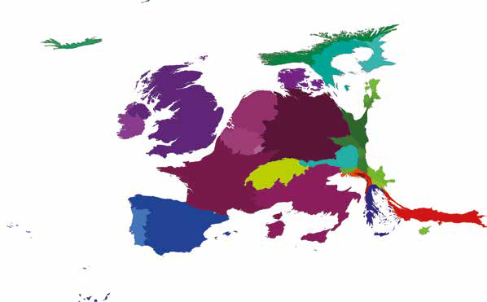
MAP 9.097 – CREDIT BY BANKING SECTOR, 2012

Slide 57
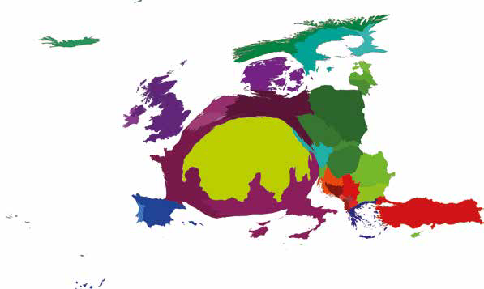
MAP 9.101 – TOTAL RESERVES (INCLUDING GOLD),
2012 (Current US$)

Slide 58
More British bankers earned more than one million euros (￡860,000) each in 2011 than [in] the rest of the European Union (EU) put together, according to the European Banking Authority (EBA). Figures from the EU’s banking regulator showed 2,346 bankers earned more than 1m euros in the UK, compared with 739 in the rest of the EU. In Germany [which had the second most] there were just 170.
(BBC News, 2013b)

Slide 59
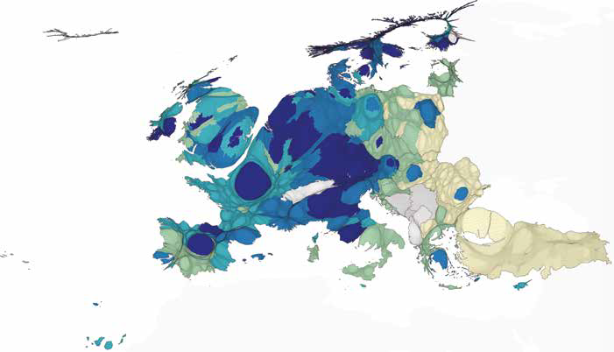
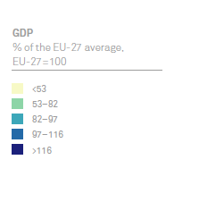
MAP 9.107 – GROSS DOMESTIC PRODUCT (GDP) PER INHABITANT, 2010
Purchasing power standard (PPS), by NUTS 2 regions
(% of EU-27 average, EU-27 = 100)

Slide 60
The proportion of the population living in regions where the average GDP per inhabitant was less than 75% of the EU-27 average was 24.2%, while the proportion living in regions where this value was 125% or more of the EU-27 average was 18.4%; the proportion of the population in the midrange (GDP per inhabitant ranging from 75% to less than 125%) was 57.4%.
European Commission, 2013d

Slide 61
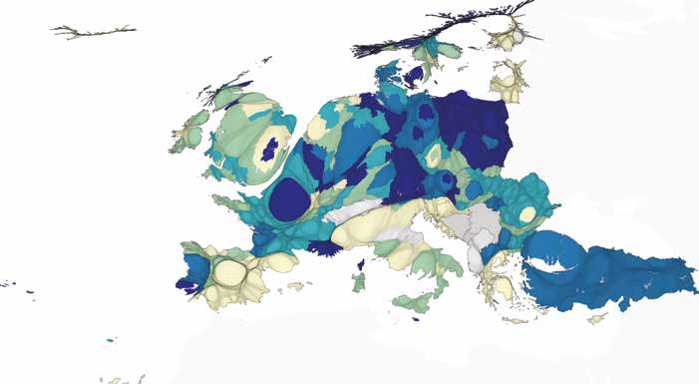
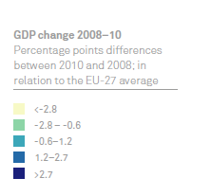
MAP 9.108 – CHANGE IN GROSS DOMESTIC PRODUCT (GDP)
PER INHABITANT, 2008–10 Purchasing power standard (PPS),
(percentage points difference between 2010 and 2008 in relation
to the EU-27 average)

Slide 62
There is growing ‘austerity fatigue’ in Europe, and this might provoke a crisis … the overwhelming result from U.S. political studies is that the level of unemployment matters hardly at all for elections; all that matters is the rate of change in the months leading up to the election. In other words, high unemployment could become accepted as the new normal, politically as well as in economic analysis.
Krugman, 2013

Slide 63
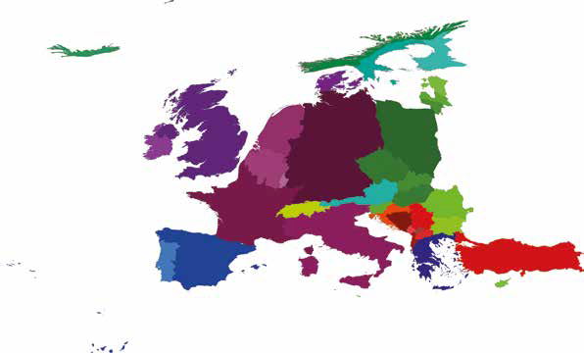
MAP 10.109 – CARBON DIOXIDE EMISSIONS (KT), 2009

Slide 64
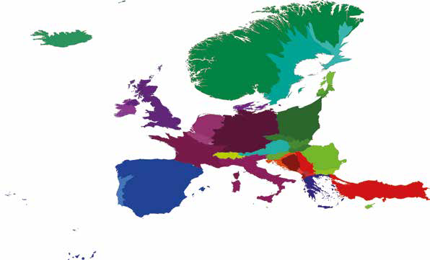
MAP 10.112 – PERFLUOROCARBON GAS EMISSIONS
(KT OF CARBON DIOXIDE EQUIVALENT), 2008

Slide 65
Carbon dioxide levels in the atmosphere have broken through a symbolic mark. Daily measurements of CO2 at a US government agency lab on Hawaii have topped 400 parts per million for the first time ... The last time CO2 was regularly above 400ppm was three to five million years ago – before modern humans existed.
BBC News, 2013c

Slide 66
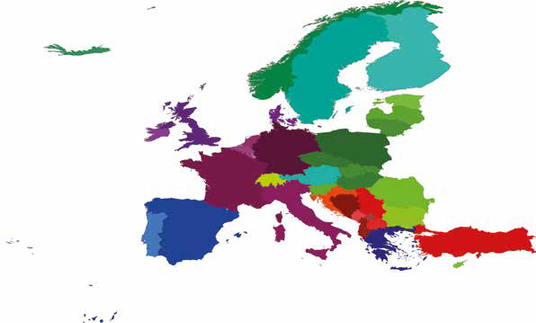
MAP 10.115 – FOREST AREA (KM2), 2011

Slide 67
Forests and agricultural land are important to climate change mitigation. Firstly because of the significance of their carbon stock and secondly because their exchange of greenhouse gases between the atmosphere and soils and vegetation can go both ways. Many human activities such as logging, grazing of livestock or ploughing, influence the exchange of greenhouse gases with the atmosphere and ultimately the carbon footprint of the sector. Both EU internal and international frameworks provide for the regulation of these sectors in terms of climate change.
European Commission, 2014b

Slide 68
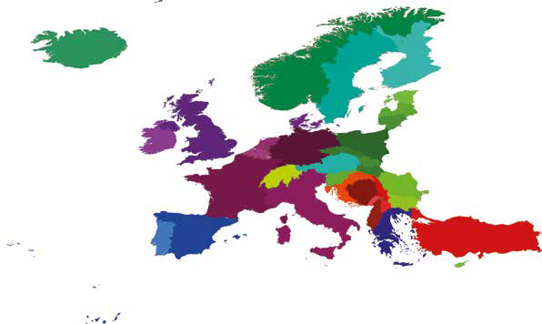
MAP 10.129 – TOTAL RENEWABLE INTERNAL
FRESHWATER RESOURCES (BILLION M3), 2011

Slide 69
Water is an essential commodity upon which all life on Earth depends. For most nations, economic development is inextricably linked to the availability and quality of freshwater supplies. Although everyone uses water on a daily basis, we often take this vital commodity for granted – particularly in regions with a natural abundance of water. We forget that, in many regions, the availability of water is a matter of life and death.
United Nations Environment Programme, 2008

Slide 70
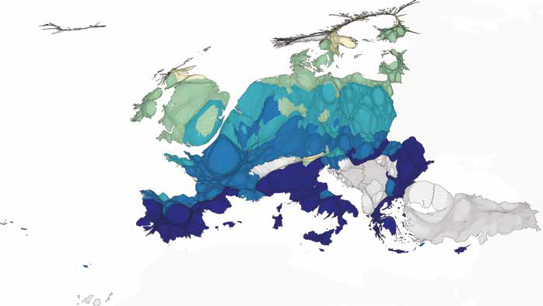
MAP 10.131 – PROJECTED CHANGE IN THE NUMBER OF
TROPICAL NIGHTS BETWEEN 1961–90 AND 2071–2100

Slide 71
The EU has declared an objective of limiting the rise in temperature to 2°C. The IPCC (Intergovernmental Panel on Climate Change) has prepared climate forecasts under several possible future scenarios for 2070–2099. According to the IPCC A1B scenario, temperatures will rise by 3–5°C in Europe as compared with the average for 1961–1990.
European Commission, 2010, p 118

Slide 72
MAP 10.132 – VULNERABILITY OF EUROPEAN REGIONS
TO CLIMATE CHANGE

Slide 73
The severity of the impact of climate change will vary across the EU according to geophysical vulnerability, the natural and human capacity to adapt, and the level of economic development. In the face of these variations, it is crucial for regions to plan an adaptation strategy most appropriate for them.
European Commission, 2010, p 118

Slide 74
MAP 11.137 – INCOME SHARE HELD BY THE LEAST AFFLUENT 20%

Slide 75
Today, as the economic crisis has planted its roots, millions of Europeans live with insecurity, uncertain about what the future holds. This is one of the worst psychological states of mind for human beings and we now see a quiet desperation spreading among Europeans, resulting in depression, resignation and loss of hope for their future.
International Federation of Red Cross and Red Crescent Societies, 2013, p 2

Slide 76
MAP 11.139 – POPULATION AT RISK OF POVERTY AFTER
SOCIAL TRANSFERS, 2008

Slide 77
Five years ago it would have been unimaginable; so many millions of Europeans lining up for food in soup kitchens, receiving food parcels at home or being referred to social groceries... Former middle class citizens living in trailers, tents, railway stations or in shelters for the homeless, hesitating to go to the Red Cross, Red Crescent and other organizations to ask for help.
International Federation of Red Cross and Red Crescent Societies, 2013, p 9

Slide 78
MAP 11.143 – BROADBAND CONNECTIONS IN HOUSEHOLDS,
BY NUTS 2 REGIONS, 2011

Slide 79
Efforts have been made to expand both the geographic reach and the speed of broadband internet across the EU and by 2011 around two thirds (67%) of all households in the EU-27 had broadband internet access at home – a share that rose to 72% in 2012. The relative importance of broadband internet access grew at an average annual rate of 11.4% within the EU-27 from 2007 to 2012 …
European Commission, 2013d

Slide 80
MAP 11.150 – NUMBER OF US DOLLAR BILLIONAIRES

Slide 81
We see emerging vulnerable groups of working poor contacting the Red Cross or Red Crescent for assistance at the end of the month, facing the dilemma of buying food or paying their utility bills – with the risk of being cut off if they do not, or evicted if unable to pay mortgages.
International Federation of Red Cross and Red Crescent Societies, 2013, p 2

Slide 82
MAP 11.152 –STANDARDISED DEATH RATE FROM
SUICIDE FOR POPULATION UNDER 65, 2006–08

Slide 83
In ten regions – Lithuania, three Hungarian regions, Bretagne, Itä-Suomi in Finland and four Belgian regions – the rate is above 20 per 100 000 people. By contrast, 30 regions, all those in Greece, 6 in Spain and Italy, Flevoland in the Netherlands, Cyprus, Outer London, Norte in Portugal and Bucureşti-Ilfov in Romania, had rates below 5.
European Commission, 2010, p 79

Slide 84
MAP 12.154 – NET PAYMENTS INTO THE EU BUDGET

Slide 85
MAP 12.155 – NET PAYMENTS RECEIVED FROM
THE EU BUDGET

Slide 86
MAP 12.163 – SEVENTH FRAMEWORK PROGRAMME, AVERAGE FUNDING PER HEAD

Slide 87
The Lisbon Strategy, launched in 2000, can be described as an ambitious project aimed at developing a coordinated European approach in the field of economic, employment and social policy.
Rodriguez et al, 2010, p 29

Slide 88
MAP 12.166 – CHANGE IN THE LISBON INDEX, 2000–08
(PERCENTAGE POINT CHANGE)

Slide 89
The continent does not appear so large when it is viewed in the context of this atlas, when all its peoples are given equal prominence. We hope that by viewing these maps the reader will have begun to see a different Europe: a Europe of cities rather than states; a continent of people rather than power; and one of hope rather than decline. After all, where else in the world is there such complexity, coherence and communality?

Slide 90
MAP 13.167 – EUROPE AT NIGHT

