Slide 1
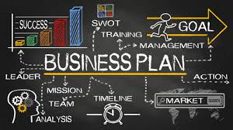
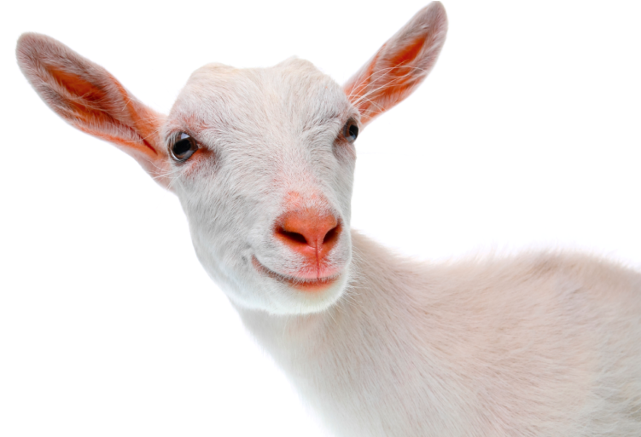
Daisy’s milk
Team:
Corman Alexandru
Deca Ana
Sandu Teodora
Tudorancia Alexia

Slide 2
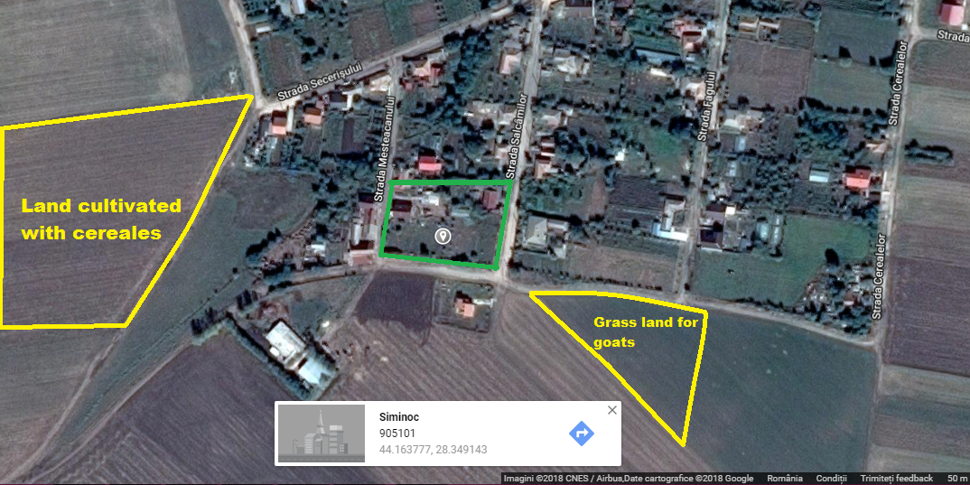
Selection of the company
We choose to have a goat farm at the the edge of village Siminoc, which is near to Murfatlar. Goats do not enjoy popularity among farmers like cows and sheep.Our farm is called “Daisy’s Milk”

Slide 3
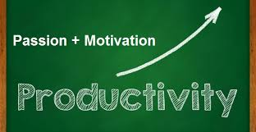
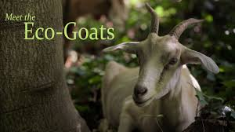
Our vision on our company
The ideal number of goats is 70 from the Carpatina breed. There are not recommended more goats because the productivity will decrease considerably. We will product goat milk of a very high quality because it is eco. As a consequence, our farm will be recognised for this, and therefore our land.

Slide 4
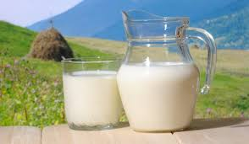
Products and personal required
We will product just milk, which will be sold in bottles of 1 litre.
1 - Chief Operating Officer
1 - General Farm Manager
1 - Administrator Sales
1 - Accountant
Field Employees:
1 - Shepherd
1 - Part time workers for milch (3-4 hours per day)
2 – Janitors (part time)

Slide 5
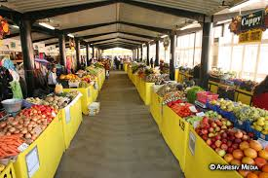
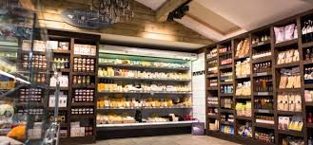
Customers and marketing
The customers have an over-average income, with a high level of education , who understand the importance of eating healthy.
We will sell the products in delicatessen shops and they will be very expensive as well, since the production is very limited. We will sell our products every Sunday in the city market.

Slide 6
The advertise
To win the trust of our customers, the products will be personalised with the picture of our first goat, Daisy (where the farm’s name comes from) and also with the slogan : “Tasty, healthy and nutritious.” A website will be also created in order to promote the farm.

Slide 7
Incomes and the expenses
First year
Incomes | Expenses
The profit from the milk selling (from a goat we will take 2,5 liers of milk per day, so in a | Buying the farm( 8500€/ 500m)
year, from 70 goats we will take 63000 litres) 1,5 euro per liter so we will earn 94500 euro – 76.100( the expenses) our profit will be 12 800 euros | Buying the animals (a goat =100€)70 goats = 7000€
 | bank rate (60000 euros for 10 years ,so 6000 euros per year)
 | Salaries (48,500€ per year for 8 workers)
 | drilling for water( 1500€)
 | Electricity(3 000€)
 | animal supplements(4500 € per year)
 | equipment for milking the goats and bottles for bottling(700 € for equipment and 2000€ For bottles
 | Total:81.700€
.

