Slide 1
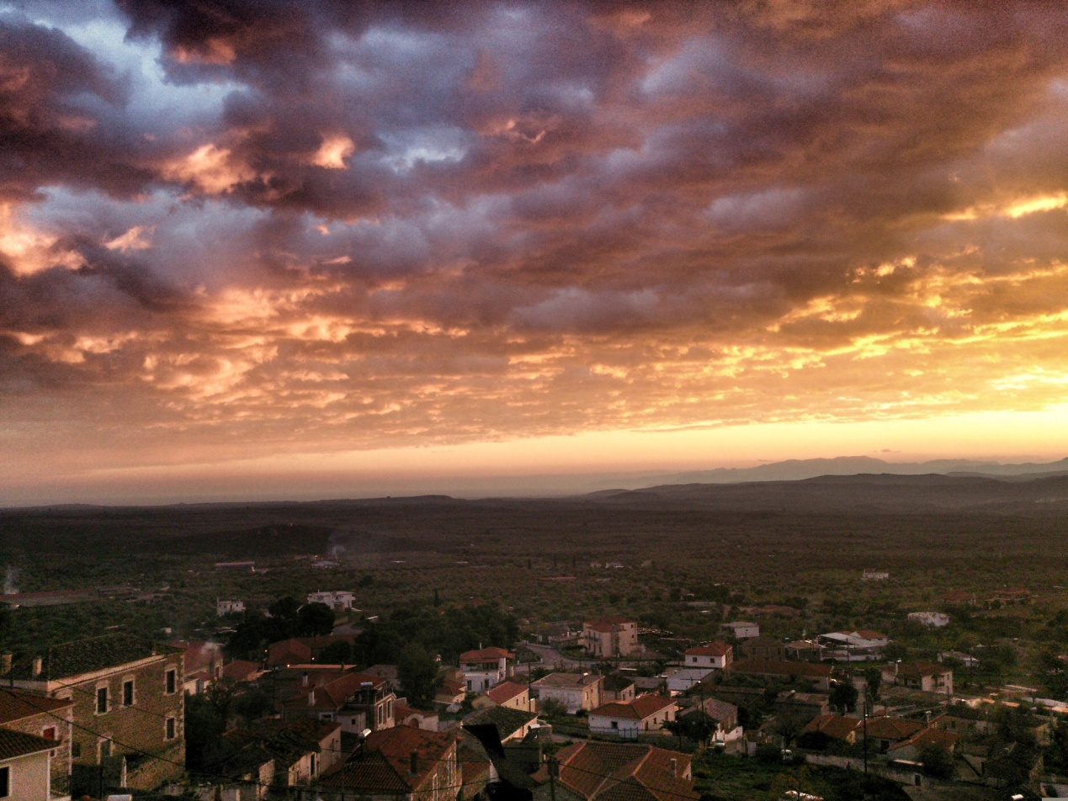
Geronthrai Farm

Slide 2
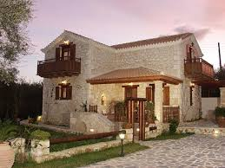
Our subject is Agrotourism
First of all we will start with a small business - farm with a traditional hostel.
Our business will be named “Dream Land”.

Slide 3
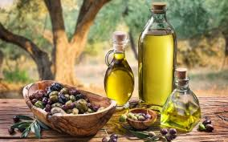
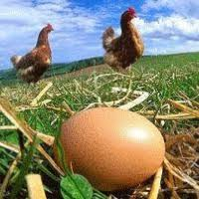
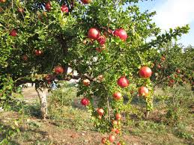
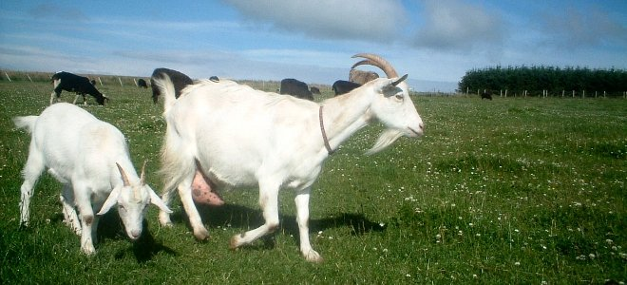
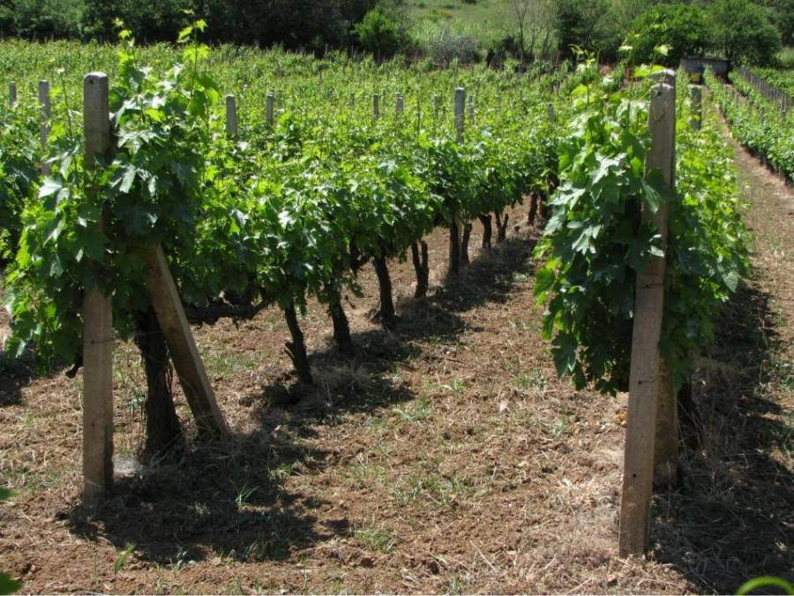
The meals that we will offer to our visitors will be made from our products .
Our products will be honey, bread, olives, olive oil, local fruits and vegetables .

Slide 4
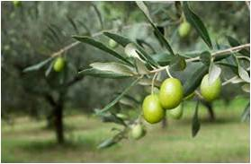
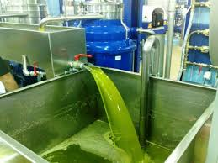
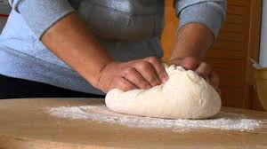
Guests will have the chance to visit the local olive oil press, winery.
Moreover they can take part in some activities that will be organized. They also will have the opportunity to participate in olive collecting, bread production, cheese making or wine production.

Slide 5
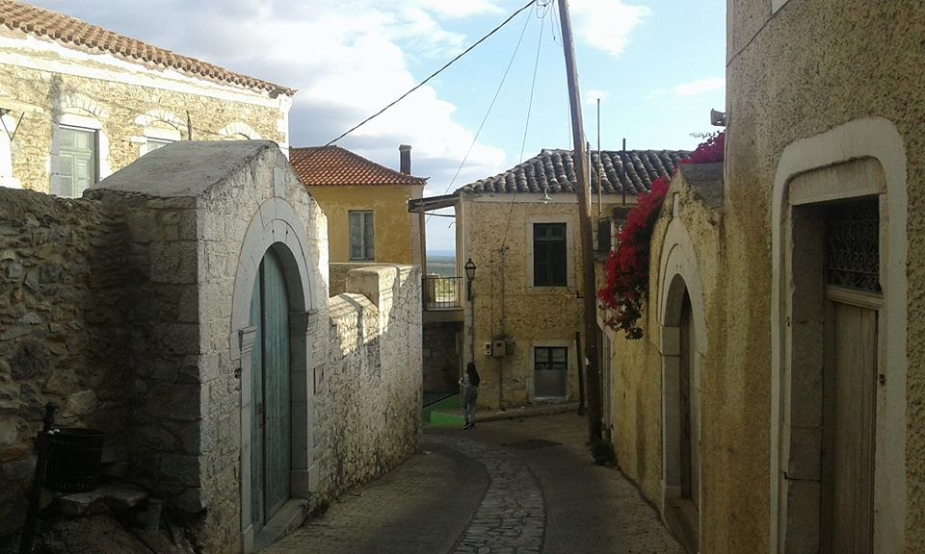
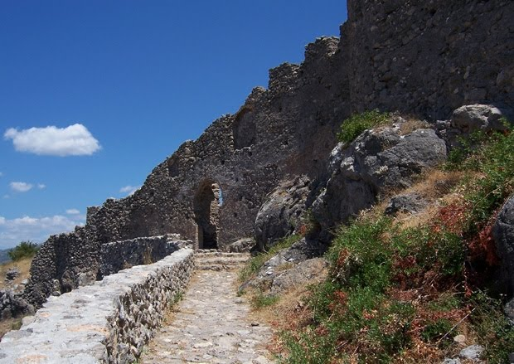
Activities
Guests also can visit the local archaeological sites and at the same time they can go for a walk to field or go horse rιding.
For those who like sports we will organize basketball and football games.

Slide 6
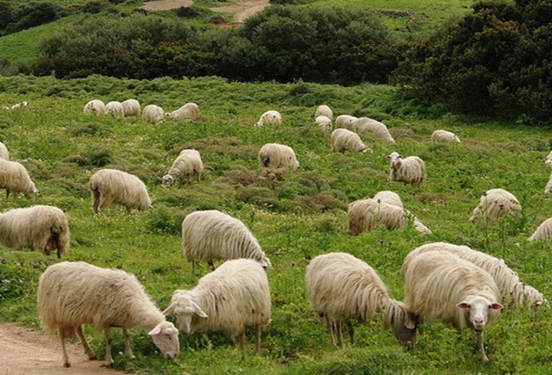
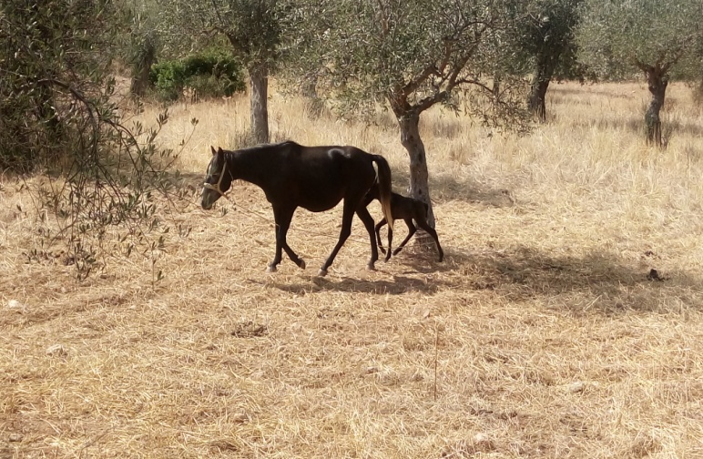
Activities
Furthermore, there will be a farm with different animals, as sheep, goats, horses, rabbits etc. where children have the chance to see them and know them better .

Slide 7
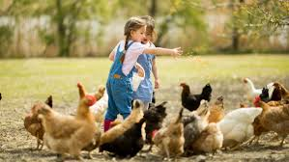
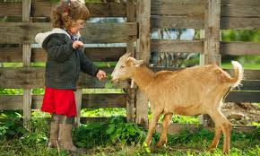
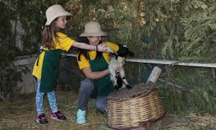
Our clients – visitors to be, are those who love nature and want to have a holiday in countryside. It is special destination for families who want to investigate the nature and have creative hours with their children.
.

Slide 8
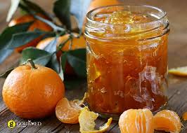
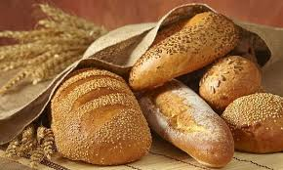
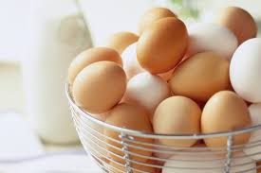
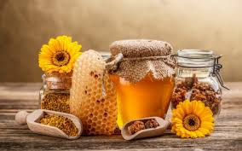
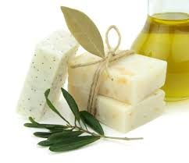
Next to our hostel we will have a small shop where our visitors can buy our biologically products. Afterwards we will give our products to local stores and small shops in Greece and later we will give to organic products shops abroad.
We will use internet on that purpose. We will create a website advertising our products and prices, but also our facilities.

Slide 9
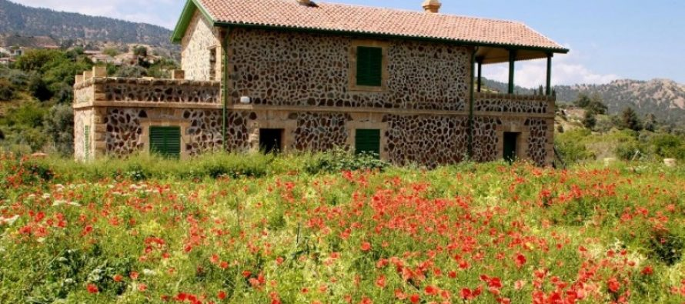
First of all our parents and generally our family will help us. They lend to us some money for our beginning and then when our business will be bigger we will take money from a bank.

Slide 10
Financial Data

Slide 11
Our team
Aggeliki Sarri
Dimitris Antoniou
Aggelos Pantazis
Ioanna Kontou
Barbara Rigopoulou
Katerina Tzovani

