Slide 1
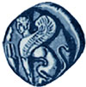
Οικολογία Τοπίου
Πανεπιστήμιο Αιγαίου
Μοντέλο ανάλυσης χωρικής βιωσιμότητας για τον Γυπαετό

Slide 2
Άδειες Χρήσης
Το παρόν εκπαιδευτικό υλικό υπόκειται σε άδειες χρήσης Creative Commons.
Για εκπαιδευτικό υλικό, όπως εικόνες, που υπόκειται σε άλλου τύπου άδειας χρήσης, η άδεια χρήσης αναφέρεται ρητώς.

Slide 3
Χρηματοδότηση
Το παρόν εκπαιδευτικό υλικό έχει αναπτυχθεί στα πλαίσια του εκπαιδευτικού έργου του διδάσκοντα.
Το έργο «Ανοικτά Ακαδημαϊκά Μαθήματα στο Πανεπιστήμιο Αιγαίου» έχει χρηματοδοτήσει μόνο τη αναδιαμόρφωση του εκπαιδευτικού υλικού.
Το έργο υλοποιείται στο πλαίσιο του Επιχειρησιακού Προγράμματος «Εκπαίδευση και Δια Βίου Μάθηση» και συγχρηματοδοτείται από την Ευρωπαϊκή Ένωση (Ευρωπαϊκό Κοινωνικό Ταμείο) και από εθνικούς πόρους.

Slide 4
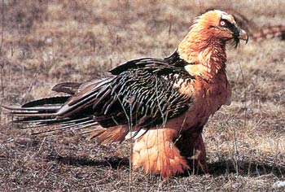
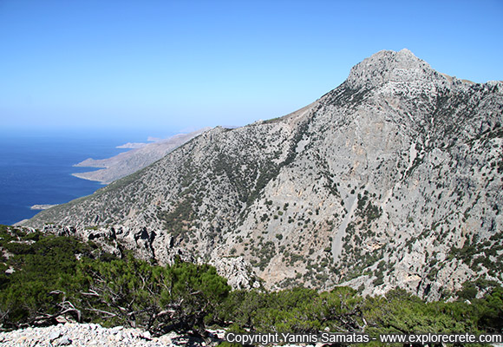
Agent based model for Gypaetus barbatus
Yiannis Matsinos
Akis Rouvelas

Slide 5
Presentation
Part 1 : Aim of study
Part 2 : Description of the vulture
Part 3 : Study area
Part 4 : a) Model development
b) The model
Part 5 : Ongoing research

Slide 6
Aim of the study
Part 1
Population Viability Analysis (PVA)
what are the main driving forces that affect population dynamics
test various conservation strategies
Dispersal patterns and how they emerge from the individual level
Upscaling : Bigger scales and different populations

Slide 7
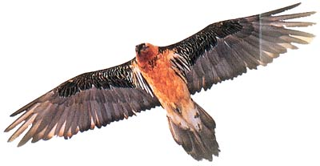
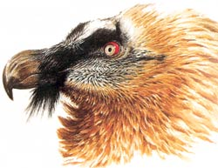
The vulture
Part 2
Characteristics
Weight : 4 – 6 kgr
Wing span : 2,55 – 2,70 m
Life span: over 30 years
Clutch size: 1 – 2 eggs but only one survivor
Food
Carcasses of small rodents and ungulates
up to 90% bones

Slide 8
The vulture
Part 2
Reproductive behavior
Monogamous
Territorial (about 250–700 km²)
Nesting areas
Average elevation in Crete 750 m (280 – 1.450 m)
Topography : small caves or ledges in high areas
Reproductive cycle G. barbatus | Sept | Okt | Nov | Dec | Jan | Feb | Mar | Apr | May | Jun | Jul | Agu
Nest building
Egg laying
Incubation (53-55 days)
Hatching
Hatchling growth (110-120 days)
feathering chick
dependence
Dispersal

Slide 9
The vulture
Part 2
Population structure
Territorial
Floaters
Lone adults
couples
Young - immature
Sub-adults
Non nesting couples
Nesting couples
Fail to reproduce
Successful reproduction

Slide 10
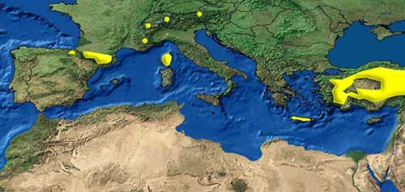
The vulture
Part 2
Population in Europe
Extinct from central Europe from 1850 – 1980
Reintroduction in the Alps
Population growth in the Pyrenees
Stable population in Turkey

Slide 11
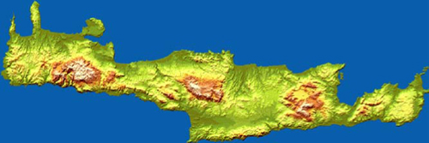
Study area
Part 3
History of Gypaetus barbatus in Crete
80’s – 00’s: Rapid decline of the population
Active breeding sites: from 20 to 6 (from 12 – 14 to 4 reproductive couples)
Causes of decline
Lack of protected areas where reproduction takes place(only 23% )
Use of poison bates
Human pressure near nests (e.g. Roads)
Human persecution (7 cases in the 90’s)

Slide 12
Model development
Part 4a
Pattern Oriented Modeling
Βottom-up approach for complex ecological agent models
Aims to a more rigorous and comprehensive ecological modeling
Focus on key patterns
Fewer data required
Patterns for validation
Spatial and temporal population
Population trends
Seasonal shifts of movement (transhumance)

Slide 13
Model development
Part 4a
Data
Landscape
Topography
Elevation
Slope
Aspect
Land uses
Pasture
Habitat Suitability index map
Food
Ungulates
Feeding stations
Gypaetus
Population
Energy
Dispersal
Behavioral

Slide 14
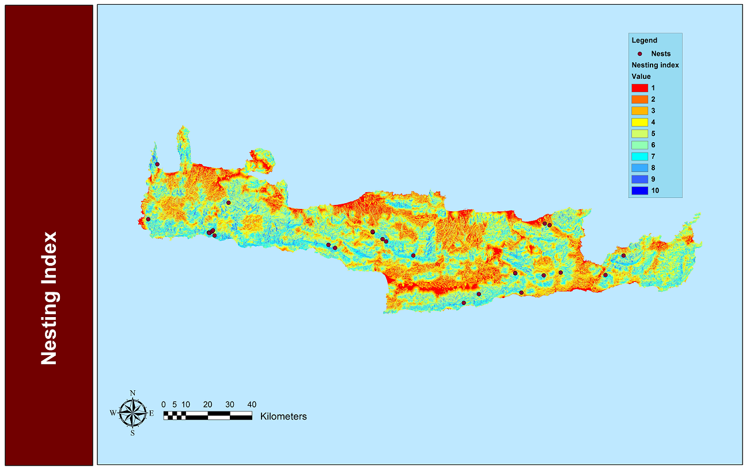
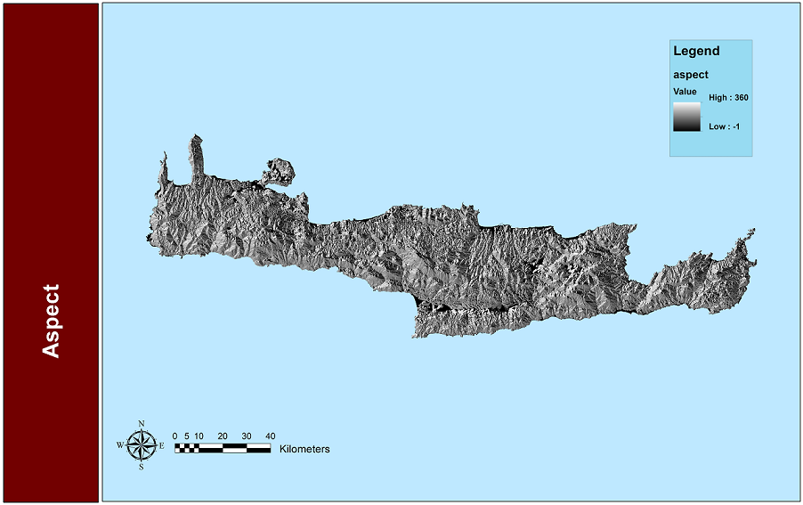
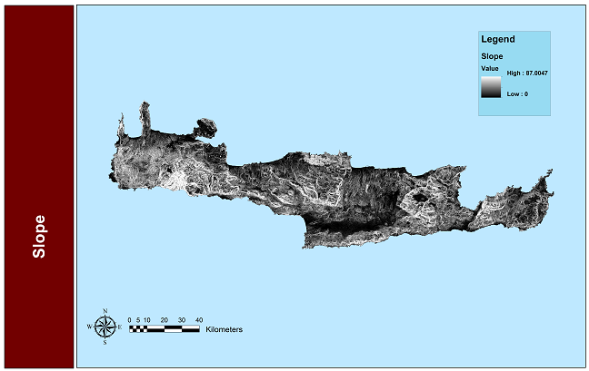
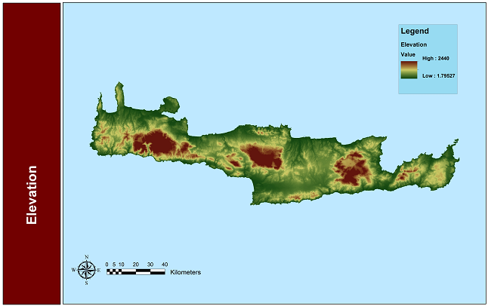
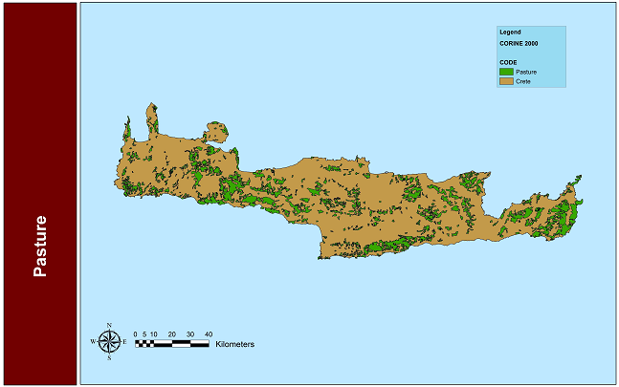
Model development
Part 4a
Backgrounds

Slide 15
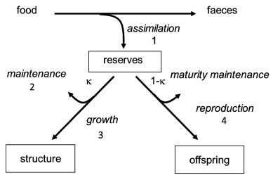
Model development
Part 4a
Metabolism – Energy management
Dynamic Energy Budget
Aims to identify simple quantitative rules for the organization of the metabolism of people.
DEM-IBM : General individual based model for the application of DEB theory
(Benjamin T. Martin, Elke Zimmer, Volker Grimm, and Tjalling Jager 2012)
(Kooijman, 2010)

Slide 16
Model development
Part 4a
Start
Gypaeus
Daily procedures
No
Energy ↗?
Yes
No
Floater?
No
Feed?
Yes
Territorial movement
Dispersal movement
Yes
Found food?
Yes
feed
No
Back to nest

Slide 17
Model development
Part 4a
Gypaetus
Monthly procedures
Adult?
No
Disperse
Yes
Establish Territory
No
Mate?
Yes
Yes
Low Fitness ?
No
Enough energy?
No
Yes
Lay eggs
Stay in territory
incubation
Rise hatchling

Slide 18
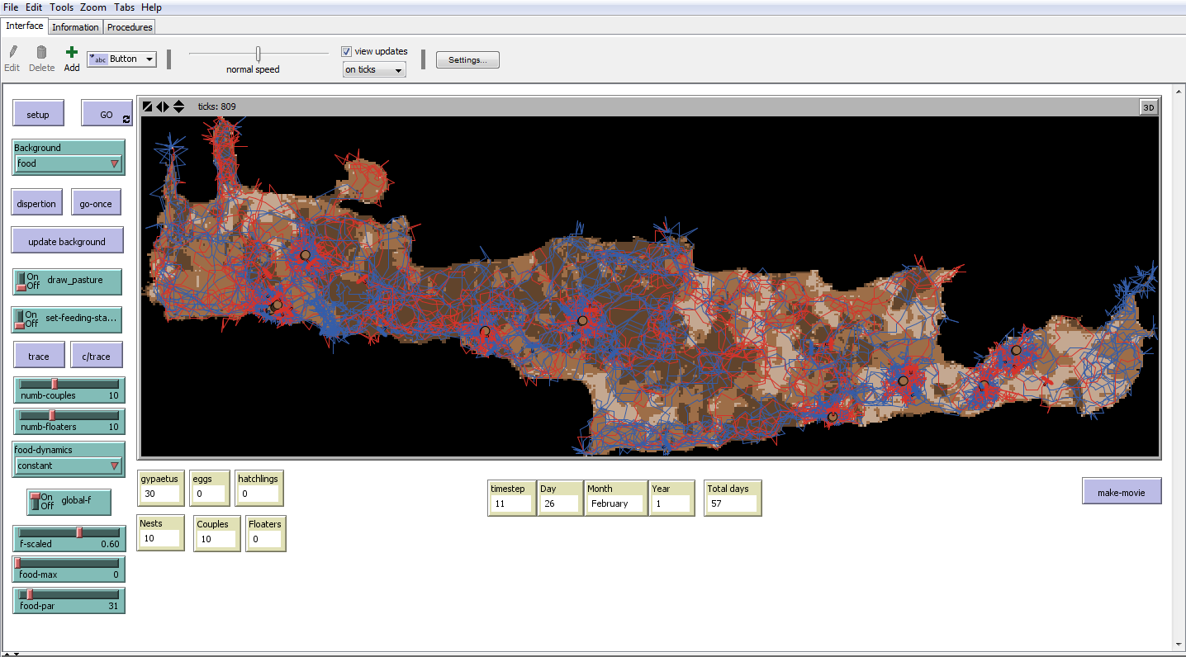
The model
Part 4b
Netlogo

Slide 19
The model
Part 4b
Netlogo
Interface
Background display
Initialization
Population
Metabolic values
Monitoring
Population
Time

Slide 20
The model
Part 4b
One year simulation

Slide 21
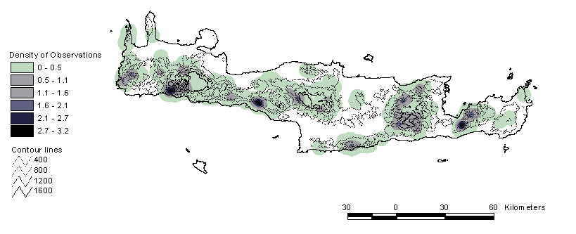
The model
Part 4b
Spatial distribution – model results and observed data

Slide 22
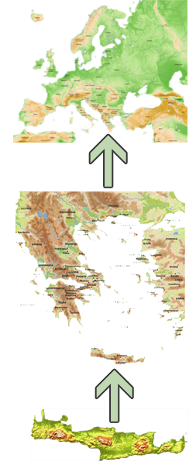
ongoing research
Part 5
Large scale model for metapopulation dynamics research
Larger time steps
Larger scale spatial data
➔ Dispersal as a procedure connecting the two scales
➔ Other case studies in different areas

Slide 23
Thank you for your attention

