Slide 1
Διεθνής Χρηματοοικονομική
Ενότητα 3: FINANCIAL STATEMENT ANALYSIS & FINANCIAL RATIOS
Θεόδωρος Συριόπουλος
Τμήμα Ναυτιλίας και Επιχειρηματικών Υπηρεσιών

Slide 2
Άδειες Χρήσης
Το παρόν εκπαιδευτικό υλικό υπόκειται σε άδειες χρήσης Creative Commons.
Για εκπαιδευτικό υλικό, όπως εικόνες, που υπόκειται σε άλλου τύπου άδειας χρήσης, η άδεια χρήσης αναφέρεται ρητώς.

Slide 3
Χρηματοδότηση
Το παρόν εκπαιδευτικό υλικό έχει αναπτυχθεί στα πλαίσια του εκπαιδευτικού έργου του διδάσκοντα.
Το έργο «Ανοικτά Ακαδημαϊκά Μαθήματα στο Πανεπιστήμιο Αιγαίου» έχει χρηματοδοτήσει μόνο τη αναδιαμόρφωση του εκπαιδευτικού υλικού.
Το έργο υλοποιείται στο πλαίσιο του Επιχειρησιακού Προγράμματος «Εκπαίδευση και Δια Βίου Μάθηση» και συγχρηματοδοτείται από την Ευρωπαϊκή Ένωση (Ευρωπαϊκό Κοινωνικό Ταμείο) και από εθνικούς πόρους.

Slide 4
UNIVERSITY OF THE AEGEAN Shipping, Trade & Transport Dpt.
International Finance_{INTFIN}
Professor Theodore SYRIOPOULOS

Slide 5
By Peter Moles, Robert Parrino, & David Kidwell
ISBN: 978-0-470-68370-5
© Copyright 2011 John Wiley & Sons Ltd
www.wiley.com/college/moles

Slide 6
Chapter Four
Analysing Financial Statements

Slide 7
Learning Objectives
Explain the three perspectives from which financial statements can be viewed.
Describe common-sized financial statements, explain why they are used and be able to prepare and use them to analyse the historical performance of a firm.
Discuss how financial ratios facilitate financial analysis and be able to compute and use them to analyse a firm’s performance.

Slide 8
Learning Objectives
Describe the DuPont system of analysis and be able to use it to evaluate a firm’s performance and identify corrective action that may be necessary.
Explain what benchmarks are, describe how they are prepared and discuss why they are important in financial statement analysis.
Identify the major limitations in using financial statement analysis.

Slide 9
Ratio Analysis
Quick Links
Financial Statement Analysis
The DuPont System, ROA, ROE
Benchmarks
Limitations of Ratio Analysis
Notes:
9

Slide 10
Perspectives on Financial Statement Analysis
A firm’s financial statements can be analysed from the perspective of different stakeholders.
Important perspectives:
Shareholder
Manager
Creditor
Notes:
10

Slide 11
Perspectives on Financial Statement Analysis
Shareholders’ perspective
Centres on value of shares held.
Interest in the financial statement is to gauge cash flows firm will generate from operations.
Allows determination of firm’s profitability, return for that period and likely dividends.
Notes:
11

Slide 12
Perspectives on Financial Statement Analysis
Manager’s perspective
Interest in firm’s financial statement is similar to shareholders’.
Manager’s job security depends on firm’s performance.
Management gets feedback on investing, financing and working capital decisions by identifying trends in various accounts reported in financial statements.
Notes:
12

Slide 13
Perspectives on Financial Statement Analysis
Creditors’ perspective
Focus on getting loans repaid and receiving interest payments on time.
A firm’s creditors closely monitor
Amount of debt firm has.
Ability to meet short-term obligations.
Ability to generate sufficient cash flows to meet all legal obligations, debt repayment and interest payments.
Notes:
13

Slide 14
Guidelines for Financial Statement Analysis
Main Concern
From whose perspective firm analysis is done.
Management, shareholder or creditor.
Use only audited financial statements if possible.
Perform analysis over 3-5 year period–time-trend analysis.
Notes:
14

Slide 15
Guidelines for Financial Statement Analysis
Main Concern
Compare firm’s performance to direct competitors’ performance.
Perform a benchmark analysis comparing it to most relevant competitors – Lufthansa with Air France or BA-Iberia.
Notes:
15

Slide 16
Common-Size Financial Statements
Common-Size Balance Sheets
Each asset and liability item on balance sheet is standardised by dividing by total assets.
Accounts are then represented as percentages of total assets.
Notes:
16

Slide 17
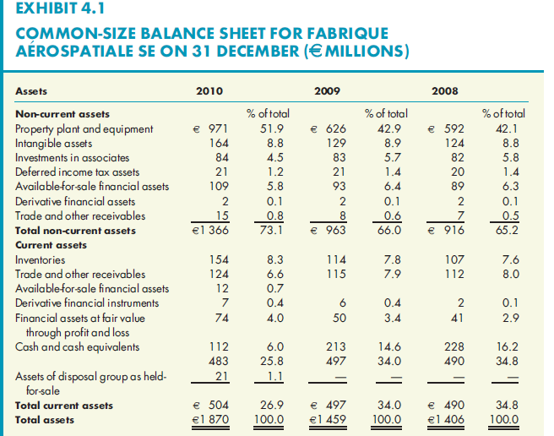
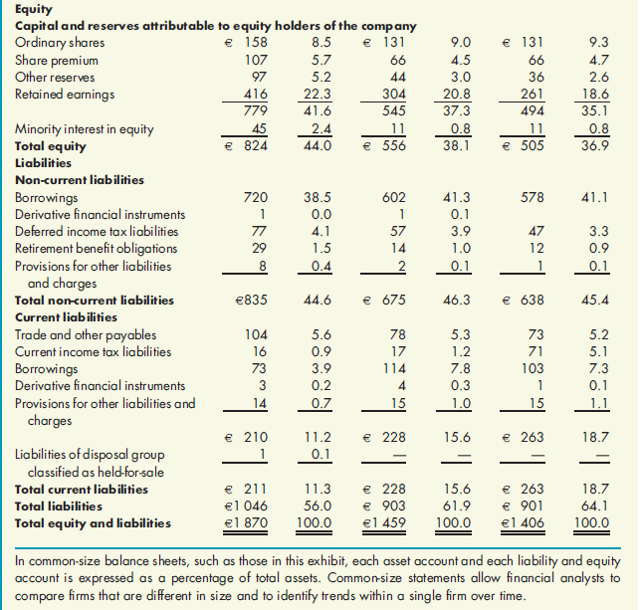
Exhibit 4.1: Common-Size Balance Sheets

Slide 18
Common-Size Financial Statements
Common-Size Income Statement
Each income statement item standardised by dividing it by the amount of net sales.
Each income statement item now indicated as a percentage of sales.
Notes:
18

Slide 19
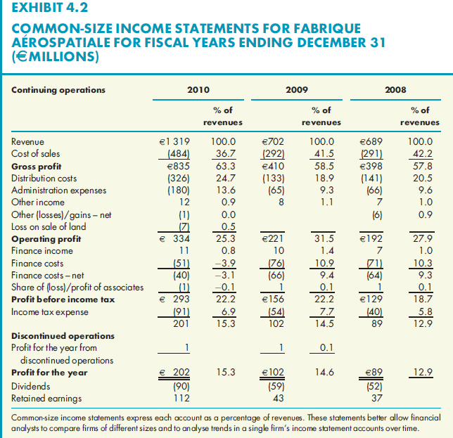
Exhibit 4.2: Common-Size Income Statements for Fabrique Aérospatiale

Slide 20
Ratio Analysis
Why Ratios Are Better Measures
A financial ratio is computed by dividing one balance sheet or income statement item by another.
Variety of ratios can be computed to focus on specialised aspects of firm’s performance.
Choice of scale determines story garnered from the ratio.
Notes:
20

Slide 21
Ratio Analysis
Why Ratios Are Better Measures
Different ratios calculated based on type of firm being analysed or kind of analysis being performed.
Ratios may be computed to measure liquidity, efficiency, leverage, profitability or market value performance.
Notes:
21

Slide 22
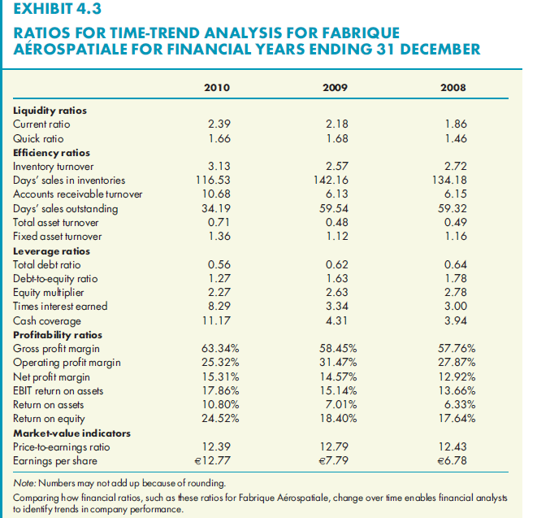
Exhibit 4.3: Ratios for Time-Trend Analysis for Fabrique Aérospatiale

Slide 23
Liquidity Ratios
Measures ability of firm to meet short-term obligations with short-term assets, without endangering the firm.
Two commonly used ratios to measure liquidity:
Current ratio
Quick ratio
Notes:
23

Slide 24
Liquidity Ratios
Current ratio is calculated by dividing current assets by current liabilities.
Amount of current assets firm has per euro of current liabilities.
Higher number = more liquidity
Notes:
24

Slide 25
Liquidity Ratios
Quick (acid-test) ratio calculated by dividing most liquid current assets by current liabilities.
Inventory subtracted from total current assets determines most liquid assets.
Amount of liquid assets firm has per euro of current liabilities.
Higher number = more liquidity
Notes:
25

Slide 26
Liquidity Ratios
Quick ratios typically smaller than current ratios for firms carrying significant inventory (e.g. manufacturing firms).
Firms carrying little inventory (e.g. service) will see no significant difference between the two.
Notes:
26

Slide 27
Efficiency Ratios
Sometimes called asset turnover ratios.
Measure how efficiently firm’s management uses assets to generate sales.
Notes:
27

Slide 28
Efficiency Ratios
Used by management to identify areas of inefficiency.
Used by creditors to determine speed of converting inventory into receivables.
Receivables convert to cash to help firm meet debt obligations.
Efficiency ratios focus on inventory, receivables and use of fixed and total assets.
Notes:
28

Slide 29
Efficiency Ratios
Inventory turnover ratio–measures how many times inventory turned over into saleable products.
In general, more often a firm can turn over inventory, the better. Too high or too low a turnover could be warning sign.
Notes:
29

Slide 30
Efficiency Ratios
Days’ sales in inventory ratio also builds on inventory turnover ratio.
Measures number of days firm takes to turn over inventory.
The smaller the number, the faster the firm turns over inventory, more efficient it is.
Notes:
30

Slide 31
Efficiency Ratios
Accounts receivable turnover ratio measures how quickly firm collects on its credit sales.
The higher the frequency of turnover, the faster it converts credit sales into cash flows
Notes:
31

Slide 32
Efficiency Ratios
Days Sales Outstanding (DSO) measures number of days firm takes to convert receivables into cash.
The fewer the days, the more efficient the firm.
Note: an overzealous credit department may offend firm’s customers.
Notes:
32

Slide 33
Asset Turnover Ratios
Total asset turnover ratio measures level of sales firm generates per euro of total assets.
The higher the turnover, the more efficiently management is using total assets.
More relevant for service industry firms.
Notes:
33

Slide 34
Asset Turnover Ratios
Fixed asset turnover ratio measures level of sales firm generates per euro of fixed assets.
Higher the fixed asset turnover, the more efficiently management uses plant and equipment.
More relevant for equipment intensive firms (e.g. mfg).
Notes:
34

Slide 35
Leverage Ratios
Leverage ratios reflect ability of firm and owners to use equity to generate borrowed funds.
Financial leverage refers to use of debt in firm’s capital structure.
Notes:
35

Slide 36
Leverage Ratios
Use of debt increases shareholders’ returns; tax benefits from interest payments on debt.
Two sets of ratios can analyse leverage:
Debt ratios quantify use of debt in capital structure;
Coverage ratios measure firm’s ability to meet debt obligations.
Notes:
36

Slide 37
Leverage Ratios
Total debt ratio is calculated using short-term and long-term debt.
The higher the amount of debt, the higher the firm’s leverage, and the more risky it is.
Notes:
37

Slide 38
Leverage Ratios
Debt to equity ratio is a second leverage ratio, measuring amount of debt per euro of equity.
Notes:
38

Slide 39
Leverage Ratios
Equity multiplier or leverage multiplier reveals amount of assets firm has for every euro of equity.
Best measure of firm’s ability to leverage shareholders’ equity with borrowed funds.
Notes:
39

Slide 40
Other Leverage Relationships
Equity multiplier = 1 + Debt to equity ratio
Notes:
40

Slide 41
Coverage Ratios
Times interest earned measures number of euros in operating earnings firm generates per euro of interest expense.
Notes:
41

Slide 42
Coverage Ratios
Cash coverage ratio measures amount of cash firm has to meet its interest payments.
Notes:
42

Slide 43
Profitability Ratios
Gross profit margin measures amount of gross profit generated per euro of net sales.
Notes:
43

Slide 44
Profitability Ratios
Operating profit margin measures the amount of operating profit generated by firm for each euro of net sales.
Notes:
44

Slide 45
Profitability Ratios
Net profit margin measures amount of net income after taxes generated by firm for each euro of net sales.
In each case, the higher the ratio, the more profitable the firm.
Management and creditors likely to focus on these profitability measures; shareholders likely to concentrate on two others.
Notes:
45

Slide 46
Profitability Ratios
Return on assets (ROA) ratio measures amount of net income per euro of total assets. There are two approaches to calculate the return on assets.
This ratio reveals how efficiently management used the assets under their control.
Notes:
46

Slide 47
Profitability Ratios
Some analysts calculate return on assets as:
Notes:
47

Slide 48
Profitability Ratios
Return on equity (ROE) ratio measures the amount of net income per monetary unit of shareholders’ equity.
For firm with no debt, ROA = ROE
For firm with debt, ROE >ROA
Notes:
48

Slide 49
Market Value Ratios
The following ratios reveal how market views a company’s liquidity, efficiency, leverage and profitability.
Earnings per share (EPS) ratio measures income after taxes generated by firm for each share outstanding.
Notes:
49

Slide 50
Market Value Ratios
Price-earnings (P/E) ratio ties firm’s earnings per share to price per share.
P/E ratio reflects investors’ expectations of firm’s future earnings growth.
Notes:
50

Slide 51
The DuPont System
Diagnostic Tool
Set of related ratios that links balance sheet and income statement.
Diagnostic tool for evaluating firm’s financial health.
Used by management and shareholders to understand factors that drove firm’s ROE.
Based on two equations that relate firm’s ROA and ROE.
Notes:
51

Slide 52
The ROA Equation
Return on assets (net income/total assets) can be broken down into two components:
Profit margin and total assets turnover ratio
Net profit margin measures management’s ability to generate sales & manage operating expenses.
Notes:
52

Slide 53
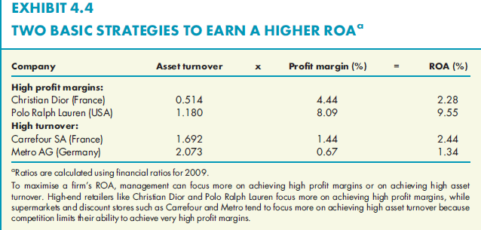
Exhibit 4.4: Two Basic Strategies to Earn a Higher ROA

Slide 54
The ROA Equation
Total asset turnover reveals how efficiently management uses assets under its control; how much output can be generated with a given asset base. Thus, asset turnover measures asset use efficiency.
The ROA equation says if management wants to increase firm’s ROA, it can increase profit margin, asset turnover or both.
Management can examine a poor ROA and determine whether the problem is operating efficiency or asset use efficiency.
Notes:
54

Slide 55
The ROE Equation
This equation is simply a restatement of equation 4.19.
ROE is determined by firm’s ROA and its use of leverage.
Firm with small ROA can increase ROE by using higher leverage.
Notes:
55

Slide 56
The DuPont Equation
Shows that a firm’s ROE is determined by three factors:
Net profit margin, which measures firm’s operating efficiency.
Total asset turnover, which measures firm’s asset use efficiency.
The equity multiplier, which measures firm’s financial leverage.
Notes:
56

Slide 57
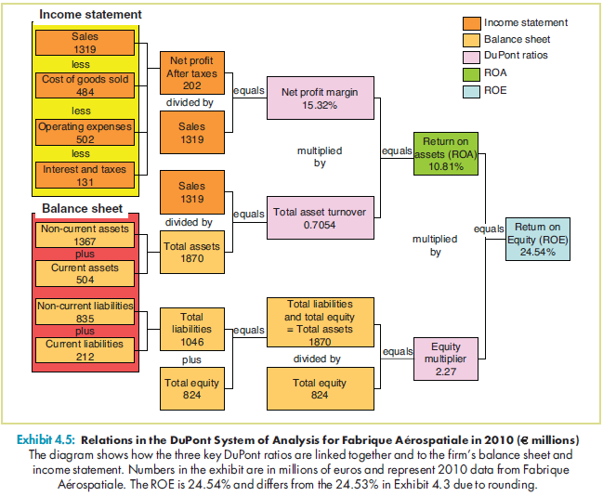
Exhibit 4.5: Relations in the DuPont System of Analysis

Slide 58
The DuPont Equation
Analysing firm’s financial performance will reveal inefficiencies and strengths.
Weak operational efficiency calls for closer look at firm’s income statement items.
Asset turnover or leverage problems shift focus to balance sheet.
Notes:
58

Slide 59
ROE as a Goal
Those who do not agree that maximising ROE is equivalent to shareholder wealth maximisation identify three key weaknesses of ROE.
ROE is based on after-tax earnings, not cash flows.
ROE does not consider risk.
ROE ignores size of initial investment as well as future cash flows.
Notes:
59

Slide 60
ROE as a Goal
Those who believe that they are consistent propose.
ROE allows management to break down performance, identify areas of strengths and weaknesses.
ROE is highly correlated with shareholder wealth maximisation.
Notes:
60

Slide 61
Selecting a Benchmark
A ratio analysis becomes relevant only when compared against a benchmark.
Financial managers can create a benchmark for comparison in three ways:
1. Time-trend
2. Industry average
3. Peer group
Notes:
61

Slide 62
Selecting a Benchmark
Time-trend Analysis
Based on firm’s historical performance.
Allows management to examine each ratio over time, determine whether trend is good or bad for firm.
Notes:
62

Slide 63
Selecting a Benchmark
Industry Average Analysis
Another way of developing benchmark.
Firms in same industry grouped by size, sales and product lines, to establish benchmark ratios.
Can identify industry groups with International Standard Industrial Classification (ISIC) system.
Notes:
63

Slide 64
Selecting a Benchmark
Peer group analysis
Instead of selecting an entire industry, management may select firms similar in size or sales, or who compete in same market.
Average ratios of this peer group would then be used as benchmark.
Peer groups can be only 3 or 4 firms, depending on industry.
Notes:
64

Slide 65
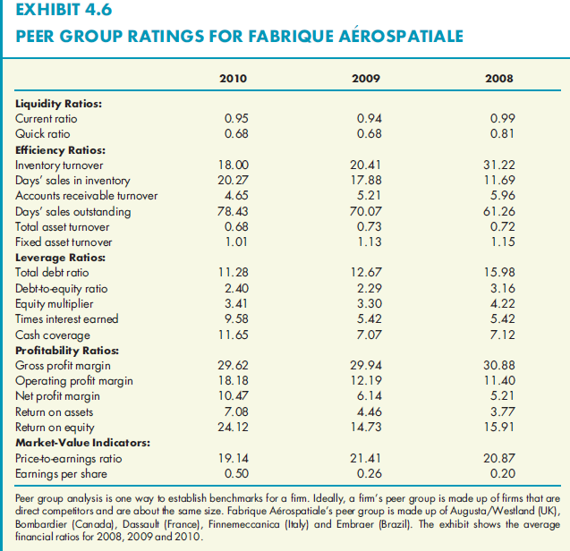
Exhibit 4.6: Peer Group Ratios for Fabrique Aérospatiale

Slide 66
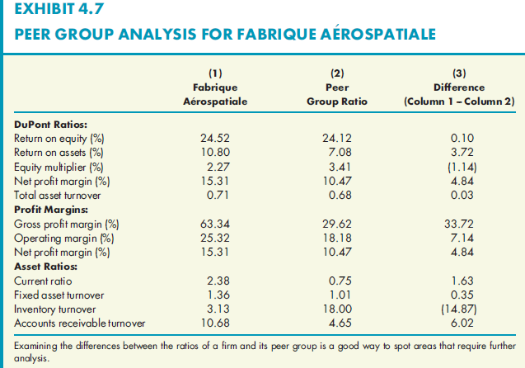
Exhibit 4.7: Peer Group Analysis for Fabrique Aérospatiale

Slide 67
Limitations of Ratio Analysis
Ratio analysis depends on accounting data based on historical costs.
No theoretical backing in making judgments based on financial statement and ratio analysis.
When doing industry or peer group analysis, one often encounters large, diversified firms that do not fit into any one ISIC code.
Notes:
67

Slide 68
Limitations of Ratio Analysis
Time trend analysis could be distorted by financial statements affected by inflation.
Multinational firms deal with many accounting standards.
Difficult to compare financial reports.
Even among domestic firms, differences in accounting practices make comparisons difficult.
E.g. differences between disclosures of public firms versus private firms.
Notes:
68

