Slide 1
STUDIO 2B SPRING 2024
APRIL 2 &3 – 9 & 10 – 16 &17 – 23 & 24

Slide 2
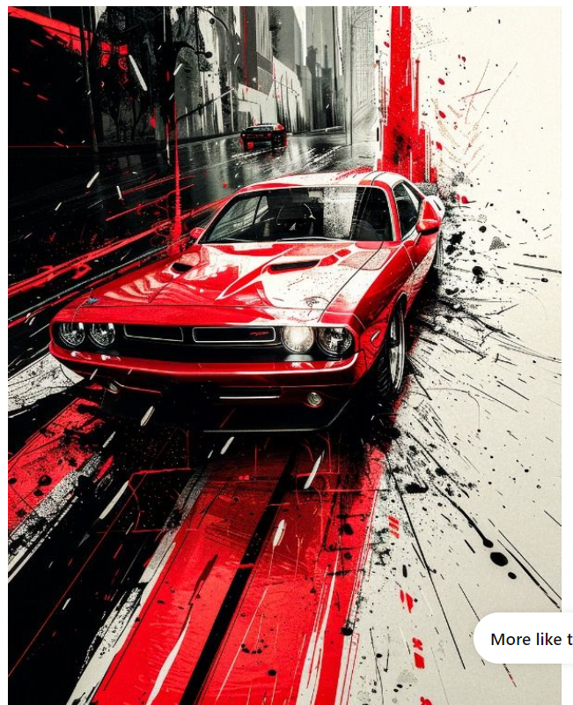
1. Studio APRIL 2 & 3 /24 – finish at home
ΣΚΙΤΣΟ ΜΟΝΟ ΑΠΟ ΠΑΡΑΤΗΡΗΣΗ
SKETCH ONLY FROM OBSERVATION
ATTENTION!
NO COPY WITH TRACING PAPER
FROM ORIGINAL
2. HOME ASSIGNMENT
REDRAW SAME AND CREATE COLOR
COMPOSITION AROUND OBJECT
YOUR COLORS – YOUR MATERIAL –
YOUR TECHNIQUE - SIZE OPTIONAL A4 OR A3
ATTENTION!
NO COPY WITH TRACING PAPER
YOU NEED TO SIGN YOU
DRAWING ASSIGNMENTS
WITH ALL YOUR INFORMATION
FULL NAME, DATE PRODUCED
DPSD NUMBER
APRIL 2 & 3 /24

Slide 3
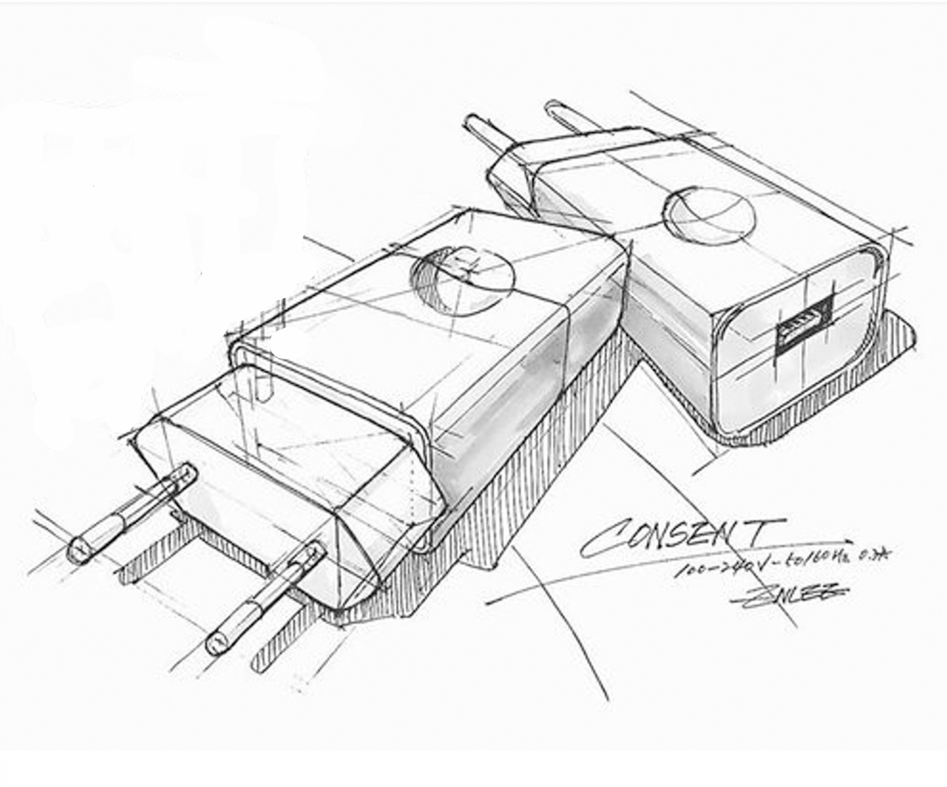
1. Studio APRIL 2 & 3 /24 – finish at home
ΣΚΙΤΣΟ ΜΟΝΟ ΑΠΟ ΠΑΡΑΤΗΡΗΣΗ
SKETCH ONLY FROM OBSERVATION
ATTENTION! NO COPY WITH TRACING PAPER
FROM THE ORIGINAL
2. HOME ASSIGNMENT
REDRAW SAME 2 OBJECTS AND CREATE COLOR
COMPOSITION AROUND THE OBJECTS AND
REFLECTIONS ON THE OBJECTS
ATTENTION!
NO COPY WITH TRACING PAPER
FROM THE ORIGINAL
ATTENTION!
YOU NEED TO SIGN
EACH DRAWING ASSIGNMENT
WITH ALL YOUR INFORMATION
FULL NAME,
DATE PRODUCED
DPSD NUMBER
SPRING SEMESTER - STUDIO 2B

Slide 4
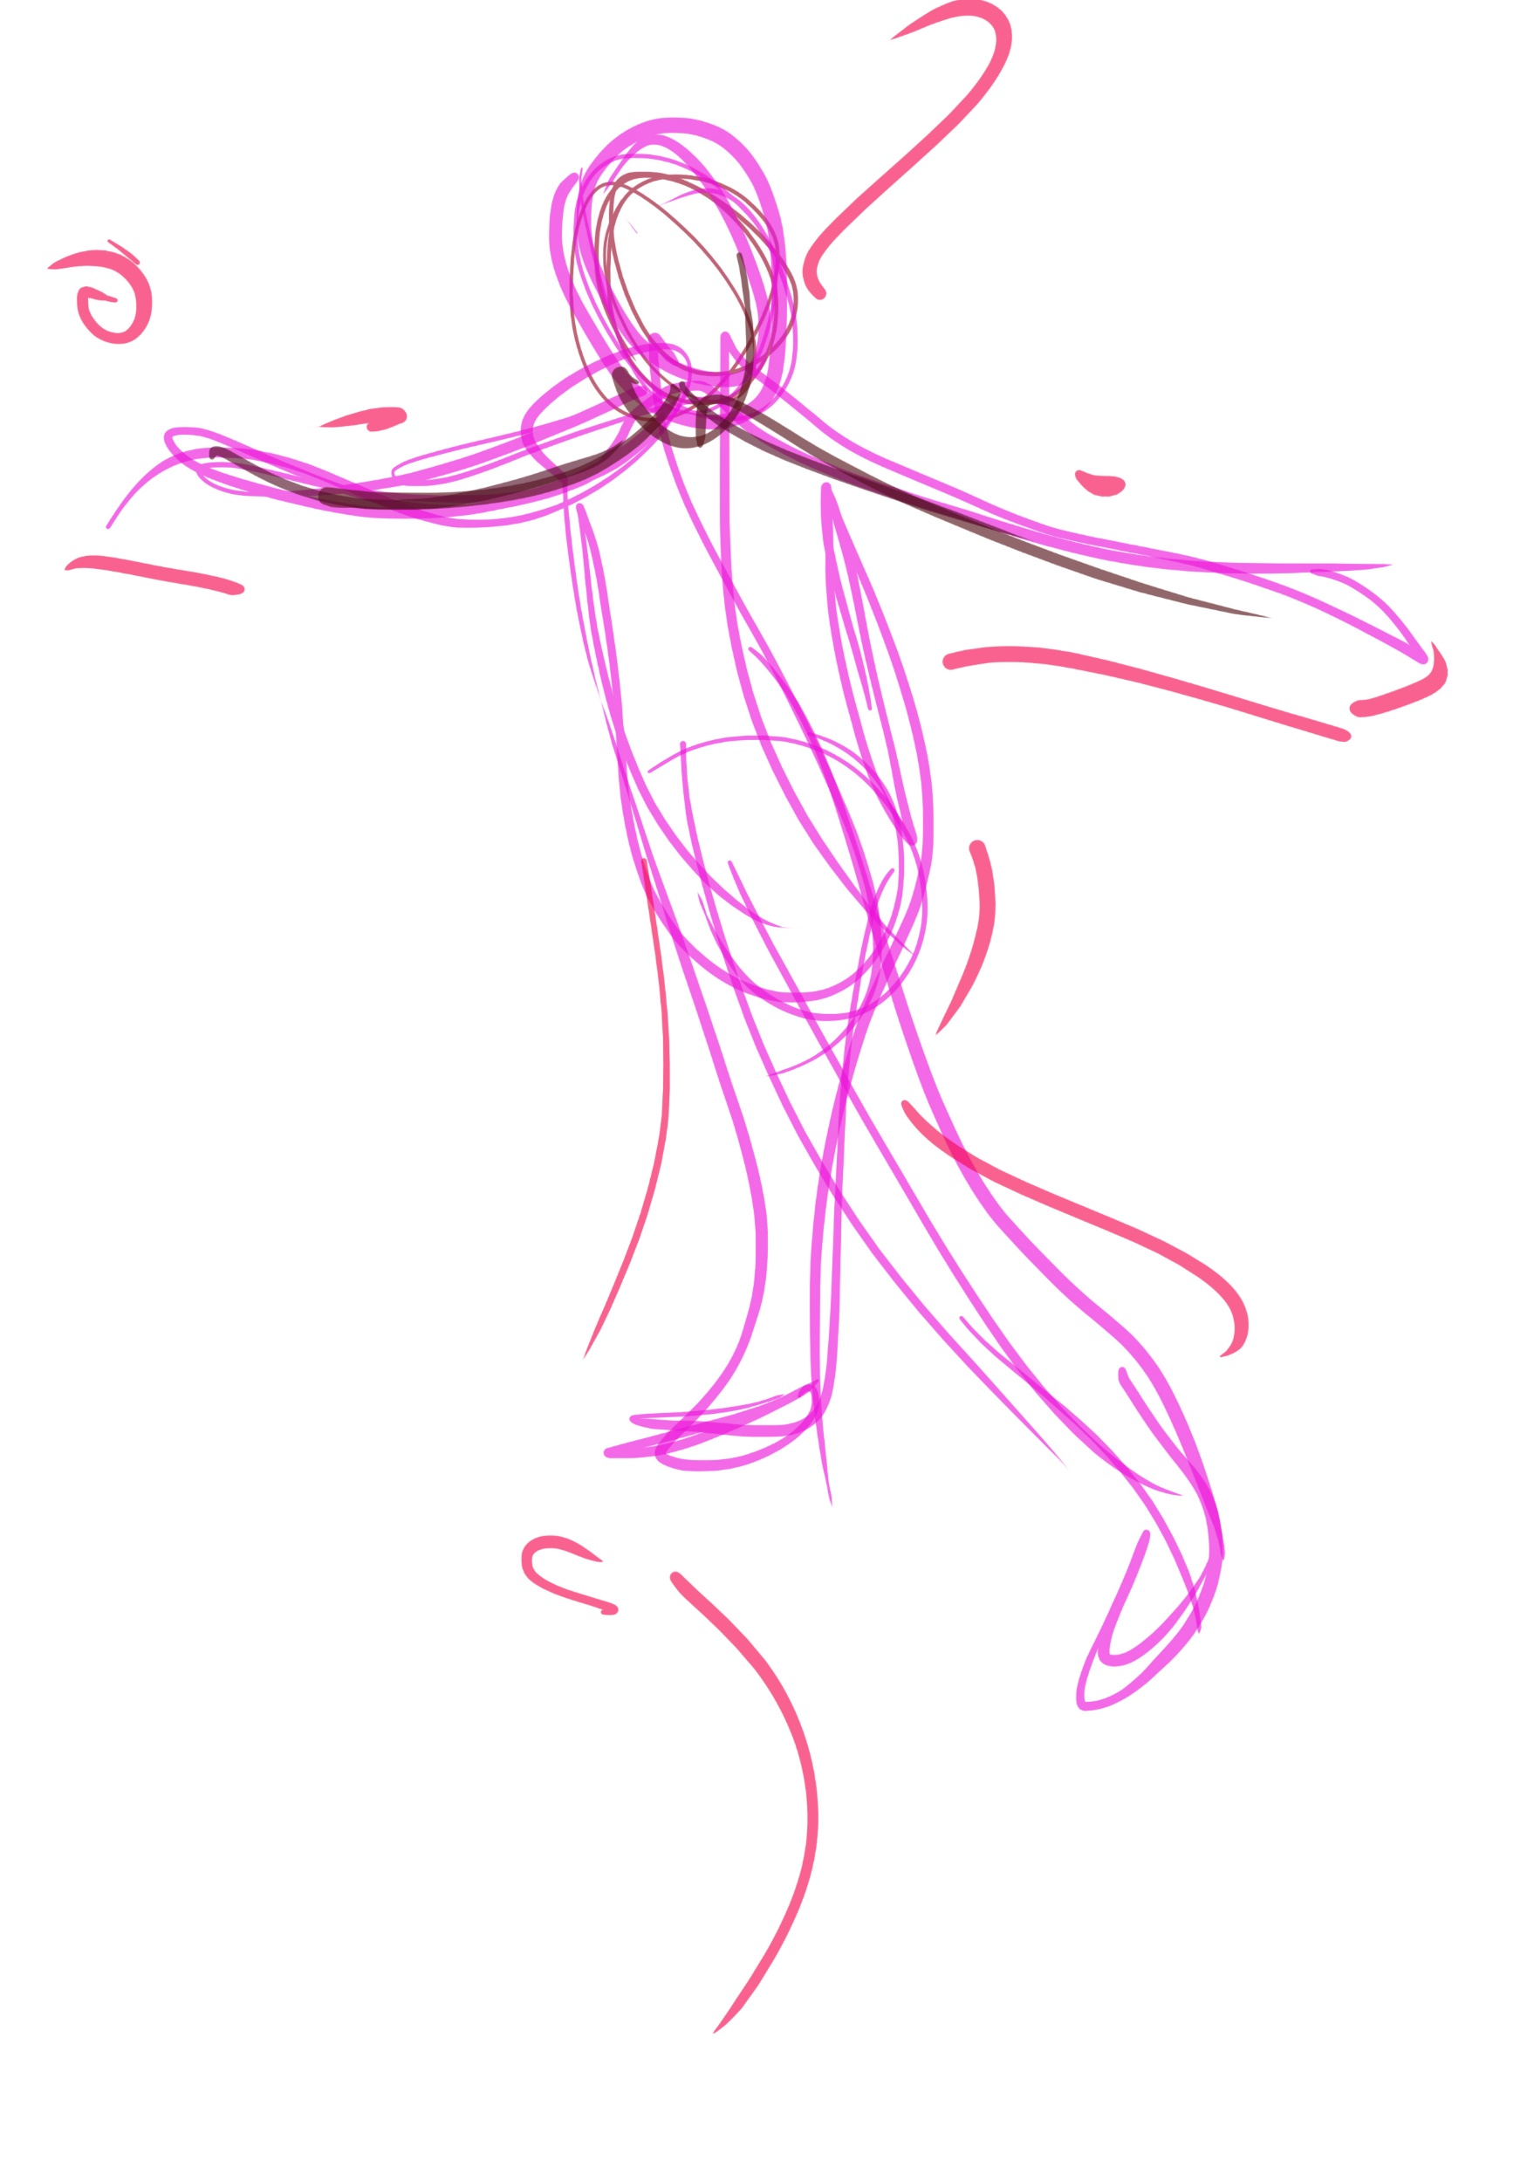
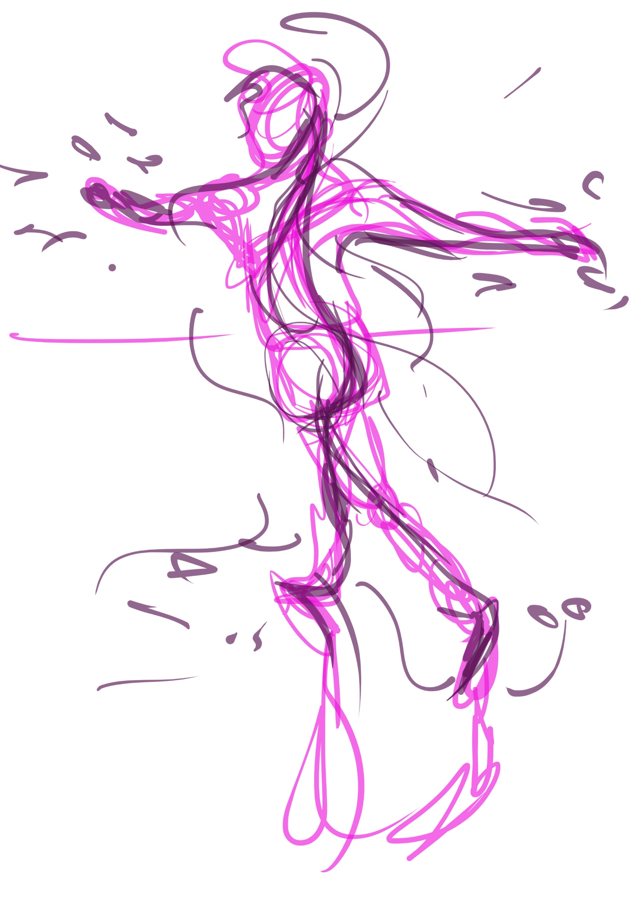
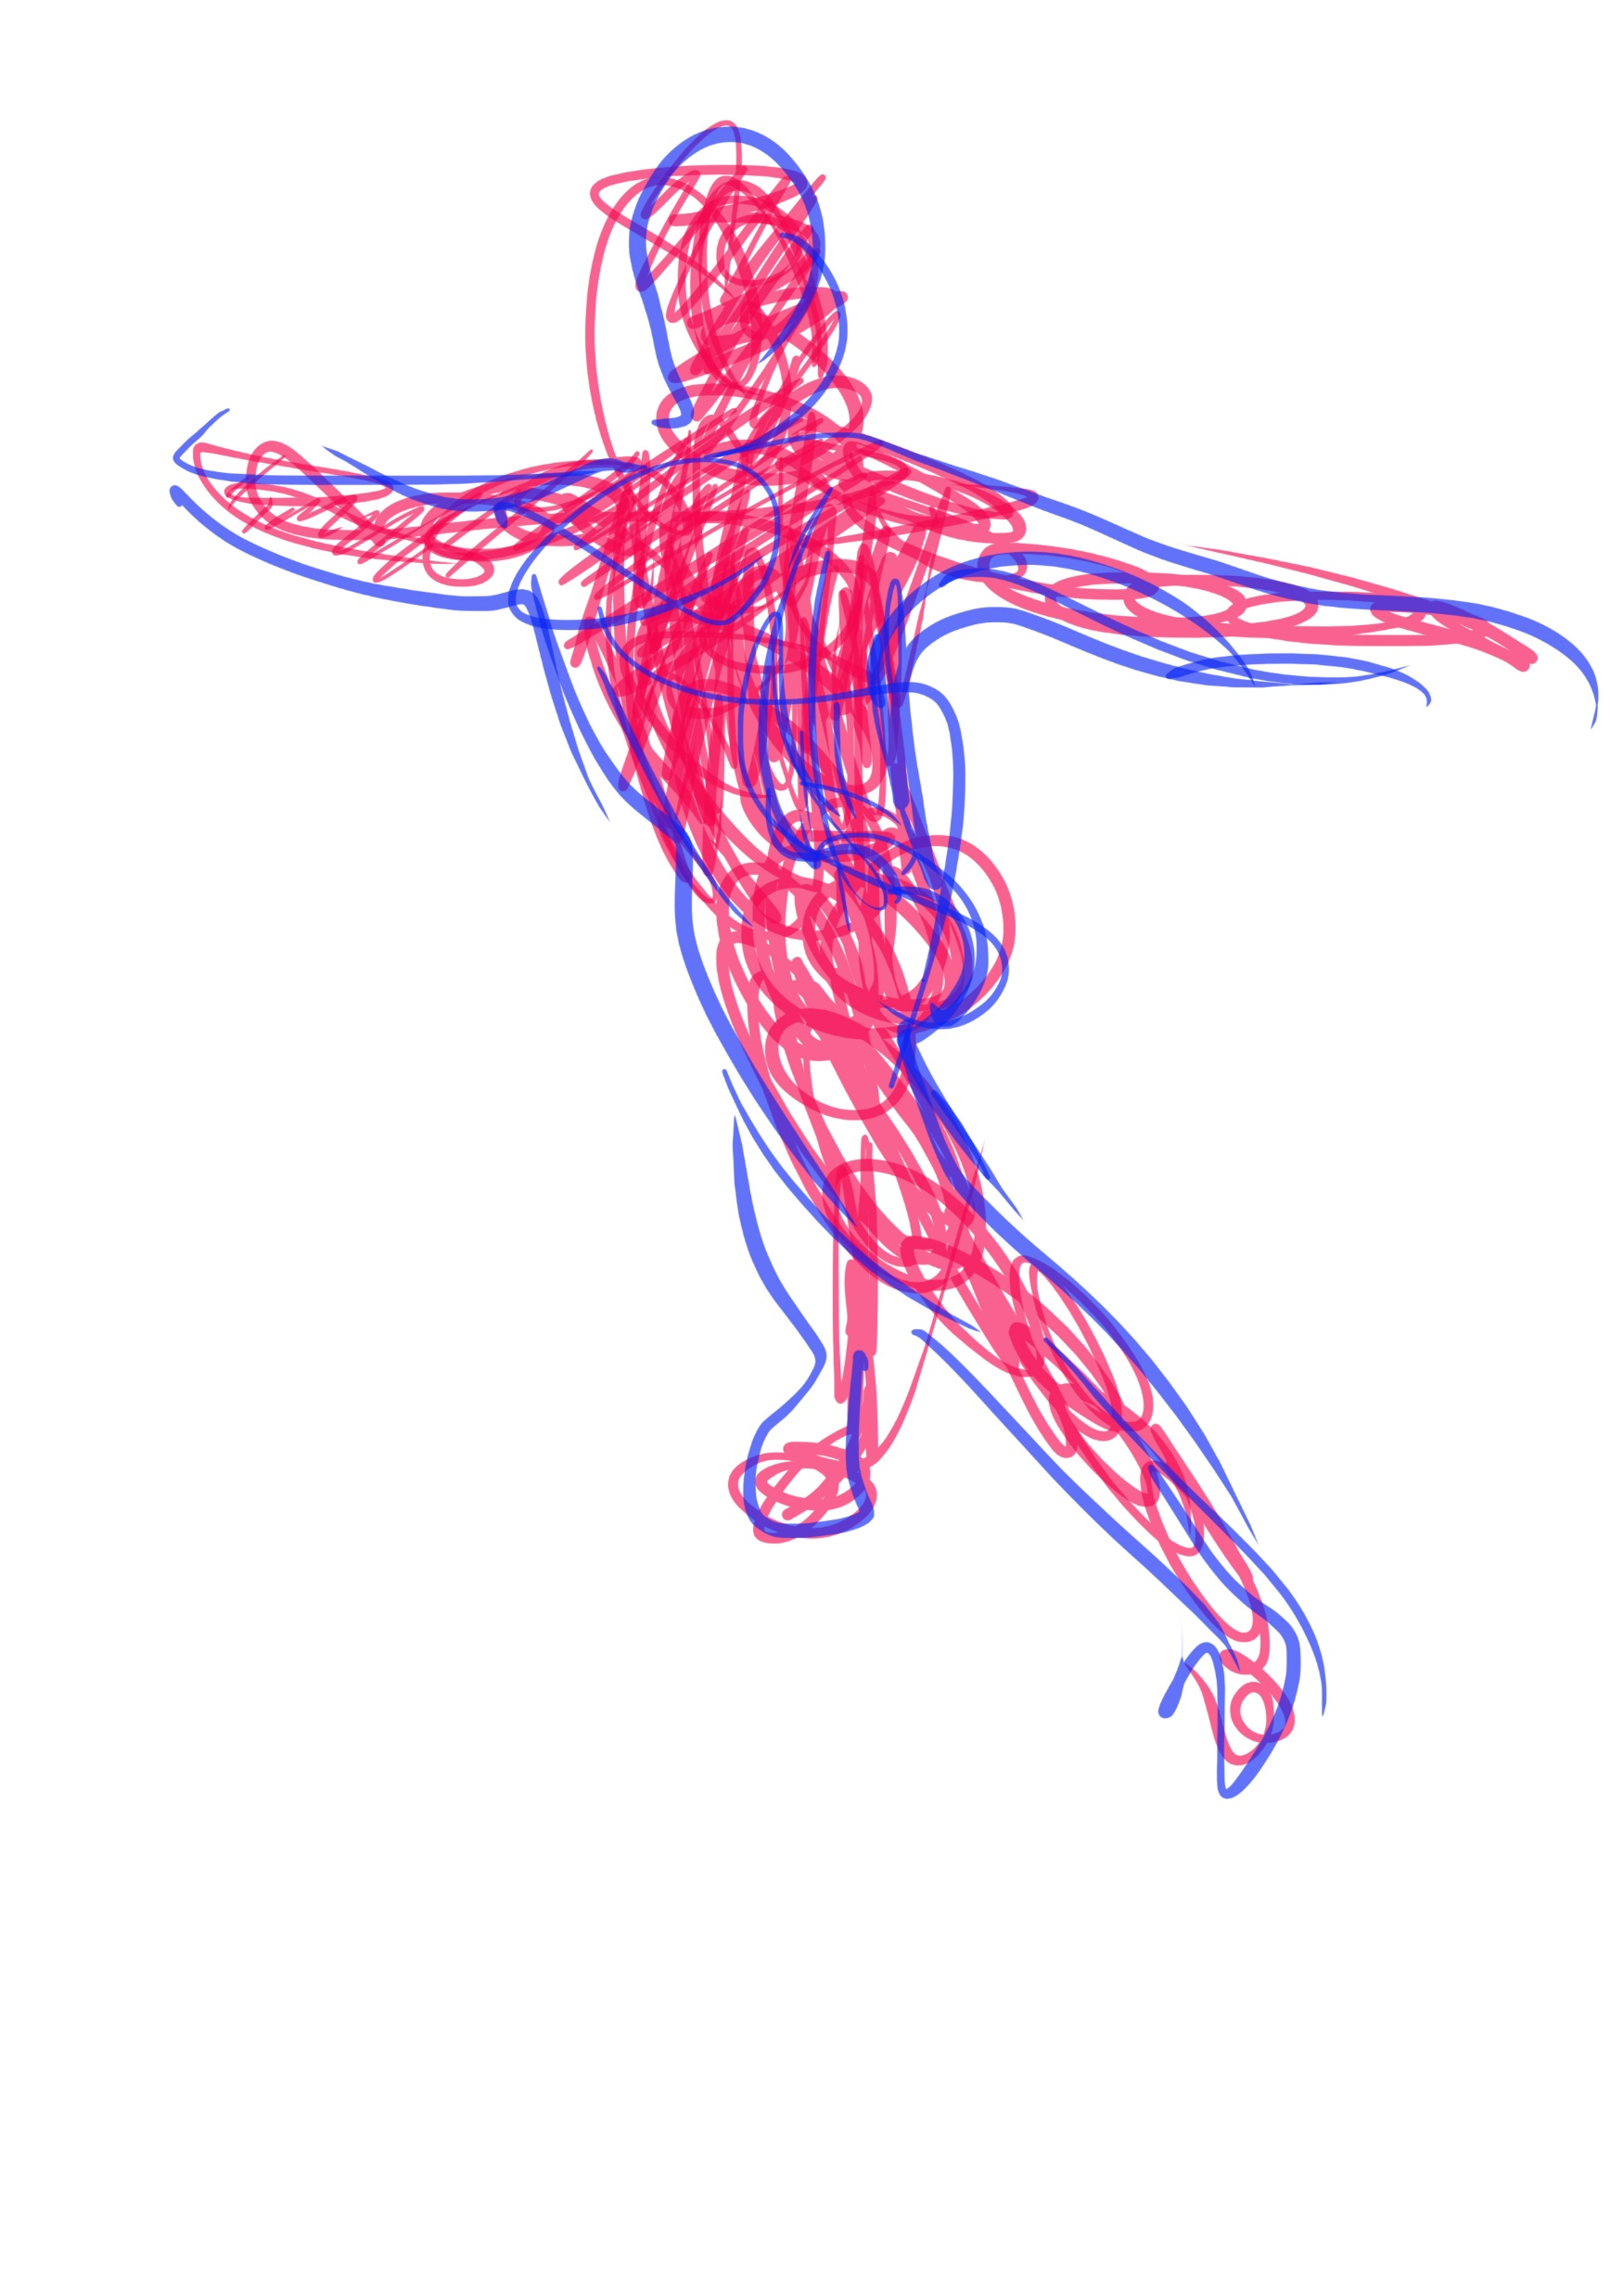
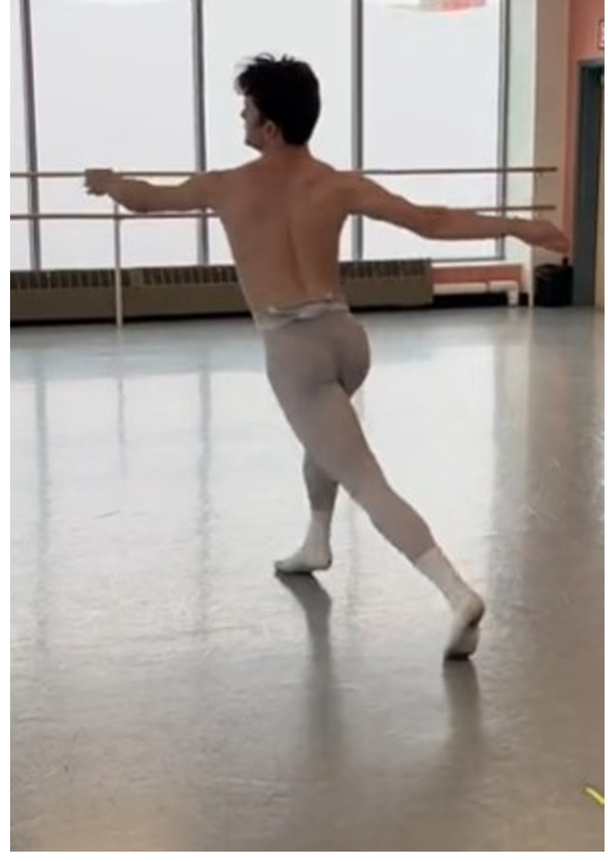
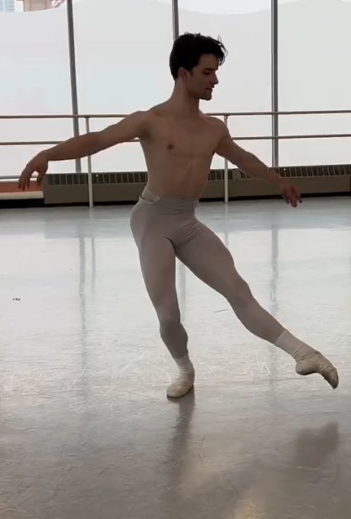
Sketching
simple with
Doodles – Tryry

Slide 5
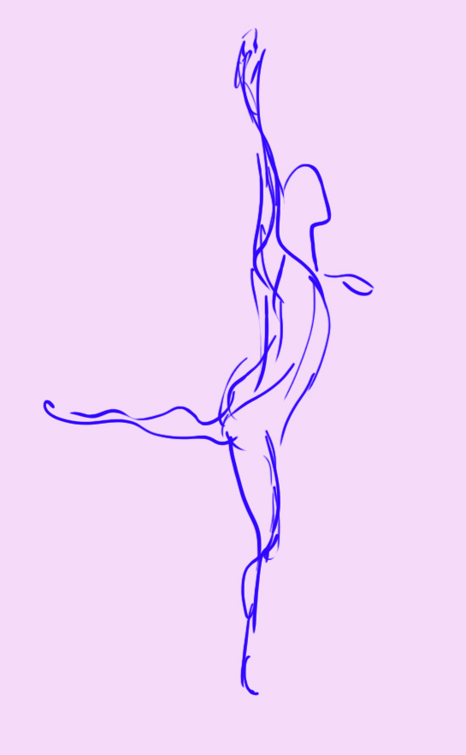
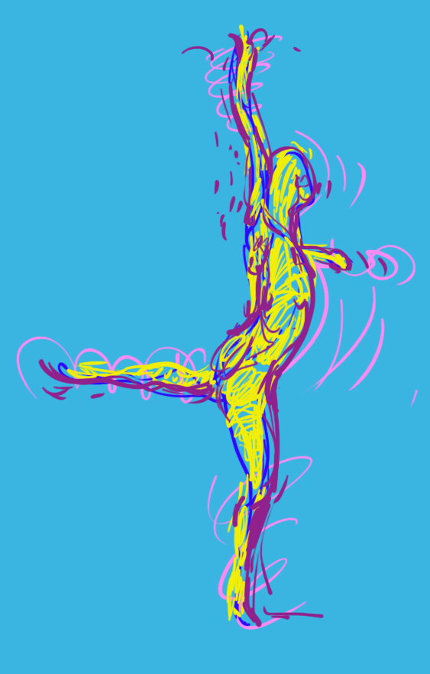
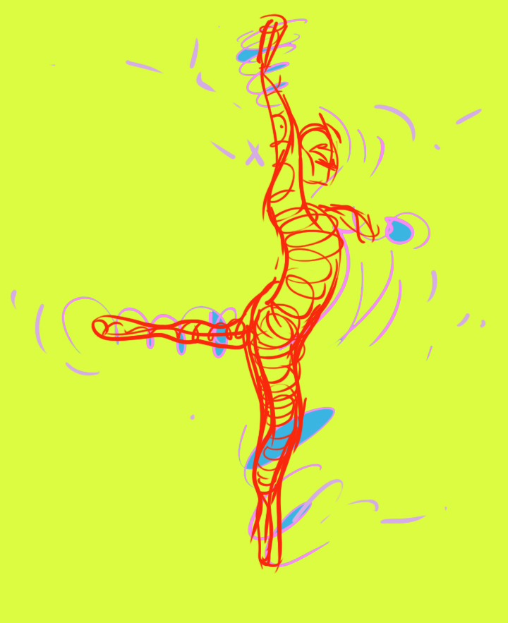

Slide 6
