Slide 1
Marine Remote Sensing
Detection of Floating Marine Litter using Sentinel 2 data
Dimitris Papageorgiou

Slide 2
Contents
Plastic waste production
Marine plastic litter
Plastic Litter Projects
Spectral Unmixing
Results and discussion

Slide 3
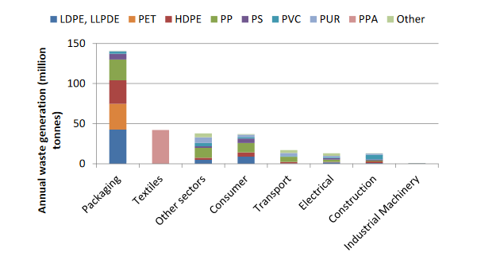
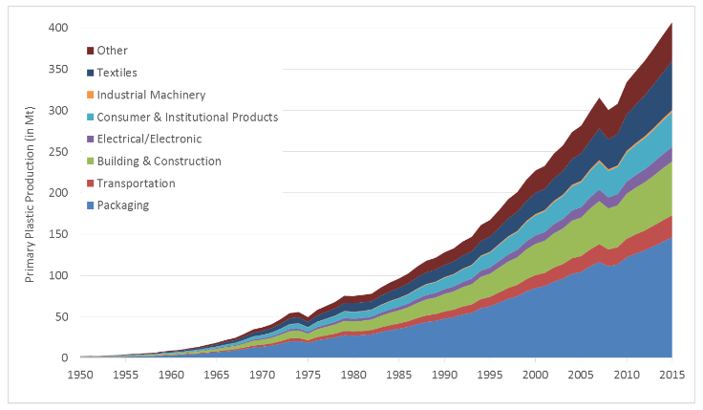
Plastic Waste Production
Plastic production: 348 Mt global , 64.4 Μt in Europe for 2017
About 302 Mt of plastic waste produced every year
About 60% of global waste production ends up in landfill, in Greece: about 80-90%
Source: OECD, 2018
Source: Geyer et al, 2017

Slide 4
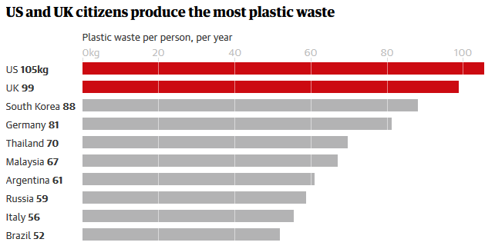
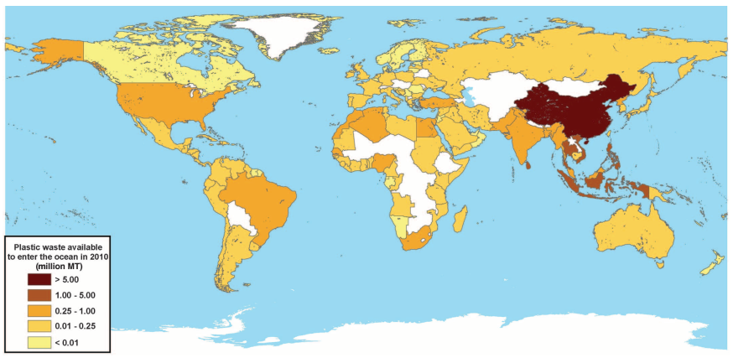
Marine Plastic Litter
40% of global population lives in <100 km from the ocean, in Europe <50 km
8.3 Mt of plastic waste (60% floating) estimated to reach the ocean ever year, x2 in 2025
Main sources: rivers, runoff, poor waste management, fishing industry, nautical activities
Increasing production/inputs/concentrations + climate change induced extreme events= need for global monitoring of marine debris
Source: Guardian graphic, data from Law et al, 2020
Source: Jambeck et al, 2015

Slide 5
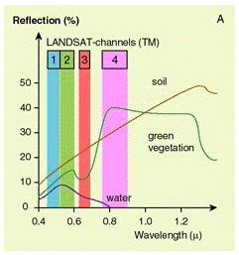
Spectral Properties of Materials
Different surface types such as water, bare ground and vegetation reflect radiation differently in various channels.
Spectral signature:
The radiation reflected as a function of the wavelength is called the spectral signature of the surface.
Source: ESA Eduspace

Slide 6
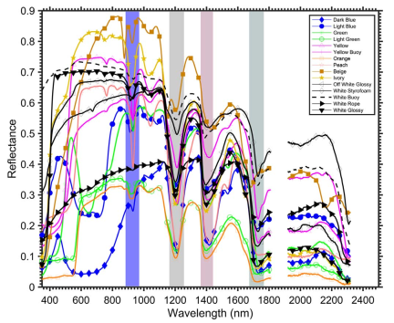
Spectral Properties of Plastics
Significant response along the whole range of the EM spectrum
Relatively flat response in VIS/NIR, variability based on colour
Characteristic absorption features in SWIR
Source: Garaba & Dierssen, 2018

Slide 7
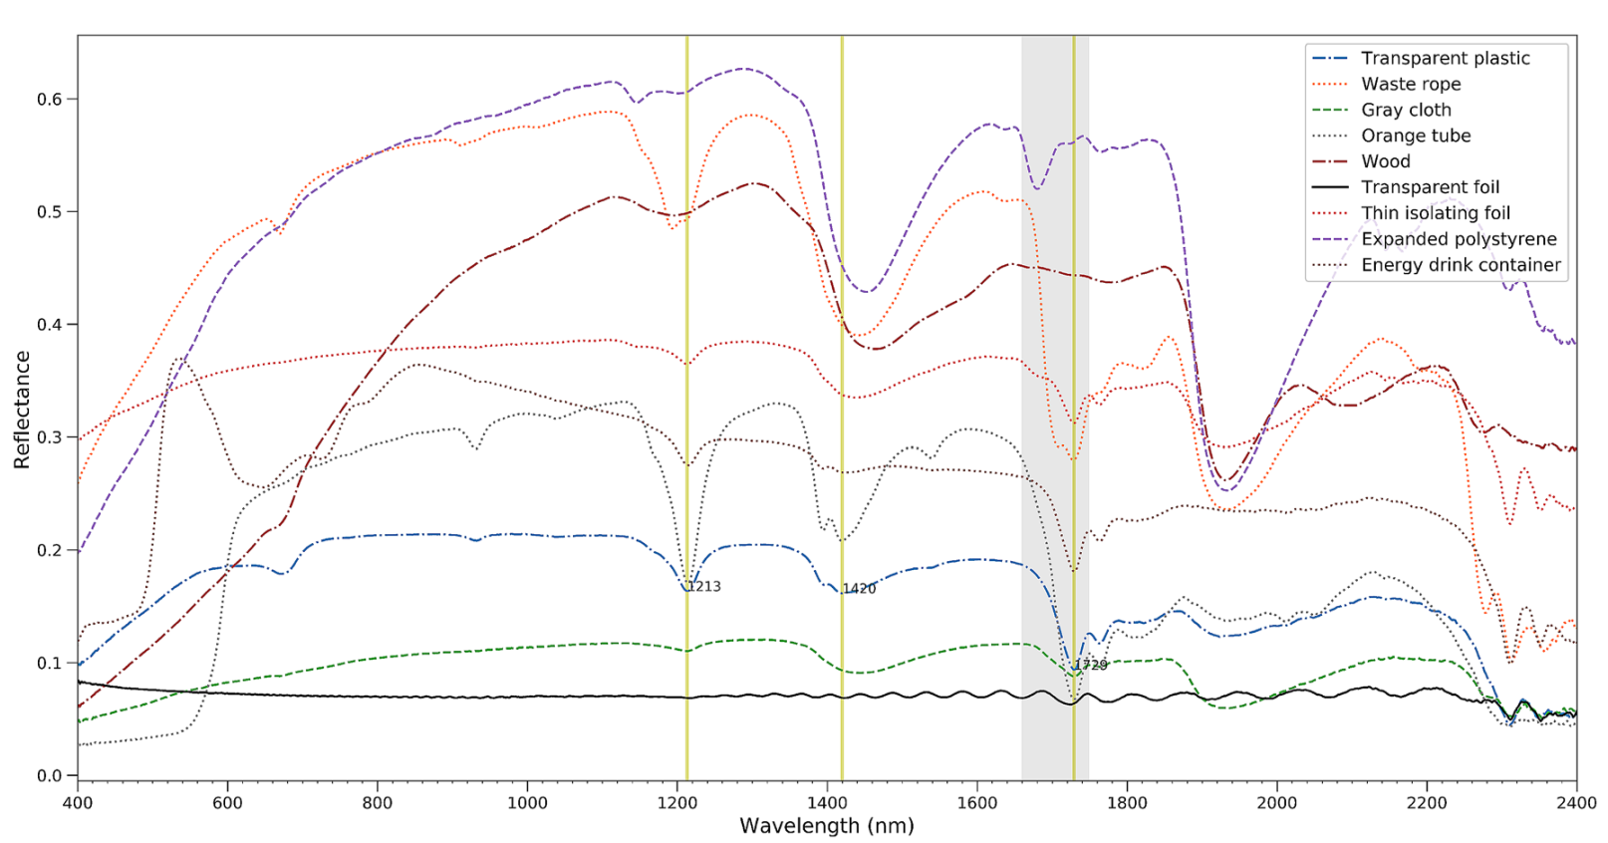
Spectral Properties of Plastics
Source: Moshtaghi et al, 2021

Slide 8
Plastic Litter Projects
Exploratory studies using open-access satellite and UAS imagery for the remote detection of floating marine litter (FML) and debris.
Controlled field experiment and data acquisition campaigns using artificial FML and natural debris targets in a realistic marine environment.
Scope:
to explore the feasibility of detecting floating plastics in the marine environment using UAS and open access satellite missions.
to extract meaningful spectral measurements in near-real scenarios.
to contribute towards the development of a floating marine debris spectral library and detection methodologies
to contribute towards the determination of sensor specifications and requirements for future satellite missions for FML detection

Slide 9
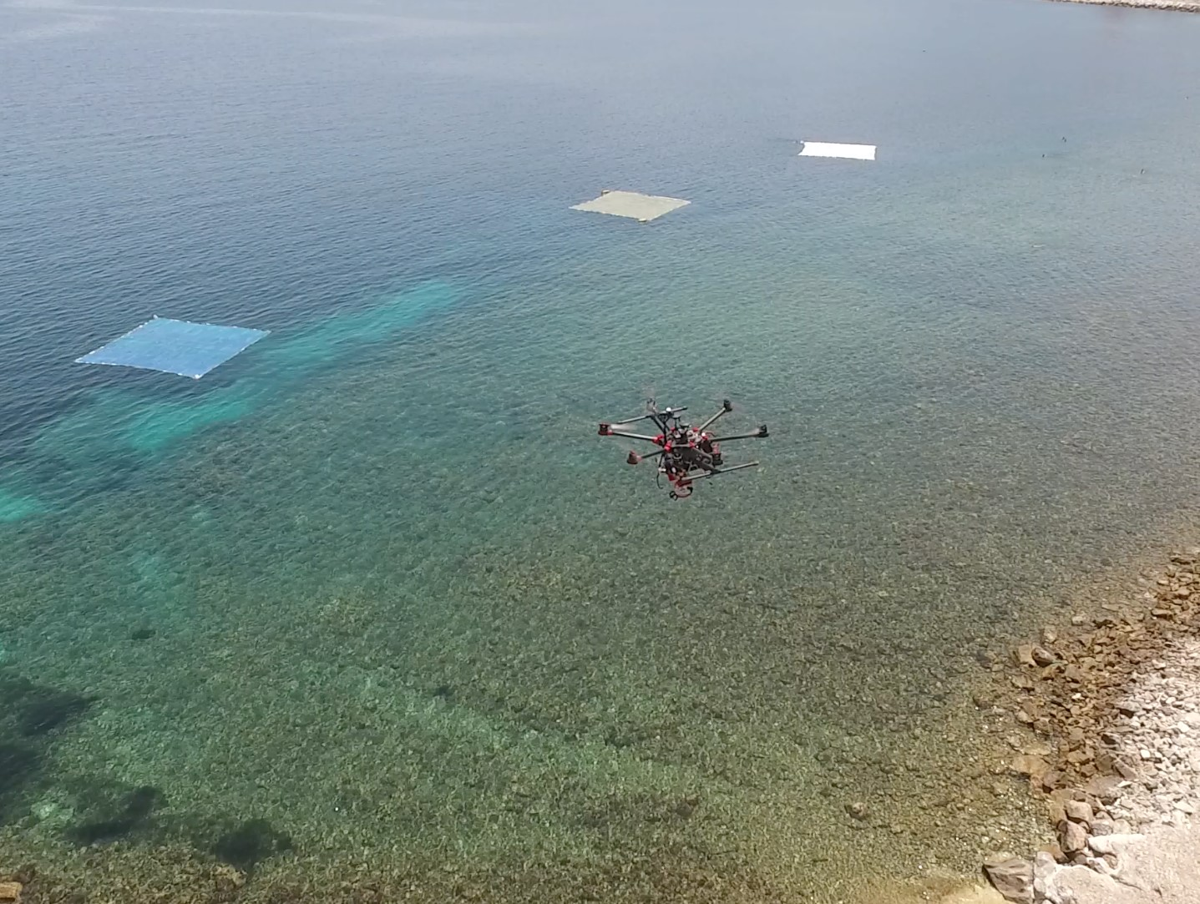
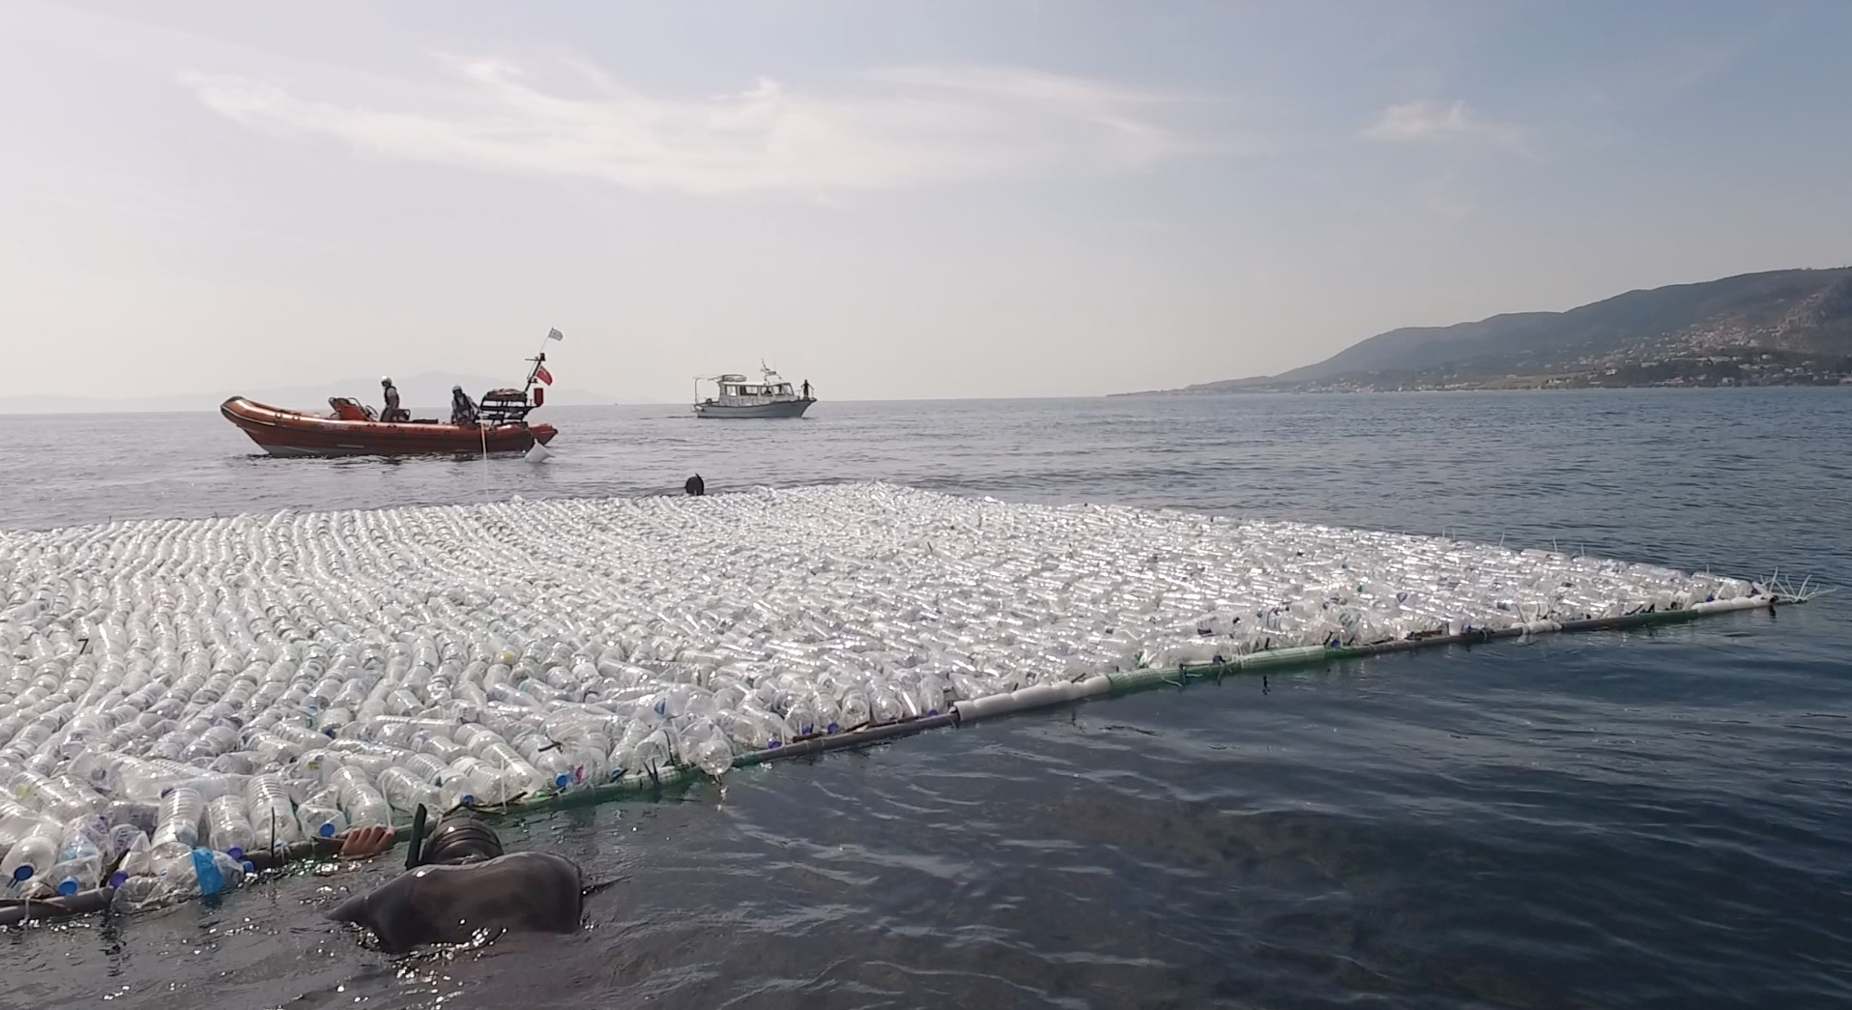
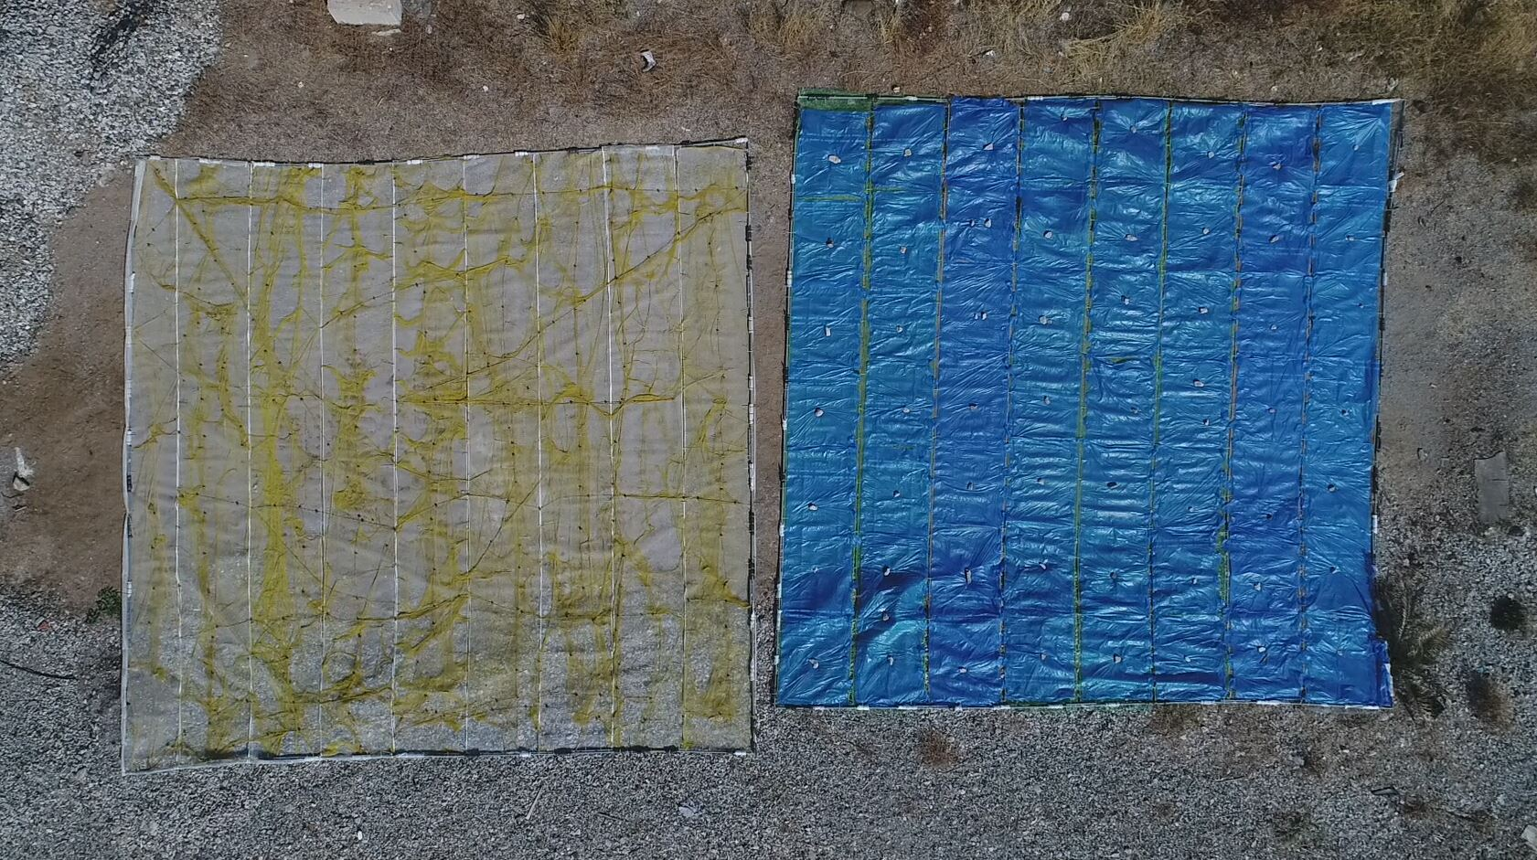
PLP 2018

Slide 10
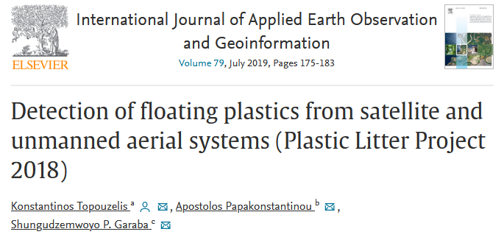
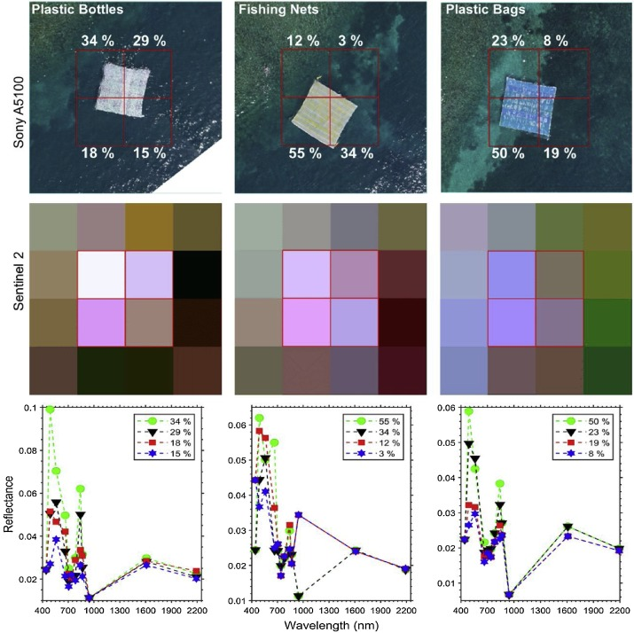
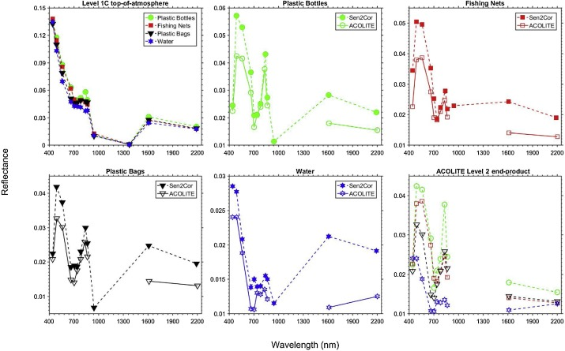
PLP 2018
Source: Topouzelis et al. (2019)

Slide 11
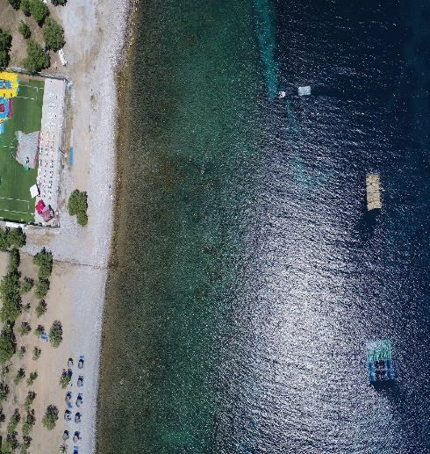
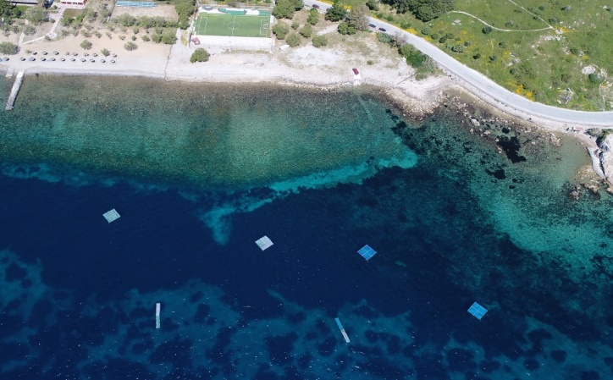
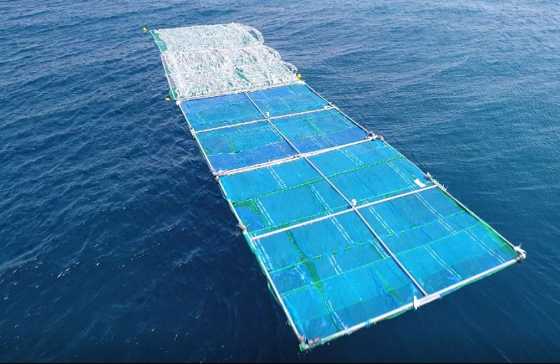
PLP 2019

Slide 12
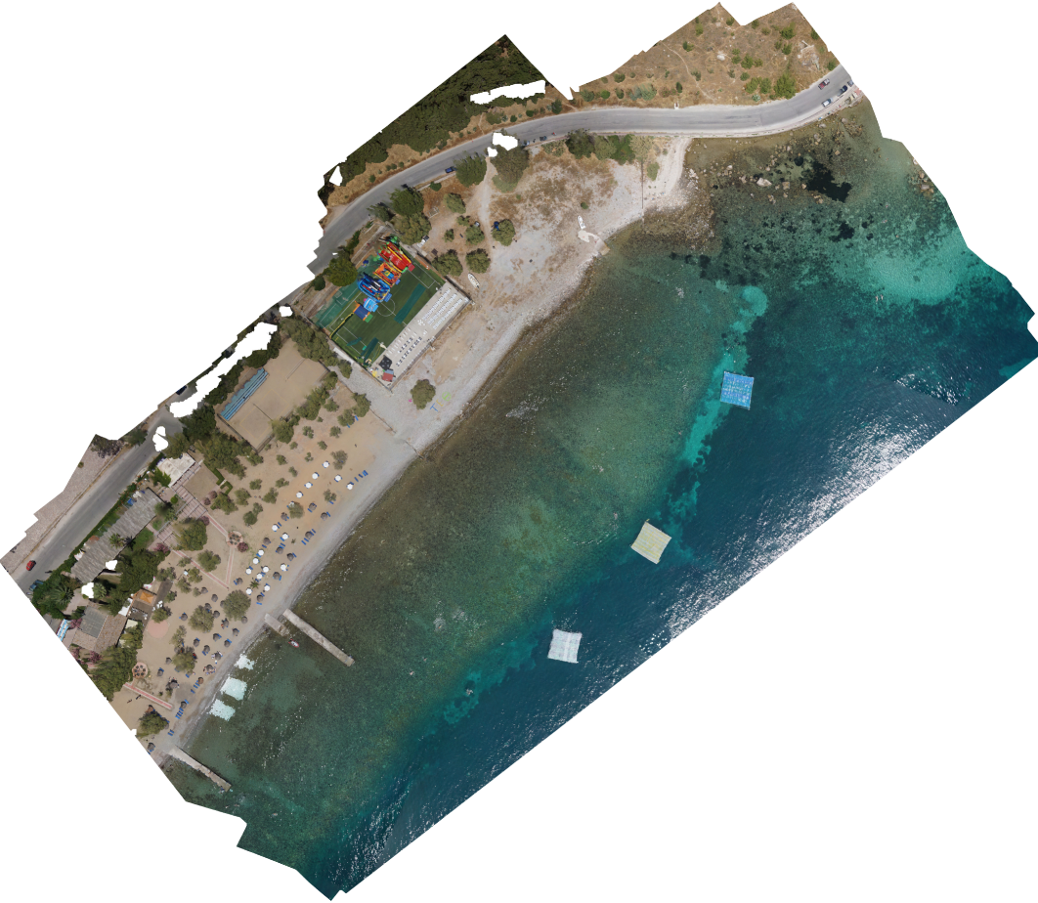
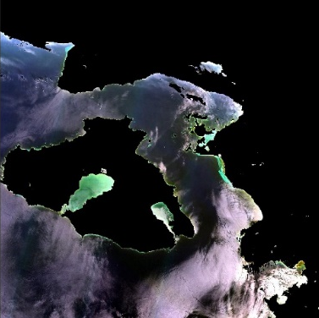
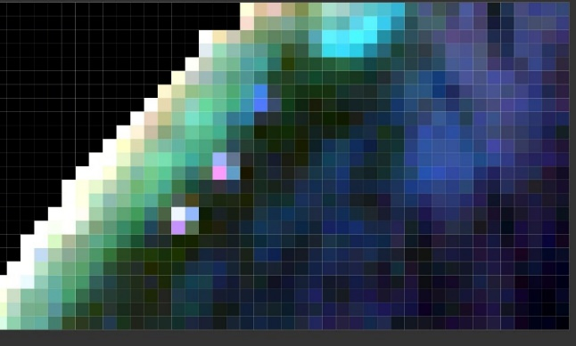
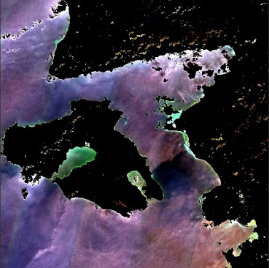
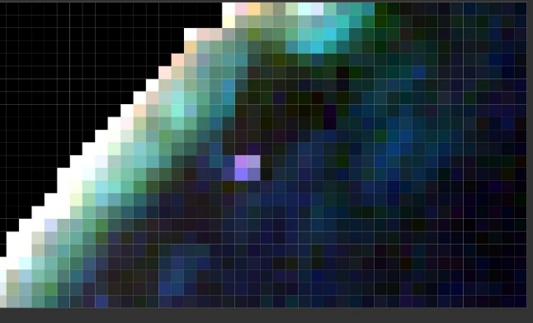
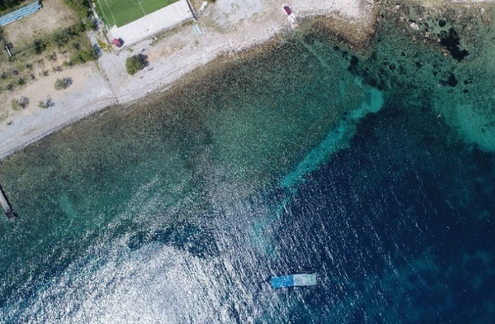
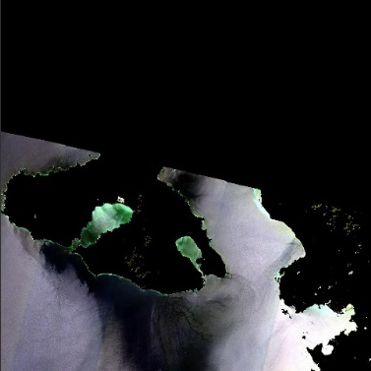
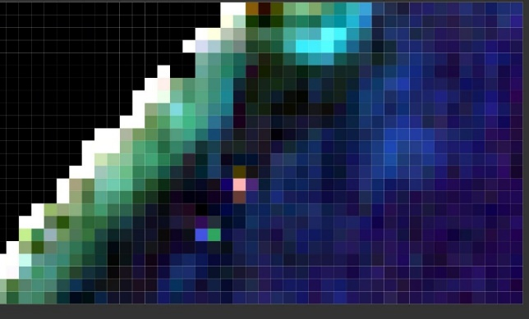
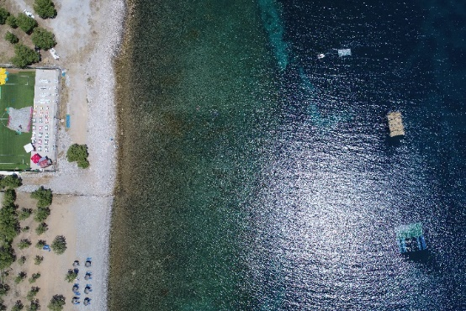
PLP 2019
20180607
10x10m targets: clear PET bottles, blue LDPE bags & nylon nets, 100% target coverage
20190418
5x20m target: PET & LDPE, 100% coverage
20190607
10x10m target: PET & LDPE, 25% coverage
5x10m: reeds,100%

Slide 13
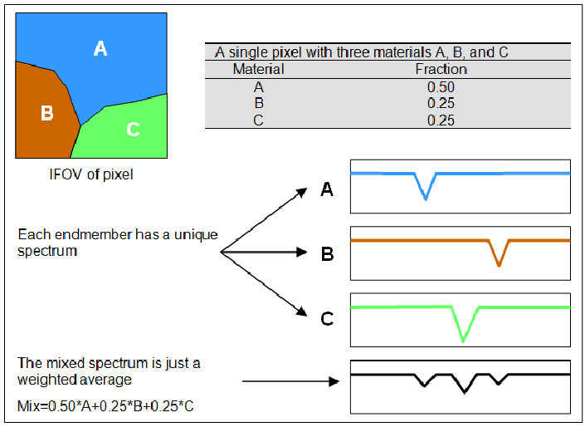
Linear Spectral Unmixing
Spectral unmixing: the procedure of decomposing the spectral signature of a mixed pixel into a set of endmembers and their corresponding abundances
Mixed pixel: a pixel whose spectral value is a combination of different spectral signatures
Endmember: a constituent of a mixed pixel with a distinct spectrum
Abundance: percentage of each endmember in a mixed pixel
$$Rt= f_{w}×R_{w}+f_{p}×R_{p}$$
Source: Kamal and Phinn (2011)

Slide 14
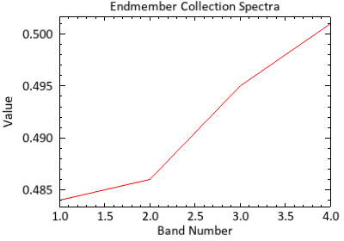
Reversed Spectral Unmixing
$$Rt= f_{w}×R_{w}+f_{p}×R_{p} ⇒ R_{p}=\frac{R_{t}−(f_{w}×R_{w})}{f_{p}}$$
USGS spectral signature for PET
Source: Topouzelis et al. (2020)

Slide 15
Reversed Spectral Unmixing
$$Rt= f_{w}×R_{w}+f_{p}×R_{p} ⇒ R_{p}=\frac{R_{t}−(f_{w}×R_{w})}{f_{p}}$$

Slide 16
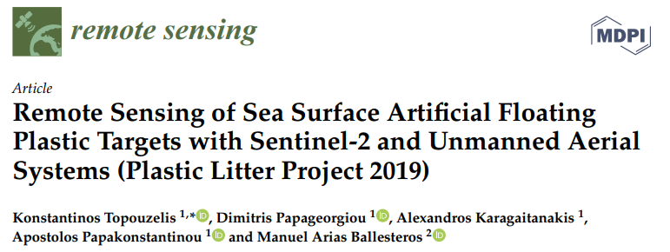
FML detection
07/06/2018, 10x10 m targets
18/04/2019, 5x20 m target

Slide 17
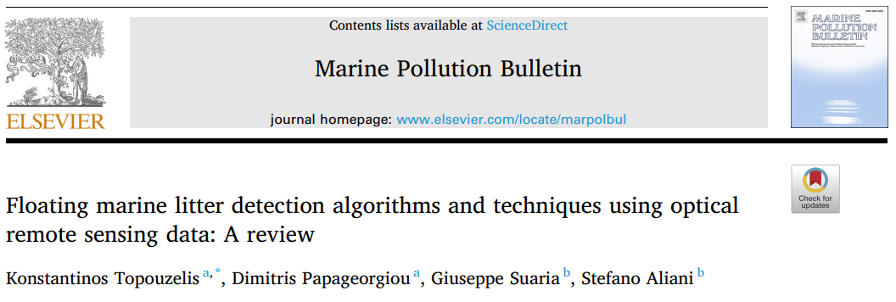
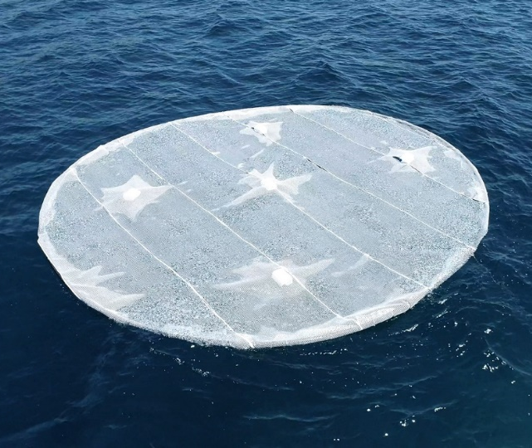
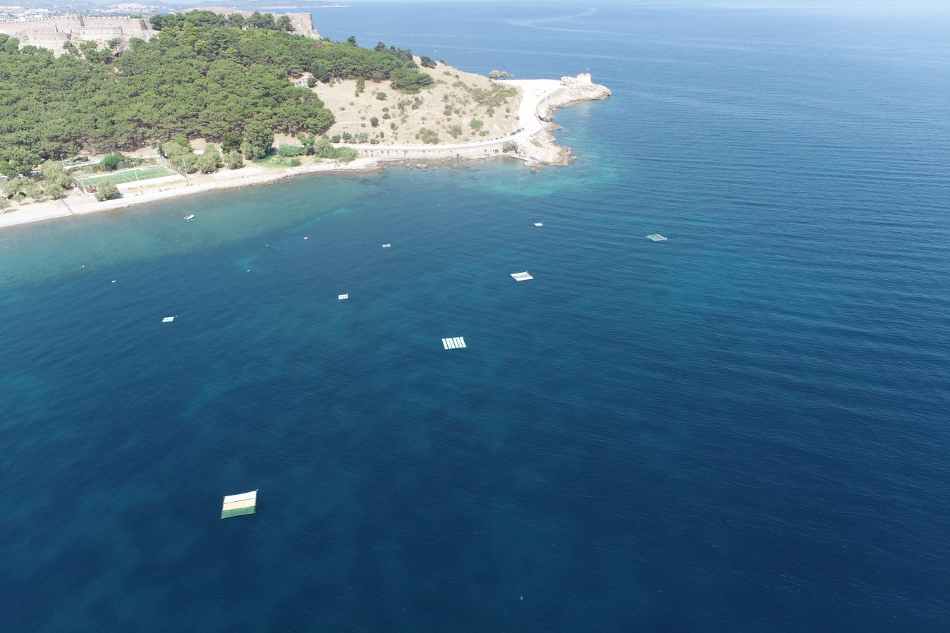
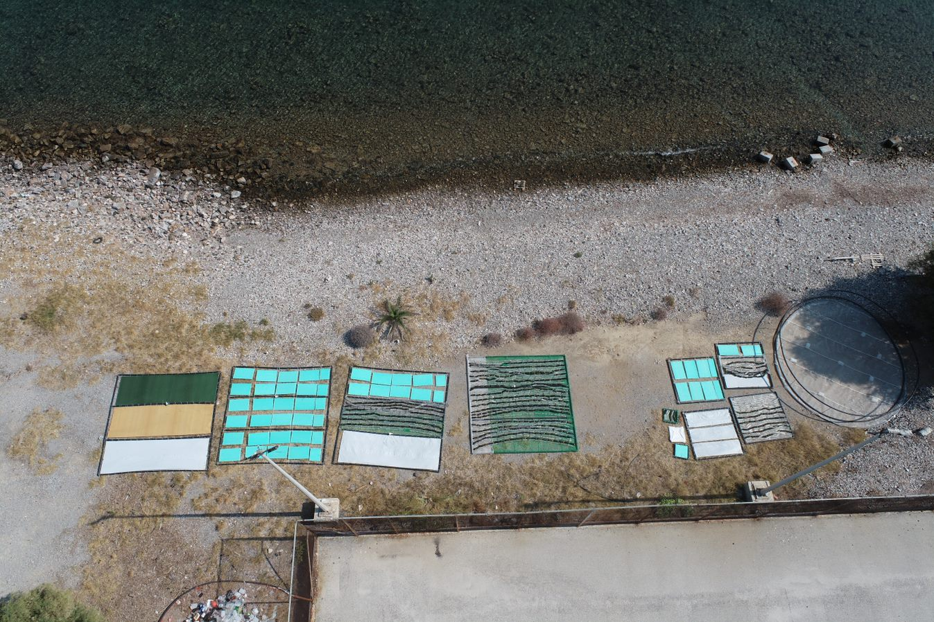
PLP 2020

Slide 18
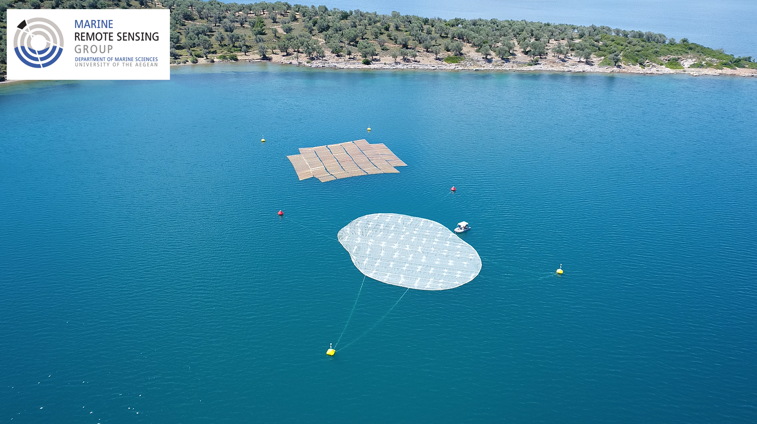
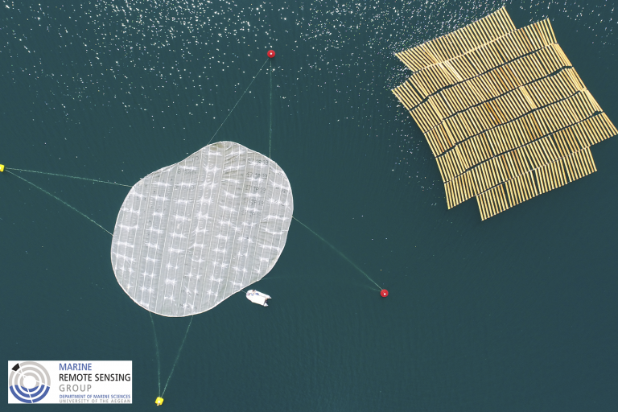
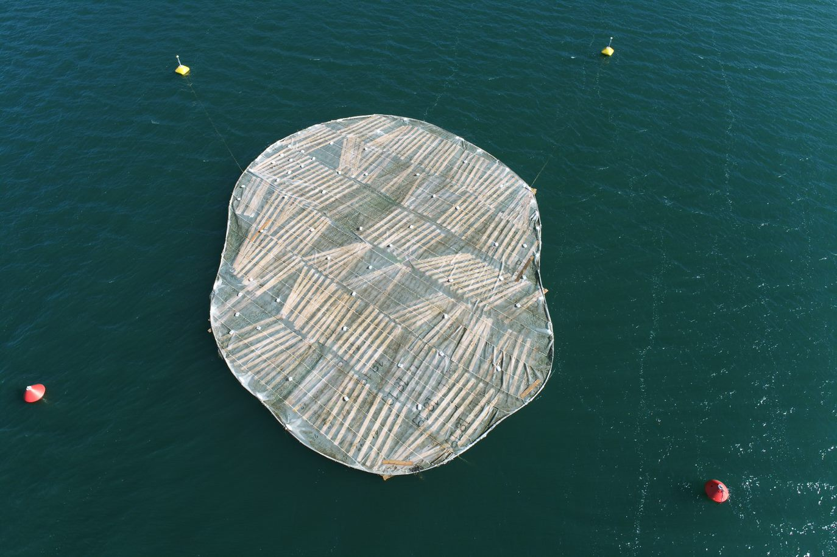
PLP 2021

Slide 19
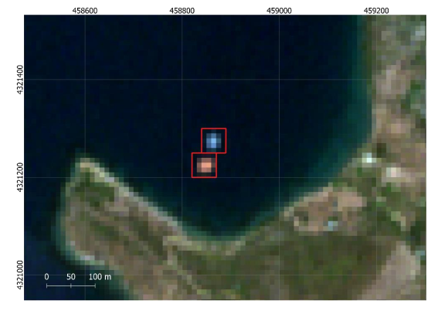
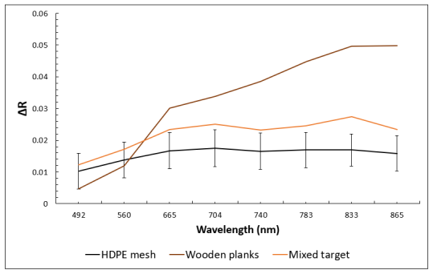
Spectral Characteristics
Source: Papageorgiou et al, 2022

Slide 20
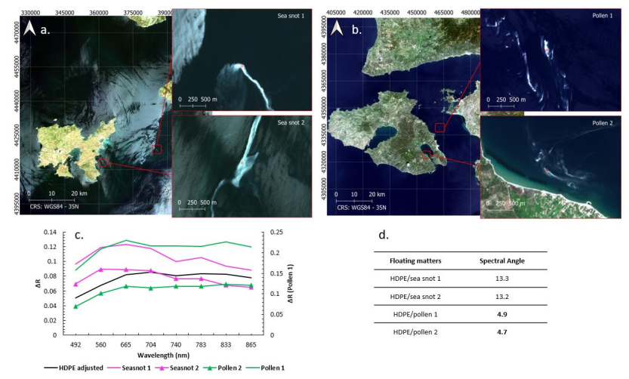
Spectral Characteristics

Slide 21
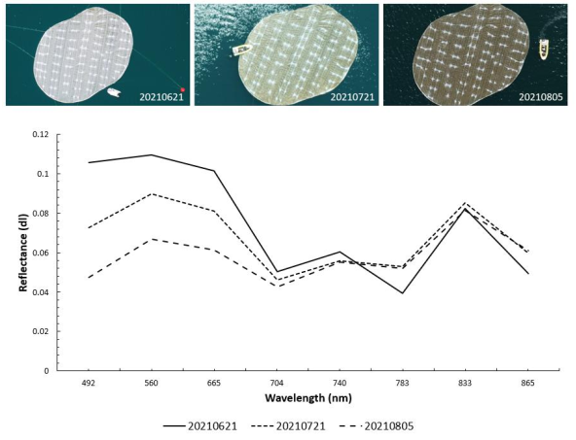
Biofouling Effects

Slide 22
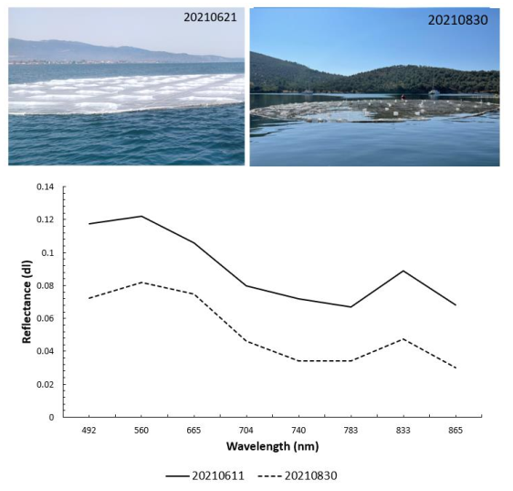
Submersion Effects

Slide 23
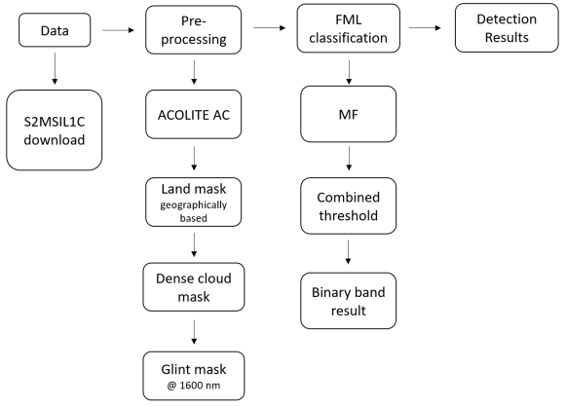
FML detection

Slide 24
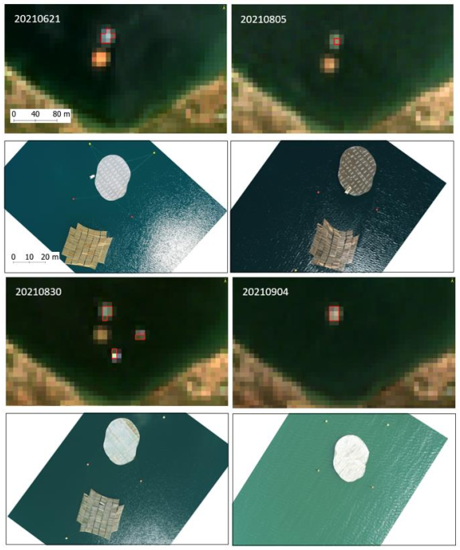
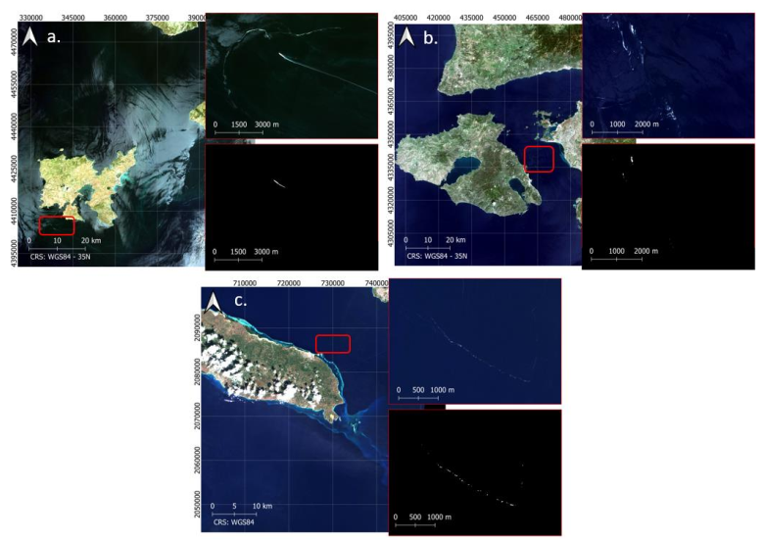
FML detection

Slide 25
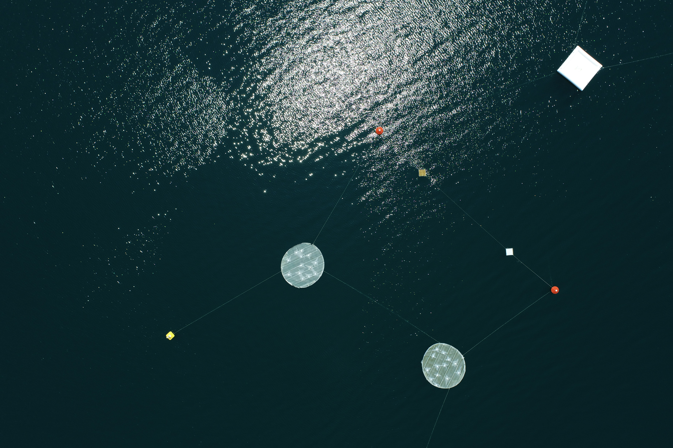
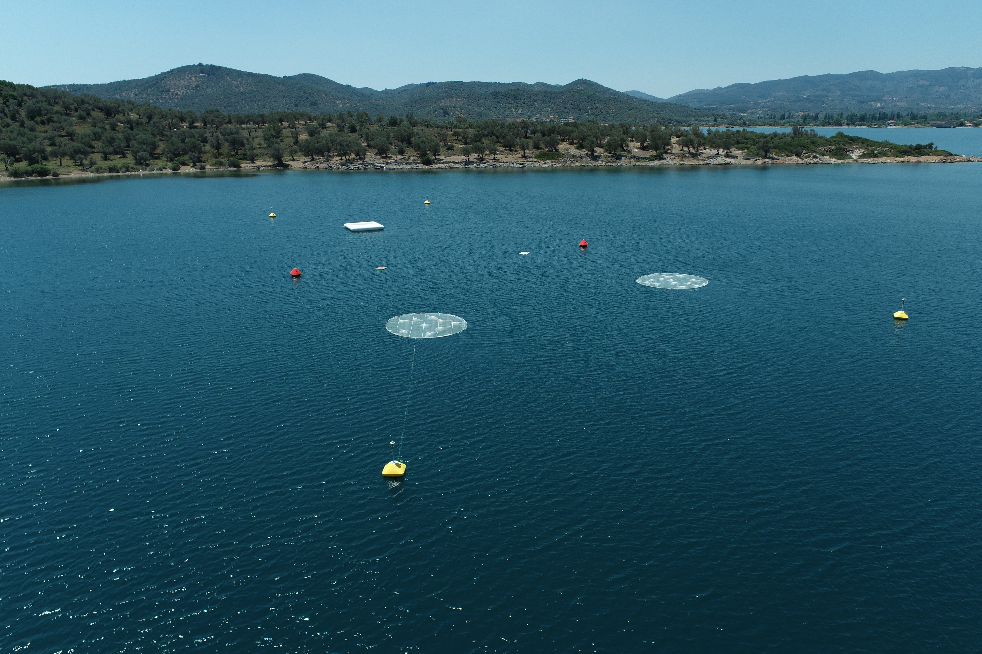
PLP 2022

Slide 26
Discussion
Factors affecting detection capacity: plastic debris abundance fractions/percentage coverage of pixel, sunglint, bottom reflectance, band signal to noise ratios, high aerosol concentrations, exhaust fumes and plumes, cloud edges and shadows, wakes, vessels.
Floating materials such as pollen and sea snot, as well as wakes, foam and vessels have spectral features comparable to those of FML, with spectral angles between the different spectra that show significant similarities.
Biofouling affects the spectral response of FML concentrations mainly in terms of signal intensity and shape in the RGB part of the spectrum.
A submersion of the target in the scale of 20 to 30 cm below the water surface results in 30–40% of signal decay throughout the visible range of the MSI’s sensor, with greater impact on NIR bands.
General Remark: FML detection and characterization using open-access satellites is extremely difficult in an operational context.

Slide 27
Dimitris Papageorgiou
d.papageorgiou@aegean.gr

