Slide 1
European Union under the influence of the current migration crisis​. An institutional and legal approach Some thoughts from the daily migration crisis management
Professor Panagiotis GRIGORIOU
Dean, Faculty of Social Studies
University of the Aegean, Greece
Jean Monnet European Chair holder

Slide 2
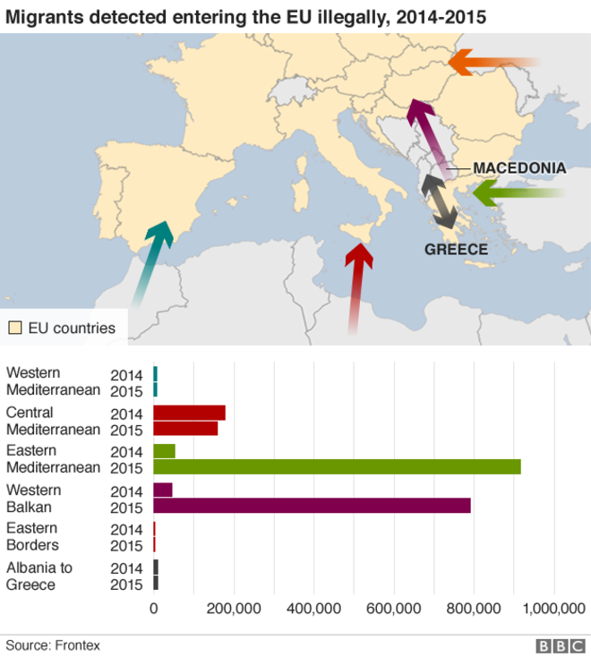

Slide 3
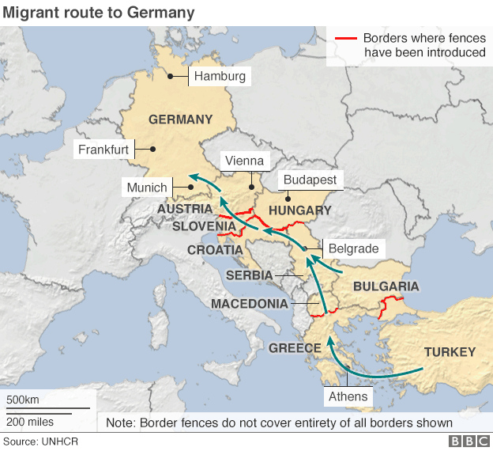

Slide 4
Describe in a few words the daily migration crisis in Lesbos Island but everywhere in the EU space from the beginning of the question until now : From panic to planning
The migration crisis is for European leaders and policy makers their greatest challenge since the Eurozone crisis.
As the EU and Member States try to balance the need for enhanced border security with their obligations to migrants under international law, deep divisions have been exposed between EU partners on how to handle the crisis

Slide 5
To better manage the crisis
EU and MS must agree on ways to address all the shortcomings in the asylum and immigration system.
The disproportionate responsibility of certain MS with external borders to handle migrant flows and a reluctance among pothers to shoulder the burden
Lengthy detention periods and poor treatment of refugees
Inadequate resettlement and integration efforts
A fundamental lack of understanding of the nature of current migration flows
An inability to tackle the root causes of the crisis

Slide 6
Defining migrants, refugees and asylum seekers
The terms refugee and migrant are often used interchangeably, but their meanings are quite distinct: one is enshrined by international law, the other subject to a country’s immigration policies and procedures.
The UN Convention Relating to the Status of Refugees defines a refugee as someone who is fleeing conflict or persecution (for reasons of race, religion, nationality, membership in a particular social group or political opinions) and is seeking refuge across international borders.
An asylum seeker is someone who has submitted a request for asylum in a country other than his or her own and awaits a decision on the application for refugee status under relevant international and national instruments. If the request is denied, the person must leave the country and may be expelled.
A migrant, on the other hand, is someone who makes a conscious choice to leave his or her home country for a better quality of life or for economic gain.
An irregular migrant is someone who lacks legal status in a transit or host country because of unauthorized entry breach of a condition of entry or an expired visa.

Slide 7
The refugee crisis in 7 points
Which countries are migrants from?
Where are migrants going?
How do migrants get to Europe?
How dangerous is the journey?
Which European countries are most affected?
How has Europe responded?
How many asylum claims are approved?

Slide 8
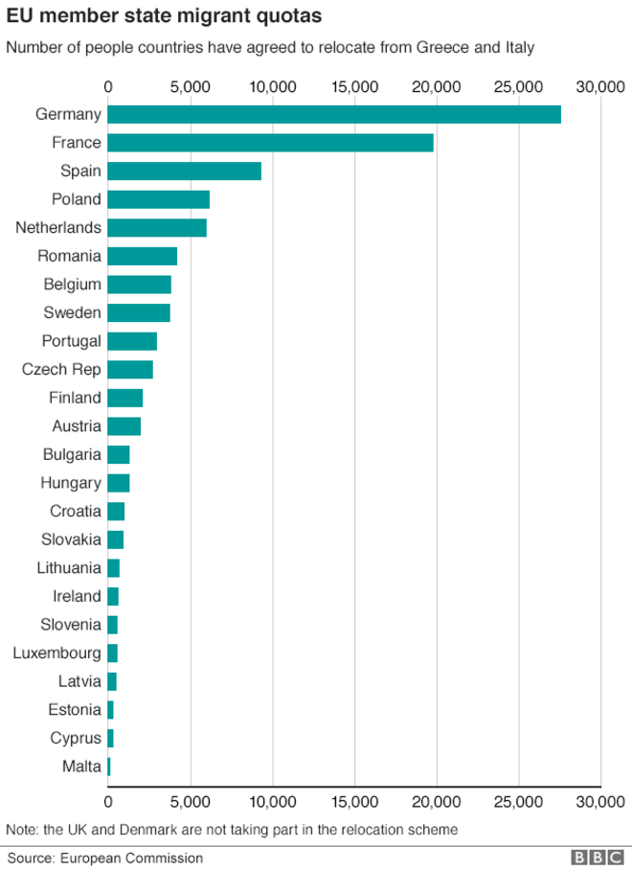
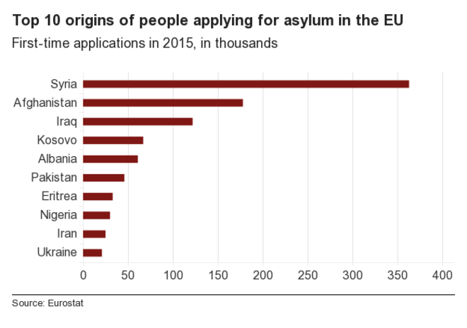

Slide 9
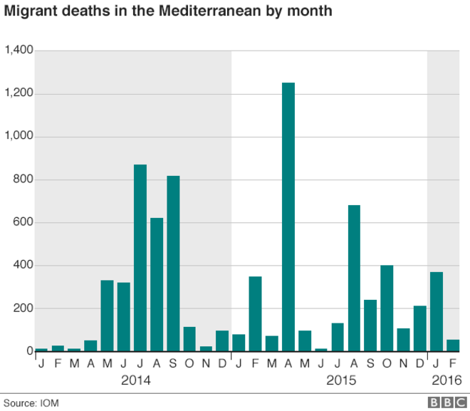

Slide 10
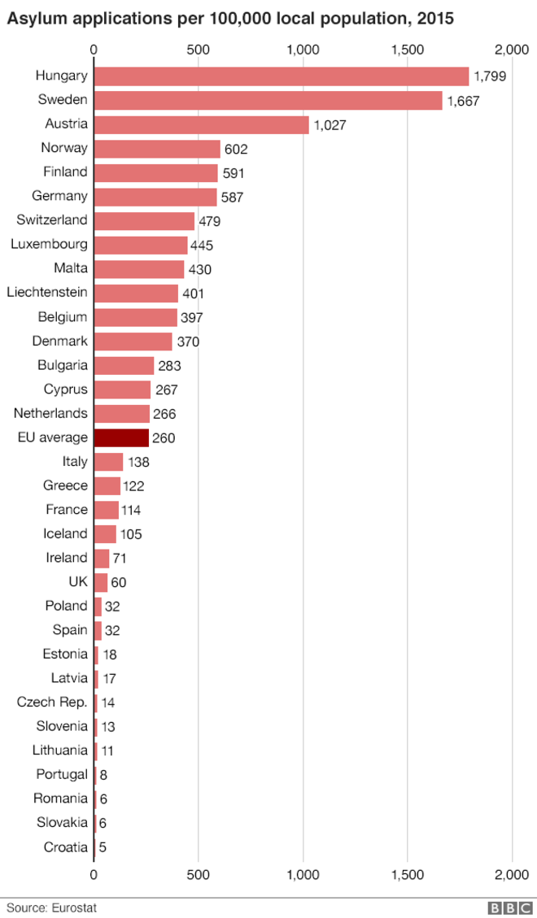

Slide 11
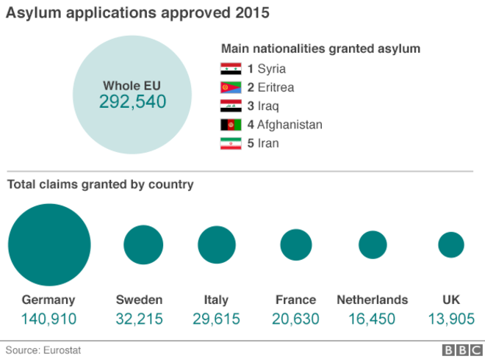

Slide 12
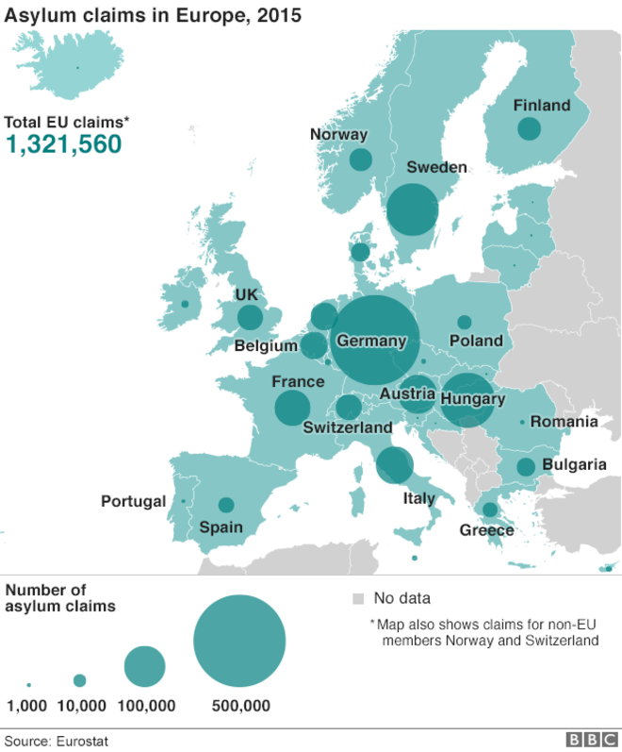

Slide 13
EU- Turkey Agreement, 18.3.2016
What has been agreed?
On what legal basis will irregular migrants be returned from the Greek islands to Turkey?
Possibilities that could be envisaged for declaring asylum applications inadmissible
What safeguards exist for asylum seekers?
Will asylum seekers remain in Greece during the appeal procedure?
Where will migrants be accommodated whilst they await return?
How can you be sure that people will be given protection in Turkey?
Operational support to Greece for the asylum process, for the appeals process, for the return process and who will coordinate this support
What financial support will provided to Greece?

Slide 14
The next day : deportations from Greece to Turkey
Dispute deal
Migrant arrivals to Greece in 2016, up to 20.4 : 154,227
376 died on Turkey-Greece route
37% of 2016 arrivals are children
853,650 arrivals in 2015 (source IOM)

