Slide 1
Sustainable Solutions at Times of Transition
SuST2024 International Symposium and Workshops
07 - 10 July 2024, Nisyros Island, Greece
Participatory processes as a key strategy for sustainable Ionian islands
Spilanis, I., Karampela, S., Alexiou, E., Katsounis, I., Dimitropoulos, P., Mitropoulou, A., Laskari, K.
Laboratory of Local and Island Development,
Department of the Environment – University of the Aegean

Slide 2
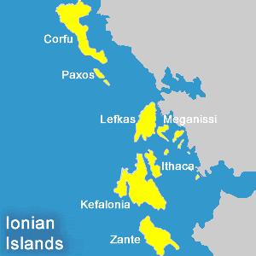
BACKGROUND
Islands, with their unique ecosystems, cultural richness, and captivating landscapes, have long been favored destinations for tourists seeking idyllic retreats.
At the same time, this increasing number of visitors can also pose significant challenges to these fragile environments.
Sustainable tourism development is a crucial issue and should be based on a strategy involving all stakeholders, among others local authorities, entrepreneurs, residents, and visitors.

Slide 3
METHODOLOGY
A primary research was conducted to tourism stakeholders from selected islands of the Ionian region (Zakynthos, Kefalonia, Ithaki, Lefkada, Kerkyra).
The tool used, was a questionnaire which was completed by 111 participants through face to face focus groups during the period between January and February 2024.

Slide 4
Percentage of stakeholders’ groups participated in the study
Other
Airport carriers
Port and Marina operators
Tourist guides
Catering Association
Chamber
Hoteliers Association
Municipality
Prefecture

Slide 5
TOOL
condition of the islands under increased tourism pressure
The questionnaire
aimed to capture the stakeholders’ perceptions regarding the…
evaluation of the reasons that have led to this situation
priorities in terms of the goals of a sustainable tourism development plan
actions that need to be undertaken

Slide 6
RESULTS

Slide 7
How sustainable do you consider the island?

Slide 8
In your opinion, in what way is the sector you represent, affected by the tourism development?
Definitely negatively
Probably negatively
Nor negatively, nor positively
Definitely positively
Definitely positively

Slide 9
Tourism
externalities
Streets crowding
Environmental impact of tourism
Water availability
Increase of noise
Rise in the cost of living
Difficulty in finding a house to rent
Traffic/Congestion problems
Problems in solid waste management
Degradation of the environment and landscape (for Zakynthos & Corfu)
Reasons that have led to this situation

Slide 10
Overall impact of tourism on the state of the destination
5.05
3.44
3.38
SUSTAINABILITY
CARRYING CAPACITY
OVERTOURISM
(rated 1-10)
Max Ithaca 6.07
Min Zakynthos 4.38
(rated 1-5)
Max Zakynthos 4.04
Min Kefalonia 2.38
(rated 1-5)
Max Zakynthos 4.11
Min Kefalonia 2.5

Slide 11
Stakeholders’ priorities concerning the goals
of a sustainable tourism development plan
Improving the quality of life of the society
Developing a strategy for sustainable tourism
Improving the decision-making and implementation system in tourism (tourism governance)
Diversification of the tourism product produced using local resources (enhancing localism)
Employing trained staff capable of meeting modern challenges
Improving economic results for the local community
Improving the working conditions of tourism employees
Certifying the destination as a sustainable one
1
2
3
4
5
6
7
8

Slide 12
In relation to the proposed actions, the following were mostly reported:
Focus on culture
and the environment to reduce tourism seasonality
Provision of training and retraining for employers and employees
Special Interest Tourism development
Improvement of
public spaces & implementation of sustainable mobility programs
Enhancing recycling
with the instant
refund system
Creation of
Destination Management & Marketing Organizations (DMMOs)

Slide 13
CONCLUSIONS
The research reveals a clear intention for substantial and immediate differentiation from the current state of tourism towards a more sustainable perspective.
This can contribute significantly to the improvement of the community's prosperity and well-being.

Slide 14
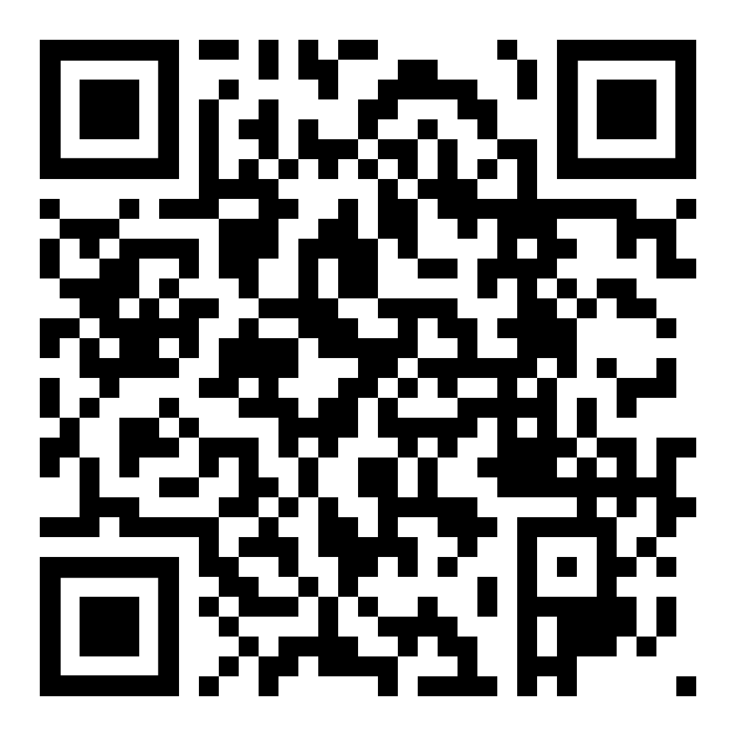
Thank you
for your attention
Acknowledgments
This research is funded by the Special Managing Authority
for the Operational Programme “Ionian Islands”

