Slide 1
Everyday Fairy tales
Digital forms of storytelling
Team 1:
Xynada xenia (dpsd14077)
Motsenigou Tatiana-myrto(dpsd15069)
Maria Forte Ruiz dpsd18144
Duygu Pug dpsd18143

Slide 2
Brief
The story its about a girl which lives her life surrounded by fairies that she does not know about. They interfere in small things of her routine, such as looking for her keys, making coffee, etc..
These fairies are living beings, there for, they are all different and have personalities of their own. Some are kind and want to help the girl and some others are just naughty and like causing trouble..

Slide 3
Some basic info for the project theme
Target group
The target group are mainly children and people who are interested in fairies, fairy tales and folklore.
Locations
Since we will show how the fairies are getting in the life of a human we will use a house as our main location where everything will happen. We will use only the interior of an apartment.
Genre
Fantasy and comedy

Slide 4
INfluences
Pete’s Dragon(1977)
Who Framed Roger Rabbit(1988)
Space Jam(1996)
Looney Tunes: Back in Action(2003)
Marry Poppins(1964)
Heavy Traffic(1973)
Winsor McCay’s Gertie the Dinosaur(1914).
Mythology/folklore
Portray some fairies ae demons (have bad intentions) (goblins and gromes)
Some others as angels (have good intentions) (pixie)

Slide 5
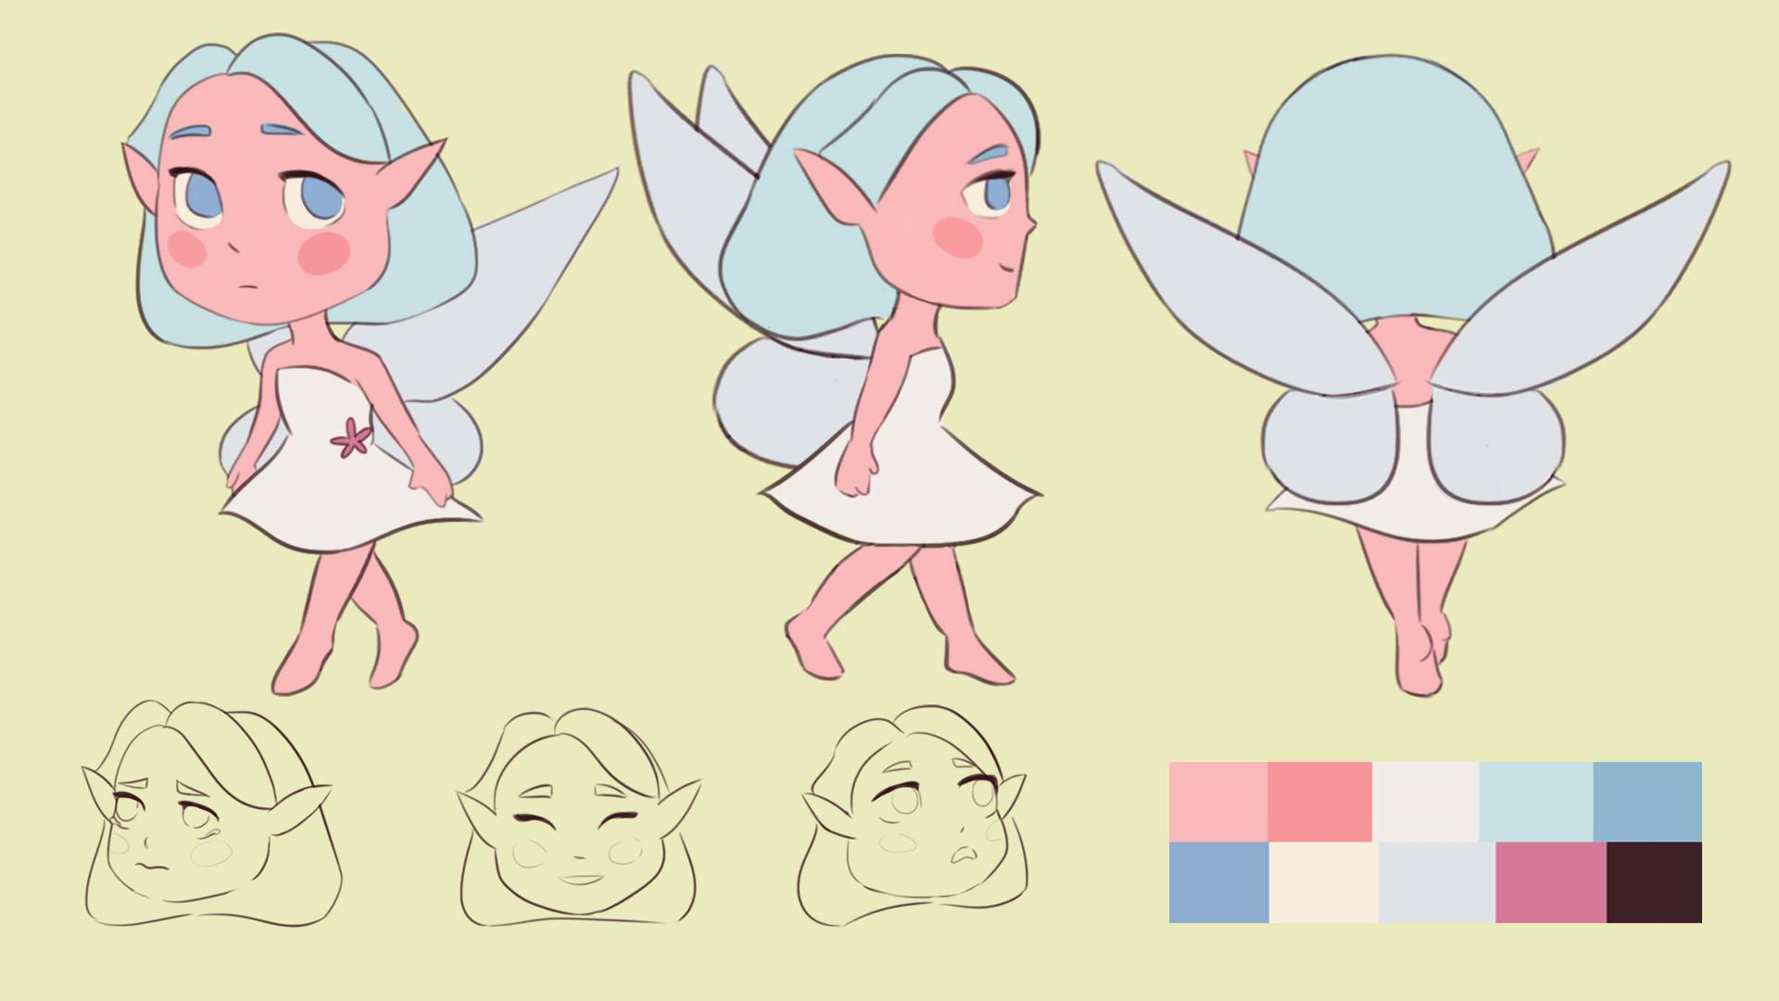
Characters
The good fairy: She just wants the girl to be save and she wants to help her. She’s kind of enemies with the naughty ones because they are always causing trouble to the girl. But she is not violent at all, she’s kind of silly, calm and positive.

Slide 6
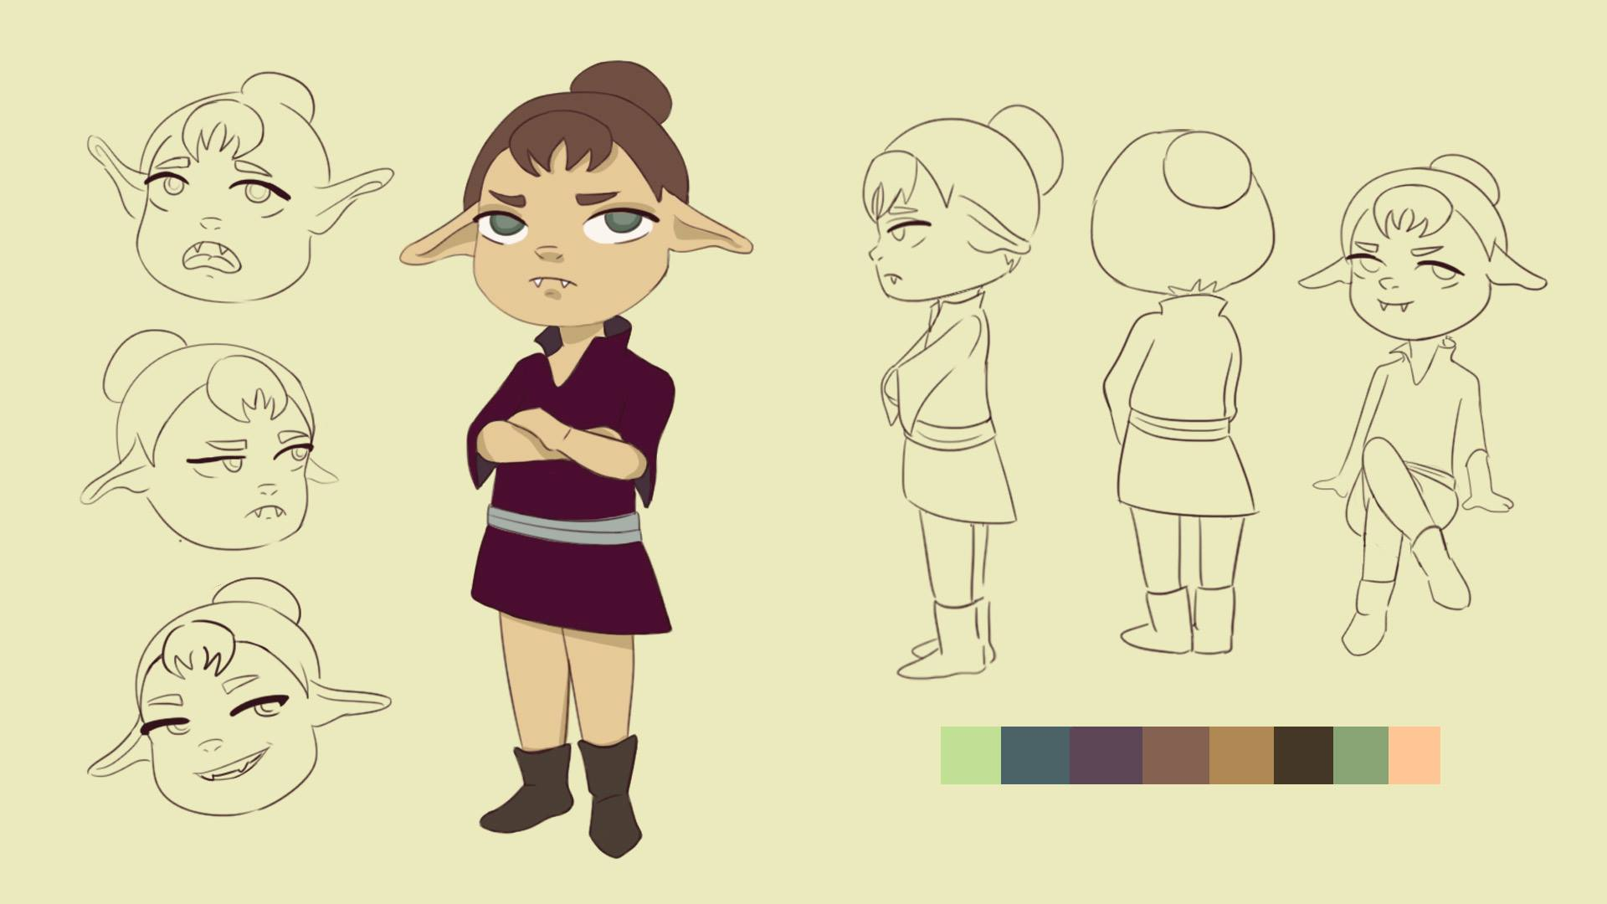
Characters
Naughty fairy 1 (the girl): She’s calm and cold. She is the brain of the group, but she is not the leader.

Slide 7
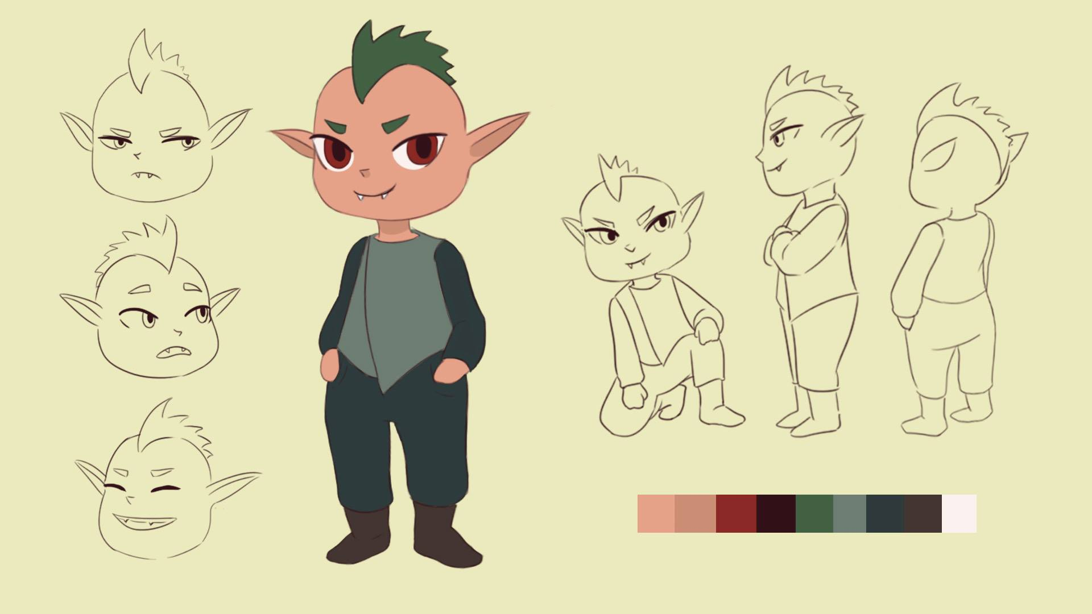
Characters
Naughty fairy 2 (to boy the mohawk): He is the leader of the group. He is also silly, he wants to have fun but also he is a bit cold.

Slide 8
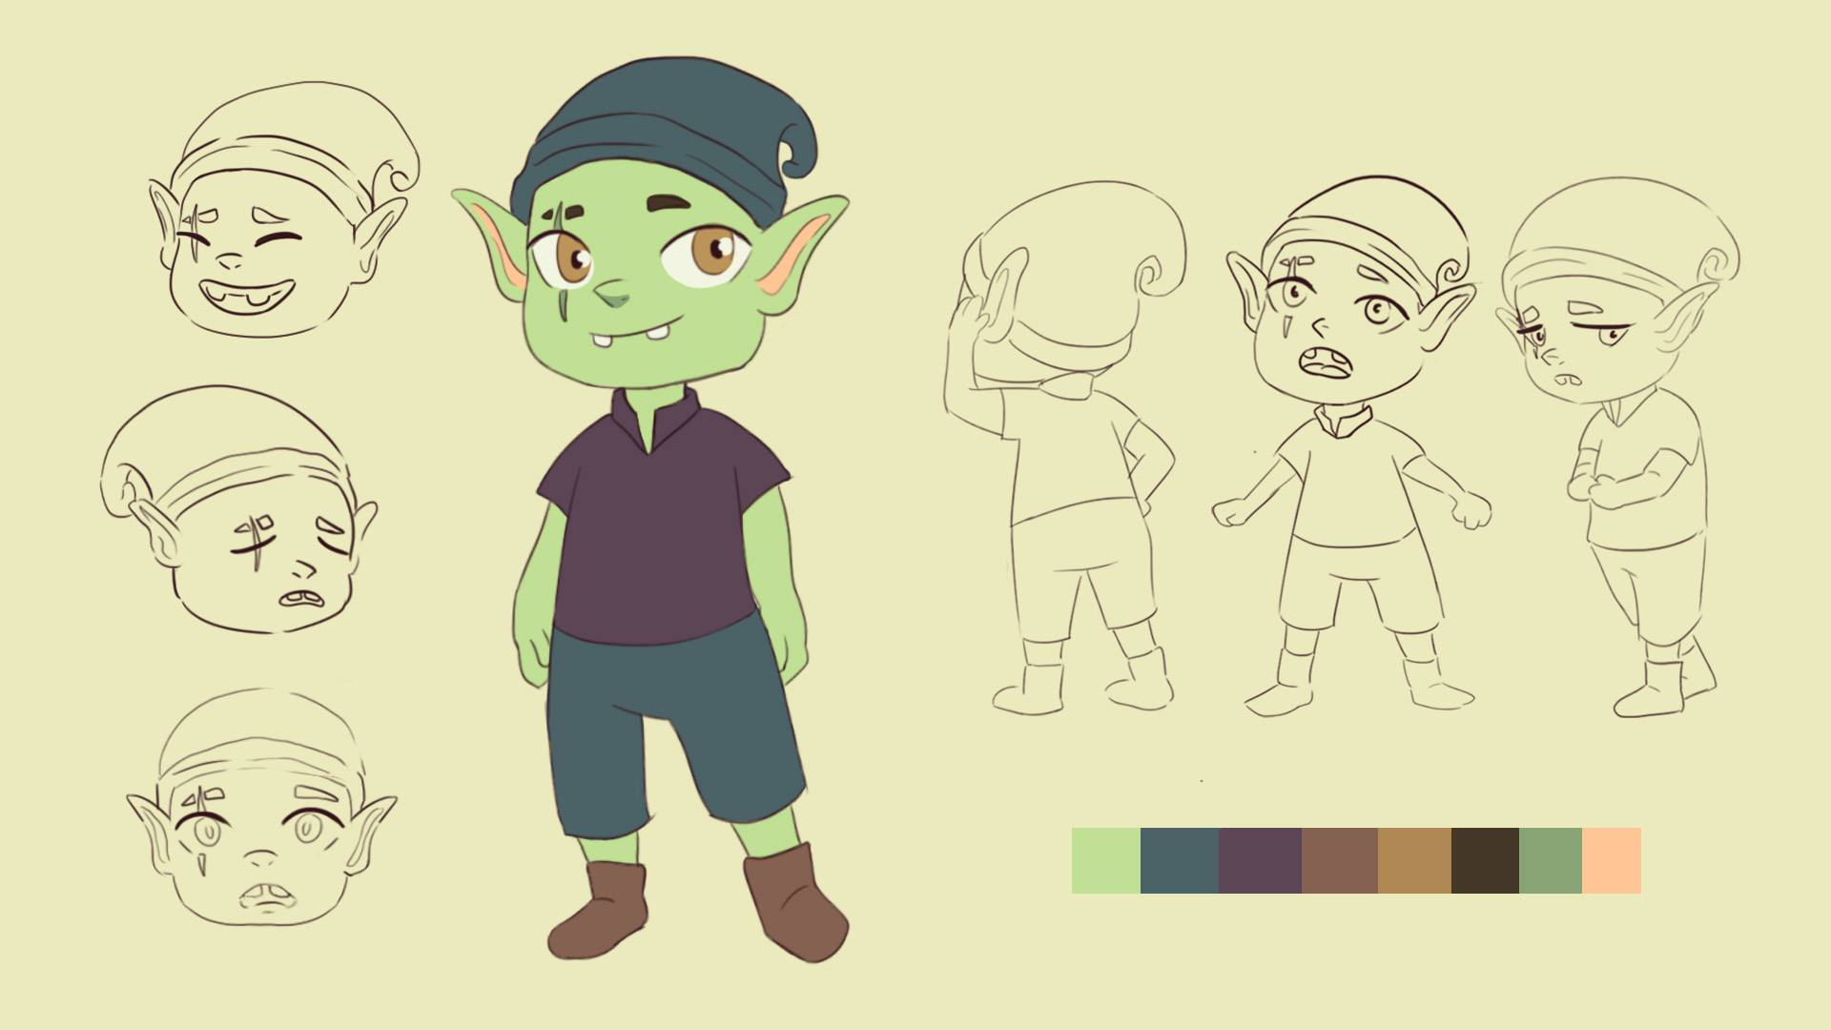
Characters
Naughty fairy 3 (to Green boy): He is the silly one. He is clumsy and basically doesn’t have a brain. He is a follower and has fun not knowing what he is doing. But has a good heart

Slide 9
Characters
The girl: She is just an average girl. She is leaving her everyday peacefully except when the naughty fairies make her life a little bit more difficult. But there is also the good fairy that likes her very much. She is unaware of their existence.

Slide 10
Comic
HOW WAS IT MADE: We used Photoshop to make the drawings and colours, specifically using a Wacom drawing tablet to make it more precised and comic like. For the background we used real photographs in order to combine two different methods in an articulate manner to make it more real and interesting. That way we can use one style to make up for the limitations of the other.

Slide 11
Movie
video camera (Panasonic HC-V380)
Photoshop
Animotica
https://www.bensound.com (audio)
How it was made:
Take a shot of a small part of the movie scene
Create the animated characters for this scene
Imported in the movie scene via photoshop
Imported in Animotica for editing

Slide 12
Thank you!

