Slide 1
“Landscape conscience and the development of a European landscape conscience”
Evangelos Pavlis, PhD
Department of Geography, University of Aegean, Lesvos, Greece
Summer School “Landscape in a Changing World”, 19-28 Sep 2012, Lesvos, Greece
epavlis@geo.aegean.gr

Slide 2
Objective
This workshop aims at:
introducing the concept of “landscape conscience” and
elucidating and analyzing the mechanisms, the historical evolution and the significance of the development of a landscape conscience in Europe.

Slide 3
Contents
Conscience: a theoretical background
‘Spatial conscience’ and geography
Applying ‘spatial conscience’ to the ‘landscape’ and the concept of ‘landscape conscience’
The historical evolution of ‘Landscape Conscience’
Prospects for Landscape Conscience (development) in Europe
Conclusions
“Conscience” Nikolai Ge, 1891

Slide 4
1. Conscience: a theoretical background
A) Historical review
Through history, there are many references to ‘conscience’ as:
immanent knowledge/ learning (Plato),
intrinsic feature of mental states and higher-order thought and an outcome of experience (Aristotle),
sharing knowledge (Stoics, Cicero),
inner judgment (Holy Bible),
application of practical and ethical knowledge (Thomas Aquinas – Italian philosopher and theologian),
psychic characteristic (René Descartes)
‘Conscience’ = knowledge, learning, experience, inner judgment, wisdom, mind, soul/ psyche
“La Conscience (after Victor Hugo) ”
François Chifflart (1825-1901)

Slide 5
1. Conscience: a theoretical background
B) Traditional philosophical approaches
During 17th century, many theories of conscience/ consciousness have been developed, either though Philosophy (based on Dualism and Monism Schools of Thought), and/or, later, through Psychology, where conscience has been approached as a function of mind and/or soul that determines human character and personality.
Conscience is an ethical judgment activated through ‘a soft inner voice that tells you when you have done wrong’ (Tkacik, 1964:76).
Conscience goes beyond a moral reading or view of the world; ‘it is an active stance towards existence, an active stance which, however, requires understanding of the situation and a sort of a priori’ (Regnier, 2006:153).
Consciousness (Locke, 1690) regards the sum of fermentation that constitute the phenomenon (inner process), while conscience regards the mechanism or widely the relation of the components that modulate the concept (which is a wider evaluation of “what is right”).

Slide 6
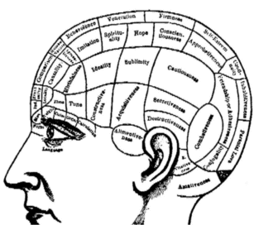
C) Modern approaches Since 1980, science approaches ‘consciousness’ either through Physics (quantum mechanics—where humans create reality through consciousness), either through Neurosciences (neurophysiology --where consciousness is a short of coherence, created by a complex process among neurons, synapses and microcircuits).
1. Conscience: a theoretical background
Points
Since today, there is a lack of a documented scientific explanation of ‘conscience’.
As social/ collective phenomenon, conscience, is also a matter of social research.
Conscience is the outcome of an interrelation of components and mechanisms of the inner world of humans.

Slide 7
1. Conscience: a theoretical background
D) A functional use of ‘conscience’
Since ancient times there is a general idea and a wider sense of ‘what conscience is’.
Conscience: not necessary to be explained, but to be applied in research and to be used in science, in order to understand a wide range of phenomena (Antony, 2001)
The concept of ‘consciousness’, as well as the concept of ‘conscience’, should be approached in specific contexts that would offer special and clearer focus (Allen, 2009).
Thus, the study of ‘consciousness’, and consequently that of ‘conscience’, shift from the explanation of nature to the explanation of relation (Crick & Koch, 1998).

Slide 8
1. Conscience: a theoretical background
Different researchers and schools of thought point to three basic broad categories of components of conscience/ consciousness: perception (cognitive processes – intellect, thought, knowledge, skill, etc), emotion (the wider emotional world), behaviour (application, adaptation, practice, action, experience, etc).
In social sciences human reality constitutes of the triptych:
a) intellectual/ perceptual/ cognitive,
b) psychological/ emotional and
c) behavioural/ experiential dimensions of the human world.
DEFINITION: As human conscience we define the outcome of the relations and interactions among perception, emotion and behaviour, from which, via complex processes of various subjective and objective factors, a mechanism is shaped that connects humans with the social being, as much as with the subconscious or/and metaphysical level.

Slide 9
2. ‘Spatial conscience’ and geography
A) The impact of space on human conscience
Until recently, the study of human conscience has been mainly anthropocentric (philosophy, psychology, biology and physics), but:
Strong influence of spatial factors and dimensions (“the environment”) on the development of human conscience and the modulation of reality, for both natural and social sciences.
Space/ environment consists of –among others– human feelings, auras, emotions, instincts, memories, values, symbols, thoughts, desires, perceptions and various cognitive processes, attitudes, habitués, behaviours, etc (Lorimer, 2008; 2007; 2005; Hudson, 2007; Thrift, 2004, 1996; Crang, 1998; Tuan, 1992; Sarre, 1987; Relph, 1976).
Space/ environment affects and is affected by all the above.

Slide 10
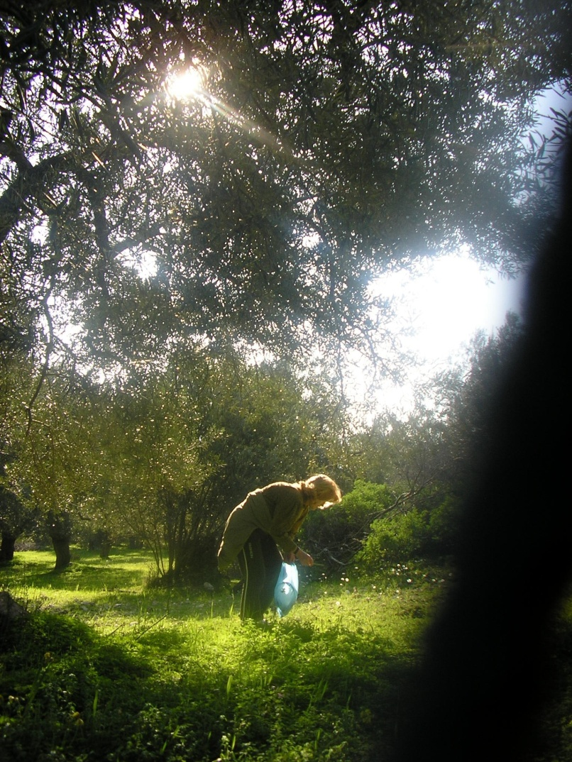
2. ‘Spatial conscience’ and geography
The application of human conscience in spatial matters is articulated through the concept of ‘spatial conscience’ (Pavlis, 2012), formulated through complex and variable human-space interrelations and interactions...
…and affected by ethics, experience, thought, cognition and the impact of biological factors on individuals, as these are shaped by wider cultural, socio-economic, political and physical factors and processes.

Slide 11
2. ‘Spatial conscience’ and geography
B) The more-than-anthropocentric geographical approach of conscience
Cultural geography claims that space consists of -among others- human emotions, perceptions and behaviors (Hudson, 2007, Thrift, 2004, Crang, 1998, Soja, 1996, Tuan, 1992, Sarre, 1987, Relph, 1976).
For non-representational theory (including more-than-representational geography), reality is approached as a result of relations and interactions between humans and space (Thrift, 1996, 2007, Lorimer, 2005, 2007, 2008).
For environmental psychology, spatial/ environmental arrangement impacts on human psychism (Gifford, 2007, Schmidt-Denter, 1981, Kaplan & Kaplan, 1982, Ittelson et al, 1974).
Cultural geography (including non-representational theory) and environmental psychology shape the proper scientific content for the development of a more-than-anthropocentric geographical approach of conscience (Pavlis, 2012), correspondingly to more-than-representational geography (Lorimer, 2005), on the basis of variable human-space interrelationships.

Slide 12
3. Applying ‘spatial conscience’ to the ‘landscape’ and the concept of ‘landscape conscience’
C) The application of ‘spatial conscience’ to the ‘landscape’
In order to apply ‘spatial conscience’ to practice, there has to be a tangible, readily perceivable geographical unit of analysis of the complex humans-space interrelationships.
‘Landscape’ is such an analytical unit, through which the human-space relationship emerges and expresses itself.
DEFINITION: ‘Landscape’ means an area, as perceived by people, whose character is the result of the action and interaction of natural and/or human factors (European Landscape Convention, 2000).

Slide 13
3. Applying ‘spatial conscience’ to the ‘landscape’ and the concept of ‘landscape conscience’
D) Space – place – landscape
When space, as a sum of physical dimensions of subjective qualities, is filled with tangible and intellectual expressions of human activities, behaviours, perceptions, emotions, ideologies, expectations, meanings, attitudes, etc, it becomes place (Stefanou, 1994; Tuan 1977).
Place exists in a certain time context–either long or short (Soini, Palang, Semm, 2006) and is more a ‘socio-cultural construction’ rather than a ‘physical location’ (Pritchard & Morgan, 2000:116; Shurmer-Smith & Hannam, 1994:13). Places are the centers of human actions and interactions (Graumann, 2002).
Landscape is the expression of the deeper “being” of a place and is associated with its physiognomy. The physiognomy of a place regards the uniqueness, identity, or even the personality of a place, as it is shaped by the characteristics of the landscape and shouldn’t be confused with its character (which is a matter of typology) (Stefanou, 2005:4).
Landscape is the emotional and ideological image of a place (Stefanou, 1980, Duncan, 1990), experienced by all the human senses.

Slide 14
3. Applying ‘spatial conscience’ to the ‘landscape’ and the concept of ‘landscape conscience’
E) Landscape: the concept
The landscape concept has developed and continues to be reproduced or re-approached on the basis of the totality of human senses, brain processes, emotions raised and behaviors expressed in the course of human life.
Therefore, landscape is the most obvious and evident representation and medium of interaction of human senses, emotions, perceptual and cognitive schemata and experiences with space and the human environment.
‘As a reflection of European identity and diversity, the landscape is our living natural and cultural heritage, be it ordinary or outstanding, urban or rural, on land or in water’ (ELC).

Slide 15
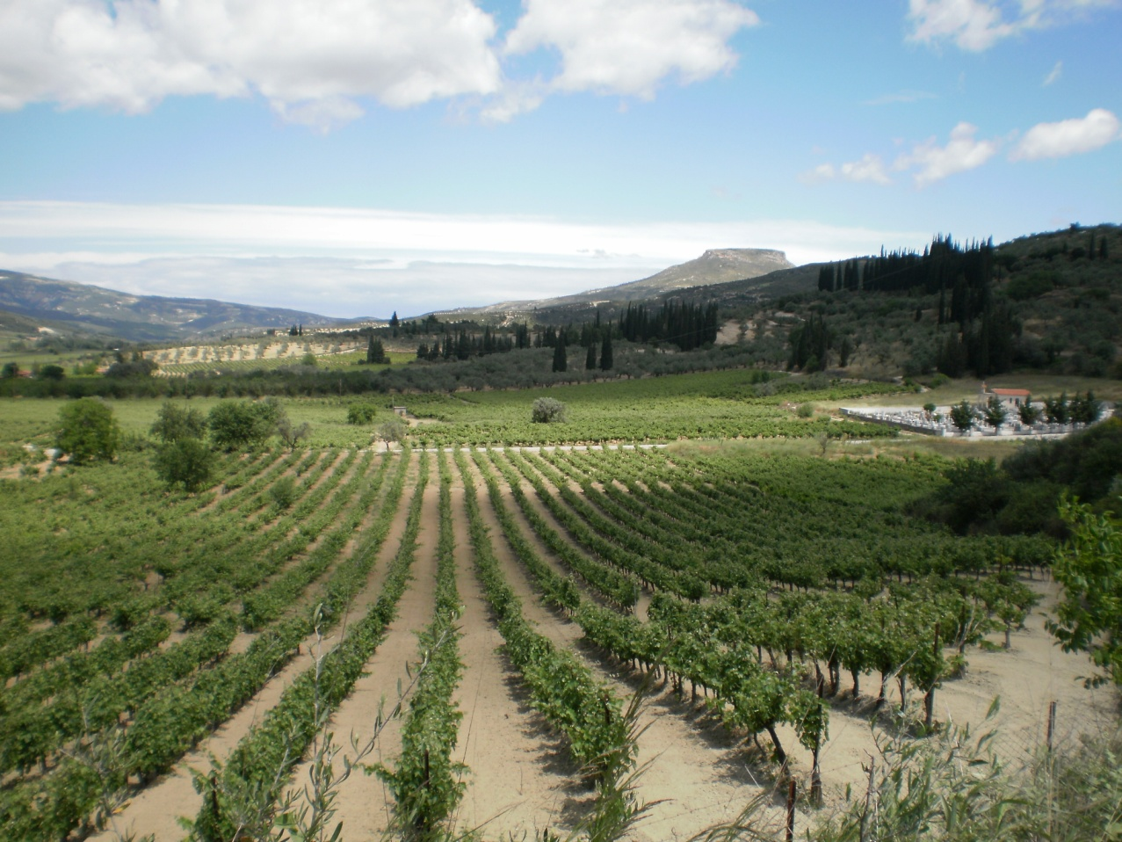
3. Applying ‘spatial conscience’ to the ‘landscape’ and the concept of ‘landscape conscience’
The dimensions of modern landscape (Pavlis, 2012)
Geologic/ geomorphologic/ climatologic
Ecological
Utilitarian/ productive
Functional/ operational
Visual/ representational
Socio-economic
Historical/ archaeological
Monumental
Symbolic
Aesthetic
Experiential
National/ political
Mystical/ ritualistic/ metaphysical
Mythological
Anthropomorphic

Slide 16
3. Applying ‘spatial conscience’ to the landscape and the concept of ‘landscape conscience’
F) Landscape conscience
DEFINITION: ‘Landscape conscience’ is the sum of perceptual/ spiritual, emotional and experiential bonds (conscious or not) characterizing the relations of humans with their landscapes (Terkenli, 2010a:38).
Landscape conscience allows, guides and informs the various ways in which humans see, understand and interpret the world, as well as develop deep and lasting relationships with space.
Landscape conscience in the western world had always been a determinant of historical evolution regarding human-space interrelationship, taking various shapes and forms through time, space and cultural settings/ backgrounds (depending on the concept of landscape).

Slide 17
3. Applying ‘spatial conscience’ to the landscape and the concept of ‘landscape conscience’
Landscape conscience makes individuals and societies to see, perceive and interpret their world, to develop deep relations with space and to shape their collective conscious and unconscious through space and time.
The ‘landscape phenomenon’ derives from the developed analytical systems of human brain (Aoki, 1999:91) and, as the painter Cezanne wrote to a friend, ‘landscape thinks by itself through myself…and I am its conscience’ (Wylie, 2007:2), emphasizing the human-landscape interrelationship, where the landscape exists only through humans.
The lay landscape conscience as a cultural expression/ construction is the sum of mental, emotional and experiential bonds (either conscious or unconscious) that characterize the relations of people/ societies with their landscapes.

Slide 18
3. Applying ‘spatial conscience’ to the landscape and the concept of ‘landscape conscience’
G) The basic principles of spatial/ landscape conscience
The world is perceived, lived and experienced—through the entirety of human senses and their interaction—as being in a constant state of becoming.
The construction of reality is an outcome of interrelations and interactions between humans and space.
More or less visible forces/ trends, instincts, affects, passions, desires, attitudes, etc, and, generally speaking, all dimensions of the human hypostasis consist the multisensual human-space relationship, constructing spatial be(com)ings (Dewsbury, 2003, Anderson 2006, Lorimer, 2008).
This relation has more-than-human dimensions, since it does not only depend on the human factor, but also on the spatio-temporal factor and on the interaction between them.
The spatial dimension of conscience is modulated by the human-space interaction and may be approached and studied through the intricate interrelationship between perceptions, emotions and behaviors (broadly conceived and defined), in space-time. Likewise: ‘landscape conscience’.

Slide 19
Diagram 1: The geographical model of landscape conscience formulation
SPACE
HUMAN
CONSCIENCE
RELATIONS/ INTERACTIONS OF PEOPLE AND SPACE
HUMAN PRACTICES & PROCESSES OF SPATIAL/ LANDSCAPE FORMATION
Cultural Factors
Socio-Economic Factors
HUMAN PRACTICES & PROCESSES OF SPATIAL/ LANDSCAPE FORMATION
REALITY
Physical Factors
Political Factors
LANDSCAPE CONSCIENCE
The shaping and the perception of reality has more-than-human dimensions and it is constructed by the continuous human-space interaction.

Slide 20
Diagram 2: Analysis of the processes shaping (landscape) conscience
PERCEPTION
Shaping Processes
BEHAVIOUR
EMOTION
RELATIONS / INTERACTIONS IN THE INNER WORLD OF HUMANS
Cognition
Thought
Shaping Processes
Experience
Ethics
Shaping Processes
Biological Factors
Human conscience is determined (to an extent) by biological factors and is shaped by cultural, socio-economic, political and physical factors and especially by human experience, cognition, thought and ethics.
The spatial dimension of conscience is shaped by human-space and is studied through the relation of perception, emotion and behaviour, which modulate (and are modulated) by space, inter-depend and interact.
Conscience
(Landscape Conscience)

Slide 21
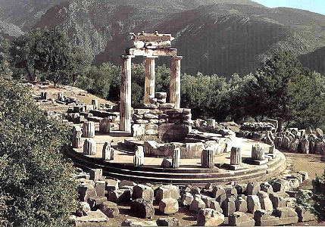
4. The historical evolution of ‘Landscape Conscience’-- Ancient Greece, 1st phase of LC
Ancient Greece (17th - 4th century BC): acute perception of landscape; symmetry; mysticism; aesthetic rationalism; emotional ties with landscapes (e.g. worship of nature), careful selection of sacred sites and good landscape practices
Knowledge of landscape influence exerted on human psychology (applied to landscape morphology and temple siting/ architecture)
Hellenistic era (323-146 BC): linear prospect & monumental dimensions of landscape
Through landscape monumentality, Greece exerts a powerful influence on landscape matters in Europe & Asia

Slide 22
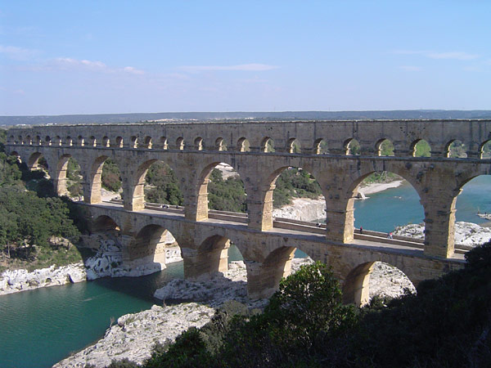
4. The historical evolution of ‘Landscape Conscience’-- Ancient Rome, 1st phase of LC
Greek landscape ideas and practices were passed on to Rome (50 AD): e.g. gardens, villas-cottages, public parks, street plans, aqueducts, walking paths, landscape architecture, etc.
The landscape view (“prospectui”): legally protected as a human right/ good (roman jurist Ulpianos Domitius).
Nature worship and the “ideal of Arcadia”: sacredness in nature, idealised rural landscapes; Homer, Plato, Theokritos, Pausanias, Virgil, Horace, Ovid, etc.

Slide 23
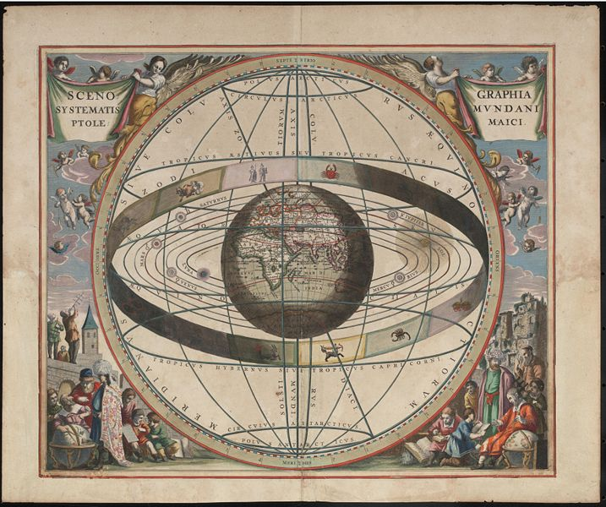
4. The historical evolution of ‘Landscape Conscience’-- Ptolemy, 1st phase of LC
Ptolemaic science (150 AC):
* Map design
- Ptolemaic maps influenced landscape history until 16th century BC (Olwig, 2006)
- strongly contributed to the geometrical representation of the world through the paper and to the idea of landscape ‘as picture of the world and of the world as picture’ (Olwig, 2001)
Visual/ representational dimension of landscape - landscape as ‘a way of seeing’ (Cosgrove, 1984)

Slide 24
4. The historical evolution of ‘Landscape Conscience’—Middle Ages, 1st phase of LC
Middle Ages (476 – 1492 AC)
- poetry and literature were religious, theocratic
- nature identified with threat (Ananiadou-Tzimopoulou, 1992)
- regulations protecting the view (Tourptsoglou-Stefanidou, 2005)
Green spaces inside the monasteries, few gardens (Preece, 1991)
Reduced influence of the Greek-Roman tradition
Ascension of the poet and historian Petrarch to Mont Ventoux: ‘signifies the ascension of the soul from the body to the spirit’ (Kassimati, 1985, Ritter, 1963/2004)
Beginnings of the making of the contemporary European rural landscape (e.g. moors)

Slide 25
4. The historical evolution of ‘Landscape Conscience’-- Renaissance, 2nd phase of LC
Renaissance (14th-17th centuries)
Italian landscape tradition: garden planning, making of artificial caves, ‘holy’ knaps and forts, labyrinths and mythical statues, added symbolic value to landscape (Jackson, 1980).
Roman gardens: emphasis on the symbolic, the mystic, the mythological and the monumental dimensions of landscape.
The Greek-Roman ideal of landscape returns; interrelationship between spatial planning/ practices and human perception/ psychology

Slide 26
4. The historical evolution of ‘Landscape Conscience’—15th-17th centuries, 2nd phase of LC
‘Landscapes’ sought through art, as alternative ways of seeing and understanding the world (Loukaki, 2005)
Dominant myth: bucolic vision, peacefulness, freedom and harmony, need for self-catharsis from dogmatic habits and restrictions; idealised return and resurgence of the old Arcadian myth.
Emergence of landscape art: 15th - 17th century
‘Prospect’ identified with the idea of ‘landscape’ as a direct source of aesthetic pleasure in itself (Appleton, 1996)
Discovery of the horizontal order/ perception of the world (Terkenli, 1996)
Landscape conscience introduced and cultivated with the aid of landscape concepts such as ‘scenery’ & later ‘prospect’ (Terkenli, 2005).
Aesthetic pleasure and myth

Slide 27
4. The historical evolution of ‘Landscape Conscience’—landscape art and architecture, 2nd phase of LC
French and Dutch landscape schools:
Different European landscape traditions, due to the different landscape spatialities (Cosgrove, 1998)
rationalism, geometry, aesthetic pleasure, promotion of power relations: top-down perspective (Renaissance)
humanistic and democratic values, sense of reflection, soul-searching and self-consciousness: bottom-up perspective (Pays Bas)

Slide 28
4. The historical evolution of ‘Landscape Conscience’—18th-19th centuries, 2nd phase of LC
Enlightenment (18th century)
- ‘wild nature’ becomes civilised/ landscape
- human effort to re-discover ‘self’ through ‘space’ (e.g. travelling) (Jackson, 1980).
English school of landscape: ‘picturesque’
- praising the mystery, sanctity and power of nature; identifying nature with God (from ‘nature is threat’ to ‘nature is god’)
- from the ‘representation of a scenery’ to ‘the scenery itself’ (Terkenli, 1996).
Landscape art was identified with the ideal landscape of collective conscience and this ideal landscape was identified with the primitive power of human soul (Belavilas, 2005).
Prevalent theme of this phase of landscape conscience development: Horace’s and Virgil’s “Arcadian ideal ” (Loukaki, 2005).

Slide 29
4. The historical evolution of ‘Landscape Conscience’— 20th century, 3rd phase of LC
20 century: modern & post-modern world
Forces of landscape reshaping and restructuring:
- massive rural depopulation (1900-1950’s/70’s; still on-going),
- counter-urbanisation (population turnaround, 1950’s-today), often through the quest for more attractive landscapes, in order to upgrade quality of life (Lowenthal, 1997, Paquette & Domon, 2003, Lamprianidis & Bella, 2004)
- agricultural intensification and industrialisation of rural landscapes
- massive consumption of countryside recreation
- infrastructure development
- tourism industry: landscape = ‘commodified product’ (Bunce, 1994); growing demand for alternative/ special forms of tourism (Sharpley & Sharpley, 1997), leading to the reconstitution and use of landscapes as places of nostalgia (Hopkins, 1998, Goss, 1993).
- disconnection of ‘landscape’ from ‘art’ (e.g. photography as the quintessential 20th century scientific tool to landscape reproduction).
- various industries (tourist, sport, construction, mining, energy, agriculture, etc) aim at mass production and profit maximisation, continue to reshape and restructure the landscape.

Slide 30
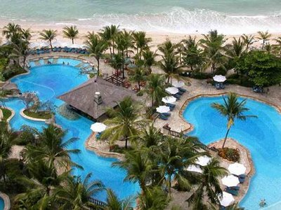
4. The historical evolution of ‘Landscape Conscience’— 20th century, 3rd phase of LC
New landscape spatialities
homogenized landscapes of tourism
commodified rural landscapes

Slide 31
4. The historical evolution of ‘Landscape Conscience’— present times, 3rd phase of LC
‘Rural nostalgia’ : nostalgia of the town dweller for the countryside and the rural landscape (‘Arcadian ideal’ turned into ‘rural idyll’).
This rural nostalgia comes along and develops through industrialisation (Terkenli, 2011; Aitchison et al, 2000).
The inflow of urbanites in rural areas leads to new landscape impacts and to the construction of new forms of landscape conscience (e.g. multiple rural idylls/ myths/ ideals).
Not a single dominant myth, but many contested ones: postmodernism.
Change in both the meaning and the morphology of landscape, taking on any number of contents and symbolisms, to accommodate almost every landscape meaning or use (landscape as a metaphor) (Terkenli, 1996).
Modern society seeks the simplicity of past rural life without problems and complications associated with it, and increasingly, ‘becomes a community of tool users, not tool makers’ (Park & Coppack, 1994).

Slide 32
5. Prospects for Landscape Conscience (development) in Europe – in general
Return trends to the countryside and to the rural landscape (associated with social and spatial restructuring)
Rise of demand for alternative forms of tourism
Emergence of unions, committees, NGO’s, etc, involved in the protection of nature and landscape
Efforts to control industrial development and negative landscape impacts (e.g. land use regulations)
Good practices of ELC implementation
The development of landscape conscience constitutes an imperative need for contemporary western and non-western societies, in the context of current trends of a wholesale spatial re-organization (globalization, proliferation of media, ICTs, etc): ‘a new cultural economy of space’ (Terkenli, 2006).

Slide 33
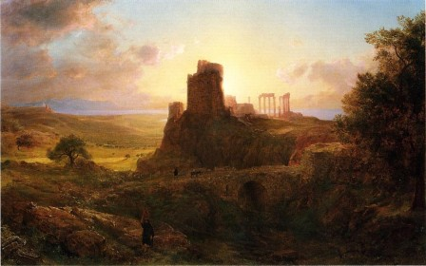
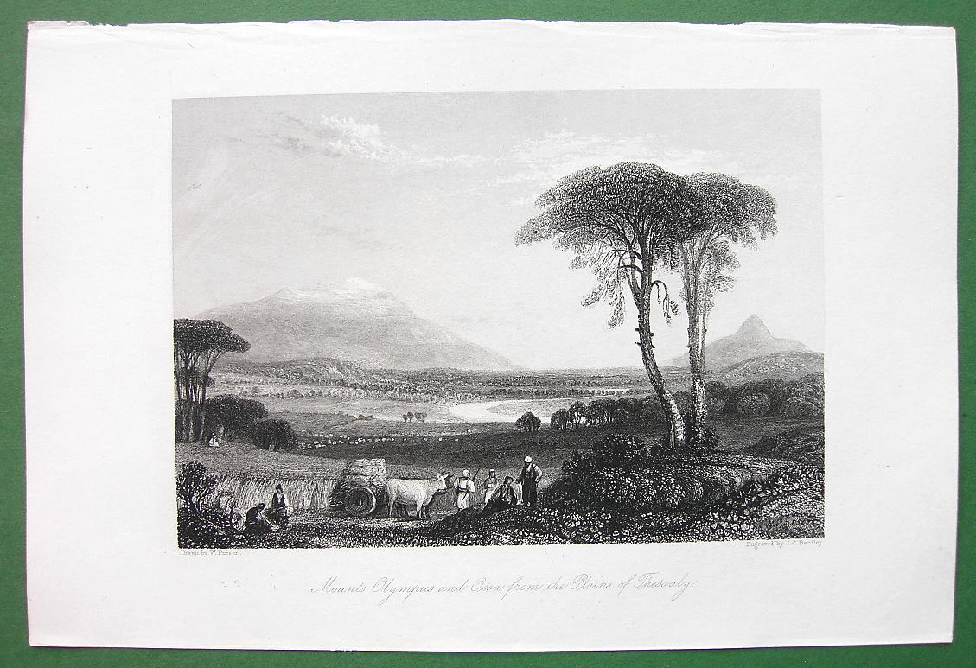
5. Prospects for Landscape Conscience (development) in Europe -- the case of Greece
Greek landscape remained an ‘idea’ which inspired Western traditions
Arcadian myth = the idealisation of the Greek rural landscape (Brown, 1996, Cosgrove, 1998)
While the Italian tradition actively impacted the 2nd phase of landscape conscience development, the role of the Greek landscape in the development of LC remained passive.
For foreign visitors, the Greek landscape has been more an idea and a vision (source of myths towards the development of a LC), than a distinct geographical space (Tsigakou, 2005)
Nowadays, landscape conscience is not well-developed in modern Greece and lay landscape conscience appears to be problematic, while ancient Greek landscape traditions remain strong, still inspiring the West.

Slide 34
5. Prospects for Landscape Conscience (development) in Europe -- the case of Greece
Before 1950’s: Greeks living in the countryside, used to have a close, organic relation with their environment and their landscape’ and through this relationship ‘they secured their living respecting their landscapes, through and by which, their cultural systems and their entire lives developed’ (Terkenli, 2010a:42)
After 1950’s (rapid changes):
Land reclamation, massive rural depopulation (1955-1971: loss half of rural population), intensification of production, uneven development, infrastructure works (transport, telecommunication, energy, etc), uncontrollable urbanization, out-of-the-plan, sprawl and illegal construction, unrestrained waste disposal, uncontrolled tourist growth, lack of rural and forest road constructions, incendiary fires and lack of protection measures & management of resources, soil erosion, aesthetic degradation/ debasement (e.g. giant billboard advertisements), land-grabbing, unregulated quarrying and mining, etc.
Law implementation problems (national, peripheral and local level), lack of communication and cooperation between academics, practitioners, activists, NGOs, politicians in landscape issues, lack of agencies or administrative bodies referring to the landscape, limited, passive and restricted public participation in decision making, etc (Terkenli & Pavlis, 2012, Terkenli, 2004).

Slide 35
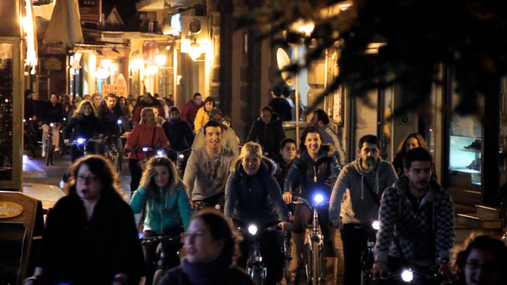
6. Conclusions
Human conscience is affected by the human-space interrelationship and can be developed through the protection, management and planning of ‘landscape’.
More and more people turn back to the landscape (especially, the rural) for various reasons, they sense and experience it in various ways – landscape as a multi-dimensional source of well-being and self-sufficiency.
Applied landscape conscience research can contribute to spatial planning (e.g. sport, recreation, therapy), new teaching methods and techniques, policy development, (active) public involvement/ participation, etc, aiming at the improvement of human quality of life and the restoration of balance between human-nature and society-environment.

Slide 36
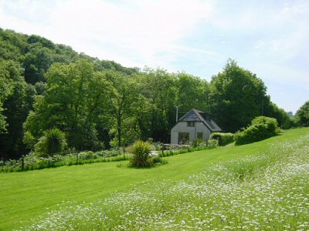
6. Conclusions
The development of ‘landscape conscience’ could strongly impact in the implementation of European Landscape Convention (Florence, 2000), encounter the difficulties and challenges and contribute to their resolution and rectification.
As the European Landscape Convention becomes the norm and tool par excellence for landscape protection, management and planning throughout Europe, a long array of practical implementation matters pertaining to all dimensions of European landscapes come to the fore.

