Slide 1
Introduction to
Project Management
Michael Vidalis

Slide 2
Learning Objectives
Describe project management objectives
Describe the project life cycle
Diagram networks of project activities
Estimate the completion time of a project
Compute the probability of completing a project by a specific time

Slide 3
Defining a Project
What is a project?
Any unique endeavor with specific objectives
With multiple activities
With defined precedent relationships
With a specific time period for completion
Examples?
A major event like a wedding
Any construction project
Designing a political campaign
Projects are processes that are performed infrequently and ad hoc, with a clear specification of the desired objective.

Slide 4
What is a Project?
A project has a single objective that must be accomplished through the completion of tasks that are unique and interrelated
Projects are completed through the deployment of resources
Projects have scopes, schedules, and costs and are accomplished within specific deadlines, budgets, and according to specification

Slide 5
Examples of Projects
Constructing highways, bridges, tunnels and dams
Erecting skyscrapers, steel mills, and homes
Organizing conferences and conventions
Managing R&D projects
Running political campaigns, war operations, and advertising campaigns

Slide 6
Project Life Cycle
Conception: identify the need
Feasibility analysis or study: costs benefits, and risks
Planning: who, how long, what to do?
Execution: doing the project
Termination: ending the project

Slide 7
Life Cycle of a Project (Stretched-S) & (Exponential)

Slide 8
Background for Project management
Project management concerned with managing organizational activities.
Often used to integrate and coordinate diverse activities.
Projects are special types of processes.

Slide 9
What is Project Management?
a method for organizing tasks
a structured framework to help a group work productively
tools to aid in task sequencing, dependency analysis, resource allocation, scheduling, etc.
tools to track progress relative to plan
Monitoring and controlling
Reporting
Continually striving to improve the process

Slide 10
Why Need Project Management?
Complex project needs coordination of:
Multiple people
Multiple resources (labs, equipment, etc.)
Multiple tasks – some must precede others
Multiple decision points – approvals
Phased expenditure of funds
Matching of people/resources to tasks

Slide 11
Phases of Project Management
Define the project’s scope
Develop the project’s plan
Implement the plan & control the process
Close out the project

Slide 12
Suggested Steps in Project Management
Generate a formal definition of the project, with goals, constraints, assumptions
Identify project start/end dates, any mandatory milestones, including reports, signoffs, deliverables, etc.
List constraints – money, equipment availability, holidays, etc.
Identify tasks to be accomplished – high level (i.e., by categories), then details within each, using brainstorming method – green light

Slide 13
Suggested Steps, cont.
Refine detailed task list, dropping/ combining, adding things omitted
Then, for each task in list:
Estimate time (person hours, calendar period)
Identify dependencies among tasks
Identify resources (people, money, parts, etc.)

Slide 14
Suggested Steps, cont.
Organize task groups roughly by starting date
List dependencies that should or MUST hold
Use MS Project to make a GANTT chart
First capture tasks and task groups, milestones
Identify critical path, see if it can be shortened (get more “slack”)
Assign person-hours and specific team member(s) to each task – identify “task leads”

Slide 15
Suggested Steps, cont.
As project progresses:
Monitor, record progress on all tasks, at least weekly – use “Tracking Gantt Chart”
Pay particular attention to those on critical path
Revise plan as needed to take into account changes, adapt to meet milestones

Slide 16
Planning and Scheduling Projects
Planning. Determining what must be done and which tasks must precede others.
Scheduling. Determining when the tasks must be completed;
when they can and when they must be started;
which tasks are critical to the timely completion of the project; and
which tasks have slack and how much.

Slide 17
Scheduling the Project: PERT and CPM

Slide 18
Develop the Project’s Plan
Break Down Project
Tasks (WBS)
Time Estimation &
Dependencies
Review & adjust
Determine Resource
Needs
Develop Gantt Chart
Notes:
Planning is an iterative process. Some projects won’t require a proposal

Slide 19
What is a Work Breakdown Structure (WBS)?
A hierarchical representation of activities
It starts with the major project areas to be accomplished
It breaks the project areas into actionable pieces of work, segmenting elements into appropriate sublevels

Slide 20
WBS – Activity Levels
Level 1 – Identify major objective areas or categories
Level 2 – Begin to divide the areas into sub-tasks
Level 3 – Continue to break down the sub-tasks into actionable items
The lowest level associated with a branch in the hierarchy is referred to as a “work package”
# of levels depends on project complexity

Slide 21
Terminology
Activity
Event
Network
Path
Critical Path
Critical Activities

Slide 22
Network Diagrams
Activity-on-Node (AON):
Uses nodes to represent the activity
Uses arrows to represent precedence relationships

Slide 23
Network Diagrams
Activity-on-Arc (AOC):
Uses arcs to represent the activity
Uses nodes to represent precedence relationships
Activity A precedes activity B
A
B
1
2
3

Slide 24
Project Planning When Activity Times are Known
Inputs
list of the activities that must be completed
activity completion times
activity precedence relationships

Slide 25
Project Planning When Activity Times are Known continued
Outputs
graphical representation of project
time to complete project
identification of critical path(s) and activities
activity and path slack
earliest and latest time each activity can be started
earliest and latest time each activity can be completed

Slide 26
Example

Slide 27
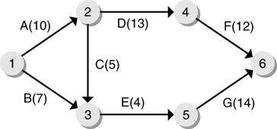
Network Diagram

Slide 28
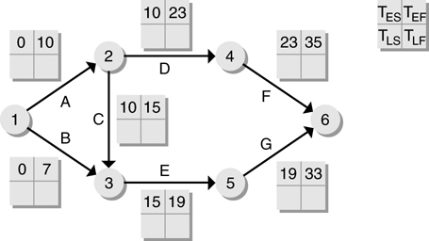
Early Start and Finish Times

Slide 29
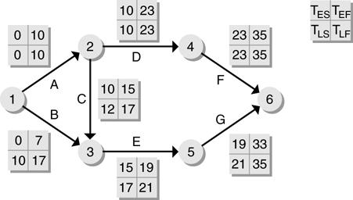
Latest Start and Finish Times

Slide 30
Activity Slack Time
T_{ES} = earliest start time for activity
T_{LS} = latest start time for activity
T_{EF} = earliest finish time for activity
T_{LF} = latest finish time for activity
Activity Slack = T_{LS} - T_{ES} = T_{LF} - T_{EF}

Slide 31
Path Slack
Duration of Critical Path
- Path Duration
Path Slack

Slide 32
Activity Slack Times

Slide 33
Project Scheduling and Tracking
Scheduling is the process of deciding:
In what sequence a set of activities will be performed.
When they should start and be completed.
Tracking is the process of determining how well you are sticking to the cost estimate and schedule.

Slide 34
Some Basic Project Management Terminology
Deliverable: some concrete thing which is to be delivered, to the client or internally to the development team; e.g.
Specifications reports
Executable program
Source code
Task/Activity: something we have to do during the project; e.g.
Defining user requirements
Coding a module
Doing system testing
Each task or activity will take some length of time
Referred to as duration of task
Sometimes measured in days, weeks, etc.
Sometimes measured in person-days, person-weeks, etc.
Person-day = number of people X number of days
Example: 12 person days for writing all code could mean 1 person 12 days or 4 people 3 days
Note: not always true that a task that takes 1 programmer 12 days would take 12 programmers 1 day

Slide 35
Dependencies and Milestones
For a given task or activity, may be impossible to start it without some other task(s) or activity(ies) having been completed; e.g.
Cannot start coding without completing design
Cannot start system testing without completing code integration and test plan
If task B cannot start without A being completed, we say
B depends on A
There is a dependency between A and B
Milestone: some achievement which must be made during the project; e.g.
Delivering some deliverable
Completing some task
Note, delivering a deliverable may be a milestone, but not all milestones are associated with deliverables

Slide 36
Setting and Making Deadlines
Deadline time by which milestone has to be met
Some deadlines are set by the client
Others are set by us on project to make sure project stays on track
To set a deadline for completing task T, we must consider how long it will take to:
Complete the tasks that task T depends on
Complete task T itself
If we miss a deadline, we say (euphemistically) “the deadline has slipped”
This is virtually inevitable
Important tasks for project managers
Monitor whether past deadlines have slipped
Monitor whether future deadlines are going to slip
Allocate or reallocate resources to help make deadlines
PERT chart and Gantt charts help project managers do these things (among others)

Slide 37
Project Management Using Microsoft Project
Allows many different ways of entering and observing information
includes many features to help identify problems with a plan
regular use can help a group refine plans to make meeting targets more realistic

Slide 38
Our “Flyover” of Project 2010
Adding tasks, durations
Setting dependencies
Seeing critical path, etc.
“Rolling up” subtasks
Assigning resources
Adjusting durations, time assignments, etc.

Slide 39
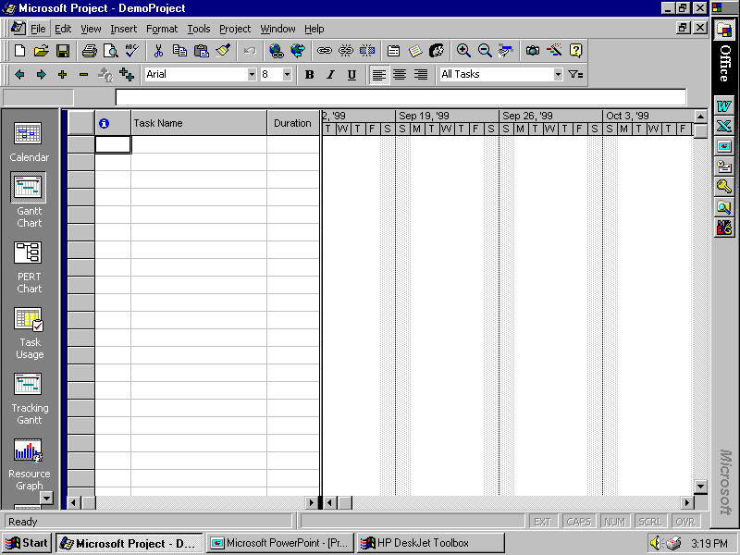

Slide 40
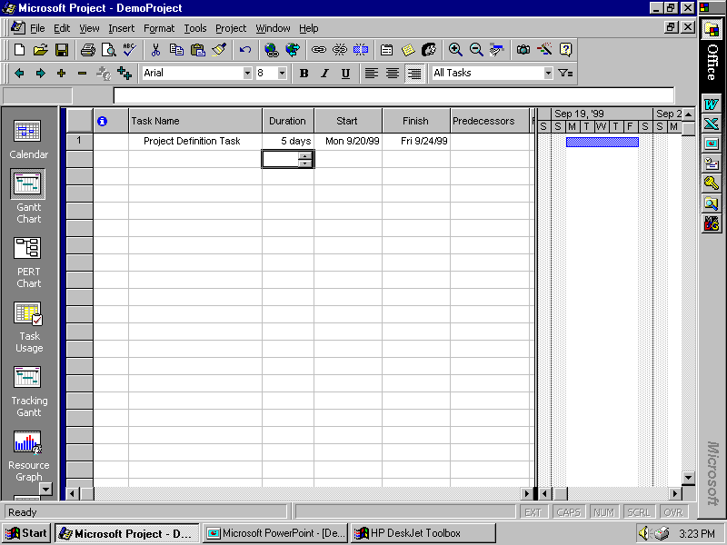

Slide 41
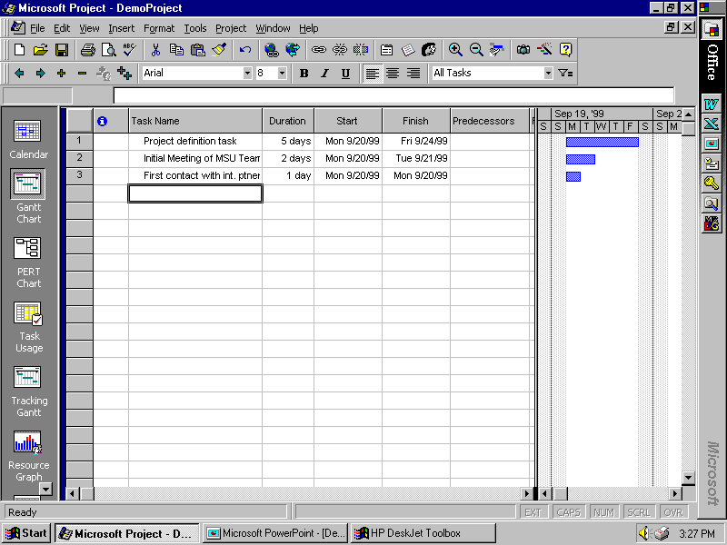

Slide 42
Our “Flyover” of Project 2010
Adding tasks, durations
Setting dependencies
Seeing critical path, etc.
“Rolling up” subtasks
Assigning resources
Adjusting durations, time assignments, etc.

Slide 43
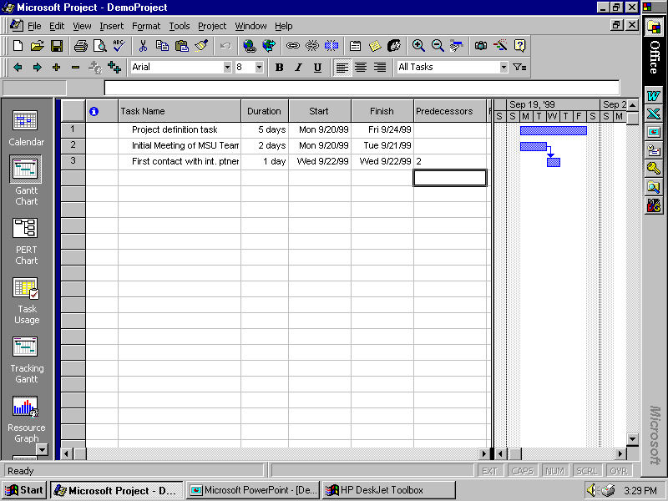

Slide 44
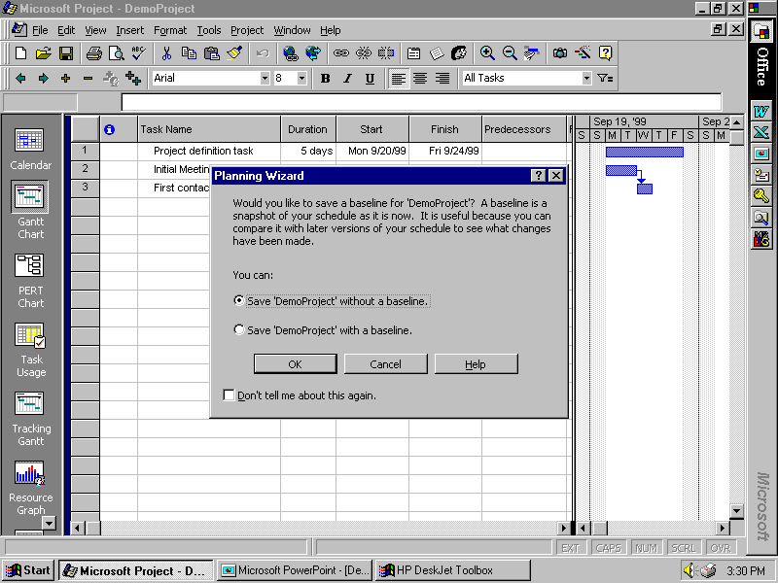

Slide 45
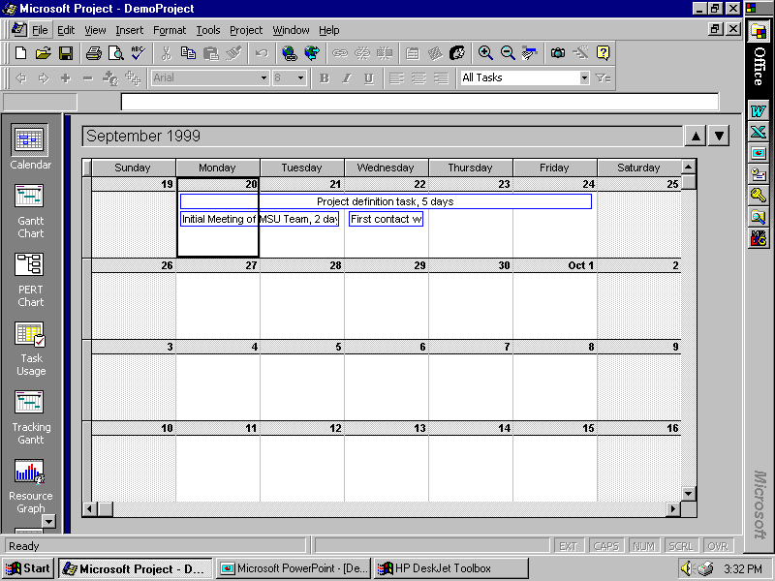

Slide 46
Our “Flyover” of Project 98
Adding tasks, durations
Setting dependencies
Seeing critical path, etc.
“Rolling up” subtasks
Assigning resources
Adjusting durations, time assignments, etc.

Slide 47
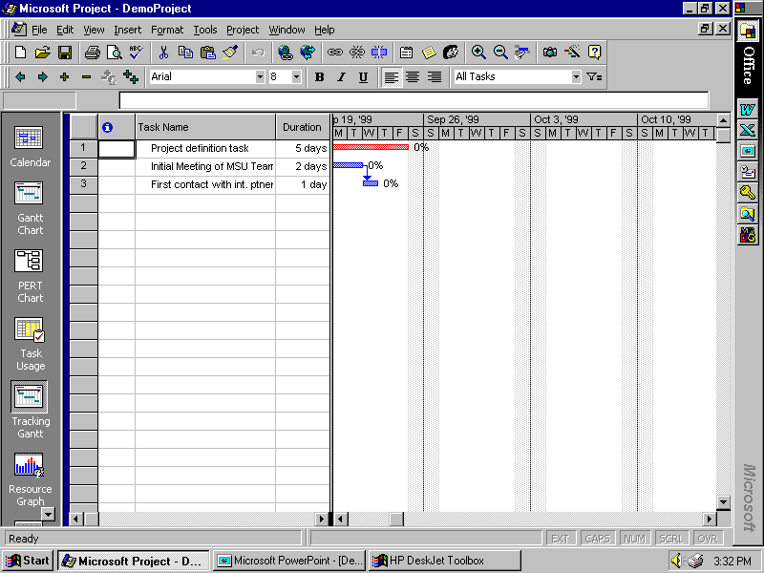

Slide 48
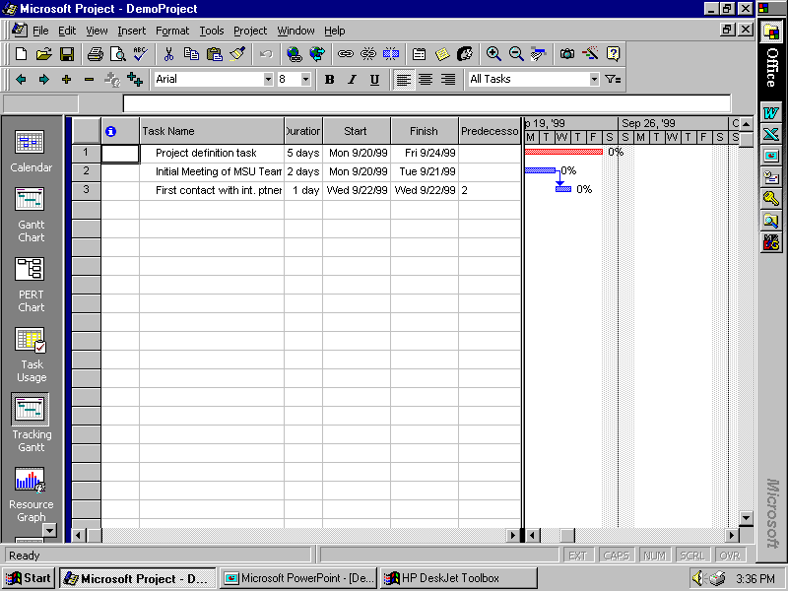

Slide 49
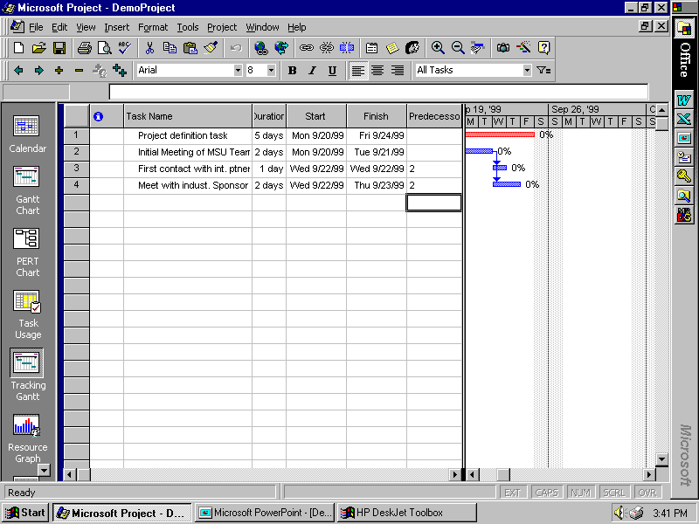

Slide 50
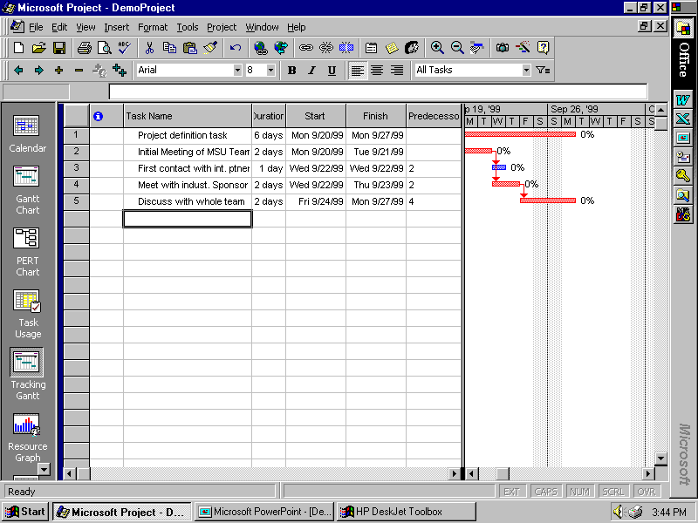

Slide 51
WATCH YOUR DEPENDENCY CHOICES!!!
If you choose something other than the “default” finish/start constraints, you will probably LOSE your ability to track the critical path
So AVOID “finish by” or “start by” with particular calendar dates, or other types of constraints.
Break tasks apart as needed, in order to make finish/start constraints realistic!

Slide 52
Our “Flyover” of Project 2010
Adding tasks, durations
Setting dependencies
Seeing critical path, etc.
“Rolling up” subtasks
Assigning resources
Adjusting durations, time assignments, etc.

Slide 53
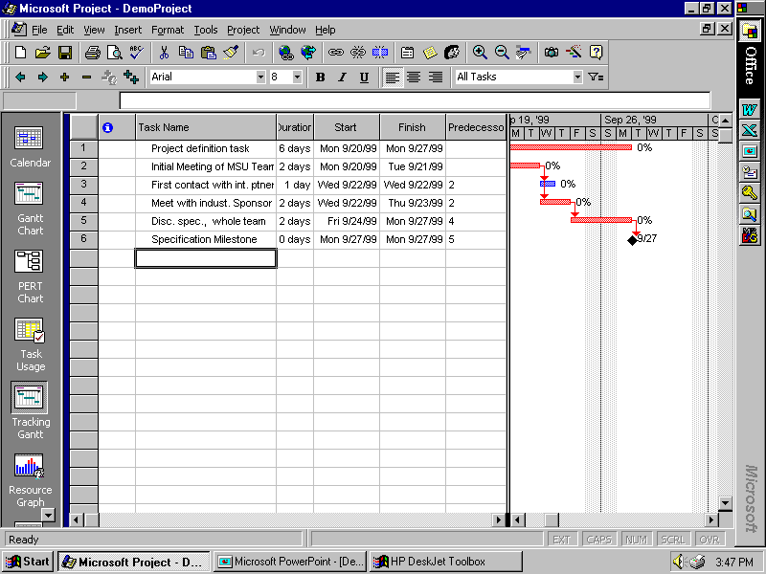

Slide 54
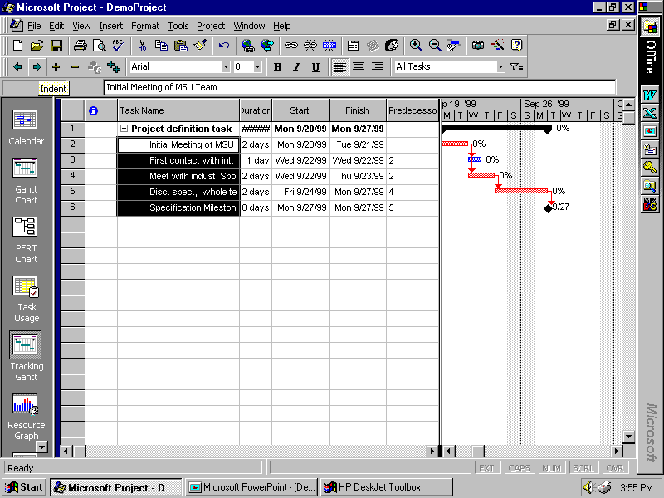

Slide 55
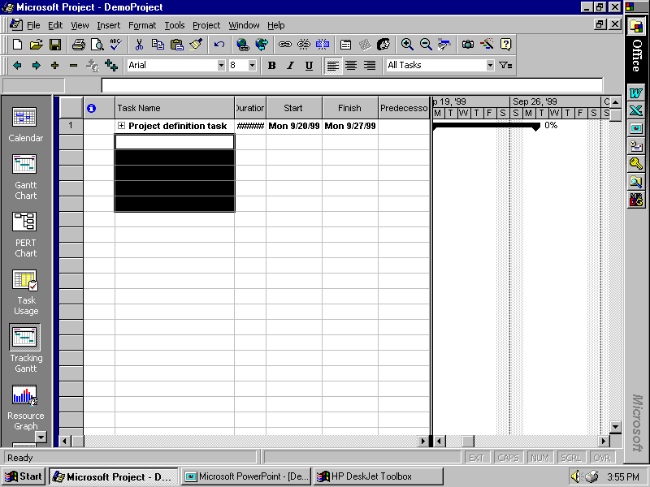

Slide 56
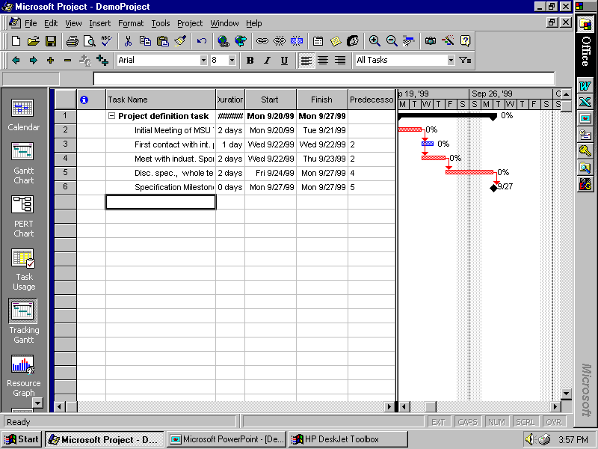

Slide 57
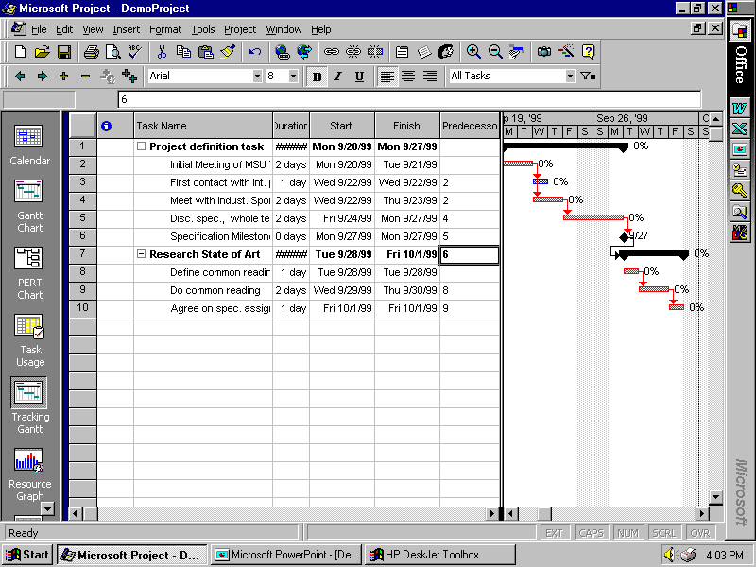

Slide 58
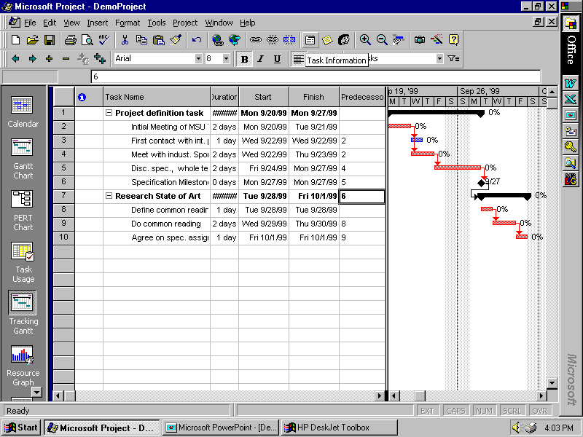

Slide 59
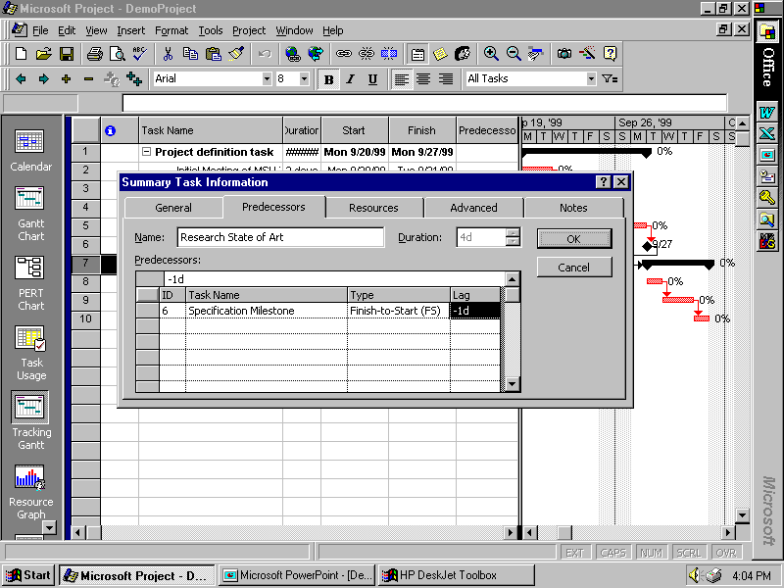

Slide 60
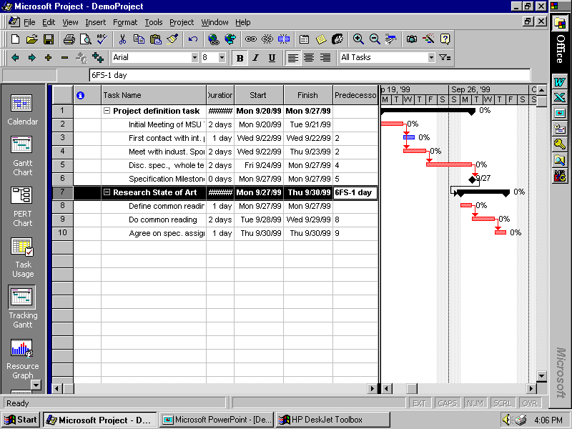

Slide 61
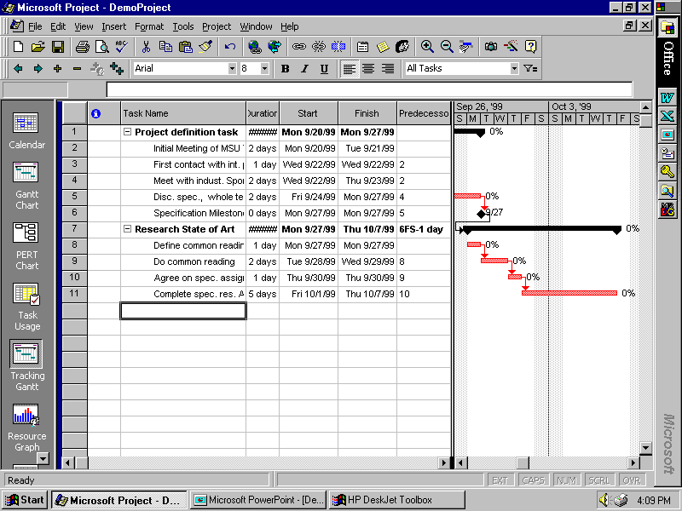

Slide 62
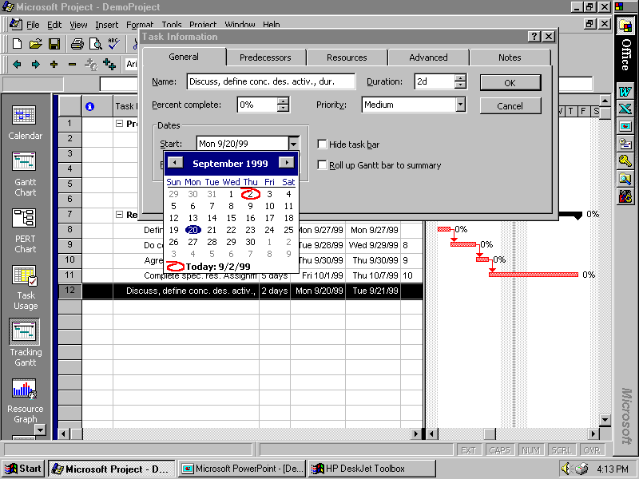

Slide 63
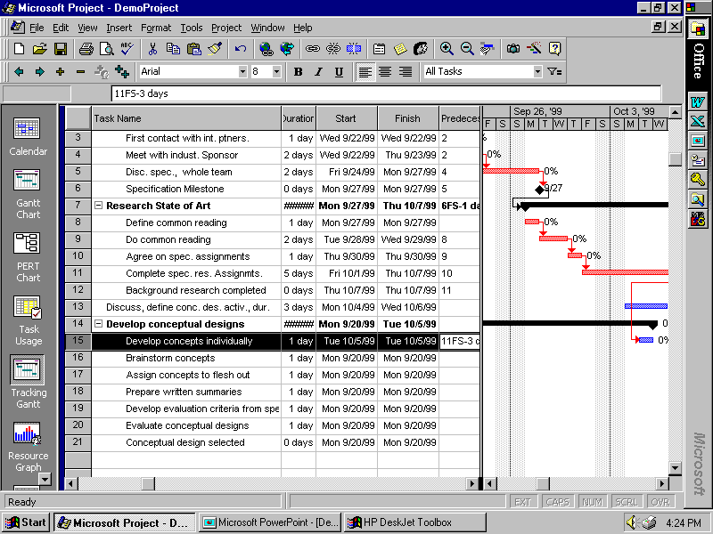

Slide 64
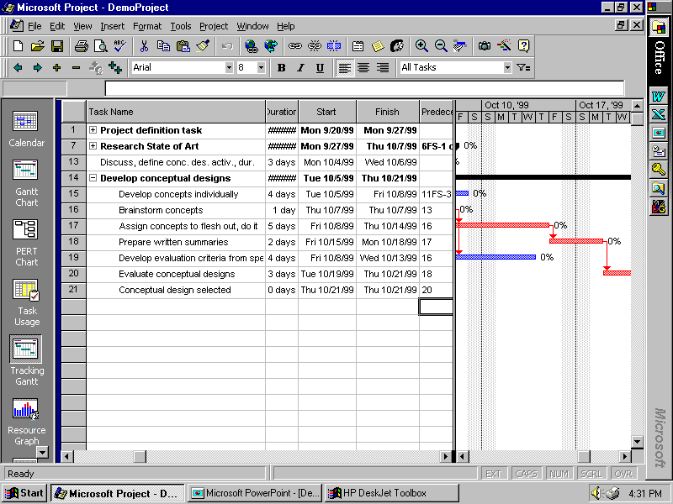

Slide 65
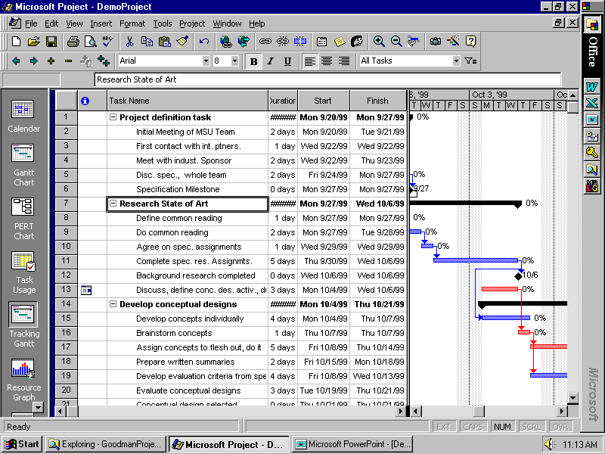

Slide 66
Our “Flyover” of Project 2010
Adding tasks, durations
Setting dependencies
Seeing critical path, etc.
“Rolling up” subtasks
Assigning resources
Adjusting durations, time assignments, etc.

Slide 67
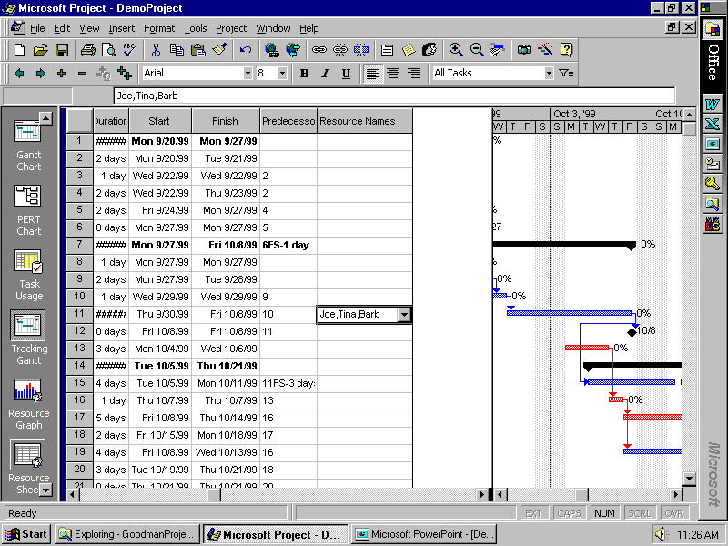

Slide 68
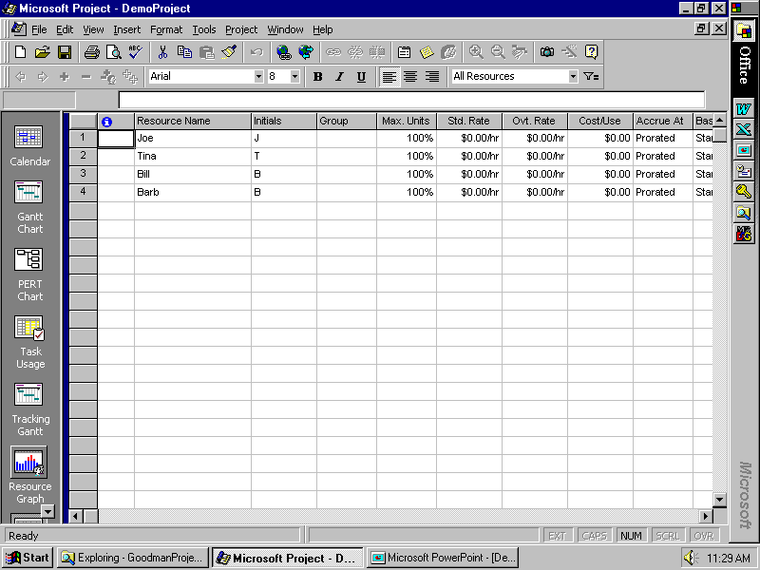

Slide 69
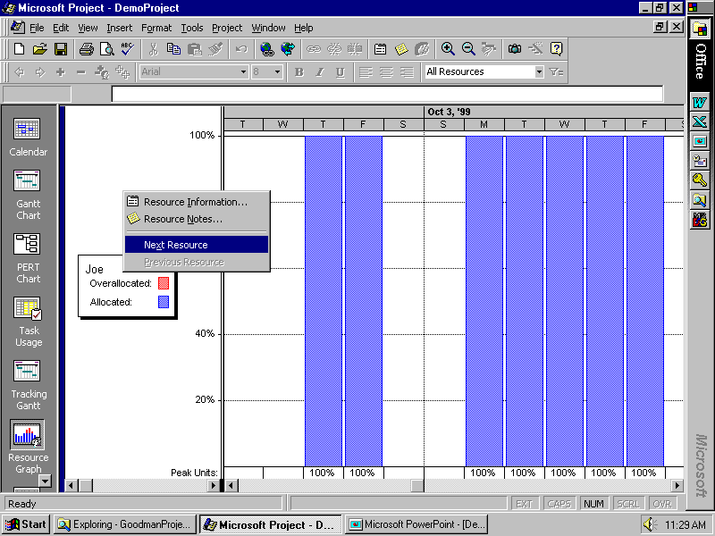

Slide 70
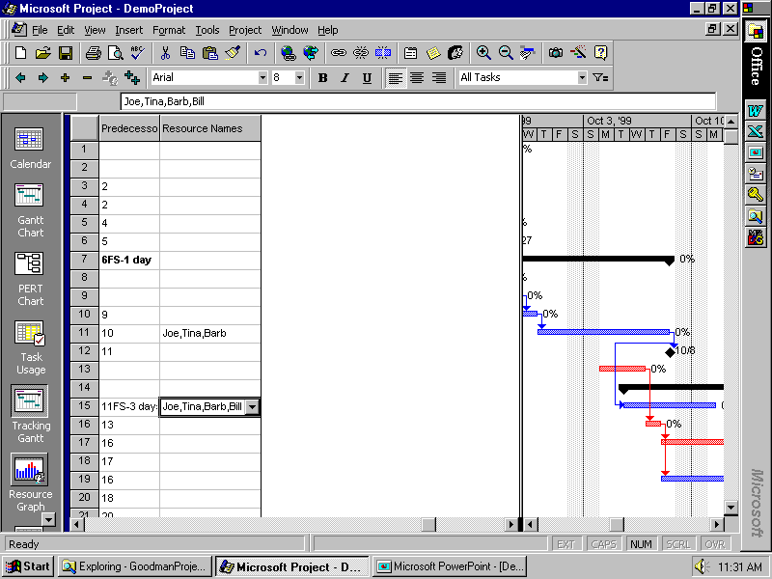

Slide 71
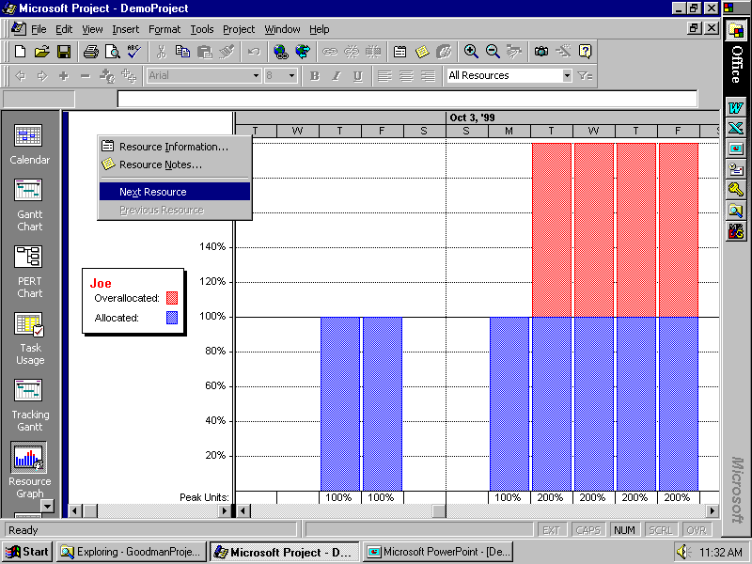

Slide 72
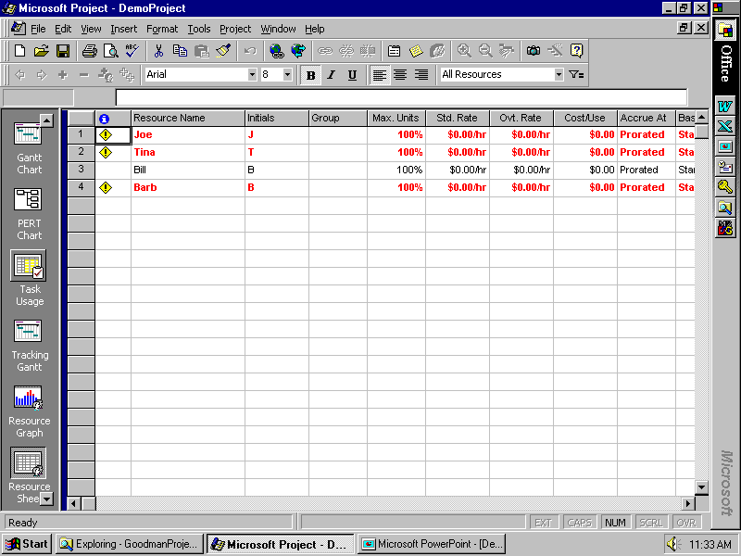

Slide 73
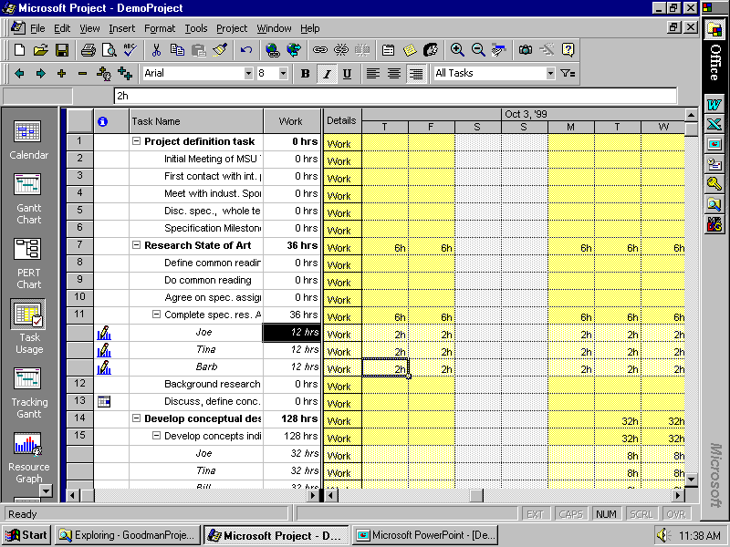

Slide 74
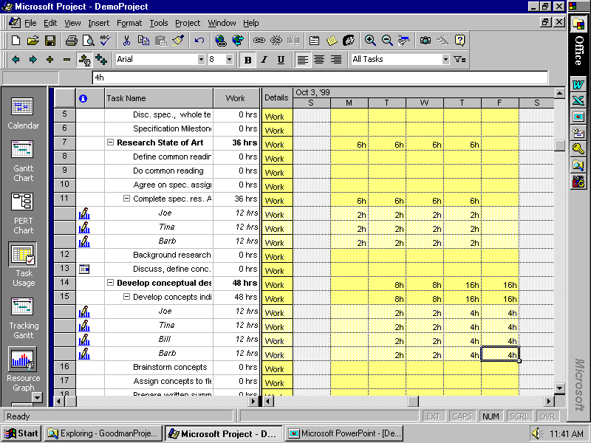

Slide 75
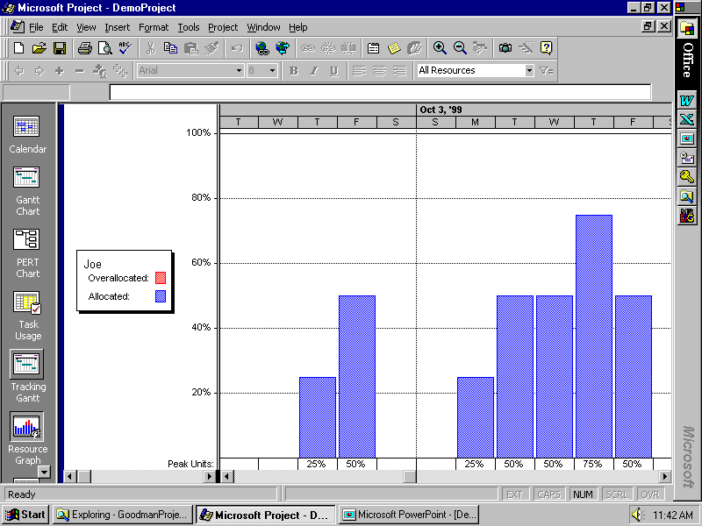

Slide 76
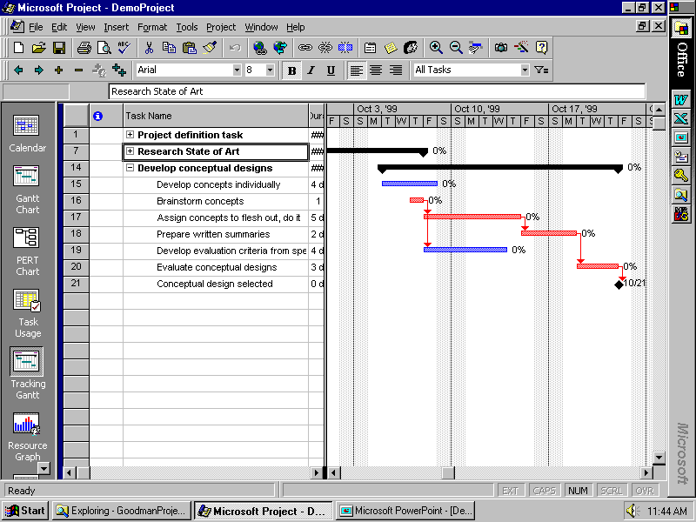

Slide 77
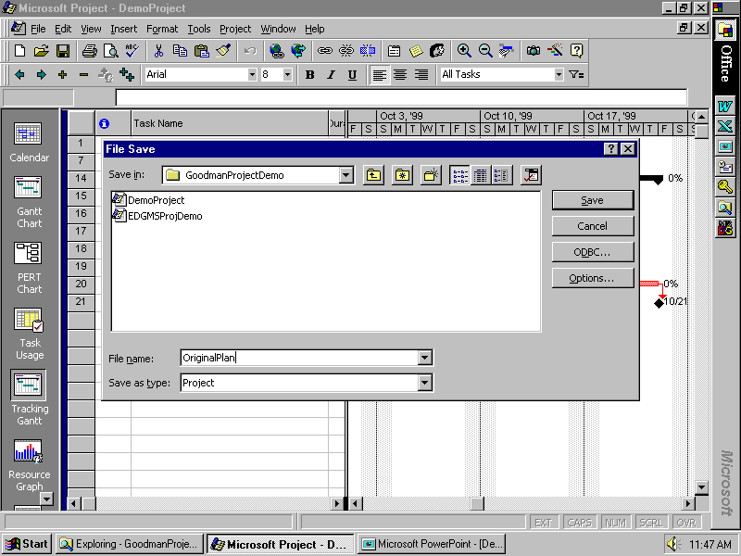

Slide 78
Our “Flyover” of Project 98
Adding tasks, durations
Setting dependencies
Seeing critical path, etc.
“Rolling up” subtasks
Assigning resources
Adjusting durations, time assignments, etc.

Slide 79
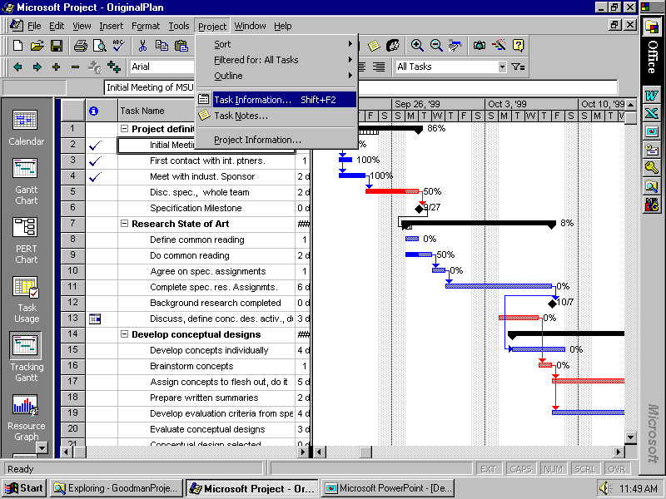

Slide 80
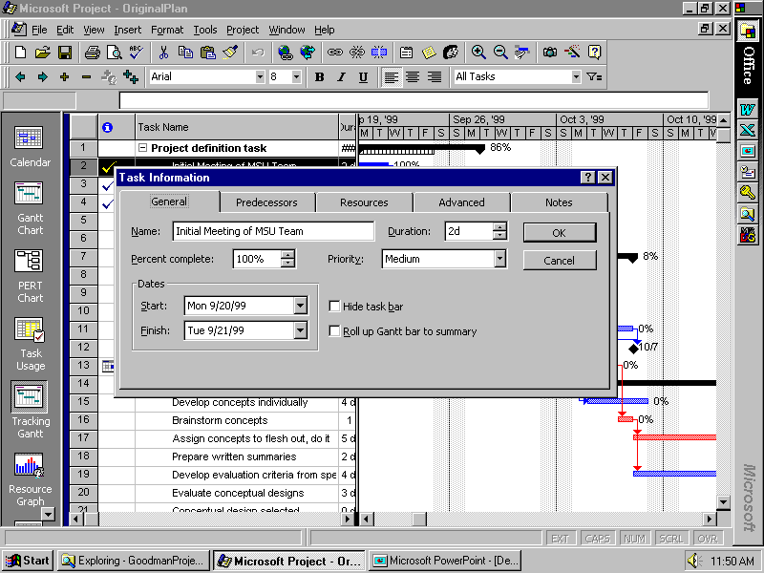

Slide 81
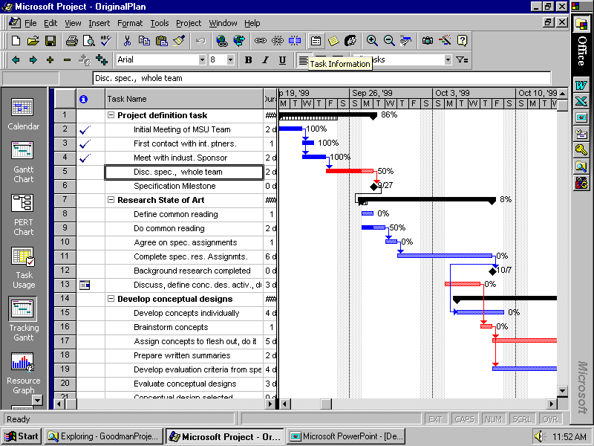

Slide 82
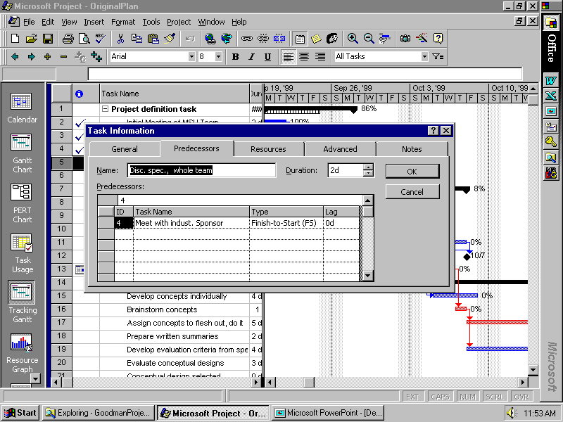

Slide 83
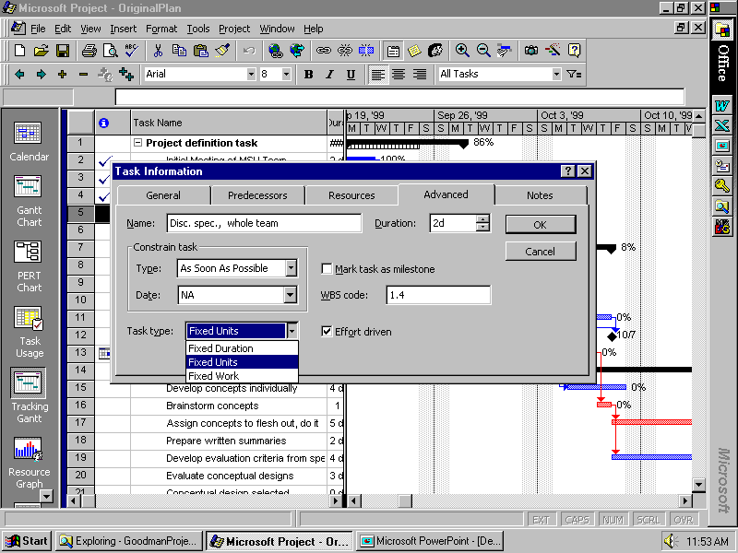

Slide 84
YOUR MS Project has a “Deadline” box
on this page! Use it to let you get warned when something gets pushed back too far, but STILL not assigning a “start no earlier than” or “finish no later than” constraint to it – still using “As soon as possible.”

Slide 85
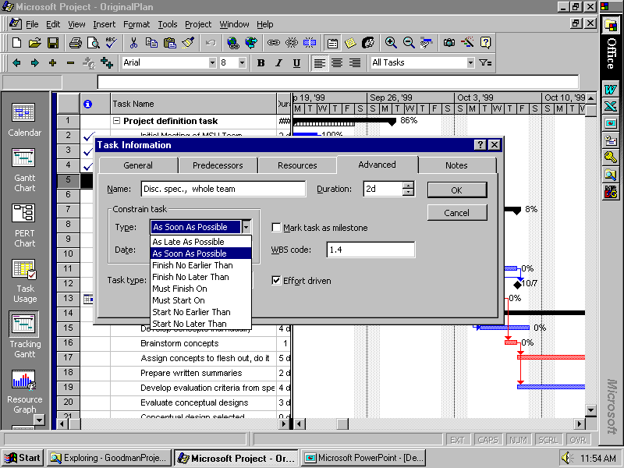

Slide 86
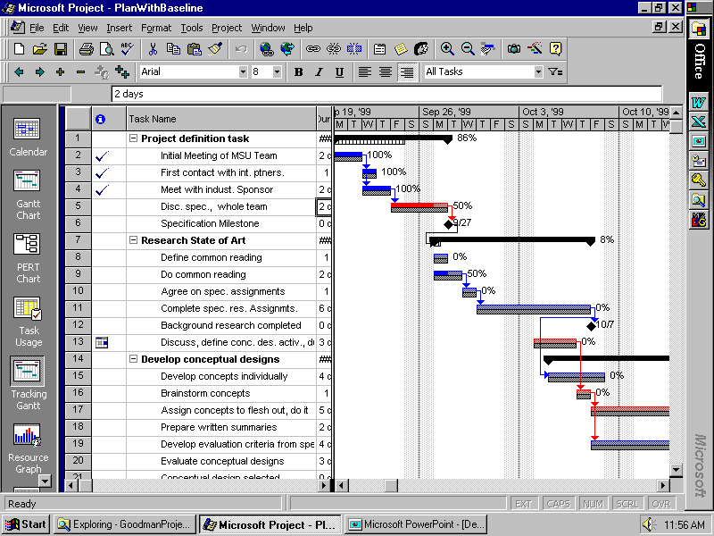

Slide 87
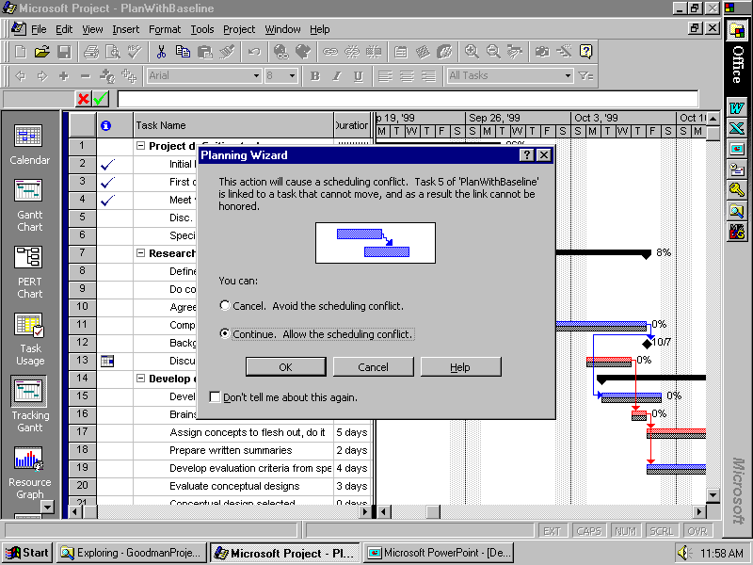

Slide 88
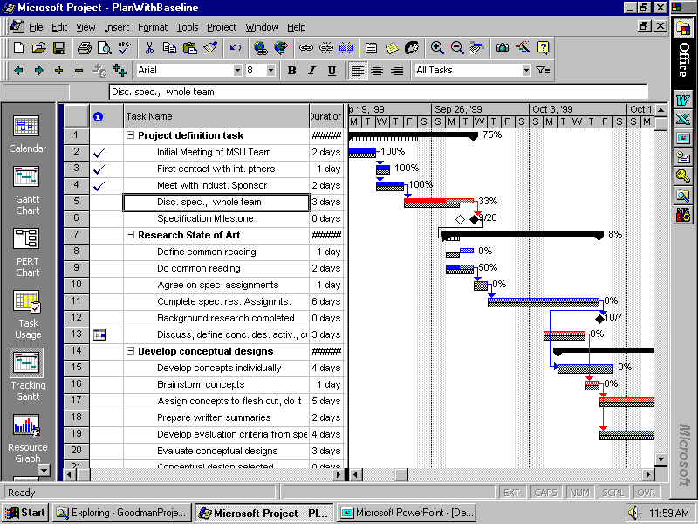

Slide 89
Management of YOUR Project
With your team members
Create a plan for the entire project
Set milestones for tracking progress
Provide more detail for near-term tasks
Use with your facilitator to report progress and revise/add detail to plan
Assign specific tasks to team members
Revise plan and activities as required to achieve objectives

