Slide 1
SHOOT TO EDIT
AND SOME OTHER STUFF
ABOUT FORMATS
HD

Slide 2
THE EDITOR…
If you’re thinking about becoming a professional editor, do NOT train yourself on programs like Premiere. Learn AVID Media Composer. You can edit with any program, but AVID is more than mere buttons. Its user interface + shortcuts understand the editing process better than ANY other commercial program!
ORGANIZATION
MEMORY
PERFECTIONISM
Obsessive organization skills – everything labeled
Images, sounds,
connections etc.
REGISTERED - single viewing
Exteme attention to detail
Extreme observation skills – they miss nothing
TEMPO / RHYTHM
EXTREMELY FAST
DECISIVE
Innate sense of rhythm, bpm and ability to pitch!!!
Savvy with shortcuts!!! TOUCH TYPING!!!
Snappy decisions!!
HOURLY RATES……..
AND THIS IMAGE OF KEYBOARD SHORTCUTS FOR PREMIERE – CHECK YOUR VERSION BUT MOST DEFAULTS NEVER CHANGE EVEN AMONG DIFFERENT PROGRAMS

Slide 3
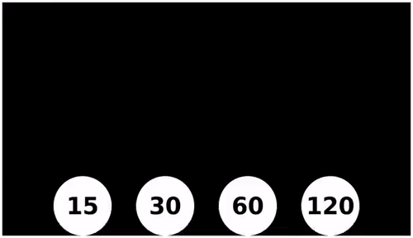
FRAME RATE

Slide 4
FRAME RATE
NTSC
National Television Standards Committee
USA
30fps (60 interlaced)
PAL
Phase Alternating Line
Europe, Australia, Asia
25fps

Slide 5
INTERLACING
Interlaced e.g., 1080i
Non-Interlaced aka Progressive e.g., 720p

Slide 6
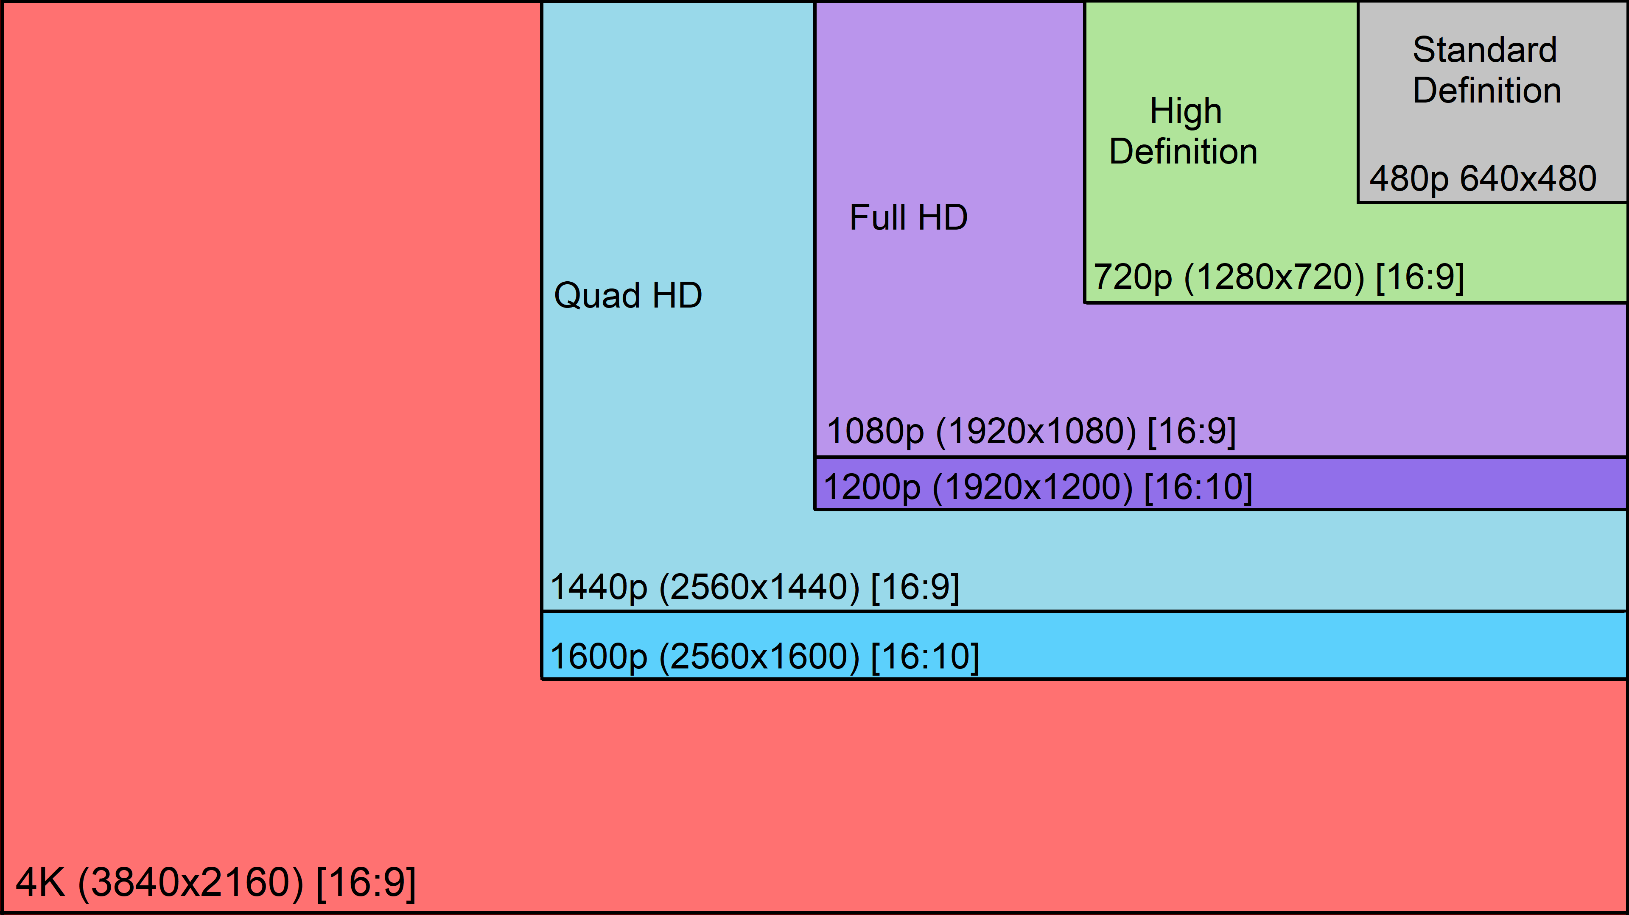
RESOLUTION

Slide 7
premiere

Slide 8
preferences
SET THAT PROGRAM

Slide 9
PRODUCTION
ORGANIZE ORGANIZE ORGANIZE
POST-PRODUCTION
SHOOTS – label EVERYTHING
Thematically (e.g., interviews)
Chronologically
Takes? …hmm depends
Frequent cuts for generic shoots
BINS + MEDIA – label EVERYTHING
Thematically
Chronologically
According to type (e.g., sound)

Slide 10
PRODUCTION
CUTAWAYS
ESTABLISHING
SHOTS
15” to 30” of generic
static or moving shots
of objects, hands etc.
Details, details, details.
Shots that help navigate the visual narration.
Especially!! Locations
DOUBLE TAKES
ALIGN
After shooting it…
Shoot it again…
And… one more time.
Don’t look at the action…
Look at your FRAME!

Slide 11
CUTAWAYS

Slide 12
ESTABLISHING SHOTS

Slide 13
DOUBLE TAKES for everything: static, pans, tilts

Slide 14
ALIGH – mind the horizon

Slide 15
ALIGH – look around the edges of your frame!

Slide 16
ALIGH – look around the edges of your frame!

Slide 17
PRODUCTION
Record room sounds. You might need as ambient a sound that helps merge cuts with sound inconcistencies.
If there is a source of noise that is messing up your main shot, TAKE a shot of the noise as well (e.g., nearby road with traffic, a cat meowing, someone doing construction work). You might be able to salvage your scene by incorporating that noise into your narrative.
When taking double takes reflect on whether there is something you can change the 2nd and 3rd time that might help the editor (e.g., different speed, framing, slight change of angle).
Always, always, always let the camera roll, paying attention to the sound as well, for +10 secs (at the beginning + at the end of a scene) or for 15 consecutive seconds for a static shot.
BE SMART ABOUT CUTAWAYS – HAVE MORE THAN YOU MIGHT NEED!!!
Here is info about the DUTCH TILT – if you’re gonna mess with your camera’s tilt do it correctly
POST-PRODUCTION
PREMIERE. SPEND AT LEAST A FEW HOURS LEARNING SHORTCUTS AND FAMILIARIZING YOURSELF WITH BUTTONS AND EFFECTS. YOUR LEFT HAND IS AAAAAAALWAYS ON THE KEYBOARD, READY TO PRESS C, V, I, O, Q, E, etc… All these keys will DO something! DO NOT WORK WITH THE MOUSE, it will double! the time needed to finish your editing!!!
Less IS more – don’t make unnecessary cuts!!!
When watching your editing again and again to make sure your flow is right, your rhythm is right and your cuts don’t “jump”, never watch only the specific spot you’re working on. The editor is patient and watches big chunks of the material again and again and again and again… and again…

Slide 18
Fun YouTube channels that can make you a better storyteller, director and editor without annoying or lecturing you.
https://www.youtube.com/user/CinemaSins
https://www.youtube.com/channel/UCL8h3ri2WN_-IbviBlWtUcQ
https://www.youtube.com/channel/UCVjsbqKtxkLt7bal4NWRjJQ
https://www.youtube.com/channel/UCCYX4s1DCn51Hpf1peHS30Q

