Slide 1
Landscape, a Societal Issue: the Example of Greece
Theano S. Terkenli University of the Aegean, Department of Geography, t.terkenli@aegean.gr
“Transitions in Landscape and Land Use”, Lesvos, 12-18/ 6/ 2013
VOLANTE and University of the Aegean Ph.D. Summer School

Slide 2
Context and Objectives
The major grand challenges facing our society are embedded in landscape: climate change, energy needs, health and safety, food security, urbanization and migration, loss of biodiversity and cultural heritage, rural exodus, lifestyle changes, etc.
Likewise, many of the solutions to these problems and challenges that contemporary societies face stem from the landscape: ‘green development’, creation of employment, resource sustainability, educational opportunities, scientific growth, tourism and recreation.
Despite recent advances in landscape science and technology, landscape multifunctionality, sustainability and identity endangered.
Current crises: greater risk to the S. European landscape, due to economic re-prioritizing and social pressures for its resources.
This presentation revisits the cultural constitution and social relevance of landscape, through an critical exploration of Greeks’ relationship with landscape, closing with a series of reflections/ hypotheses about the role and meaning of landscape for societies, in times of change.

Slide 3
Part I. LANDSCAPE Landscape and Geography
Geographers have been traditionally arguing for a cultural definition of the landscape. Moreover, in the last few years, the cultural constitution of the landscape has been gaining ground in all scientific fields pertaining to the landscape (Tress and Tress, 2001).
On this basis, the landscape may be conceptualized as a literal or metaphorical image of the humanized environment (Urry, 1995; Daniels and Cosgrove, 1988; Cosgrove, 1998). “As a portion of land which the eye can comprehend at a glance” (Jackson, 1984:3). It represents both a medium and an outcome of human perception, experience and action.

Slide 4
Part I. LANDSCAPE From the tangible …
A) Landscape is constituted and substantiated primarily through the human senses and—historically—mostly through its visual attributes (Tuan, 1979; Meinig, 1979; Rose, 1996; Nash, 1996; Appleton, 1996).
This landscape dimension refers to its form/ structure and its ‘objective’, tangible entity. Accordingly, landscapes are created by human action and experience, inscribed in place through time, enhancing and upholding human livelihoods (landscape and regional scales of analysis).
B) The tangible landscape quality recently upheld also by more-than-representational geography (Thrift 1996/2007, Lorimer 2005/ 2008), turning to the most intimate scale of landscape articulation, intricately relating the subject (observer, user, visitor) with the object of perception, intervention or pleasure (landscape).
C) The enduring intensity of pleasure sought and found in landscape, since the Renaissance, by a then emerging European bourgeoisie, expresses something profound and constant about the human condition (Daniels in Rose 1996: 345), ‘something’ that links landscape and pleasure or attraction inextricably together.

Slide 5
Part I. LANDSCAPE … to the intangible
Inextricability of landscape definition and landscape production/ reproduction/ consumption from the scale of the human body and human reach—be that landscape as home, as an economic resource or as an object of recreation, i.e. pleasure of walking.
Regardless of scale, however, real, perceived or imaginary landscape becomes only through its relationship with its ‘observer’. Multiple ‘landscape spatialities’. “We are the landscape”.
Our lives are carried out and assume their meanings through landscapes: quality of life, landscape/place/cultural identity, everyday practices.

Slide 6
Part II. LANDSCAPE AND SOCIETY The Case of Greece—the study context
Downgrading and sometimes downright destruction of the contemporary Greek landscape: widely addressed.
The causes are well-known. Perhaps, most significant among these: a) rampant urbanization in the 1950’s and 1960’s, leading to a mass migration of the rural population into the major urban centers, and to the abandonment of agriculture and livestock raising and b) the boom in the unplanned growth of tourism and vacation home construction—much of it illegal—in the countryside.
Within the problem lies its solution: urbanization and tourism.
This presentation will mainly elaborate on the deeper causes of the landscape problem in Greece: its cultural roots, as well as the cultural means to its remedy and rectification. It will be argued that:
As Greek landscape problems effectively started with the urbanization boom and unplanned/ illegal recreation development, so Greeks are beginning to re-discover landscape, mainly through a) the country’s urban transformation, giving rise to new ways of life and a yearning for a return to the countryside, and b) through domestic tourism.

Slide 7
Part II. LANDSCAPE AND SOCIETY The Case of Greece—the cultural backdrop
In search of the necessarily urban origins of a landscape conscience, the legal, historical, aesthetic, and socio-cultural trajectory of Greeks’ relationship with their landscapes has already been examined elsewhere (Terkenli 2010, Manolidis 2008, Stathatos 1996).
The unfulfilled cultural geography of the Greek landscape has its origins in a multitude of factors, such as: the deficient industrialization of the country; the prevalence of a ‘market-place principle’ among its populace (McNeill 1978); the role of Greek Orthodox ecclesiastical art in landscape representations; the lack of a sense of commons concerning environmental resources: only a few, but critical, pieces of the puzzle.
Although any sort of spatial conscience generally attributed to a cultural system tends to find its roots in the history of a modern nation-state, caution must be exercised in generalizing and totalizing as regards whole cultures or social systems.

Slide 8
Post-war Greece: modernization and development defined mostly in economic terms, often to the detriment of environmental, socio-cultural or civic values.
The disintegration of the traditional environmental conscience of formerly rural populations with regard to outdoor resources, including the landscape, has been replaced by rampant laisser-faire capitalism, land speculation, illegal construction, and short-term profit in most entrepreneurial activity domains.
‘As far as the Greek perception of natural space is concerned, the problem is exacerbated by a peculiarly Greek form of parochialism, whereby allegiance is pledged to extremely small territorial subdivisions, down to the level of neighborhood or village’ (Stathatos 1996:16).
Long-term cultural particularities, such as clientelism and patronage, have been responsible for an atrophic civil society (Demertzis 1997), with serious repercussions on community life. ‘Despite decades of social and economic change, the state still overwhelms civil society, and personal and family ties remain significant in most areas of life. The domination of civil society by the state is an overwhelming fact of Greek economic, social, and political life’ (Legg & Roberts 1997:72).

Slide 9
Part II. LANDSCAPE AND SOCIETY The Case of Greece—a matter of conscience
Consequently, environmental and landscape matters were relegated to the jurisdiction of the state and absolved of individual, personal responsibility, despite the fact that such attitudes are detrimental to the environment and the landscape: many of the threats the latter face need countering by long-term policies that often demand the sacrifice of short-term private interests.
Thus, landscape never constituted a collective good for most Greeks, and especially for urban Greeks. No sense of the landscape as part of a common home (Terkenli 1993).
Greece’s problematic relationship with its landscape is a cultural problem: it may be traced to lack of a defined and well-developed landscape conscience in the country, as compared to other modern (European or not) nation-states.
If ‘conscience’ is defined as the mixture of perceptions, thoughts and emotions, it presupposes the existence of an external world (Sutherland 1989). Landscape conscience refers then to the distinctive bonds (conscious or subconscious) that characterize a person’s or a people’s relationships with their landscapes.

Slide 10
In search of the urban origins of a landscape conscience, tracing the historical, aesthetic and socio-cultural trajectory of the relationship of Greece with its landscape, in the past 150 years:
Greece never went through a Renaissance, an urban rebirth, baroque phase, etc. It rather adopted aspects of modernity in certain realms of life, a posteriori, by implanting and overlaying them on pre-existing cultural particularities and local ways of life.
The landscape ideal and form of representation most characteristic of this cultural realm remained the two-dimensional, apparently flat, but actually inverted, perspective of Greek Orthodox art: ecclesiastical iconography, powerfully evocative and compelling for all Greeks, to-date. The Greek landscape was constructed by Western painters, in the 19th century, in accordance to romantic ideals, at the basis of the then emergent Greek cultural identity: a) archaism and b) orientalism (Terkenli et al. 2001).
Greece also never went through a full-fledged industrial revolution. There was not even a bourgeoisie, when the new nation-state of Greece was created, to re-invent the landscape concept, through the urban-rural contradistinction (the urbanites’ nostalgia for the loss of the countryside).

Slide 11
Part II. LANDSCAPE AND SOCIETY The Case of Greece—historical/ cultural causes
One common factor that appears to play a significant role in the development of a landscape conscience in the modern European realm is the advent of the Industrial Revolution. ‘It was precisely this urbanization, and the increasing distancing from nature to which were subjected the population of societies in the process of industrialization, which almost simultaneously created the need for contact with some substitute, however false’ (Stathatos 1996: 16)
Thus, the bourgeoisie reinvented the landscape concept, initially closely tied to the English picturesque landscape school.
A series of new landscape spatialities and a sense of landscape conscience ensued through the newly emergent contradistinction rural-urban, and through the nostalgia of urbanites for the ‘lost’ countryside.
Greece, under Ottoman occupation and cultural stagnation from the mid-15th to the early or mid-19th century, never went through any of the stages of landscape formation and landscape conscience formation that modern European societies have gone through up to our times (Cosgrove 1998; Olwig 2001).

Slide 12
Part II. LANDSCAPE AND SOCIETY The Case of Greece—historical/ cultural causes
Upon becoming ‘urban’, Greeks lost the old connection with the land, nature, and the landscape, traditionally been handed down from one generation to another. The few already existing urbanites and the children of the first and subsequent generations of rural migrants into the big cities never developed a sense of landscape, in the first place.
Most significant: the lack of a sense of community (a cooperative, ethically active and vigilant strategy of generous mutuality) and a sense of the landscape as a “common good” (Bromley 1991, Ostrom 1990, Tuan 1986).
Rather, among Greek cultural characteristics, a “marketplace principle” has persisted since the antiquities, in Greek social life, all the way up to the present (McNeill 1978).
The Greek landscape, taken for granted till the end of the 1970’s, was first acknowledged through interconnections emerging then between agricultural modernization and the rural landscape (nature vs society) and through tourism.

Slide 13
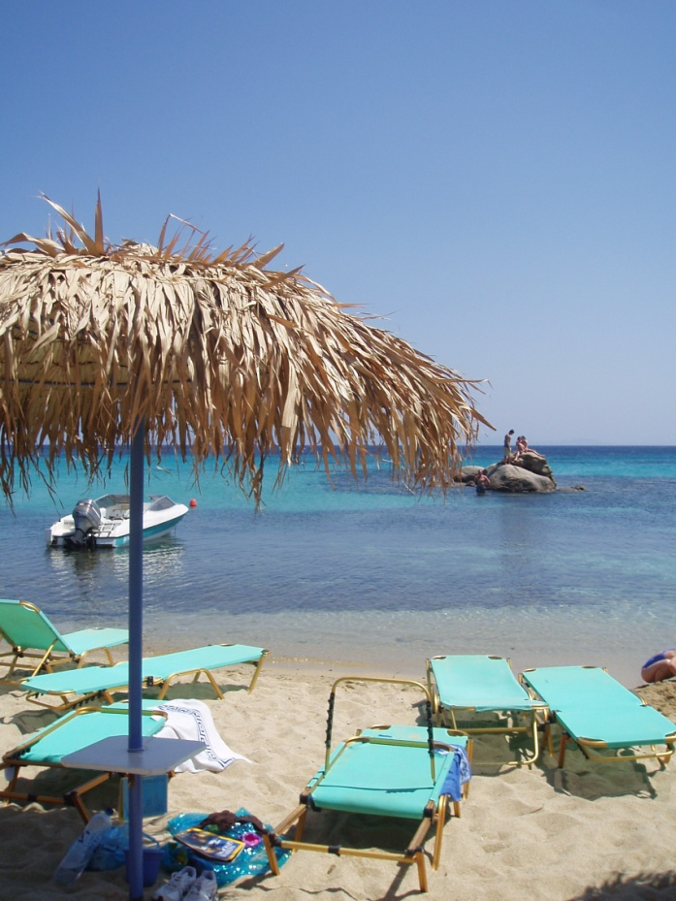
Part II. LANDSCAPE AND SOCIETY The Case of Greece—urbanization and tourism
Rampant urbanization in the 1950’s and 1960’s, lead to a mass migration of the rural population into the major urban centers, and to the abandonment of agriculture and livestock raising.
Need/ acknowledgment of landscape came through the insurmountable pressures of urbanization. Also loss of landscape (i.e. forest fires of summer of 2007) and EU’s CAP played a role in the rediscovery of the Greek landscape, but it was mostly, urban culture that propelled changing attitudes:
The need for ‘nature’, and nostalgia for ‘Greece as it used to be’ culturally, physically, ethically, aesthetically, historically, and symbolically—as opposed to life in the city: mainly materialized through internal tourism, often in search of personal or collective identity and ancestral roots.

Slide 14
Part II. LANDSCAPE AND SOCIETY The Case of Greece—urbanization and tourism
Since the early to mid-1990’s, the balance of tourism demand in the country between international and domestic tourism has been changing. Whereas, till then, international tourism had been most significant and well developed (over 75% in 1989), the trend has since been partly reversed, although domestic tourism is extremely difficult to measure.
In the past 10-15 years, Greeks have been rediscovering their landscapes en masse. The reasons are: a) a higher standard of living and intolerable conditions of city life, b) aggressive advertisement and promotion of Greek destinations by the state and the supply side, and c) the combination of emerging alternative tourism forms/ opportunities with the discovery by the Greeks of “long-weekend” tourism.
A detailed study of domestic tourism, shows that—excluding special motives (such as convention or health tourism)—among the 3 most significant motives of domestic tourism in Greece, is the environment, generally speaking (no explicit “landscape” category), third in people’s preferences, after “holidays and entertainment” and “rest and relaxation” (Tsartas et al. 2001). Not surprise: it is 3S tourism that most Greeks pursue during their established vacation period in July/ August.

Slide 15
Part II. LANDSCAPE AND SOCIETY The Case of Greece—urbanization and tourism
Instead of a full-fledged industrial revolution, tourism has been the main source of the development of a countryside awareness among contemporary Greeks.
Through domestic tourism, Greek urbanites have slowly began to develop a landscape conscience, to rediscover landscape, and, through it, to rediscover family roots, local histories, ‘authentic’ Greece and to ‘return to nature.’
Concurrently, these tourism/ recreation landscapes have been turning into urban or semi-urban consumption spaces, through recreation activities and second-home construction.
Thus, the (mostly rural) landscapes themselves—whether coastal, island, mountain or other—have been adjusting to their new uses, through a) the preservation solely of landscape forms, for purposes of visual appeal, and through b) the protection of their basic (or selected) rural or natural features, for purposes of tourism consumption (ranging from local products to beautiful beaches).

Slide 16
These representations promote an imaginary country on which the sun always shines brightly, where the sea is always blue and placid, the houses invariably freshly whitewashed, and all of whose inhabitants are permanently cheerful, welcoming and colorful (Stathatos 1996).
The problem is that Greece has been exporting, but also consuming this distorted image of itself, for 4 consecutive decades, and there is reason to believe that it may be becoming innate.
Post-war Greek governments were quick to realize the vast profits that could be made out of a modernized tourism industry; the result was an intensive promotional campaign at home and abroad--still active today--through publicity photographs, posters, postcards and other representations of Greek space.

Slide 17
Part III. LANDSCAPE IN TRANSITION Landscape in a time of change
Context: landscapes around the world, old or new, highly-prized or ordinary, prominent or mundane, are increasingly calling for acknowledgment/ recording, preservation, management and/ or development. Some are under threat of being irreparably lost.
Forces of globalization have been transforming spatial and landscape organization, through processes of ‘a new cultural economy of space’: globalization, standardization and simulation of landscapes (elements/ dimensions); landscape deconstruction/ redefinition; and the loss of pre-existing place/ landscape identity (Terkenli and d’Hauteserre, 2006).
RESULTS:
formation of new types of landscapes, often disconnected from local geographies and histories— ‘inauthenticity’/placelessness;
commoditization of landscape, in any or all of its dimensions—emergence of a symbolic economy (Zukin 1995); and
its constant reproduction/ promotion and dissemination around the world, through actual, virtual or imaginary connections and flows, via booming info-communication technologies (Gantzias 2012).

Slide 18
Part III. LANDSCAPE IN TRANSITION Crisis and the tangible landscape
Landscape as a common good: common property/ responsibility. It belongs to everybody, for a variety of uses, hence the significance of participatory landscape governance (Jones and Stenseke 2011).
In times of crisis, a return to the landscape for purposes of survival and building a ‘better life’: urban outmigration; community garden plots; sustainable energy sources, a revival of (organic) agriculture; alternative forms of tourism (camping, cycling, etc).
For instance, significance of landscape for tourism—inextricable link, brilliant prospects for various forms of tourism development, based on the principles of locality and sustainability, i.e. local products.
The tangible landscape is, thus, a valuable resource, widely accessible and available: a solution to shortage and a medium/ means of sustainable development (return to ‘greener’ ways of life).
Under severe threat of depletion, through lack of comprehensive planning and proper management—especially in the case of fragile, overextended, overpopulated Mediterranean landscapes.

Slide 19
Part III. LANDSCAPE IN TRANSITION Crisis and the intangible landscape
Not only does the extraction of all means for life come from the landscape, but also all we humans are constituted of the landscape.
At a cultural level: we are the landscape and the landscape is us. If we are to protect and preserve our identity, we need not only to preserve our natural heritage and our historical/ archaeological treasures, but also our landscape, that lies at the core of our cultural constitution. We are a product of these landscapes.

Slide 20
Part III. LANDSCAPE IN TRANSITION Crisis and the intangible landscape
At a personal level: landscape is contact, communication, introspection, self-quest, exploration, attraction, pleasure, involvement… Landscape ~ therapy, a source of inner balance.
All of these dimensions of landscape are of extreme and timely relevance to societies in crisis, such as those of the Mediterranean.
Need to re-assert our identities and gain our livelihoods, through our landscapes, but also need to find in them a spiritual shelter/ retreat and a source of peace, harmony and affirmation, in times of hardship.

Slide 21
Part III. LANDSCAPE IN TRANSITION Summing up: Landscape in a changing world
“Many of the social, economic and environmental decisions facing Europe and the wider world concern the cultural uses and meanings of the land. Their spatial dimensions can be addressed through the idea of landscape, which comes into being wherever land and people come together” (ESF, 2010:2).
Landscape in a changing world: for Europeans, from quality of life to coping with crises. A retrenchment.
Ways ahead:
1. Development of appropriate tools and intervention strategies ~ change; employment of new info-communication technologies and social media in landscape research, use and management
2. Landscape education and training, towards a lay landscape conscience
3. Engagement of public participation in landscape governance—the only way to secure the future of our landscapes.

Slide 22
Concluding thoughts
Sustainable, integrated landscape management, thus, now more urgently than ever before, needs to address, combine and connect a large number of diverse landscape uses and functions, such as ecological stability, economic viability, expression of place identity, recreational activity, historical dynamics and so on.
This remains quite a daunting task--offering, nonetheless, exciting challenges for all related disciplines, politicians and practitioners, at all levels.
What are harder to negotiate, however—but is our duty to achieve—are human ways of thought and action, central and foremost to any landscape change or articulation (lay landscape conscience): more difficult to adjust than changes in the landscape itself, especially at a time when changes are occurring at a global scale and at long-term time-frames, beyond individual grasp and local or national control.

