Slide 1
Διεθνής Χρηματοοικονομική
Ενότητα 2: INTEREST RATES
Θεόδωρος Συριόπουλος
Τμήμα Ναυτιλίας και Επιχειρηματικών Υπηρεσιών

Slide 2
Άδειες Χρήσης
Το παρόν εκπαιδευτικό υλικό υπόκειται σε άδειες χρήσης Creative Commons.
Για εκπαιδευτικό υλικό, όπως εικόνες, που υπόκειται σε άλλου τύπου άδειας χρήσης, η άδεια χρήσης αναφέρεται ρητώς.

Slide 3
Χρηματοδότηση
Το παρόν εκπαιδευτικό υλικό έχει αναπτυχθεί στα πλαίσια του εκπαιδευτικού έργου του διδάσκοντα.
Το έργο «Ανοικτά Ακαδημαϊκά Μαθήματα στο Πανεπιστήμιο Αιγαίου» έχει χρηματοδοτήσει μόνο τη αναδιαμόρφωση του εκπαιδευτικού υλικού.
Το έργο υλοποιείται στο πλαίσιο του Επιχειρησιακού Προγράμματος «Εκπαίδευση και Δια Βίου Μάθηση» και συγχρηματοδοτείται από την Ευρωπαϊκή Ένωση (Ευρωπαϊκό Κοινωνικό Ταμείο) και από εθνικούς πόρους.

Slide 4
UNIVERSITY OF THE AEGEAN Shipping, Trade & Transport Dpt.
International Finance_{INTFIN}
Professor Theodore SYRIOPOULOS

Slide 5
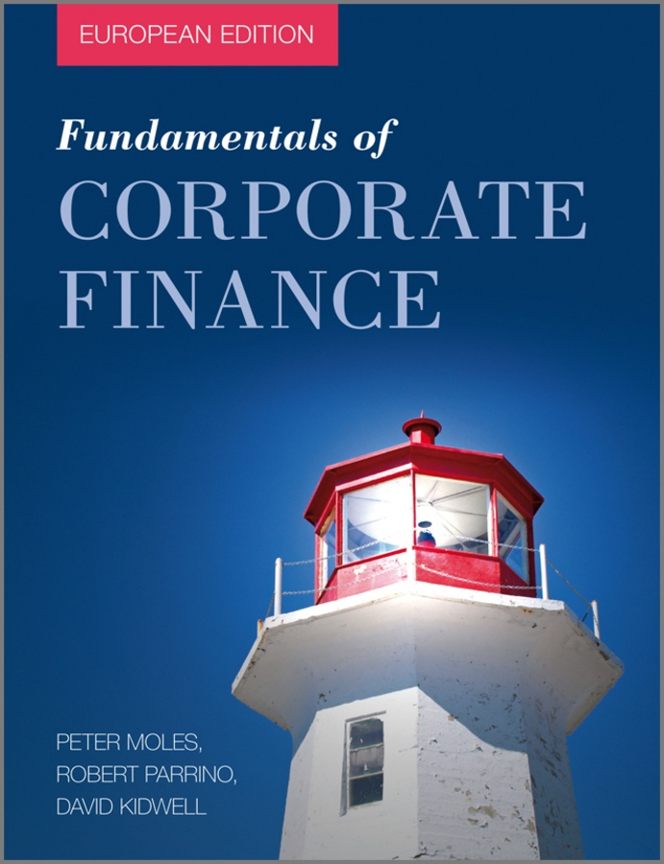
By Peter Moles, Robert Parrino, & David Kidwell
ISBN: 978-0-470-68370-5
© Copyright 2011 John Wiley & Sons Ltd
www.wiley.com/college/moles

Slide 6
Chapter Two
The Financial Environment and the Level of Interest Rates

Slide 7
Learning Objectives
Discuss the primary role of the financial system in the economy and describe the two basic ways in which fund transfers take place.
Discuss direct financing and the important role that investment banks play in this process.
Describe the primary and secondary markets and explain why secondary markets are so important to business.
Explain why money markets are important financial markets for large companies.

Slide 8
Learning Objectives
Discuss the important stock market exchanges and indices.
Explain how financial institutions serve consumers and small businesses that are unable to participate in the direct financial markets and describe how companies use the financial system.
Explain how the real rate of interest is determined in the economy, differentiate between the real rate and the nominal rate of interest and be able to compute the nominal or real rate of interest.

Slide 9
Direct Financing
Quick Links
The Financial System
Types of Financial Markets
The Stock Market
Financial Institutions and Their Services
The Determinants of Interest Rate Levels
Notes:
9

Slide 10
The Financial System
Financial System at Work
The financial system is competitive.
Money is aggregated in small amounts and loaned in large amounts.
Financial system directs money to the best investment opportunities in the economy.
Banks earn much of their profits from the spread between the lending and borrowing rates.
Notes:
10

Slide 11
The Financial System
Moving Funds from Lenders to Borrowers
The financial system is most concerned with funneling money from lender savers to borrower spenders.
Two basic mechanisms by which funds flow through the financial system:
Directly through financial markets
Indirectly through financial institutions.
Notes:
11

Slide 12
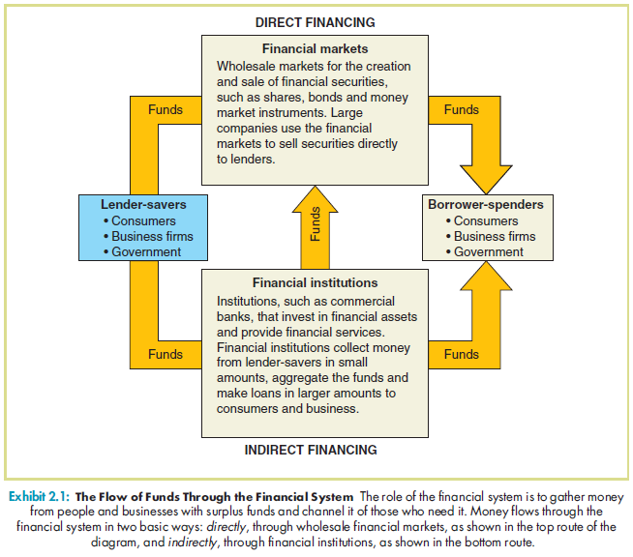
Exhibit 2.1: Flow of Funds Through the Financial System

Slide 13
Direct Financing
Direct Financial Markets
Direct Financial Markets are wholesale markets
Minimum transaction ≥€1 million
Investment Banks help companies sell new debt or equity issues in public or private security markets.
Clearing Banks are large commercial banks in major financial centers
Notes:
13

Slide 14
Direct Financing
Direct Financial Markets
Underwriting is a basic investment banking service to assist firms in the sale of debt or equity in the primary market
Investment banker buys the entire issue at a guaranteed price from the issuing firm and resells the securities to institutional investors and the public.
Investment banker’s compensation is called the underwriting spread.

Slide 15
Types of Financial Markets
Primary Market
Financial market selling new security issues for the first time.
Secondary Market
Financial market where owners of outstanding securities can resell.
Notes:
15

Slide 16
Types of Financial Markets
Marketability and Liquidity
Marketability: a security can be easily sold and converted into cash.
Liquidity: an asset can be easily converted into cash without loss of value.
Notes:
16

Slide 17
Types of Financial Markets
Brokers versus Dealers
Brokers
Market specialists who bring buyers and sellers together in secondary markets.
They bear no risk of securities ownership.
Dealers
They make markets for securities.
They buy and sell from their own securities inventory, so they do bear some risk.
Notes:
17

Slide 18
Types of Financial Markets
Securities Exchanges
Organised Exchanges
London Stock Exchange, Paris Bourse, Deutsche Börse, Milan Stock Exchange, Madrid Stock Exchange, Warsaw Stock Exchange—and others.
Central trading location.
Only members can use the exchange.
Over-the-Counter (OTC) Markets
No central trading location.
Notes:
18

Slide 19
Types of Financial Markets
Money Markets
Global wholesale markets where short-term debt instruments with maturities of less than one year are sold.
Money market instruments have short maturities; Highly marketable.
Instruments include government treasury bills, negotiable certificates of deposit, commercial paper.
Notes:
19

Slide 20
Types of Financial Markets
Capital Markets
Where capital goods are financed with equities or long-term debt.
Public and Private Markets
Public markets are where the general public buy and sell securities through their broker.
Private markets involve direct transactions between two parties.
Notes:
20

Slide 21
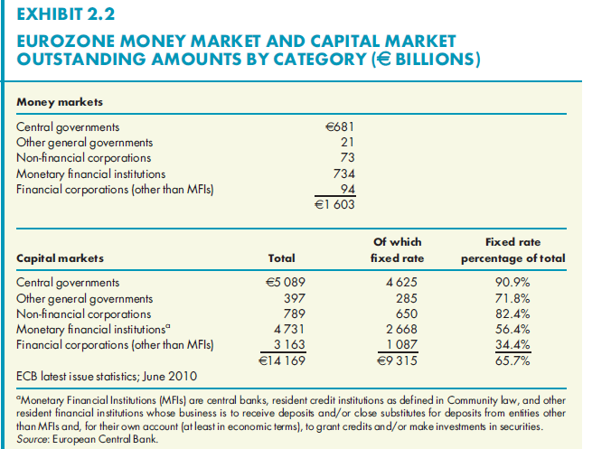
Exhibit 2.2: Eurozone Money Market and Capital Market Outstanding Amounts by Category

Slide 22
Types of Financial Markets
Futures and Options Markets
Often called derivative securities, they derive their value from some underlying asset.
Futures Contracts – contracts for future delivery of securities, foreign currencies, interest rates or commodities.
Options Contracts - call for one party (option writer) to perform specific act at request of option buyer or owner.
Notes:
22

Slide 23
The Stock Market
Main and Second Markets
Large companies are normally listed on the exchange’s main market.
Smaller and more risky companies are listed on the exchange’s second market.
The London Stock Exchange has a second market called “AIM” (Alternative Investment Market)
The Paris Bourse has a second section called “Second Marché”
Multilateral trading facilities (MTFs) are electronic order matching systems that bring together buyers and sellers of securities.

Slide 24
The Stock Market
Stock Market Indices
Measure stock market performance - whether stock prices on average move up or down
Dow Jones Euro Stoxx 50 is made up of 50 large, representative European companies.
Individual exchanges have their own indices:
ATX (Austria); Bel-20 (Belgium); CAC-40 (France); DAX (Germany); Athex 20 (Greece); BUX (Hungary); MIBTEL (Italy); AEX (Netherlands); OSE All Share (Norway); WIG (Poland); MICEX (Russia); Madrid General (Spain); SSMI (Switzerland) FTSE 100 (United Kingdom)
Notes:
24

Slide 25
The Stock Market
Stock Market Indices
MSCI index is considered a leading stock index for the world. It includes sub-indices for different regions and countries.
Standard and Poor’s 500 Index - considered best for measuring performance of largest companies in U.S. economy, represents more than 70% of total market capitalisation of all shares traded in the United States.
There are special indices that cover particular aspects of the stock market, such as the Cleantech Index (clean technology companies.
Notes:
25

Slide 26
Exhibit 2.3: Selected National, International and Sector Indices

Slide 27
Financial Institutions and Their Services
Commercial Banks
Most prominent, largest financial intermediaries in the economy, offer widest range of financial services to businesses.
The major funding sources are current and savings accounts and time deposits. Banks accumulate these funds, make a variety of loans to consumers, businesses and governments.
Also, banks do significant amount of equipment lease financing.
Notes:
27

Slide 28
Financial Institutions and Their Services
Life Insurance Companies
Obtain funds by selling life insurance policies that protect individuals against loss of income from family member’s premature death.
Funding to public companies through purchase of shares and bonds in direct credit markets.
Fund private companies through direct placement financing.
Notes:
28

Slide 29
Financial Institutions and Their Services
General Insurance Companies
Sell protection against property loss from fire, theft, accidents, negligence and other unpredictable causes.
Pension Funds
Provide pension plans for businesses as part of employee pension plans.
Obtain money from employee and employer contributions during employee’s working years, then provide monthly retirement payments.
Notes:
29

Slide 30
Financial Institutions and Their Services
Investment Funds
Sell shares to investors, use funds to purchase wide range of direct and indirect financial instruments.
Business Finance Companies
Sell short-term IOUs (commercial paper) to investors in direct credit markets where funds are used for short- and intermediate-term loans, leases to small and large businesses.
Notes:
30

Slide 31
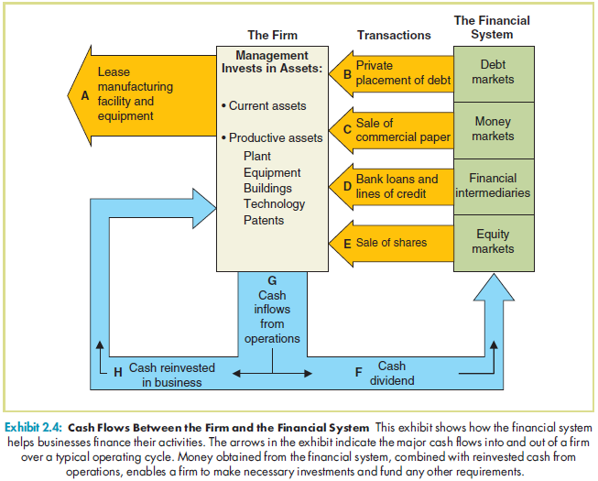
Exhibit 2.4: Cash Flows between the Firm and Financial System

Slide 32
The Determinants of Interest Rate Levels
The Real Rate of Interest
Interest rate determined in the absence of inflation.
The determinants of the real rate are a firm’s return on investment and the time preference for consumption.
Notes:
32

Slide 33
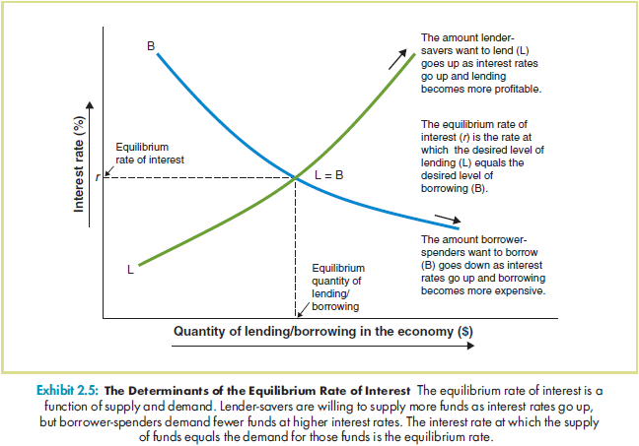
Exhibit 2.5: The Determinants of the Equilibrium Rate of Interest

Slide 34
The Determinants of Interest Rate Levels
Changes in the Equilibrium Rate of Interest
Several economic factors cause a shift in the desired lending and borrowing.
Some of these economic factors are a major breakthrough in technology, a change in tax rates, growth in population, age of population and cultural differences.
Notes:
34

Slide 35
The Determinants of Interest Rate Levels
Inflation and Loan Contracts
Real rate of interest ignores inflation.
Lenders must incorporate anticipated inflation into lending contracts.
Notes:
35

Slide 36
The Determinants of Interest Rate Levels
The Fisher Equation and Inflation
The simplified Fisher Equation is
where i = nominal interest rate
r = real rate of interest
= expected annualised price-level
change.
Notes:
36

Slide 37
The Determinants of Interest Rate Levels
Fisher Equation example
Notes:
37

Slide 38
The Determinants of Interest Rate Levels
Interest Rates: The Business Cycle and Inflation
Interest rates tend to follow business cycle.
During periods of economic expansion, interest rates tend to rise.
During a recession, opposite tends to occur.
Notes:
38

Slide 39
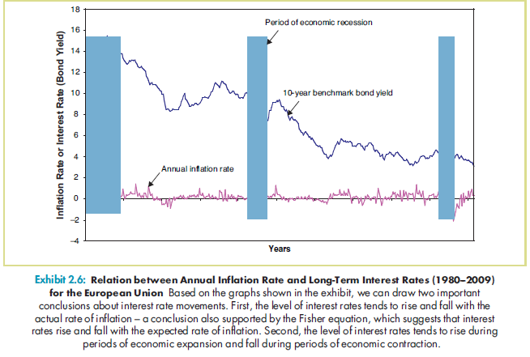
Exhibit 2.6: Relation between Annual Inflation Rate and LTIR

