Slide 1
Romberries Company
Address: 8, Cibinului Street, Constanta County.
Telephone: 0341445764
Fax: 0241638001
E-mail: romberries@yahoo.com
Web site: www.romberriescompany.ro
Members: Ilinca Maria
Burlacu Roxana
Ionescu Roxana
Marin Andreea

Slide 2
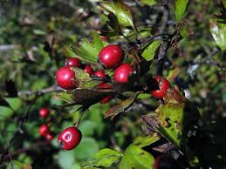
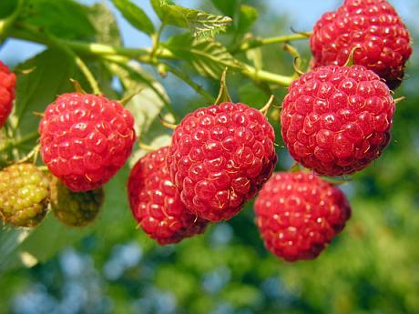
COMPANY’S VISION
The mission of the commercial society is to produce and market vegetables and berries by continuously improving the technology to fit into European standards.
A happy and healty life
A community that evolves positively and steadily towards a quiet life.

Slide 3
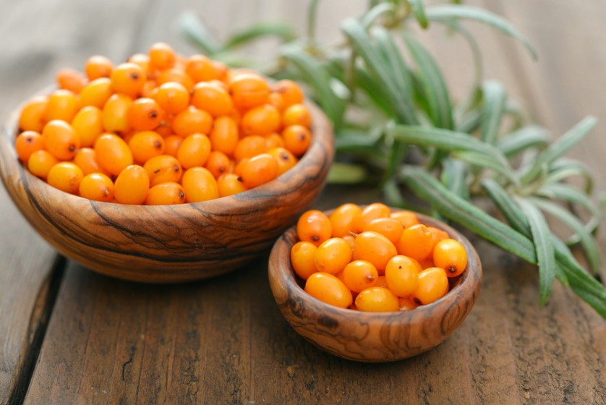
Business description
Location: Siminoc Village
Products: raspberries, seabuckthorn, jam plant
Services: cultivation of berries, delivery, production of raspberries jam
The development strategy of the commercial company:
the acquisition of know-how adapted to high-performance technologies
equipping with advanced equipment and technologies
Expanding to new markets

Slide 4
Risk analysis
When estimating the development of the business, the following risk sources were identified:
Macroeconomic factors ( supply and demand )
Technology ( malfunctioning equipment )
Internal factors ( bad management )
Weather conditions ( drought, floods )

Slide 5
BUSINESS SUCCESS FACTORS
Employee attitude drive growth and chang
Technology utilization
Marketing consistency
Good management and planning

Slide 6
Market definition
Potential clients:
Individuals or legal entities who are eager to collaborate with us
Restaurants, hostels, canteens
Bakeries
Cosmetics factories
Wholesale
Supermarket

Slide 7
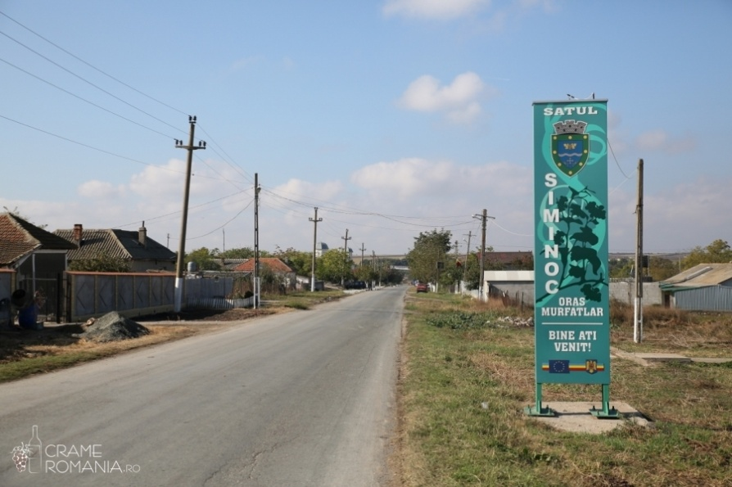
BRAND MY LAND
Branding online and offline will boost awareness and build your reputation
the more you do it, the greater the chances are that people will actively seek it out and remain loyal

Slide 8
ADMINISTRATION AND MANAGEMENT
- Management – directing/guiding the operations of the organization
- Administration – creating policies and establishing objectives of the organization
Required stuff: - manager
- employees
- accountant
- sales personnel
- production supervisor
- marketing personnel

Slide 9
BUDGET AND COST CONTROL
Components of the budget:
Resourcing ( staff costs or consultants’ fees 0
Consumables ( power, IT supplies, others )
Expenses ( travel and subsistence )

Slide 10
Promoting service
WEB site: www.romberries.ro
Facebook page
Flyers, brochures
Autumn fair for traditional products
Customer’ recommendations

