Slide 1
Διεθνής Χρηματοοικονομική
Ενότητα 1: INTERNATIONAL FINANCIAL MANAGEMENT
Θεόδωρος Συριόπουλος
Τμήμα Ναυτιλίας και Επιχειρηματικών Υπηρεσιών

Slide 2
Άδειες Χρήσης
Το παρόν εκπαιδευτικό υλικό υπόκειται σε άδειες χρήσης Creative Commons.
Για εκπαιδευτικό υλικό, όπως εικόνες, που υπόκειται σε άλλου τύπου άδειας χρήσης, η άδεια χρήσης αναφέρεται ρητώς.

Slide 3
Χρηματοδότηση
Το παρόν εκπαιδευτικό υλικό έχει αναπτυχθεί στα πλαίσια του εκπαιδευτικού έργου του διδάσκοντα.
Το έργο «Ανοικτά Ακαδημαϊκά Μαθήματα στο Πανεπιστήμιο Αιγαίου» έχει χρηματοδοτήσει μόνο τη αναδιαμόρφωση του εκπαιδευτικού υλικού.
Το έργο υλοποιείται στο πλαίσιο του Επιχειρησιακού Προγράμματος «Εκπαίδευση και Δια Βίου Μάθηση» και συγχρηματοδοτείται από την Ευρωπαϊκή Ένωση (Ευρωπαϊκό Κοινωνικό Ταμείο) και από εθνικούς πόρους.

Slide 4
UNIVERSITY OF THE AEGEAN Shipping, Trade & Transport Dpt.
International Finance_{INTFIN}
Professor Theodore SYRIOPOULOS

Slide 5
By Peter Moles, Robert Parrino, & David Kidwell
ISBN: 978-0-470-68370-5
© Copyright 2011 John Wiley & Sons Ltd
www.wiley.com/college/moles

Slide 6
Chapter One
The Financial Manager and the Firm

Slide 7
Learning Objectives
Identify the key financial decisions facing the financial manager of any business firm.
Identify the basic forms of business organisation and review their respective strengths and weaknesses.
Describe the typical organisation of the financial function in a large company.
Explain why maximising the current value of the firm’s shares is the appropriate goal for management

Slide 8
Learning Objectives
Discuss how agency conflicts affect the goal of maximising shareholder value..
Explain why ethics is an appropriate topic in the study of corporate finance.

Slide 9
Legal Forms of Business Organisations
Quick Links
The Role of the Financial Manager
Managing the Financial Function
The Goal of the Firm
Agency Conflicts: Separation of Ownership and Control
The Importance of Ethics in Business

Slide 10
The Role of the Financial Manager
It is all About Cash Flows
A firm generates cash flows by selling the goods and services produced by its productive assets and human capital.
The firm is successful when these cash inflows exceed the cash outflows needed to pay operating expenses, creditors, and taxes.
The firm can pay the remaining cash, called residual cash flows, to the owners as a cash dividend, or reinvest the cash in the business.
Notes:
10

Slide 11
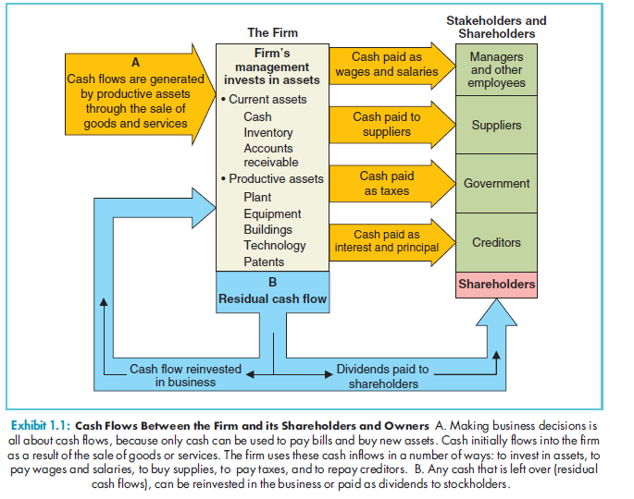
Exhibit 1.1: Cash Flow Diagram

Slide 12
The Role of the Financial Manager
It is all About Cash Flows
A firm is unprofitable when it fails to generate sufficient cash flows.
Firms that are unprofitable over time will be forced into bankruptcy by their creditors.
In bankruptcy, the company will either be reorganised or the company’s assets will be liquidated.
Notes:
12

Slide 13
The Role of the Financial Manager
Three Fundamental Decisions in Financial Management
The capital budgeting decision: Which productive assets should the firm buy?
A good capital budgeting decision is one in which the benefits are worth more for the firm than the cost of the assets.
The financing decision: How should the firm finance or pay for assets?
Notes:
13

Slide 14
The Role of the Financial Manager
Three Fundamental Decisions in Financial Management
Financing decisions involve trade-offs between advantages and disadvantages of debt and equity financing.
Working capital management decisions: How should day-to-day financial matters be managed?
The mismanagement of working capital can cause the firm to go into bankruptcy even though the firm is profitable.
Notes:
14

Slide 15
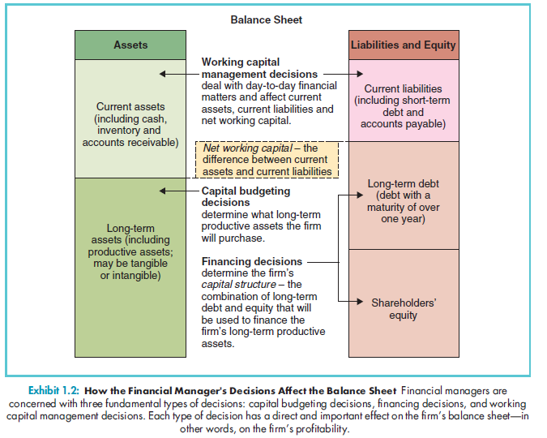
Exhibit 1.2: How Financial Manager’s Decisions Affect the Balance Sheet

Slide 16
Legal Forms of Business Organisations
Sole Proprietorship
No legal distinction between personal and business income for a sole proprietor.
All business income is taxed as personal income.
A sole proprietorship has unlimited liability for all business debts and other obligations of the firm.
Notes:
16

Slide 17
Legal Forms of Business Organisations
Partnership
Has the same basic advantages and disadvantages as a sole proprietorship.
When a transfer of ownership takes place, the partnership is terminated and a new partnership is formed.
The problem of unlimited liability can be avoided in a limited partnership.
Notes:
17

Slide 18
Legal Forms of Business Organisations
Company
In a legal sense, it is a “person” distinct from its owners.
The owners of a company are its shareholders.
A major advantage of the corporate form of business is that shareholders have limited liability.
Notes:
18

Slide 19
Legal Forms of Business Organisations
Company
The owners of companies are subject to double taxation first at the corporate level and then at the personal level when dividends are paid to them.
Public companies can sell their debt or equity in the public securities markets.
Private companies are held by a small number of investors.
Notes:
19

Slide 20
Legal Forms of Business Organisations
Hybrid Forms of Business Organisation
Limited liability partnerships (LLPs) combine the limited liability of a company with the tax advantage of a partnership.
Limited liability companies (LLCs)
Professional corporations (PCs)
Notes:
20

Slide 21
Managing the Financial Function
Chief Executive Officer (CEO)
Ultimate management responsibility and decision-making power in the firm.
Reports directly to the board of directors, which is accountable to the company’s owners.
Notes:
21

Slide 22
Managing the Financial Function
Chief Financial Officer (CFO)
Responsible for the best possible financial analysis that is presented to the CEO.
Positions that report to the CFO:
The chief accountant prepares financial statements, oversees the firm’s cost accounting systems, prepares taxes and works closely with the firm’s external auditors.
Notes:
22

Slide 23
Managing the Financial Function
Chief Financial Officer (CFO)
CFO’s Key Financial Reports
The Treasurer looks after the collection and disbursement of cash, invests excess cash, raises new capital, handles foreign exchange and oversees the firm’s pension fund managers.
Notes:
23

Slide 24
Managing the Financial Function
Chief Financial Officer (CFO)
CFO’s Key Financial Reports
The Internal Auditor is responsible for in-depth risk assessments, performing audits of high-risk areas.
The Risk Manager manages the firm’s risk exposure in financial markets and the relationships with insurance providers.
Notes:
24

Slide 25
Managing the Financial Function
External Auditors
Provide an independent annual audit of the firm’s financial statements.
Ensure that the financial numbers are reasonably accurate, and accounting principles have been consistently applied.
Notes:
25

Slide 26
Managing the Financial Function
Audit Committee
Approves the external auditor’s fees and engagement letter. The external auditor cannot be fired or terminated without the audit committee’s approval.
Notes:
26

Slide 27
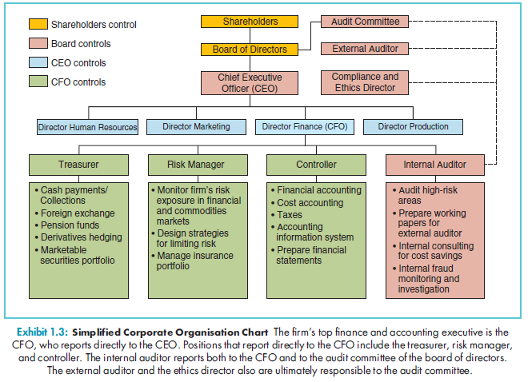
Exhibit 1.3: Simplified Corporate Organisation Chart

Slide 28
The Goal of the Firm
What Should Management Maximise?
Minimising risk or maximising profits without regard to the other is not a successful strategy.
Why not maximise profits?
With creative accounting the firm can manipulate the profit figures.
Accounting profits are not necessarily the same as cash flows.
Notes:
28

Slide 29
The Goal of the Firm
What Should Management Maximise?
Why not maximise profits?
Profit maximisation does not tell us when cash flows are to be received.
Profit maximisation ignores the uncertainty or risk associated with cash flows.
Notes:
29

Slide 30
The Goal of the Firm
Maximise the Value of the Firm’s Share Price
When analysts and investors determine the value of a firm’s shares, they consider:
The size of the expected cash flows.
The timing of the cash flows.
The riskiness of the cash flows.
The mechanism for determining share prices overcomes all the cash-flow objections raised.
Notes:
30

Slide 31
The Goal of the Firm
Maximise the Value of the Firm’s Share Price
An appropriate goal for financial management is to maximise the current value of the firm’s shares.
For private companies and partnerships, the goal is to maximise the current value of owner’s equity.
Notes:
31

Slide 32
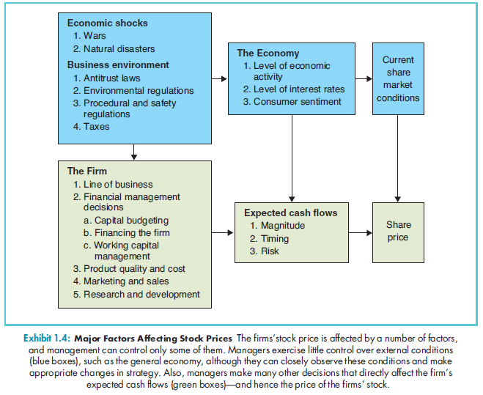
Exhibit 1.4: Major Factors Affecting Share Prices

Slide 33
The Goal of the Firm
Can Management Decisions Affect Share Prices?
YES!!!
Notes:
33

Slide 34
Agency Conflicts: Separation of Ownership and Control
Ownership and Control
For large companies, the ownership of the firm is spread over huge number of shareholders and the firm’s owners may effectively have little control over management .
Management may make decisions that benefit their self-interest rather than those of the shareholders.
Notes:
34

Slide 35
Agency Conflicts: Separation of Ownership and Control
Agency Relationships
An agency relationship arises whenever one party, called the principal, hires another party, called the agent.
The relationship between shareholders (principals) and management (agents) is an agency relationship.
Notes:
35

Slide 36
Agency Conflicts: Separation of Ownership and Control
Do Managers Really Want to Maximise the Share Price?
Shareholders own the company but managers control the money and have the opportunity to use it for their own benefit.
Agency Costs
The costs of the conflict of interest between the firm’s owners and its management.
Notes:
36

Slide 37
Agency Conflicts: Separation of Ownership and Control
Aligning the Interests of Management and Shareholders
Management Compensation
A significant portion of management compensation should be tied to firm performance (e.g. share price).
Notes:
37

Slide 38
Agency Conflicts: Separation of Ownership and Control
Aligning the Interests of Management and Shareholders
Managerial Labour Market
Firms with unethical behaviour have difficulty hiring top managers.
Executives with poor performance or criminal convictions can rarely secure good positions in the future.
Notes:
38

Slide 39
Agency Conflicts: Separation of Ownership and Control
Aligning the Interests of Management and Shareholders
Board of Directors
Lack of board independence is a key factor in the misalignment between board members’ and shareholders’ interests
Other Managers
Large Shareholders
The Takeover Market
The Legal and Regulatory Environment
Notes:
39

Slide 40
Agency Conflicts: Separation of Ownership and Control
Principles of Corporate Governance
Key OECD principles
Transparent and efficient markets
Protection and facilitation of shareholder rights
Equitable treatment of all shareholders
Encourage active co-operation between companies and stakeholders
Timely disclosure of material information
Key role for board of directors

Slide 41
Agency Conflicts: Separation of Ownership and Control
Principles of Corporate Governance
Key OECD principles regarding the role of the board of directors
Acts in interest of company and shareholders
Should ensure strategic guidance of the company
Monitor management
Be accountable to the company and shareholders
Apply high ethical standards and take account of all stakeholders’ interests

Slide 42
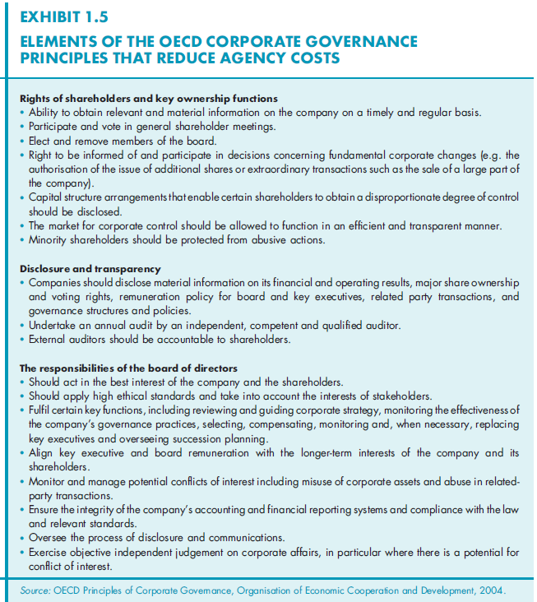
Exhibit 1.5: OECD Corporate Governance Principles that Reduce Agency Costs

Slide 43
Agency Conflicts: Separation of Ownership and Control
Sarbanes-Oxley and Other Regulatory Reforms in the U.S.
Ensure Greater Board Independence
Establish Internal Accounting Controls
Establish Compliance Programs
Establish an Ethics Program
Expand Audit Committee’s Oversight Powers
Notes:
43

Slide 44
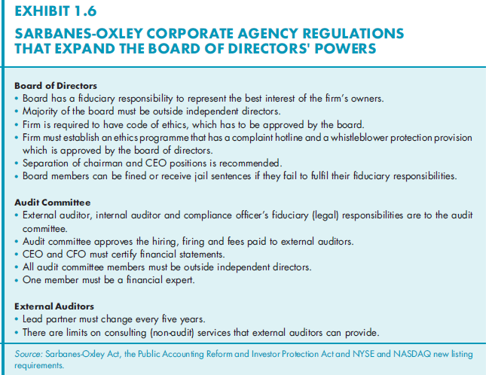
Exhibit 1.6: Sarbanes-Oxley Corporate Governance Regulations That Reduce Agency Costs

Slide 45
The Importance of Ethics in Business
Business Ethics
A society’s ideas about what actions are right and wrong.
Are Business Ethics Different?
Traditions of morality are relevant to business and financial markets.
Corruption in business creates inefficiencies in an economy.
Notes:
45

Slide 46
The Importance of Ethics in Business
Types of Ethical Conflicts in Business
Agency Costs
Conflicts of Interest
Conflict between individual’s personal or institutional gain and the obligation to serve the interest of another party.
Information Asymmetry
One party in a transaction has information that is unavailable to the other parties.
Notes:
46

Slide 47
The Importance of Ethics in Business
The Importance of and Ethical Business Culture
Ethicists argue that laws and market forces are not enough.
Serious Consequences
Legal cost of ethical mistakes can be extremely high.
Notes:
47

Slide 48
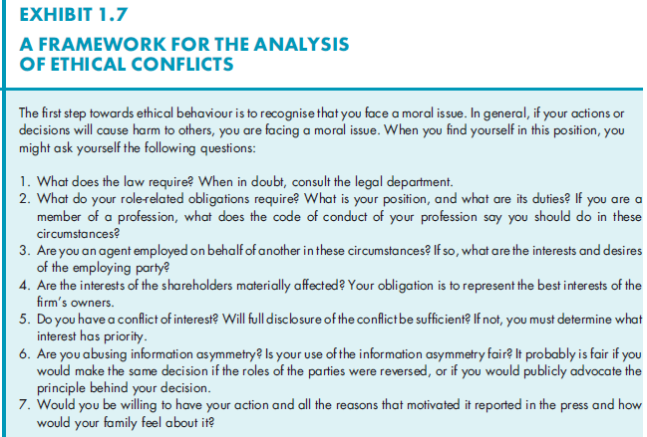
Exhibit 1.7: A Framework for the Analysis of Ethical Conflicts

