Slide 1
University of the Aegean
SUMMER SCHOOLS
Transitions in Landscape and Land Use
Tourism Growth and Land Use Change in Greece
Mary Constantoglou

Slide 2
TRENDS
Despite on-going challenging economic conditions, global Travel & Tourism direct contribution to GDP rew by a robust 3.2% in 2012.
This was faster than growth of the world economy as whole (2.3%), and also faster than growth of a number of broad industries including manufacturing, financial & business services and retail.
Total Travel & Tourism employment, including those working in the industry’s supply chain and supported by the spending of their employees, increased by 4.0 million jobs in 2012.

Slide 3
TRENDS
Did you know that…?
• Travel & Tourism contributes more to GDP than automotive manufacturing in every region of the world.
• With 98 million people directly employed in 2011, this industry directly employs:
• 6 times more people than automotive manufacturing
• 5 times more than chemicals manufacturing
• 4 times more than mining
• Travel &Tourism supports more jobs than the automotive and chemicals manufacturing industries combined across every region of the world.
• In every region of the world, T&T directly supports more jobs than the financial services, communications and mining industries.
• For every one dollar spent on Travel & Tourism, 3.2 dollars are generated in GDP across the entire economy.
• 1 million dollars in tourism sales generates twice as many jobs than the same 1 million dollars in financial services, communications and automotive manufacturing.

Slide 4
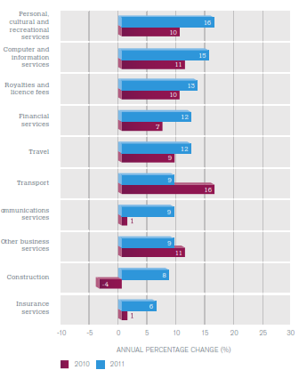
TRENDS
Exports 2010-2011. Source: WTO, 2012

Slide 5
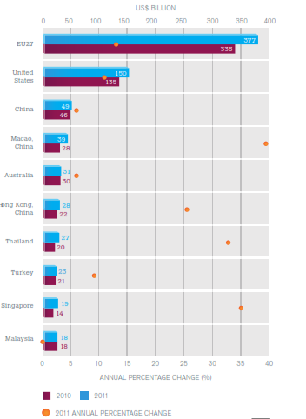
TRENDS
Σχήμα 3: Export in travel and Tourism 2010-2011. Source: WTO, 2012

Slide 6
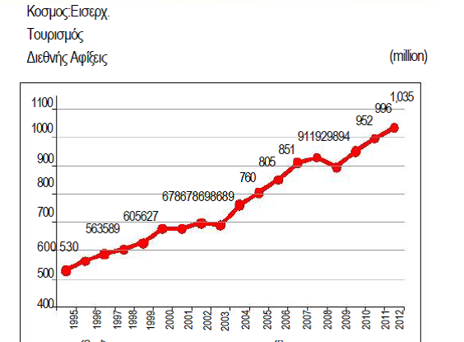
TRENDS
Global International Arrivals 1995-2012.
Source: WTO, 2012

Slide 7
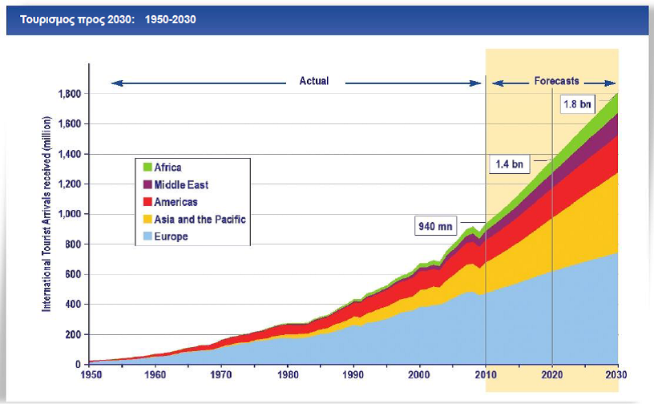
TRENDS

Slide 8
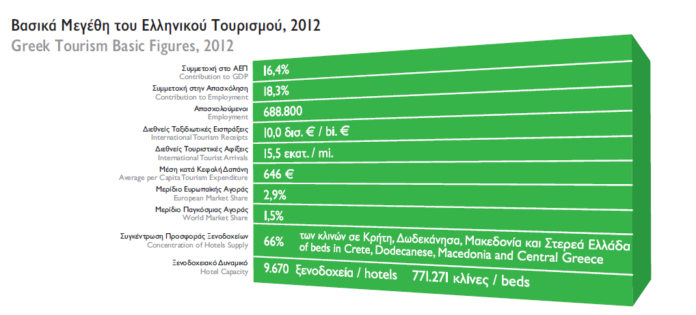
Tourism in Greece: Basic Figures
Data Source: SETE

Slide 9
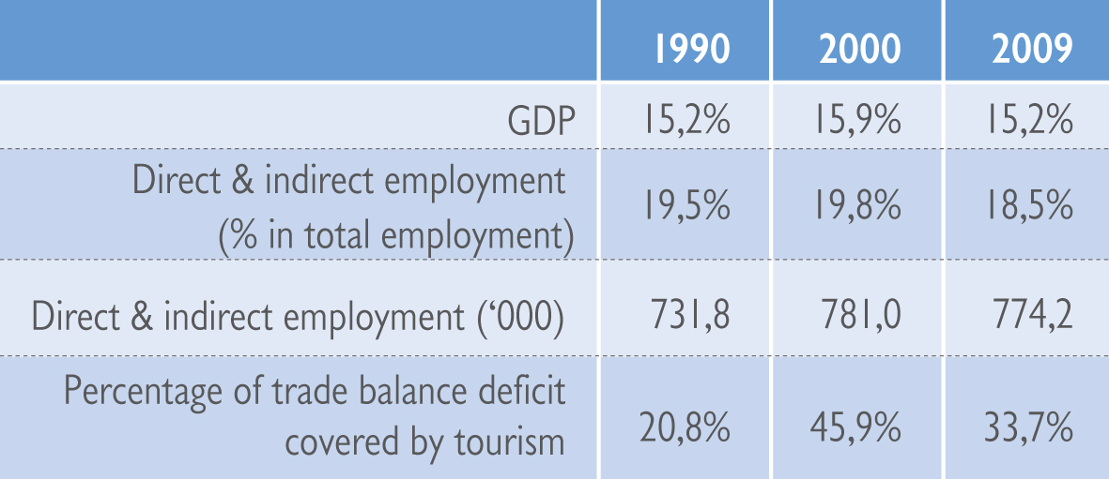
Tourism in Greece: Basic Figures
Source: WTTC, Bank of Greece
Data Source: SETE

Slide 10
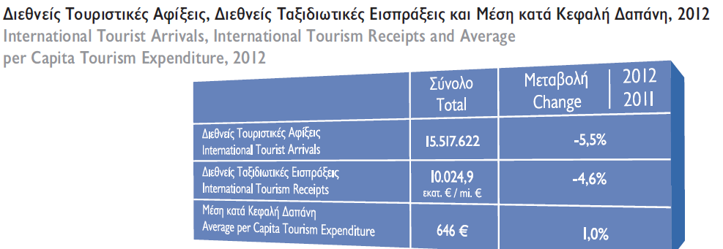
Tourism in Greece: Basic Figures
Data Source: SETE

Slide 11
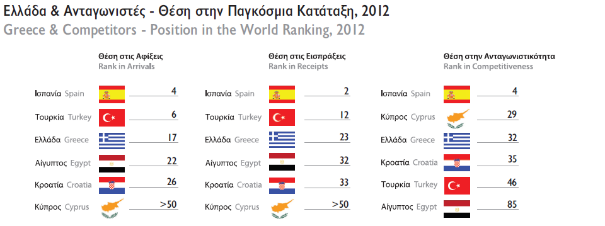
Tourism in Greece: Basic Figures
Data Source: SETE

Slide 12
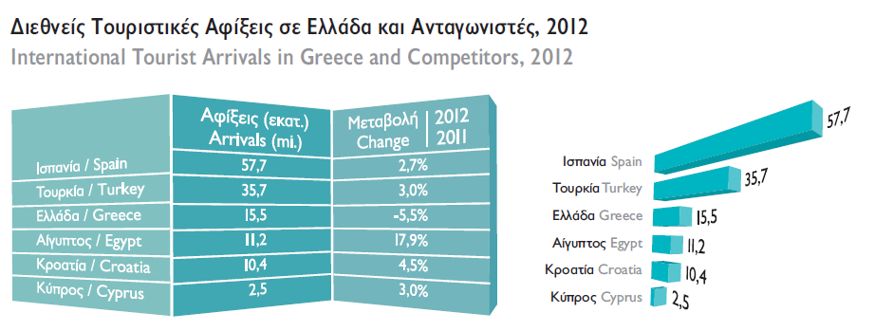
Tourism in Greece: Basic Figures
Data Source: SETE

Slide 13
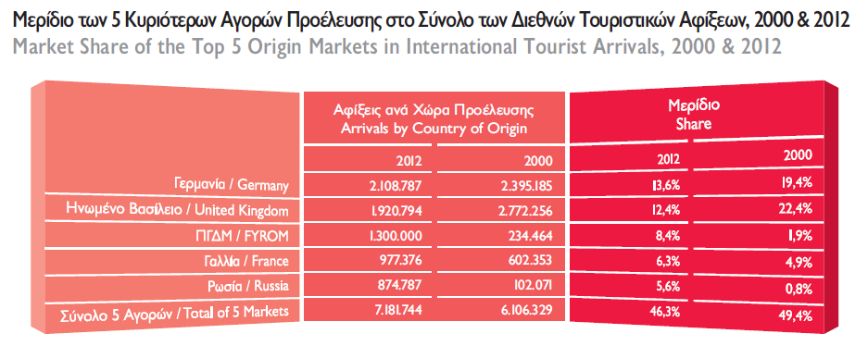
Tourism in Greece: Basic Figures
Data Source: SETE

Slide 14
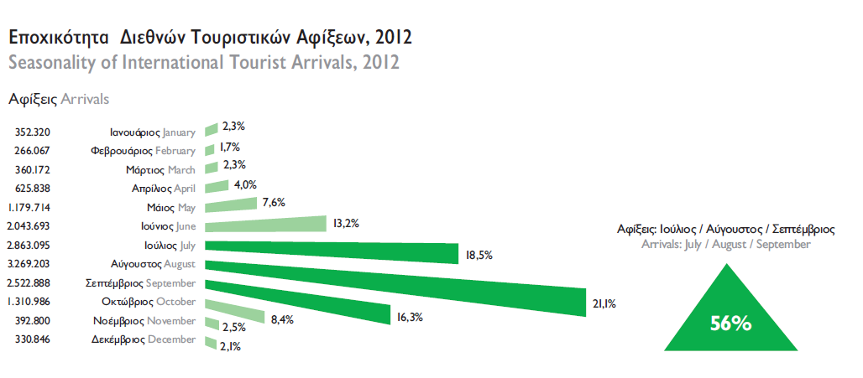
Tourism in Greece: Basic Figures
Data Source: SETE

Slide 15
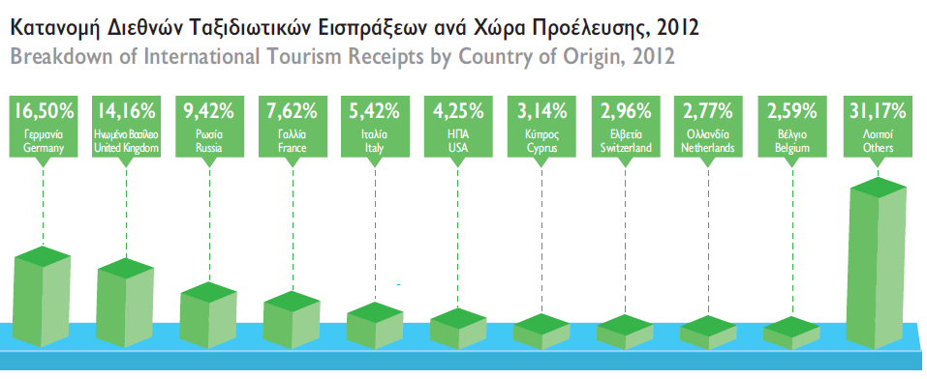
Tourism in Greece: Basic Figures
Data Source: SETE

Slide 16
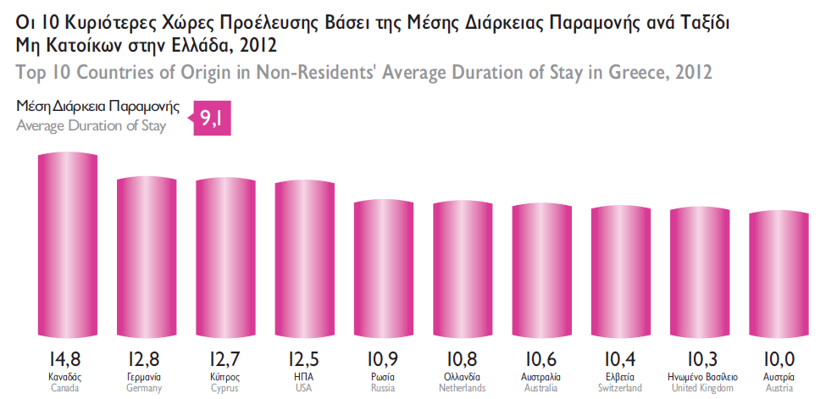
Tourism in Greece: Basic Figures
Data Source: SETE

Slide 17
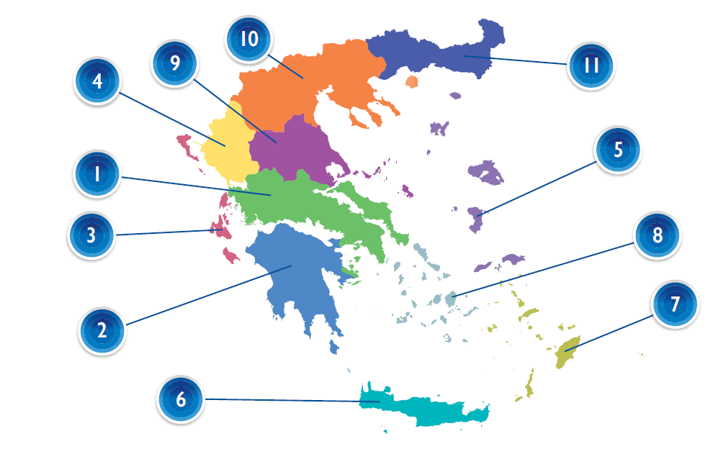
Tourism in Greece: Basic Figures
Data Source: SETE

Slide 18
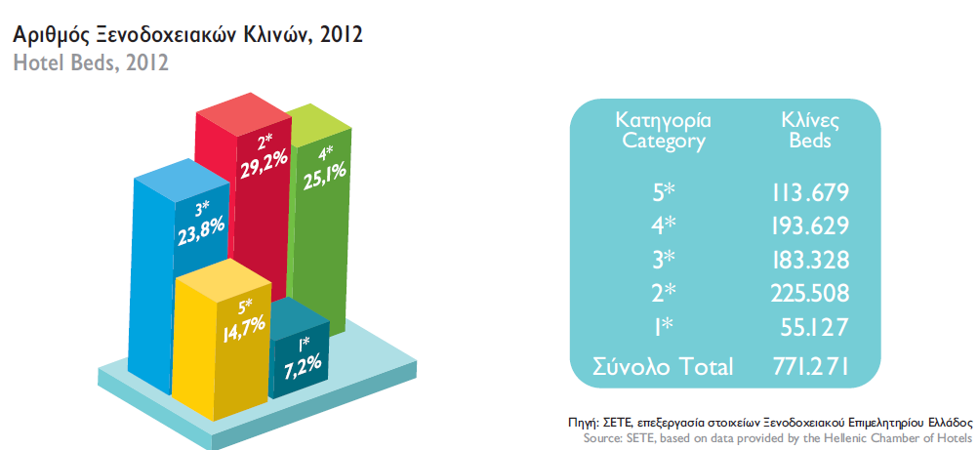
Tourism in Greece: Basic Figures
Data Source: SETE

Slide 19
Tourism in Greece: Basic Figures
Source: SETE, based on data provided by the Hellenic Chamber of Hotels, EL. STAT
Data Source: SETE

Slide 20
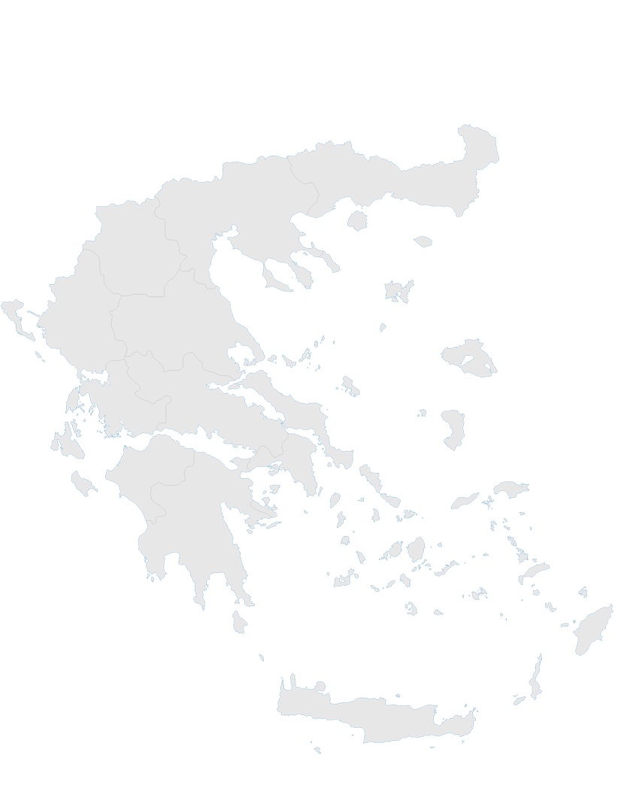
Tourism in Greece: Basic Figures
65%
Data Source: SETE

Slide 21
Tourism in Greece: Basic Figures
Human Factor: Employment in Tourism
In Greece:
Tourism stimulates employment in a wide range of economic sectors including employees with different educational levels.
Tourism employment positively affects young people in regional areas.
For every (1) job created in tourism, another one (1) is created in the broad economy.
One (1) out of five (5) Greeks is directly or indirectly employed in the tourism sector.
Data Source: SETE

Slide 22
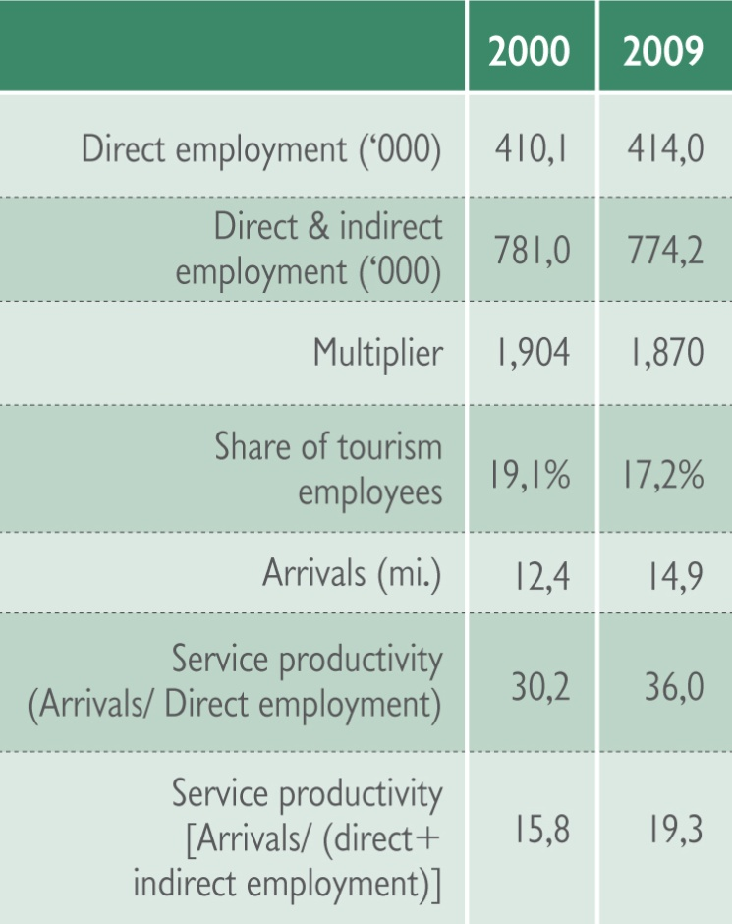
Tourism in Greece: Basic Figures
Human Factor: Employment in Tourism
Data Source: SETE

Slide 23
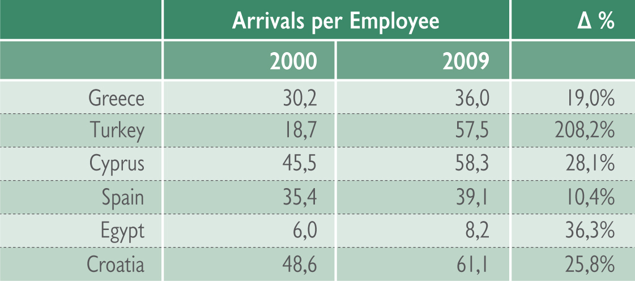
Tourism in Greece: Basic Figures
Service Productivity in tourism : Greece and competitors
Data Source: SETE

Slide 24
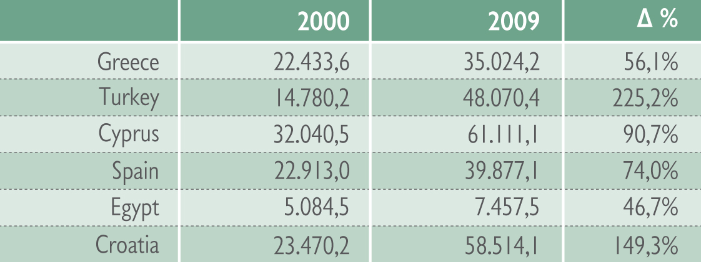
Tourism in Greece: Basic Figures
Human Factor: Employment in Tourism
International tourism receipts per employee (US$)
Data Source: SETE

Slide 25
Tourism in Greece: Basic Figures
Human Factor: Employment in Tourism
Beds vs Employment
For every
100 beds
16 jobs
are created
For every
100 beds
6 jobs
are created
Data Source: SETE

Slide 26
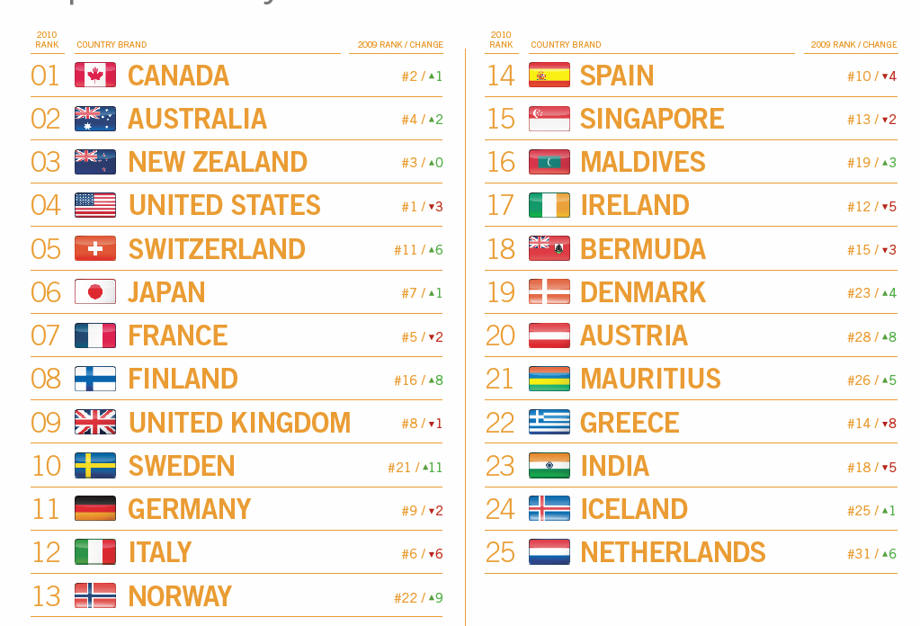
Tourism in Greece: Basic Figures
Brand Positioning

Slide 27
Tourism in Greece: Basic Figures
Brands Used
Live your myth in Greece
’05
Explore your senses
’06
The true experience
’07 - ‘08
Data Source: SETE

Slide 28
Tourism in Greece: Basic Figures
New Integrated Strategy is needed!
Organizational and institutional reforms
Tourism supply management
Tourism demand management

Slide 29
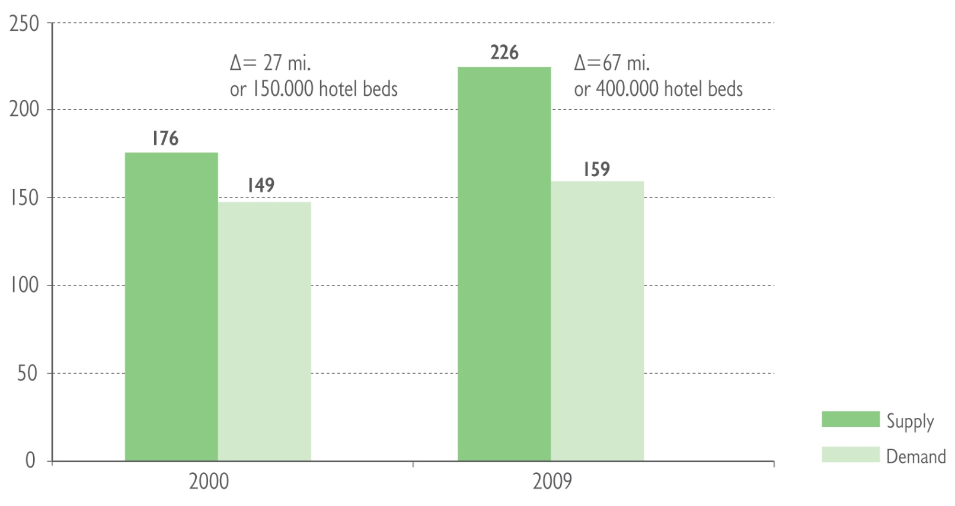
Tourism in Greece: Basic Figures
Supply vs Demand
Data Source: SETE

Slide 30
Tourism and the Environment
In the absence of an attractive environment, there would be little tourism.
Ranging from the basic attractions of sun, sea and sand to the undoubted appeal of historic sites and structures, the environment is the foundation of tourism.

Slide 31
Tourism and the Environment
because of the highly dynamic nature of the coastal environment and the significance of mangroves and the limited coral sand supply for island beaches in particular, any development which interferes with the natural system may have severe consequences for the long-term stability of the environment.

Slide 32
Impacts of tourism in the environment
erosion, where vegetation clearance exposes land to storms, and building activity makes land more vulnerable to erosion
impacts on ground water - the salination of fresh ground water sources, which are usually in limited supply
sewage outfall into shallow waters, which cause nutrients to build up and algal growth that leads to eutrofication of the sea water and damage to the aquifer.
The modification of mangrove swamps leads to loss of ecological diversity and a rich environment for wildlife.
environmental degradation and pollution
the destruction of habitats and ecosystems
the loss of coastal and marine resources
coastal pollution

Slide 33
Impacts of tourism in the environment:
The island case
As island ecosystems are characterized by limited space, species , limited and scarce resources.
architectural pollution owing to the effect of inappropriate hotel development on the traditional landscape
the effect of ribbon development and urban sprawl in the absence of planning and development restrictions
the resort infrastructure becomes overloaded and breaks down in periods of peak usage
tourists become segregated from local residents
good quality agricultural land may be lost to tourist development
ecosystem changes
traffic congestion may result in resort areas
the local ecosystem may be polluted from sewage
litter and too many visitors in the peak season.

Slide 34
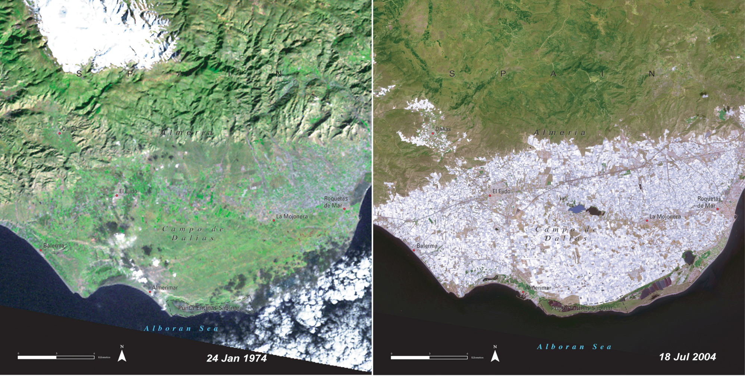
Tourism & land Uses
Drastic land use changes in the Campo de Dalias in Andalusia, Spain over a 30 years period. Tourism and agricultural has been followed by extensive groundwater pumping to meet irrigation water needs.
Spain is the largest exporter in the EU for fresh fruits and vegetables and the second most visited country!
Data Source: UNEP, Atlas of our changing environment 2005

Slide 35
Tourism and the Environment
The geography of Greece consists of a very large number of small islands and a hilly or mountainous terrain with steep slopes. More than 40% of the land is over 500 meters in altitude, with several peaks reaching an elevation of more than 2,000 meters.
Greece’s extensive coastline ‑the longest in Europe with its nearly 14,000 km length is equally distributed between the mainland and some 3,000 islands which cover approximately 20% of the territory. These physical characteristics have economic repercussions in terms of transport infrastructure and represent a significant challenge regarding sustainable land use.

Slide 36
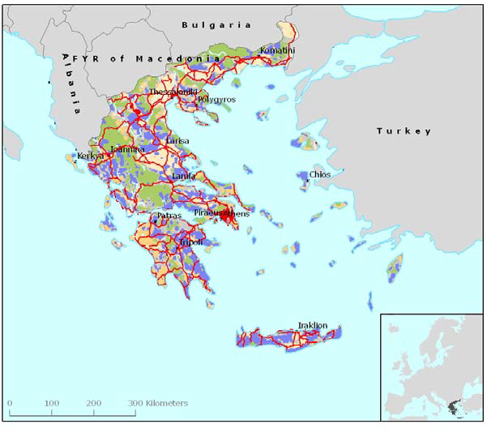
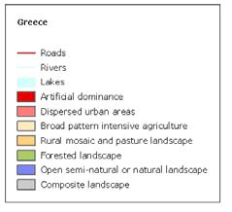
Land Uses in Greece
Data Source: YPEXODE

Slide 37
Tourism in Greece: Basic Figures
In a growing and dynamic sector like tourism in Greece is this information of land uses enough in order to formulate policies for tourism?

Slide 38
References
Internet Resources:
Association of Greek Tourism Enterprises. www.sete.gr
Ministry of tourism. www.gov.gnto.gr
Hellenic Statistical Authority www.statistics.gr
72. Sachs A (2010) The Travel Gold Rush 2020. Διαθέσιμο στη διεύθυνση: www.oef.com/free/pdfs/travelgoldrush2020.pdf . [Ημερομηνία τελευταίας επίσκεψης 24 Ιουνίου 2013].
Selected Bibliography:
Coccossis H. , Constantoglou M. , (2006). The Use of Typologies in Tourism Planning: Problems and Conflicts, 46th Congress of the European Regional Science Association (ERSA), Volos, Greece. 10th most downloaded article in ERSA conferences.
Coccossis H. , Constantoglou M. , (2005). The Need of Spatial Typologies in Tourism Planning and Policy Making - The Greek Case, 45th Congress of the European Regional Science Association (ERSA), Amsterdam, Netherlands.
Constantoglou M. , (2009), The creation of a supply tourism typology for the Greek coastal area with the use of GIS and FcM for planning purposes, 4th International Scientific Conference of the University of the Aegean, Planning for the Future - Learning from the Past: Contemporary Developments in Travel, Tourism Hospitality, Rodos Island, Greece.
Constantoglou M. (2003). Tourism Typologies for Coastal Areas and the use of GIS: The case of Greece, Association of American Geographers (AAG) 2003 Annual Meeting, New Orleans, USA, First Award in Student Paper Competition.
Coccossis, H. & Nijkamp, P., 1995. Sustainable Tourism, London :Avebury.
Debbage, K., & Ioannides, D., 2004. The cultural turn? Toward a more critical economic Geography of Tourism. In A. Lew, C.M. Hall, and A.M. Williams (Eds.), A companion to tourism (pp. 99-109). Oxford: Blackwell Publishing.
Terkenli T. & d'Hauteserre Anne-Marie (eds)(2006) Landscapes of a New Cultural Economy of Space, Landscape Series, Springer
Tribe, J., 2006. The truth about tourism. Annals of Tourism Research 33(2), pp. 360–381.
Yeoman I., 2012. 2050: Tomorrows Tourist. Bristol: Channelview.
Τερκενλή Θ., Κωνστάντογλου Μ., (2007), Γεωγραφία του τουρισμού, στο Ανθρωπογεωγραφία: Άνθρωπος, Κοινωνία και Χώρος, Θεανώ Σ. Τερκενλή, Θεόδωρος Ιωσηφίδης και Ιωάννης Χωριανόπουλος (επιμ.). Αθήνα: Εκδόσεις Κριτική.

Slide 39
Thank you for your attention, I wish you a successful Summer School and I hope you enjoy your stay in Lesvos.

