Slide 1
Visions to elicit future landscapes
Marta Pérez-Soba, Joske Houtkamp and Anouk Cormont
Marc Metzger, Dave Murray-Rust and James S. Paterson
Marjan Maes, Marc Gramberger and Tommaso Chiamparino
Anne Jensen
VOLANTE Summer school 20123
Lesvos, 18 June 2013

Slide 2
What is a vision in VOLANTE?
“A vision is a lodestar (a guiding star), an image of the future that offers direction yet is never reached” (Andy Haines – Thinking about the Future)
“A vision is a picture of the future you seek to create, described in the present tense as if it were happening now” (Senge, 1990)
“Shared visions expand the ability to create” (Senge, 1990)

Slide 3
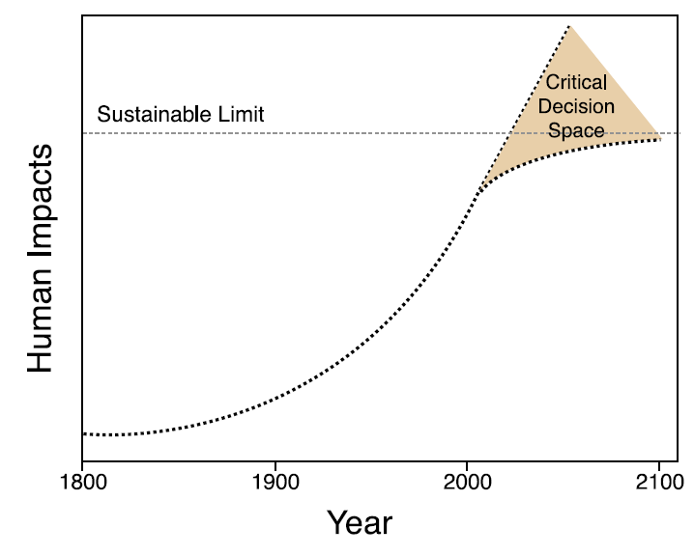
VISIONS to deal with Critical decision space

Slide 4
European policy needs visions
Ongoing changes in land management of energy sources, climate adaptation and mitigation, and changing urban-rural relationships lead to unprecedented land use transitions
Great uncertainty
European Policy will need a vision for managing these land use transitions in a responsible way
Notes:
Make it a second slide; text bigger

Slide 5
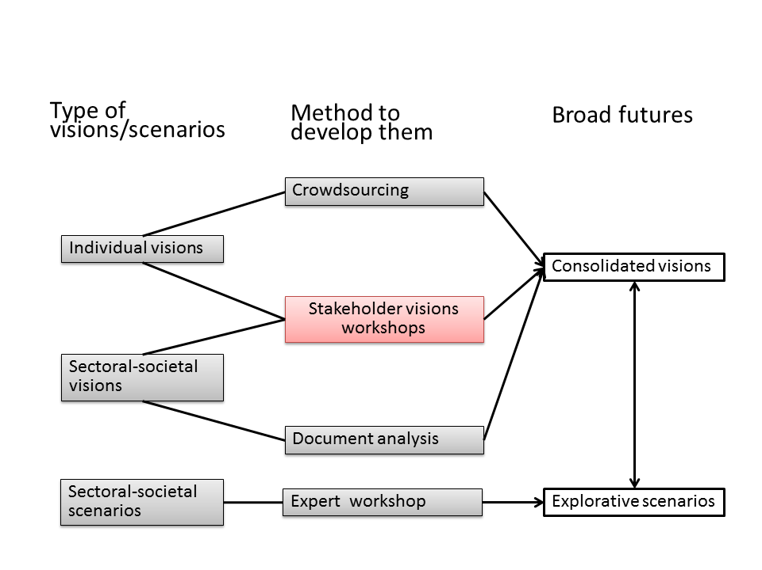
Visions and scenarios in VOLANTE

Slide 6

Developing visions process
Four stakeholder workshops
Individual visions
Sectoral-societal visions
Results

Slide 7
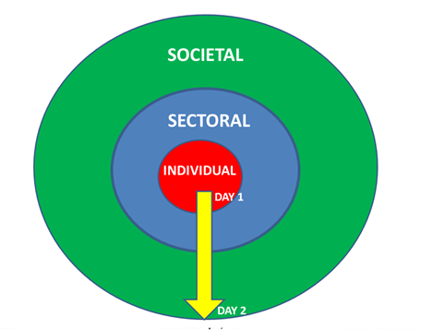
The four stakeholders visions workshops

Slide 8
Material gathered in workshops
DAY | SESSION | MATERIAL
1 | Developing individual visions | A. Individual expectation and desire for life in Europe in 2040 B. Individual canvas (four per person)
 | Developing visions | A. Individual desire for future land use B. Flip charts covering the discussion in vision groups on how they like land to be used for their sector in 2040
 | Canvases on land use area | A. Two sectoral canvases per vision group
2 | Developing societal visions | A. Flip charts covering the discussion in vision groups on the desired link between land use areas B. Pie chart of future land use cover
 | Mapping visions | A. 5 maps of land cover in Europe per vision group on which stakeholders could mark areas of strong change B. One blank map on Europe on which stakeholders could present an important aspect of their vision C. Pictures of land cover: stakeholders could select a few of them and illustrate significant change by 2040
 | Grand expo | A. Sound recordings and videos of the presentation of each of the vision groups

Slide 9
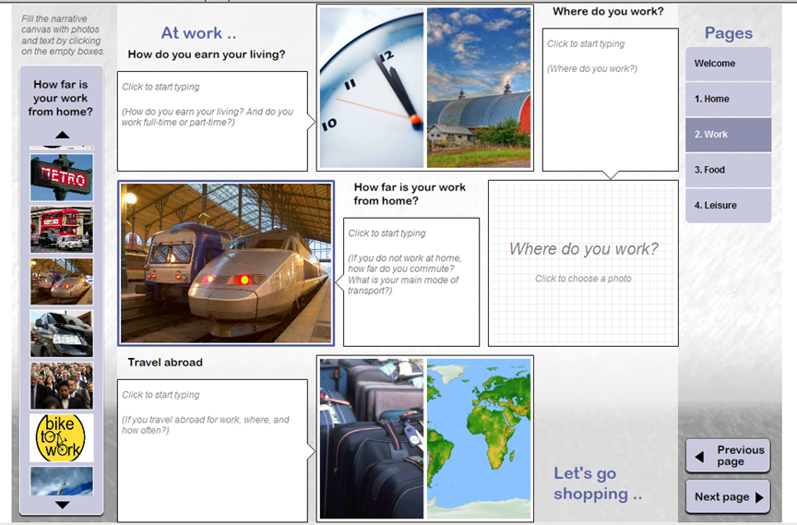
Canvas tools: individual visions

Slide 10
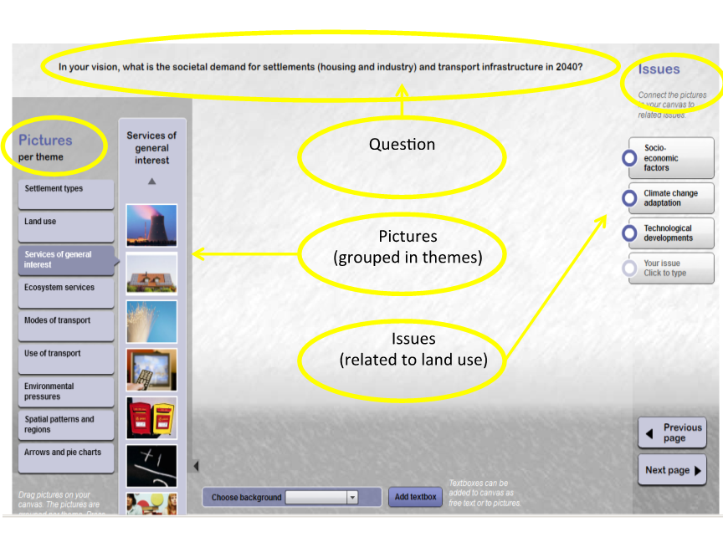
Canvas tools: sectoral visions

Slide 11
Individual visions
Visions individually developed by all the stakeholders in the four workshops, when using the software canvas tool
We focus on the images selected by each stakeholder from the lists available to answer the four questions in each of the four pages
Theme | Question
Living | Who is in your household?
 | Where do you live?
 | What type of home do you live in? Which building materials are used?
 | What technology is in your home?
Work | How do you earn your living?
 | Where do you work?
 | How far is your work from home?
 | If you travel abroad to work, where and how often?
Recreation | How do you spend your leisure time?
 | What green areas are close to your home?
 | What do you do on vacation?
 | How do you travel when on vacation?
Food (shopping) | How is your food produced?
 | Where do you go shopping?
 | What food do you buy?
 | How does your food get to you?

Slide 12
Results of 69 individual visions

Slide 13
Theme | Nature Recreation | Primary Production | Urban Transport | Energy Water | TOTAL | Question
Living | a | b | ac | c | abc | Who is in your household?
 | a | b | c | d | acd | Where do you live?
 | a | b | a | c | abc | What type of home do you live in? Which building materials are used?
 | a | b | b | b | ab | What technology is in your home?
Work | a | a | b | c | abc | How do you earn your living?
 | a | b | bc | c | abc | Where do you work?
 | a | b | c | d | abcd | How far is your work from home?
 | ac | b | c | ab | abc | If you travel abroad to work, where and how often?
Recreation | a | b | bc | c | abc | How do you spend your leisure time?
 | a | b | c | a | a | What green areas are close to your home?
 | a | b | b | c | abc | What do you do on vacation?
 | a | b | c | ac | ac | How do you travel when on vacation?
Food (shopping) | a | b | b | c | abc | How is your food produced?
 | a | b | bc | c | abc | Where do you go shopping?
 | a | a | a | a | a | What food do you buy?
 | a | b | bc | c | abc | How does your food get to you?

Slide 14
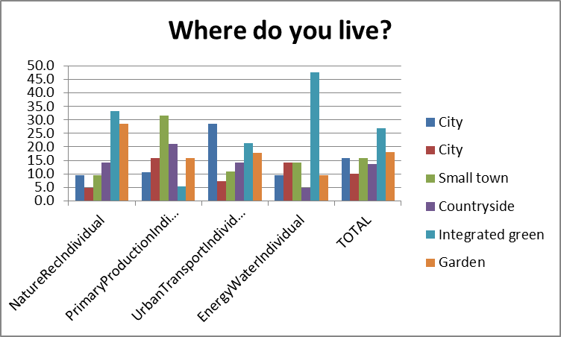

Slide 15
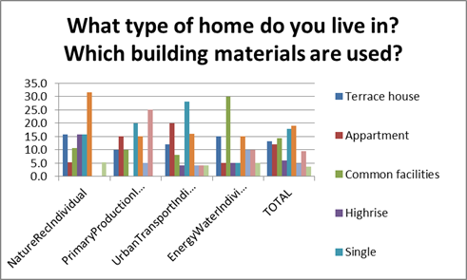

Slide 16
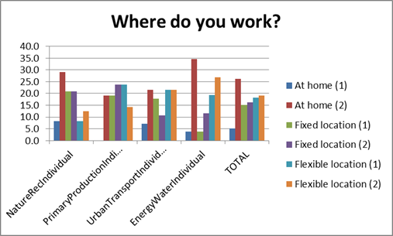

Slide 17
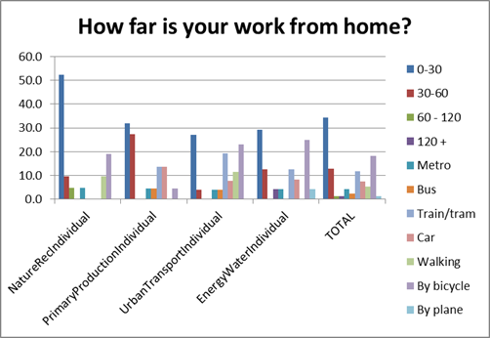

Slide 18
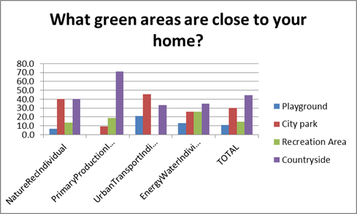

Slide 19
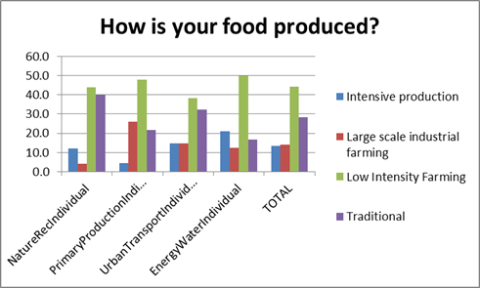

Slide 20
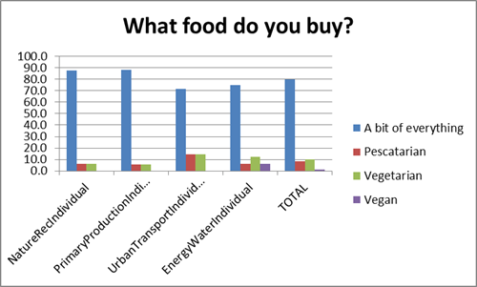

Slide 22
15 sectoral-societal visions
Workshop | Vision name
NATURE CONSERVATION, RECREATION | EURECO
 | NVL
 | Ostrom 2040
 | Past to the Future
PRIMARY PRODUCTION | Value Land Use
 | Foodscapes
 | FORUS
 | 3R’S
URBAN SETTLEMENTS AND INFRASTRUCTURE | Challenging suburbia
 | Eutopia
 | Neural network
 | Smart denscity
ENERGY AND WATER | Insola 2040
 | Local matters
 | Open Mind, Closed Cycles

Slide 24
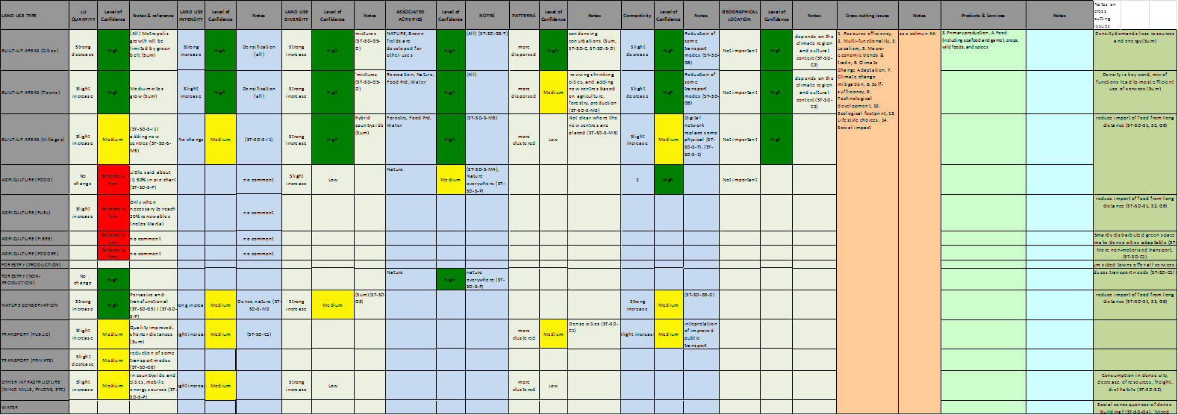
15 summary tables based on all material

Slide 25
Results of sectoral-societal visions

Slide 26
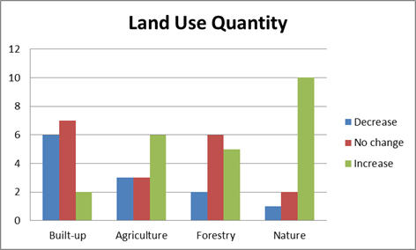

Slide 28
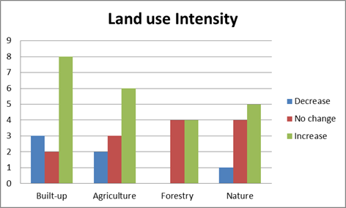

Slide 29
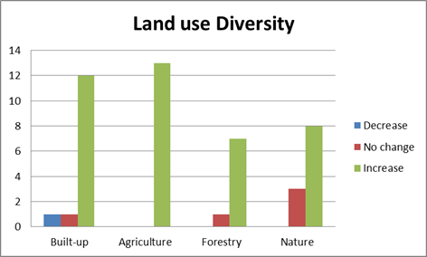

Slide 30
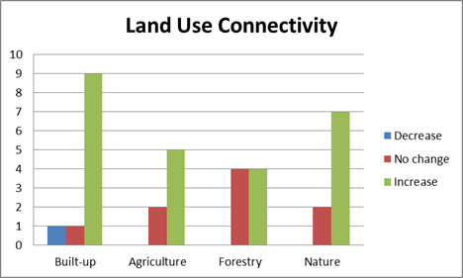

Slide 31
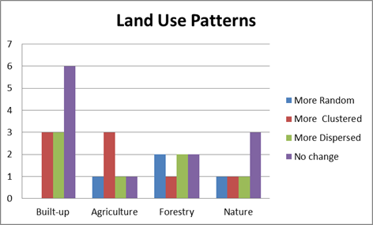

Slide 32
Built-up areas
There is a significant wish to stop or even decrease the surface occupied by built-up areas, which is reflected by the increase in their compactness (less urban sprawl) and number of functions. The majority desires a higher connectivity within the urban area and between different urban areas and urban areas and nature. The location and spatial distribution of urban areas is the same.
Notes:
Diagram/ way to do it and output

Slide 33
Agriculture
The surface increases because agriculture occupies new land as part of the overall multifunctionality of land, e.g. more urban agriculture, more high nature value farming, etc. At the same time, some agricultural areas become more intensive to compensate the decrease in crop productivity in the extensive agriculture areas. These intensive agricultural areas are placed together leading to a more clustered agriculture. As part of the dominating multifunctionality, agricultural areas enhance their connectivity with other land uses, e.g. more green corridors and consequently higher number of landscape elements.
Notes:
Diagram/ way to do it and output

Slide 34
Forestry
There is a strong wish to keep or increase the current surface occupied by forests, partly because the aspiration of achieving a higher multifunctionality (e.g. agro-forestry, mixtures of nature conservation with recreation and production, etc.). Because expected higher demands of wood production there is a wish to keep or enhance the forest production capacity.
Notes:
Diagram/ way to do it and output

Slide 35
Nature
There is a very strong wish to increase the natural areas in Europe, both in terms of multi-functional nature embedded in urban, agriculture and forestry areas, as well as protected nature. The connectivity of natural areas will increase resulting in a large green infrastructure.
Notes:
Diagram/ way to do it and output

Slide 36
The way forward consolidated visions

Slide 37
Stakeholder visions
cluster Label x y
1 1 Smart Denscity 1.000000 -1.544924
5 1 Local Matters 1.539685 -1.648083
8 1 Value Land Use 1.381262 -1.196309
10 1 Forus 1.525925 -1.385901
12 1 Eureco 1.628336 -1.000000
> clusterdata_2
cluster Label x y
2 2 Neural Network -0.3658464 -0.7192660
4 2 Challenging Suburbia -0.2221277 -0.2218922
7 2 Open Minds, Closed Cycles 1.0481742 -0.7386590
9 2 Foodscapes 0.6350280 -0.5263376
14 2 Ostrom 2040 1.0929274 0.5123255
> clusterdata_3
cluster Label x y
3 3 EUtopia -0.7726771 0.7252037
13 3 NVL -0.8241313 0.2059729
15 3 Past to the Future -1.6642945 -0.1337093
> clusterdata_4
cluster Label x y
6 4 Insola 2040 -1.299280 -1.416333
11 4 3Rs -1.164812 -1.166925
>
> median_per_cluster = aggregate(clusterdata[,-c(2,1)],list(groups.4),median,na.rm=TRUE)
> data.frame(median_per_cluster,Freq=as.vector(table(groups.4)))
Group.1 x y Freq
1 1 1.5259250 -1.3859014 5
2 2 0.6350280 -0.5263376 5
3 3 -0.8241313 0.2059729 3
4 4 -1.2320463 -1.2916287 2
>
> # A1: neg, pos
> # A2: pos, pos
> # B1: neg, neg
> # B2: pos, neg

Slide 38
Stakeholder visions

Slide 39
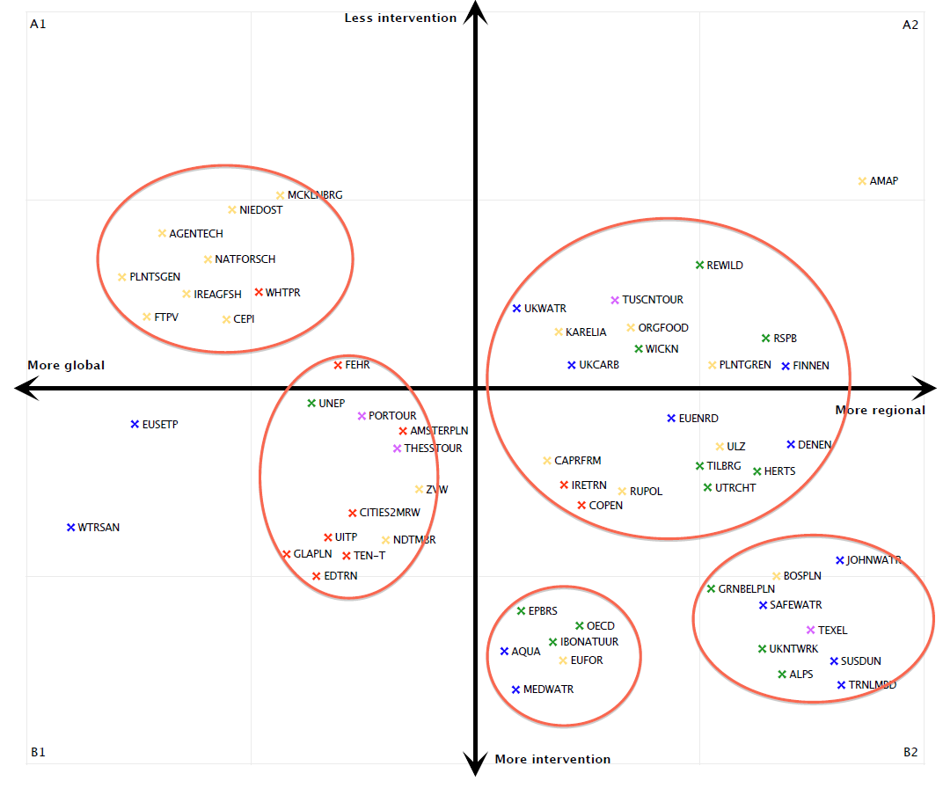
Document visions
5 clusters

Slide 40
Stakeholder visions

Slide 41
Document vision (5 clusters)

Slide 42
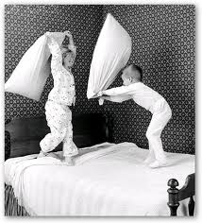
Talking about future is difficult
“Research tells us that people find more joy in thinking about the past than they do in reflecting on the present or anticipating the future” (Psychologist Fred Bryant)
Tools to help self reflection.

