Slide 1
The Greek Crisis and its Cultural origins –
A Study in the theory of multiple modernities
Constructing a model of cultural research
Manussos Marangudakis with Theodoros Chatjipantelis

Slide 2
The Greek Crisis
How responsible is the ‘Greek culture’ for the ongoing economic crisis?
What constitutes Greek culture?
How do we explain the ups and downs of economic performance if there is an influential Greek culture?

Slide 3
But…
how to distinguish culture from social structure?
how to account for ‘modern polytheism’?
how to distinguish between instrumental and reflective use of symbols?
how to verify the significance of culture?
how to depict the symbolic structure of culture?
How to relate culture and social structure?

Slide 4
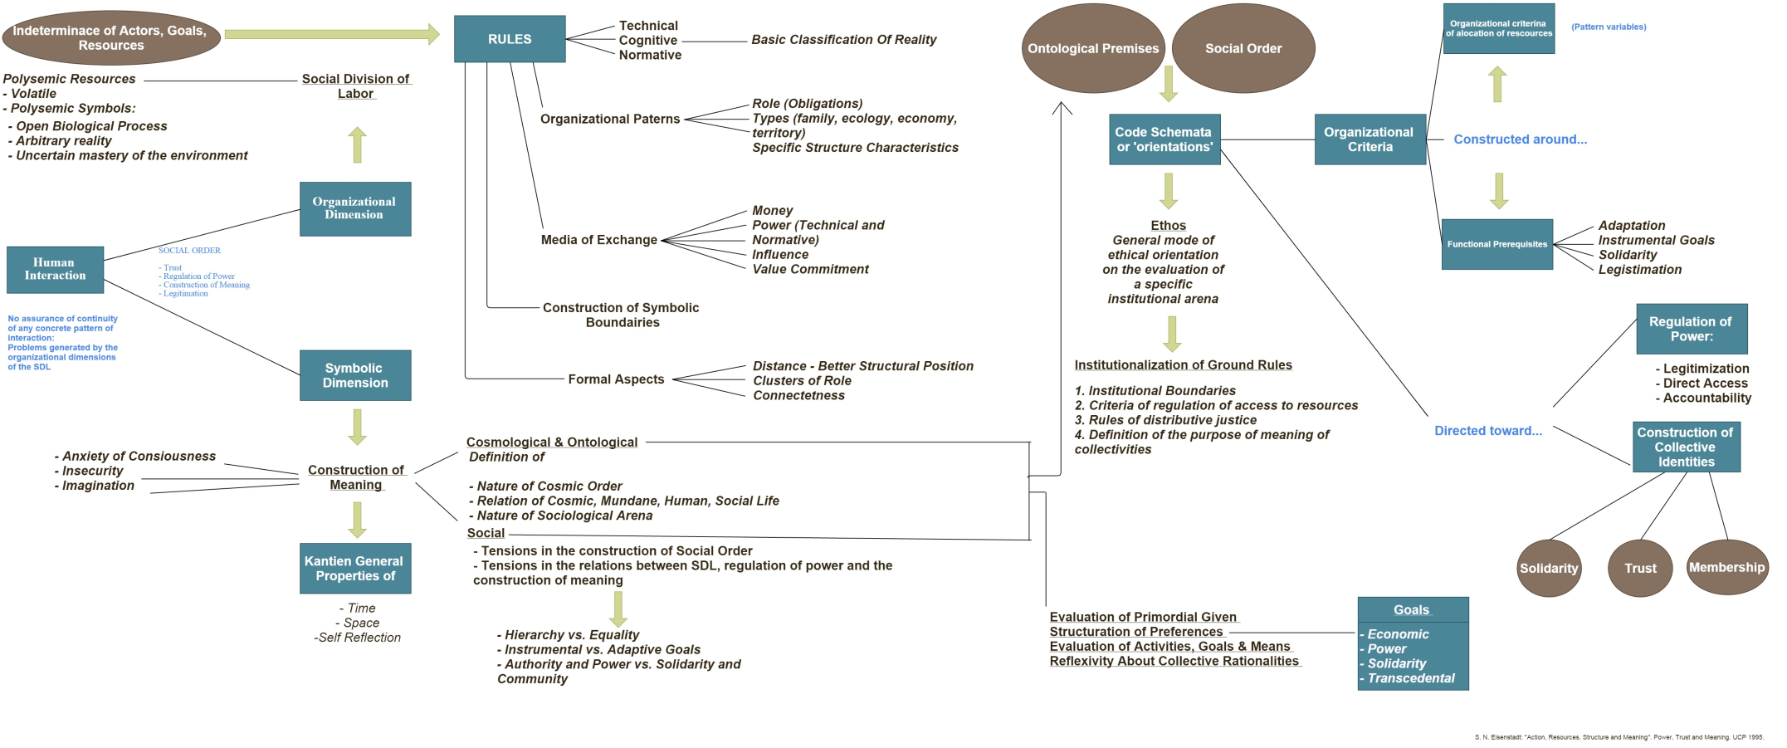
The basis of our analysis: Shmuel Eisenstadt’s understanding of culture:
the infusion of social structures with meaning

Slide 5
The definition of culture
Culture is the domain of deep, constitutive, moral convictions and thereof moral evaluations of the self structured around binary oppositions, and codified in symbolic patterns.
Culture is a distinct and essential component of a social system since in the form of symbolic structures it renders social organization meaningful
Culture is passive in that it constitutes the ‘unmovable mover’ part of the self
S. Eisenstadt, Ch. Taylor, M. Weber, J. Alexander, V. Turner, R. Bellah, A. Szakolczai, E. Durkheim

Slide 6
Key-elements of the model
Central Concept |  | Key-concept
Cosmological/ontological principles Ground Rules Code-orientations Regulation of power Construction of collective identities | Eisenstadt | Indeterminacy
Substantive rationality | Weber | Psychological Premiums
Social division of labor as social networks of power | Mann | Instrumentality of power
Rituals as crucial performances to the construction of communal spirit | Durkheim | Collective effervescence
Civil rituals as depictions of the political morality of the public sphere | Bellah | Civil religion
Ambiguity or disorientation that occurs in the middle stage of a crisis | Turner | Communitas Trickster
Meaning as a permanent destructive forces | Bateson | Schismogenesis
The crucial role of the discourses in shaping collective morals | Alexander and Smith | Binary codes

Slide 7
… bracketing out non-symbolic social relations (Michael Mann’s model)

Slide 8
Hypothesis:
Structures of social power…
…through selective affinity
encourage the proliferation of a certain symbolic/moral system
as the latter provides those structures with moral meaning
thus legitimizing them

Slide 9
Key hubs of symbolic flows
Ontological and cosmological principles
(the ultimate source of meaning – S. Eisenstadt)
Constitutive goods
(the desirable ideal state of being – C. Taylor)
Discursive manifestations of culture
(civil religion, ceremonies, social dramas – Alexander, Bellah, Durkheim, Turner, Bateson)
Internalized code-orientations
(the personal ethos of social action – M. Weber)
Institutional ground rules
(the moral justification of the social division of labor – S. Eisenstadt, M. Weber)

Slide 10






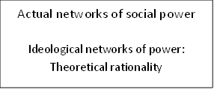
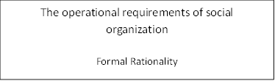
A model for cultural research

Slide 11
Reviewing
Ethnographic research
Social-psychological studies
Anthropological field work
Literacy, music
Historical developments and contingencies
Theological interpretations of social action
Press

Slide 12
Greece as a multiple nexus
as what happens when:
(a) a mystical religion is interweaved with western, secular, ideologies;
(b) a collectivist, Zone III, society of immensely strong Mythical memories is constantly upset by war and strife and concomitant cultural traumas; and
(c) rural familism is intertwined with the structures of an imported centralized, modern, state.

Slide 13
Three internalized code-orientations
Generalized clientelism
Amoral familism
Anarchic individualism

Slide 14
Two sources of schismogenesis
Religious:
a very sharp distinction between the transcendental and the immanent domain
morally insignificant and meaningless in-worldly social action
Communitas: the mystical union of believers
Political:
democracy as protest and insubordination
the People as a suffering supra-historical entity
Communitas: the undifferentiated citizens united through collective representations

Slide 15







The traditional configuration of rural Greece

Slide 16







Mythical collectivism (the literary depiction of modern Greece)
1930s onwards

Slide 17








Secular ‘anarchic individualism’

Slide 18







Generalized Clientelism

Slide 19
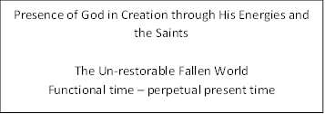
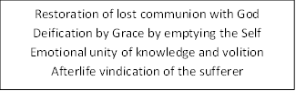

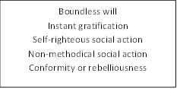
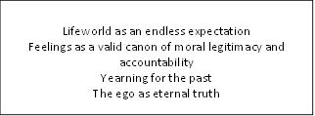
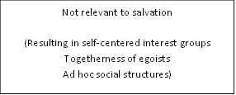

The Greek-Orthodox Salvationism Model

Slide 20
Ontological and Cosmological principles
Traditional Rural Configuration | The 1930s Literal Mystical Collectivism | Ethnographic anarchic individualism | Generalized clientelism | The Greek-Orthodox religion
The fallen world Family as Eden Vs. The world as a treacherous place Social order perceived as given | Mystical union of past and present time | Out-worldly authenticity Vs. In-worldly compromise | Out-worldly purity Vs. Worldly pollution Social order perceived as given | Out-worldly salvation The fallen world Perpetual present time
The world as a feeble reflection of timeless purity

Slide 21
Constitutive goods
Traditional Rural Configuration | The 1930s Literal Mystical Collectivism | Ethnographic anarchic individualism | Generalized clientelism | The Greek-Orthodox religion
Security Survival Observance Repentance | Greece as the eternal spring of truth and authenticity | The rigorous defense of the inner world | Control of fixed and limited recourses | Restoration of lost communion with God Emotive union of knowledge and volition After-life vindication of the sufferer
The world as the enemy of authenticity

Slide 22
Discursive manifestation of culture
Traditional Rural Configuration | The 1930s Literal Mystical Collectivism | Ethnographic anarchic individualism | Generalized clientelism | The Greek-Orthodox religion
Religious rites ‘washing-off’ necessary sin Performativities of saving face, defending the moral integrity of the family | Collectivist representations of survival, victimhood and resurrection Absence of redemption | The performativity of the individual confronting the cruel and alienating world | The paternalistic performativity of mediator-suppliant | Mystical fusion of time and space, of individual and the collectivity
The performativity of the hero-sufferer

Slide 23
Internalized code-orientations
Traditional Rural Configuration | The 1930s Literal Mystical Collectivism | Ethnographic anarchic individualism | Generalized clientelism | The Greek-Orthodox religion
Amoral familism | The authentic of the nation | The authentic self | Family member-stranger | Emotion as eternal truth and a canon for accountability
Authenticity

Slide 24
Institutional ground-rules
Traditional Rural Configuration | The 1930s Literal Mystical Collectivism | Ethnographic anarchic individualism | Generalized clientelism | The Greek-Orthodox religion
Negative reciprocity | Imagined familial community | Anarchic individualism | Patron-client social exchange Weak institutional loyalties | Boundless will Frustration toward rules and regulations Non-methodical social action
Anarchic Individualism

Slide 25
Actual networks of social power
Traditional Rural Configuration | The 1930s Literal Mystical Collectivism | Ethnographic anarchic individualism | Generalized clientelism | The Greek-Orthodox religion
Segmentary collectivities | Greece as a direct continuation of ancient Greece and the byzantine empire | Agonistic social interaction | Cut-throat antagonistic networks | No relevance to salvation
Non-methodical social structures

Slide 26
The operational requirements of social organization – formal rationality
Traditional Rural Configuration | The 1930s Literal Mystical Collectivism | Ethnographic anarchic individualism | Generalized clientelism | The Greek-Orthodox religion
Traditional religious rules and regulations | Formal rationality as the enemy of authenticity | A contest with the individual to remain authentic | Bureaucracy as a means to facilitate patron-client relationship | No relevance to salvation
Formal rationality as the enemy of authenticity

Slide 27
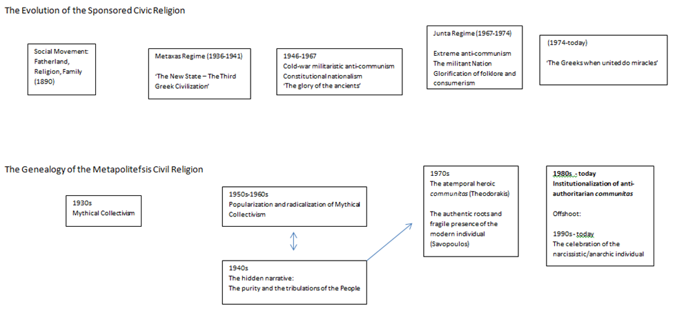
The two civil religions

Slide 28
The Metapolitefsis Public Sphere (1974-2014)
Major realignment of the civil/civic binary code
The People vs. The Dictatorship:
The dark forces (capitalism, imperialism etc.)
the bourgeoisie life-style (discipline, formality etc.)
social & political disciplinary hierarchies
Major realignments of social power and political structures (1981-2010)
Who are the People?
Power to syndicates – party cronies – marginalized social groups
Expansion of State-controlled economy
Expansion of civil service employment sector

Slide 29







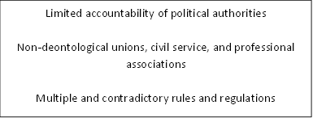
The Metapolitefsis Civil Religion (1974-2010)

Slide 30
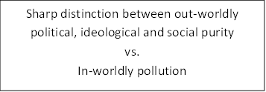


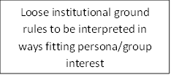



The Metapolitefsis cultural system

Slide 31
The three anti-memorandum discourses
The nationalist discourse: Greeks vs. ‘the foreign powers’
The proletariat discourse: the ‘workers’ vs. the capitalist system
The direct-democracy discourse: the people vs. the system

Slide 32
The Syriza party
The vision of traditional communism (monopoly of state power)
Incorporation of the New Left discourse (symbolic hegemony of the public sphere)
Revenge against the victorious, nationalist, social forces
Full compliance with the EU powers in exchange for EU tolerance for anti-liberal actions in Greece

Slide 33
The Syriza civil religion
The leftist communitas
Total war against the profane ‘system’
Alexis Tsipras
Documento newspaper
Party trolls
The performativity of the antisystemic movements
The dressing-code of the party members
Liminality
The antinomian ‘living saint’
Generalized clientelism
Unconcealed corruption
Blatant nepotism
Manifest disregard of rules and regulations
Ends justify means

Slide 34
Quantifying culture
Constitutive goods: images of desirable ‘states of being’
Internalized code-orientations: political statements as ‘value-postulates’
Patterned order of ethics: combination of 1 and 2
Symbolic identity: combination of 1 and pattern of social behavior
Geometric data analysis

Slide 35




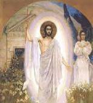
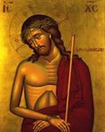




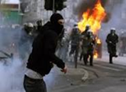
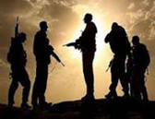
The patterned order of Constitutive Goods
Naturalist c/goods and Revolution
Religion
Individuality + Science
Violence and subversion

Slide 36
Internalized code-orientations
Social justice is more important than individual rights.
The interests of the people are more important than institutions and laws.
When following my personal interests I do not consider the law.
I experience the world around me mainly with through my feelings rather than through my intellect.
I believe that the destiny of each person is predetermined.
When the people truly get power, the most important problems would be solved in a mere matter of time.
I believe in the miraculous intervention of God in the world.
In general I trust my fellow citizens, irrespective of how well I know them personally.

Slide 37
Internalized code-orientations (cont.)
At the end of the day, I am responsible for what happens to me.
I feel that my life is controlled by sinister power networks.
If I consider something to be right, I will act on that basis, irrespective of its consequences to others.
Immigrants pose a threat to our national identity.
I am ready to fight for what I believe is right, even by breaking the Law.
Physical violence does not belong in political life.
The role of politicians is to do favours for their constituency.
Foreigners are jealous and conspire against us.
If I had to choose between individual freedoms and social equality, I would choose social equality.
I stick to my beliefs and values, even if this harms my personal interests.

Slide 38
Phobic
Egoistic
Ο ταμπουρωμένος εαυτός
Self-righteous
Internalized code orientations
Ο λαϊκιστής εαυτός
Messianic
Civil
Ο κοινοτιστής εαυτός
Egalitarian

Slide 39
The three world-views - Weltanschauung
The entrenched self – the dangerous world
Sacred: The habitus
Profane: The unknown world of potentialities
The populist self / The People as the carrier of purity
Sacred: Saint People
Profane: Coercion
The Communalist self / The collectivity as carrier of truth
Sacred: The communitas
Profane: The individualized society

Slide 40
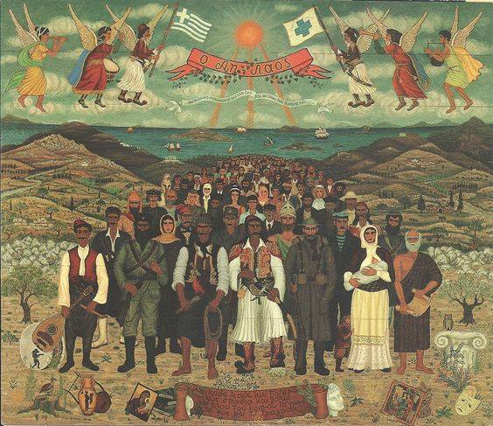
The saint People
Notes:
Θέμης Τσιρώνης

Slide 41
Patterned orders of ethics
1) The Hobbesian ethics(1,1%)
2) The egoistic ethics (1,9%)
3) The schismogenetic ethno-populist ethics (19%)
4) The schismogenetic ethno-romantic ethics(41%)
5) The clientelistic ethics (12%)
6) The civil ethics (21%)

Slide 42
Personal social behavior
I prefer to rely on myself rather than on others.
It is important for me to perform better than others in my job.
When a co-worker or friend gets a prize, I feel proud for them.
An individual should sacrifice their own interests for the team.
I often “do my own thing”.
Accomplishing my goals means everything to me.
The well being of my co-workers is important for me.
It is my duty to take care of my family, even if I have to put aside my personal desires.
Being who I am, regardless of what others believe, is very important for me.
Competition with others is the law of nature.
It is very important for me to spend time with my friends.
It is important for me to accept the decisions of the team that I belong to.

Slide 43











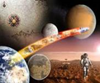
Construction of symbolic identity
Horizontal-Individualist (cooperative)
Vertical-Individualist (antagonistic)
Horizontal-Collectivist (collectivist)
Vertical-Collectivist (familial)
Disagree 2 HI, 1 VC, 1 VI (1%) Disagree 2 Ο-Α, 1 Κ-Σ, 1 Κ-Α (2%)
Agree 3 HC, 1 HI (company, pride, well-being, identity) (42%)
Agree 3 HC, 1 HI (company, pride, well-being, identity) (19%)
Strongly Agree 2 HI, 3 HC, 3 VC, 2 VI (30%)
Disagree 3 HC, Strongly Disagree 1 VC (23%)

Slide 44
Conclusions
The core of the political culture in Greece follows various patterns of collectivism
It is sensitive to discourses which underlie alternatively the morality of the traditional family and the politics of defiance and struggle
The most civil part of the population is self-defined negatively – its political views are not related to collective representations.

Slide 45
The construction of the political public sphere
The structuration of the ‘democratic self’
The structuration of the ‘democratic relations’
The perception of ‘democratic’ institutions
The placement of the self inside those (3) institutions
Result: the semantic map of political semiotics

Slide 46
The ‘democratic’ self, and the ‘democratic’ relations
GROUP A |  |  |  |  | GROUP B
 | DEMOCRATIC | - | NOT DEMOCRATIC |  |  | DEMOCRATIC | - | NOT DEMOCRATIC
i. | Unconventional | - | Conventional |  | i. | Active | - | Passive
ii. | Defiant | - | Compromised |  | ii. | Autonomous | - | Dependent
iii. | Authentic | - | Hypocrite |  | iii. | Rational | - | Irrational
iv. | Altruist | - | Egoist |  | iv. | Reasonable | - | Hysterical
v. | Oppressed | - | Oppressor |  | v. | Controlled | - | Excitable
vi. | Victim | - | Offender |  | vi. | Calm | - | Passionate
vii. | Sensitive | - | Calculative |  | vii. | Realistic | - | Unrealistic
viii. | Independent | - | Dependent |  | viii. | Sane | - | Mad
GROUP A |  |  |  |  | GROUP B
 | DEMOCRATIC | - | NOT DEMOCRATIC |  |  | DEMOCRATIC | - | NOT DEMOCRATIC
i. | Authentic | - | Hypocritical |  | i. | Open | - | Secret
ii. | Mutual support | - | Egotist |  | ii. | Trusting | - | Suspicious
iii. | Genuine | - | Manipulative |  | iii. | Critical | - | Deferential
iv. | Interpersonal | - | Mediated |  | iv. | Truthful | - | Deceitful
v. | Brotherly bond | - | Stranger |  | v. | Straightforward | - | Calculating
vi. | Affective | - | Formal |  | vi. | Citizen | - | Enemy

Slide 47
The communalist self
E16A (items) | Type (E17) | Title | Weight (%) | E16A Gr Variable
v, vi | A | “The sufferer” | 14,7% | GA1
i, viii |  | “The anti-conformist” | 16,6% | GA2
iii, iv, vii | B | “The altruist” | 20,5% | GA3
ii, iii, iv, viii | B | “The hero” | 21,5% | GA4
i, ii, v | A | “The rebellious” | 26,6% | GA5

Slide 48
The civil self
E16B (items) | Type (E17) | Nomenclature | weight (%) | E16B group
i, iii, iv, viii | B | The Moderate Activist | 13,2 % | GB1
i, vi | C | The Calm Activist | 16,5% | GB2
v |  | The Controlled | 22,2% | GB3
iii, vii, viii | A | The Sober Onlooker | 23,5% | GB4
i, ii | Α &C | The Autonomous Activist | 24,7% | GB5

Slide 49
The communalist relations
GR18Α (items) | Framework | Title | Weight (%) | Grouping variable
i, iii, v, vi |  | Religious | 27,4% | GA18_1, GA18_2
ii, iv, v, vi |  | Political | 48,6% | GA18_3, GA18_4, GA18_5
i, ii, iii | B | Intermediate | 23,9% | GA18_6

Slide 50
The civil relations
GR18Β (items) | Framework | Title | Weight (%) | Grouping
i, ii, iii, v |  | Civil-critical | 18,6% | GΒ18_1
ii, iv |  | Civic-direct | 28,3% | GΒ18_2
ii, vi | C, A | Civil | 26,6% | GΒ18_3
i, iii, iv, vi | B | Civil-suspicious | 26,5% | GΒ18_4

Slide 51
The ‘democratic’ institutions
 | + / –
a. |  | …they regulate the activities of the different interest groups
b. |  | …they primarily care for the people
c. |  | …they deal with numbers and statistics
d. |  | …they guarantee equality
e. |  | …they take into consideration the particular needs of citizens
f. |  | …they are impersonal
g. |  | …they are sensitive to social needs
h. |  | …they are stern and non-negotiable
i. |  | …they guarantee the desires of the people
j. |  | …they are based on a contract between the state and citizens
k. |  | …they are malleable and flexible
l. |  | …they prioritize the duties of an office over the power of individuals to make decisions

Slide 52
Placing statements in Democratic institutions – The dominance of Populism
 | 16Α Groups (weight) | 16Β Groups (weight) | 18Α Groups (weight) | 18Β Groups (weight) | 20 Groups (weight)
1 2 | GA16_1 –A (14%) “The Sufferer” Oppressed-Oppressor Victim-Offender | GB16_2-C (16%) “Calm Activist” Active-Passive Calm-Passionate | GA18_3-B (14,8%) “Brotherly Mutuality” Mutual support-Egotist Brotherly bond-Stranger | GB18_3-A,C (26,6%) “Civil” Trusting-Suspicious Citizen-Enemy | Civil-Liberal 4,4%
3 | GA16_2 (16.6%) “Anti-conformist” Unconventional-Conventional Independent-Dependent |  | GA18_1-B (12,5%) “Brotherly expressivity” Authentic-Hypocritical Genuine-Manipulative Brotherly bond-Stranger Affective-Formal | GB18_1 (18,6%) “Civil-Critical” Open-Secret Critical-Differential Trusting-Suspicious Straight forward-Calculating | Intermediate 20,1%
4 | GA16_3 B (20.5%) “Altruist” Sensitive-Calculative Authentic-Hypocrite Altruist-Egoist | GB16_3- (22%) “Controlled” Controlled-Excitable | GA18_4-C (14,3%) “Affective Mutuality” Mutual support-Egotist Affective-Formal
5 | GA16_4 B (21.5%) “Hero” Unconventional-Conventional Authentic-Hypocrite Altruist-Egoist Independent-Dependent GA16_5 A (26.6%) “Rebel” Oppressed-Oppressor Defiant-Compromised Unconventional-Conventional | GB16_5-Α, C (25%) “Autonomous Activist” Active-Passive Autonomous-Dependent GB16_4-Α (24%) “Rational Onlooker” Rational-Irrational Realistic-Unrealistic Sane-Mad | GA18_2-C (14,9%) GΑ2-C “Interpersonal expressivity” Authentic-Hypocritical Genuine-Manipulative Interpersonal-Mediated Affective-Formal GA18_6-Β (23,9%) “Authentic Mutuality” Authentic-Hypocritical Mutual support-Egotist Genuine-Manipulative | GB18_2 (28,3%) “Civic-Direct” Trusting-Suspicious Truthful-Deceitful | Populist 67,2%
6 |  | GB16_1-Β (13%) “Rational Activist” Active-Passive Rational-Irrational Reasonable-Hysterical Sane-Mad | GA18_5-Α (19,5%) “Interpersonal Mutuality” Mutual support-Egotist Interpersonal-Mediated | GB18_4-Β (26,5%) “Civil-Truthful” Open-Secret Critical-Differential Truthful-Deceitful Citizen-Enemy

Slide 53
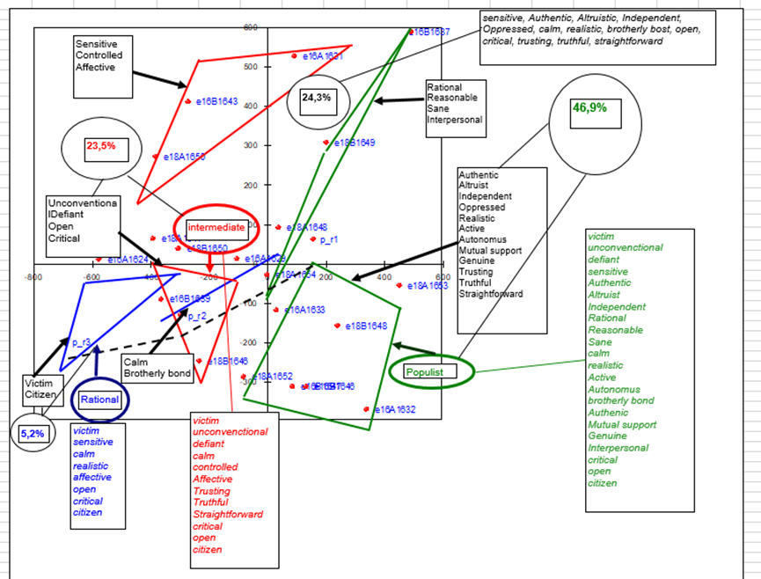
The semantic map of the political self

Slide 54
Conclusions
1. Clientelism is based on religion-inspired paternalism
2. Anomie is based on collective representations of democratic defiance and protest
1 and 2 are interchanged through civic-religious ceremonies
The civil world-view is isolated without public or private collective representations
The public sphere is controlled by communalist discourses
Communalism: Democracy is the collectivist, traditional, ‘authentic’ community

Slide 55
The perpetuation of entrenched collectivism
Elective affinity between statism and collectivism
Persistence of collectivist cosmological/ontological orientations
Social networks of paternalistic polity – economy – ideology
Frustrated outsiders seeking entry into the system
No incentives for cultural innovation

