Slide 1
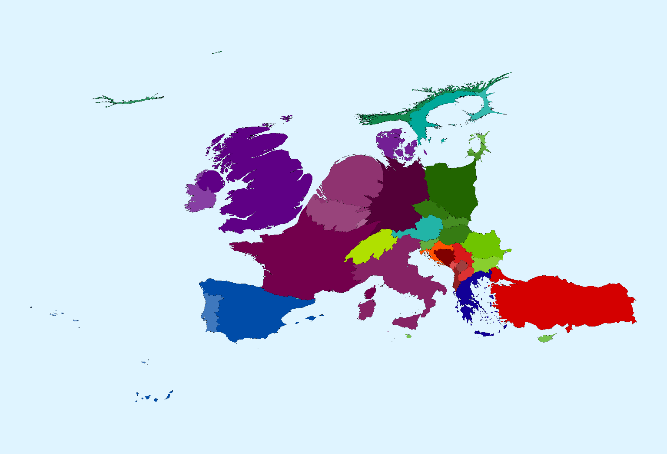
Global Transformations, Local Processes and ‘left behind’ people and places
Dimitris Ballas
https://www.rug.nl/staff/d.ballas/

Slide 2




Happiness, unhappiness and discontent

Slide 3
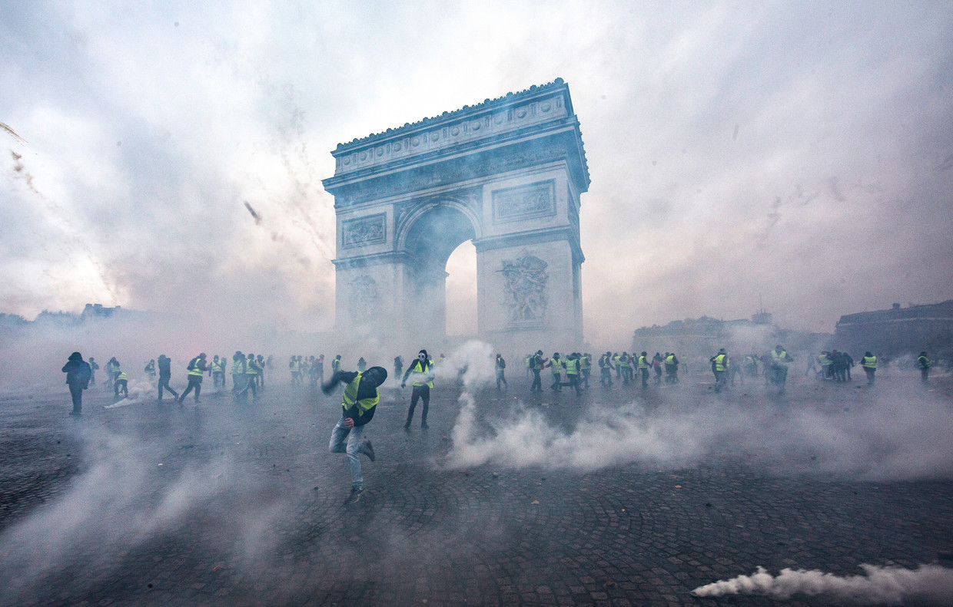
Le Parisien, December 2018
Presentation Graduate Research Day
Stijn Ringnalda MSc Economic Geography, University of Groningen , 2019

Slide 4
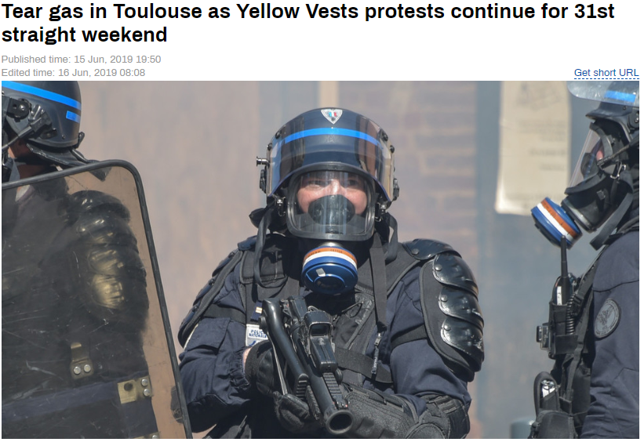
RT France, June 2019
Presentation Graduate Research Day
Stijn Ringnalda
27 – 6 – 2019

Slide 5
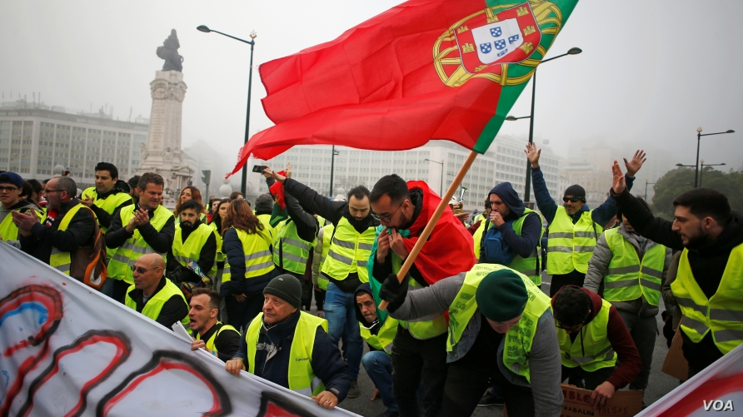
Público, December 2018
Presentation Graduate Research Day
Stijn Ringnalda
27 – 6 – 2019

Slide 6
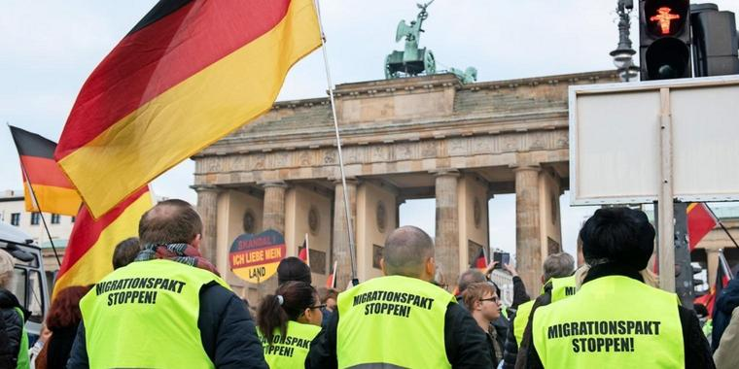
Die Welt, February 2019
Presentation Graduate Research Day
Stijn Ringnalda
27 – 6 – 2019

Slide 7
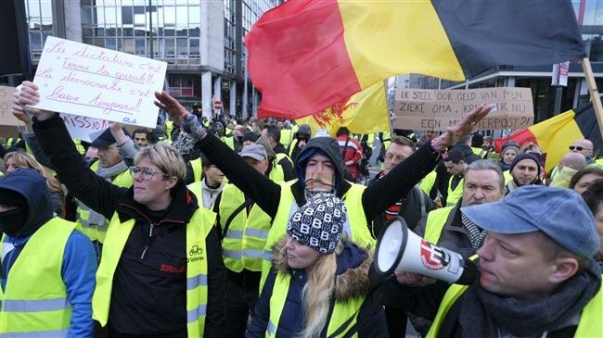
Presentation Graduate Research Day
Stijn Ringnalda
27 – 6 – 2019
Reuters, January 2019

Slide 8
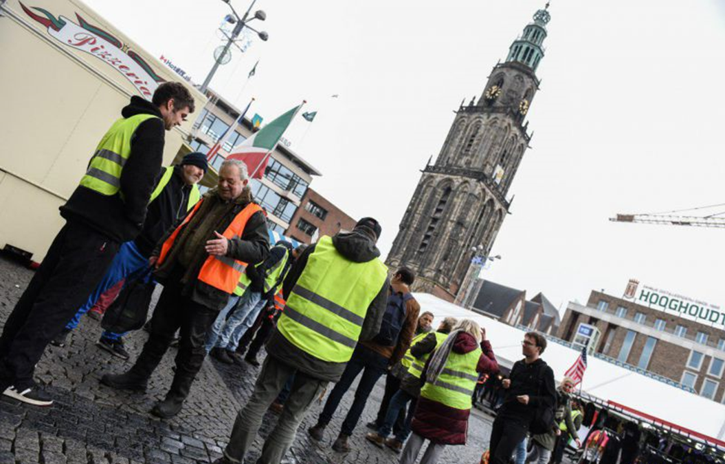
Groningen, December 2018
Presentation Graduate Research Day
Stijn Ringnalda
27 – 6 – 2019

Slide 9
The Geography of Discontent
“Persistent poverty, economic decay and lack of opportunities are at the root of considerable discontent in declining and lagging-behind areas around the world”
“The places that don’t matter have increasingly used the ballot box to rebel against the feeling of being left behind”
Andres Rodriquez-Pose, 2018

Slide 10
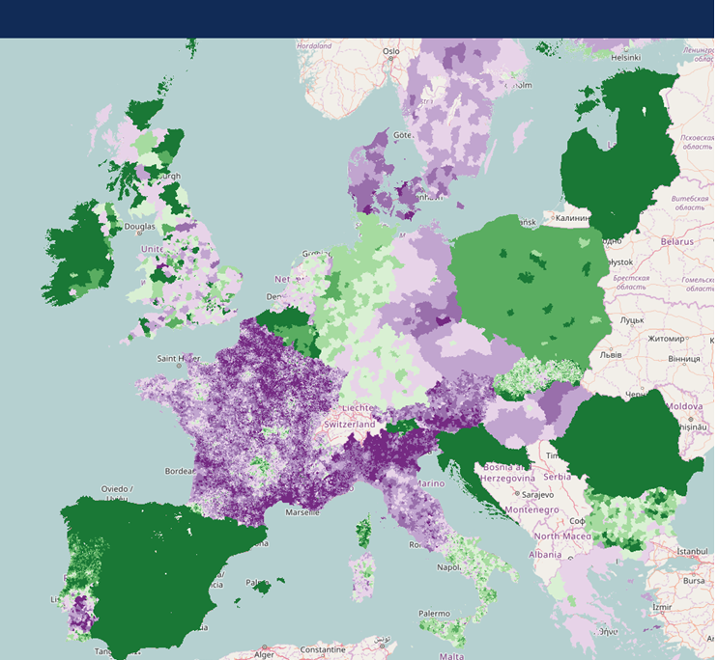
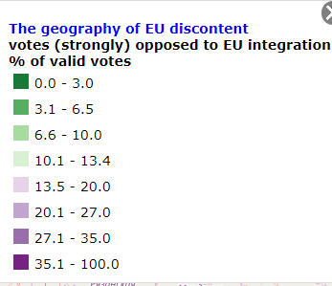
Dijkstra, Poelman &
Rodríguez-Pose, 2018

Slide 11
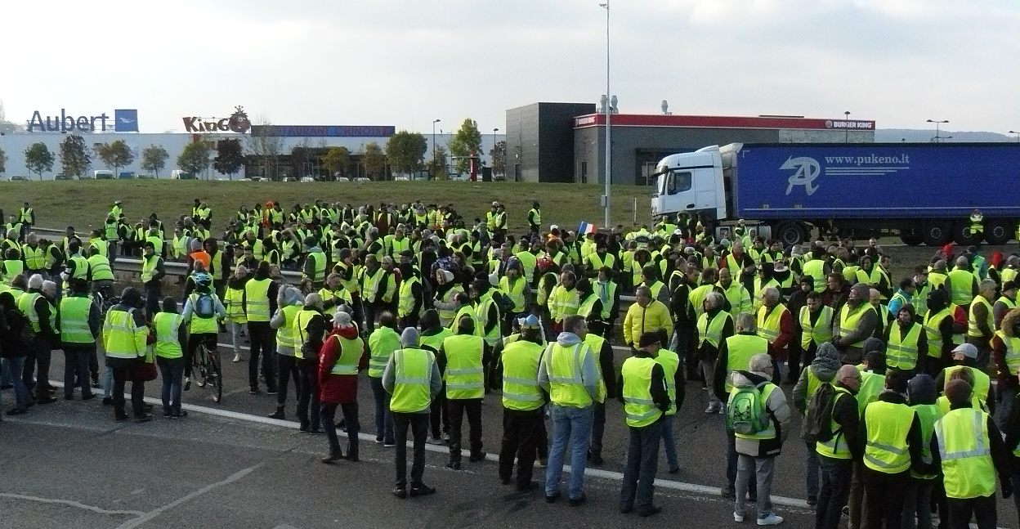
Building discontent indices
Presentation Graduate Research Day
Stijn Ringnalda
27 – 6 – 2019
Le Monde, November 2018

Slide 12
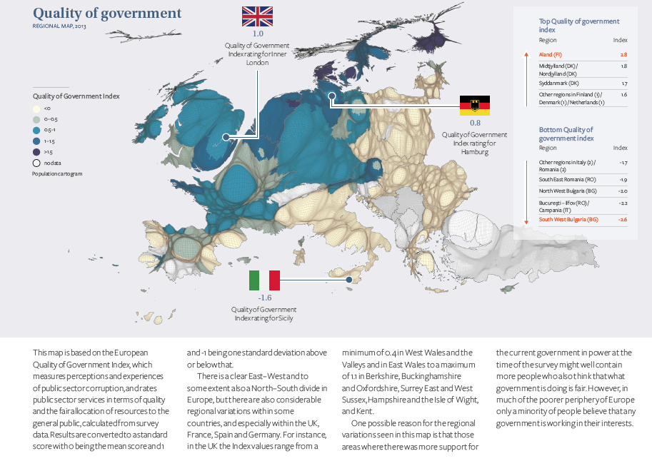

Slide 13
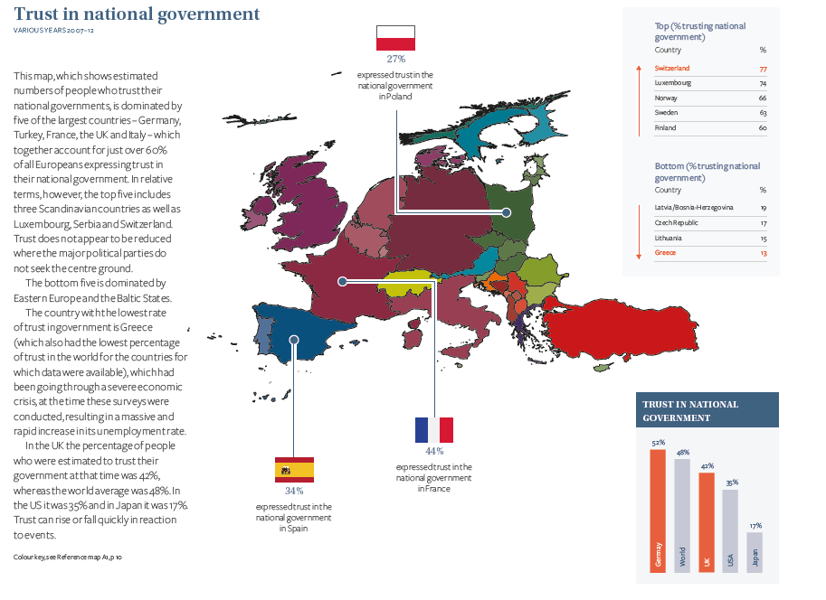

Slide 14
Principal components analysis
Examples of Statements
1. Trust in country's parliament
2. How satisfied with life as a whole
3. Immigrants make country worse or better place to live
Component Name | % variance explained | eigenvalue
‘Discontent’ | 29,442 | 8,833
Anti-immigration | 10,986 | 3,296
Life satisfaction | 5,821 | 1,746
Stijn Ringnalda, 2019

Slide 15
ID | Statement/Question | Measurement Scale
1 | Most people can be trusted or you can’t be too careful | 0-10
2 | Most people try to take advantage of you, or try to be fair | 0-10
3 | Most of the time people helpful or mostly looking out for themselves | 0-10
4 | Political system allows people to have influence on politics | 1-5
5 | Confidence in own ability to participate in politics | 1-5
6 | Trust in country's parliament | 0-10
7 | Trust in the legal system | 0-10
8 | Trust in the police | 0-10
9 | Trust in politicians | 0-10
10 | Trust in political parties | 0-10
11 | Trust in the European Parliament | 0-10
12 | Trust in the United Nations | 0-10
13 | Voted last national election | 0=No, 1=Yes,
14 | Taken part in lawful public demonstration last 12 months | 0=Yes, 1=No
15 | How satisfied with life as a whole | 0-10
16 | How satisfied with present state of economy in country | 0-10
17 | How satisfied with the national government | 0-10
18 | How satisfied with the way democracy works in country | 0-10
19 | State of education in country nowadays | 0-10
20 | State of health services in country nowadays | 0-10
21 | European Union: European unification go further or gone too far | 0-10
22 | Allow many/few immigrants of same race/ethnic group as majority | 0-3
23 | Allow many/few immigrants of different race/ethnic group from majority | 0-3
24 | Allow many/few immigrants from poorer countries outside Europe | 0-3
25 | Immigration bad or good for country's economy | 0-10
26 | Country's cultural life undermined or enriched by immigrants | 0-10
27 | Immigrants make country worse or better place to live | 0-10
28 | How happy are you | 0-10
29 | How emotionally attached to Europe are you | 0-10
30 | Would vote for [country] to remain member of European Union or leave | 0=leave, 1=remain
Stijn Ringnalda, 2019

Slide 16
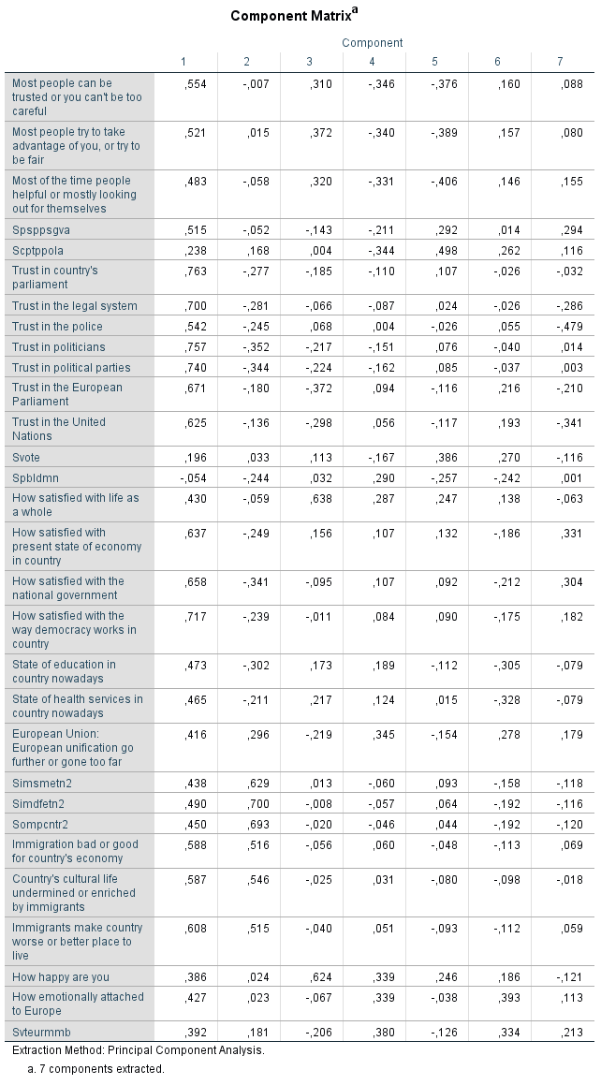
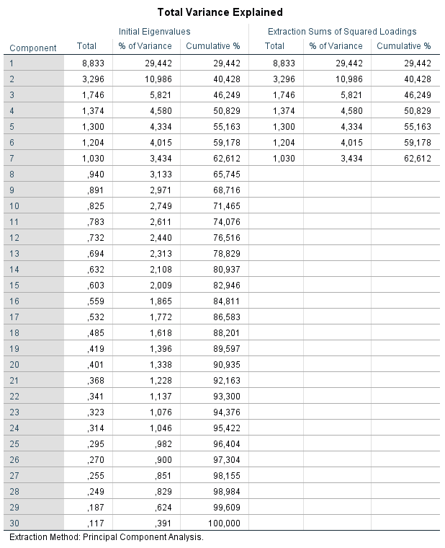
Stijn Ringnalda, 2019

Slide 17
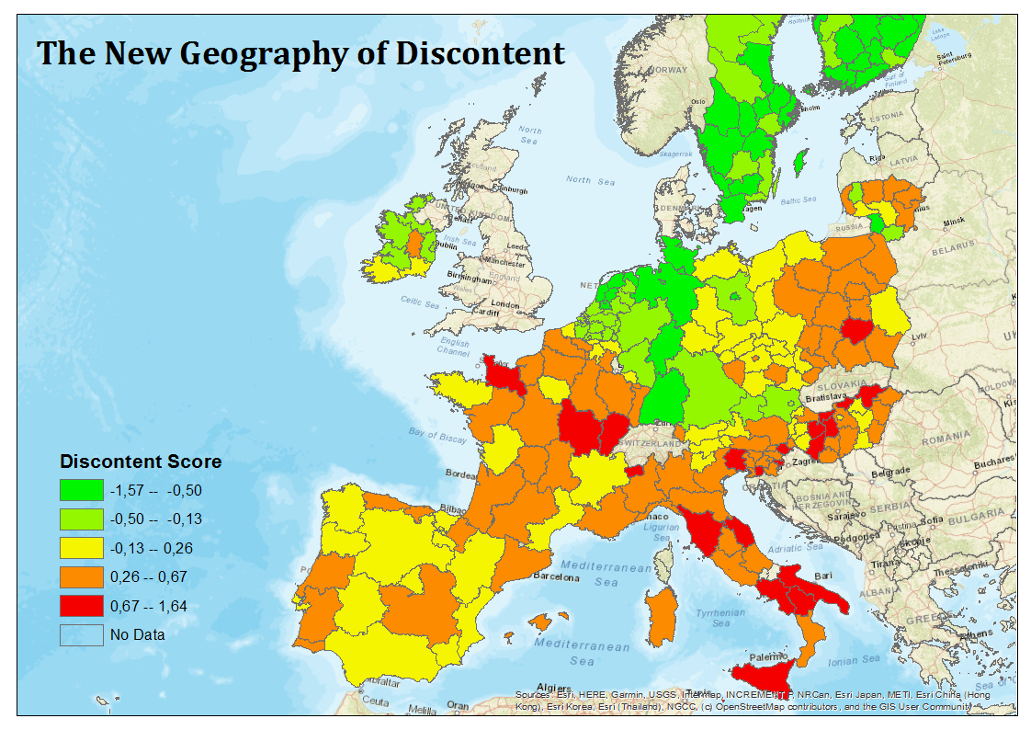
Stijn Ringnalda, 2019

Slide 18


Results
+1 Income Percentile
- 0,084 Discontent
+ €1000 Regional GDP per head
- 0,017 Discontent
+1% Annual average GDP growth per head
- 0,035 Discontent
Stijn Ringnalda, 2019

Slide 19

Results
+0.01 Gini Coefficient
+ 0,045 Discontent
Stijn Ringnalda, 2019

Slide 20

Results
‘Very Bad’ to ‘Very Good’
- 0,687 Discontent
Stijn Ringnalda, 2019

Slide 21
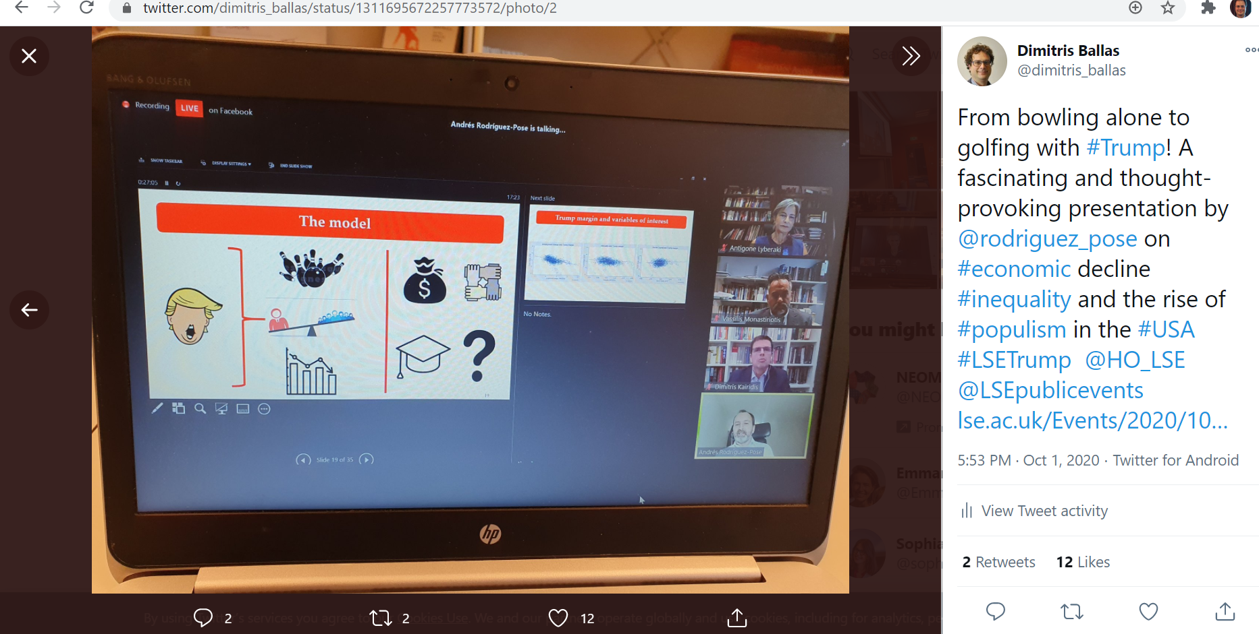
https://twitter.com/dimitris_ballas/status/1311695672257773572
https://www.lse.ac.uk/Events/2020/10/202010011600/trump

Slide 22
“’In 2000 Robert Putnam forecast that United States (US) democracy was at risk from the twin challenges of declining civic engagement and rising interpersonal inequality. Sixteen years later, his predictions were vindicated by the election of Donald Trump as president of the US. This paper analyses the extent to which the election of Donald Trump was related to levels of social capital and interpersonal inequalities and posits a third alternative: that the rise in vote for Trump in 2016 was the result of long-term economic and population decline in areas with strong social capital. This hypothesis is confirmed by the econometric analysis conducted for counties across the US”
Andres Rodriguez-Pose & Neil Lee & Cornelius Lipp, 2020. "GOLFING WITH TRUMP: Social capital, decline, inequality, and the rise of populism in the US," Papers in Evolutionary Economic Geography (PEEG) 2038, Utrecht University, Department of Human Geography and Spatial Planning, Group Economic Geography, revised Sep 2020.

Slide 23
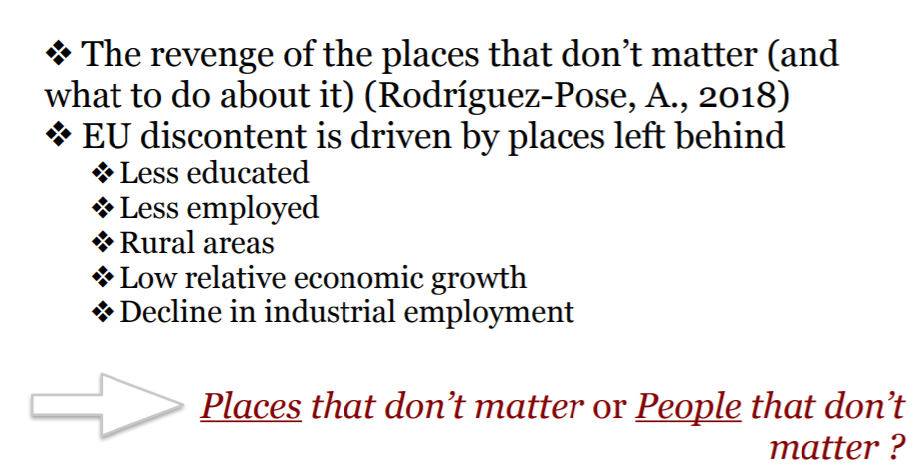
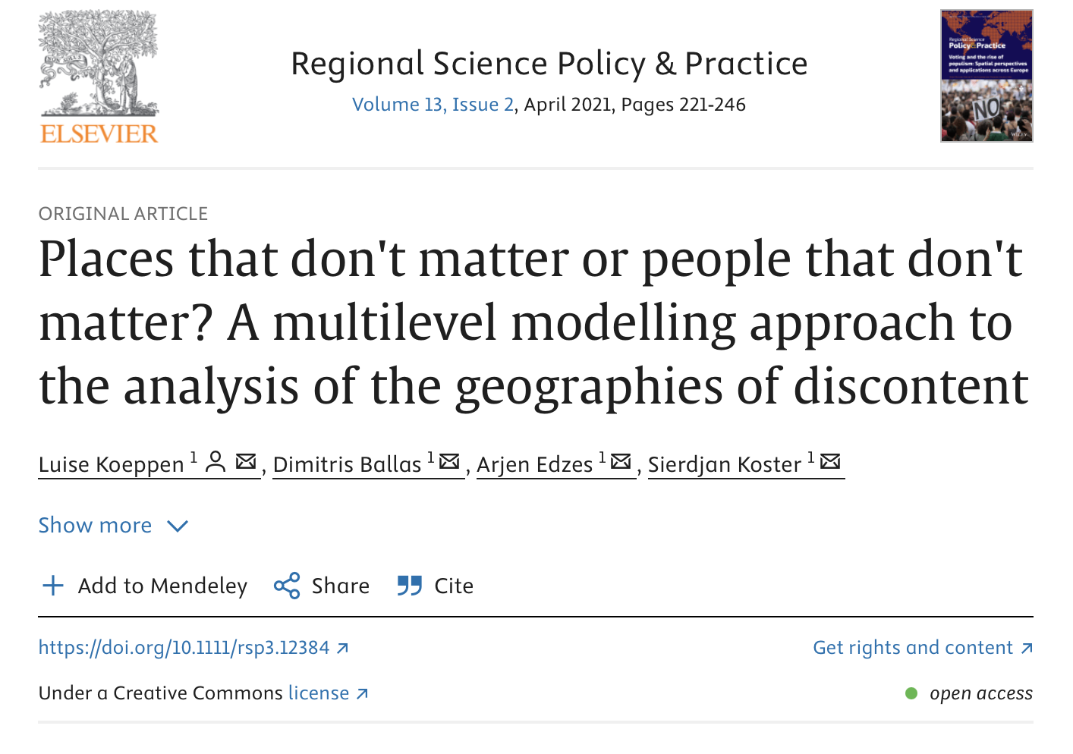

Slide 24
Determinants of Grievances and Discontent
Economic Grievances and Discontent
  Globalisation has led to regional socio-economic inequalities
  Spatial mobility patterns
Cultural backlash theory/ thesis (e.g. anti-immigration and Eurosceptic attitudes) (Norris and Inglehart, 2019)
“Empire“ – nostalgia and empire mentality (Dorling and Tomlinson, 2019)
Notes:
the main socio-economic perspective on voting for anti-establishment/ populist can be divided into three parts
1. The focus within the literature is that globalisation - has let to the loss of jobs across the geography and let to the creation of new jobs but these are highly concentrated - specifically concentrated in highly diverse and skilled and innovative cities - this can be linked to regional disparities (i.e. concentration of jobs) which results in the places “left behind“
2. Another factor that has intensified the disparities: Spatial mobility patterns (demographic change is an important aspect of) from these declining places, particularly from younger and more skilled and healthy people, which created additional problems; because it is perceived that politicians ignore these issues since they tend to focus on more successful cities and then linked to that low levels of funding (e.g. infrastructure funding) and consequently this leads to a feeling of being left behind and a negative outlook
3. As a consequence: this leads to discontent in these left behind places, high level of distrusts towards politicians -> because it seems that the situation is not improving and as a result we see low turnout in elections and an increase in support for anti-establishment parties
In addition to the socio-economic determinants just highlighted the “cultural backlash theory or thesis” holds that the Brexit vote can be explained by nostalgic reactions by once-predominant parts of the population (mostly Western societies) reacted with nostalgia to progressive value change, increased immigration and Euroscepticism, insofar as the European Union can be perceived as a cultural threat and a challenge to national identities.
Another dimension which is of relevance is the work by Dorling and Tomlinson (2019) who argue that “Empire”-nostalgia and empire-mentality were key factors affecting the result of the referendum on the UK's membership of the European Union.

Slide 25
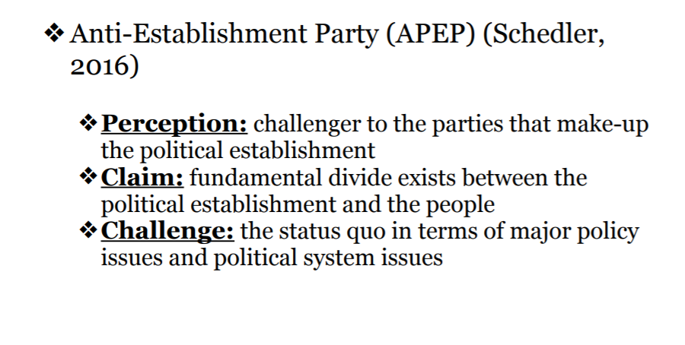
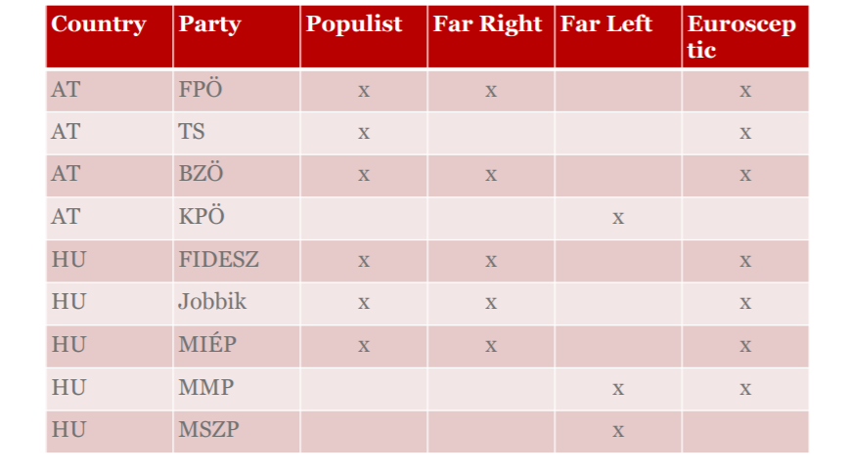

Slide 26
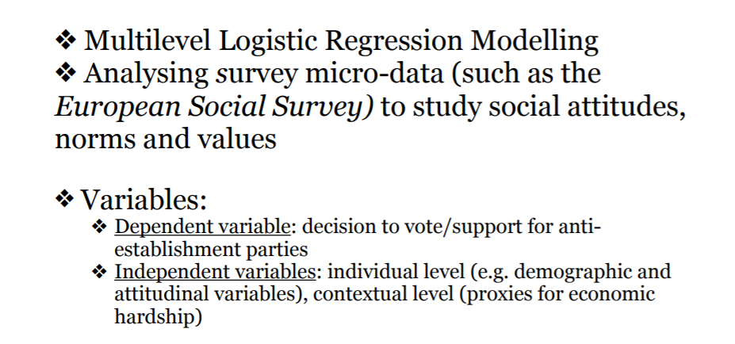

Slide 27
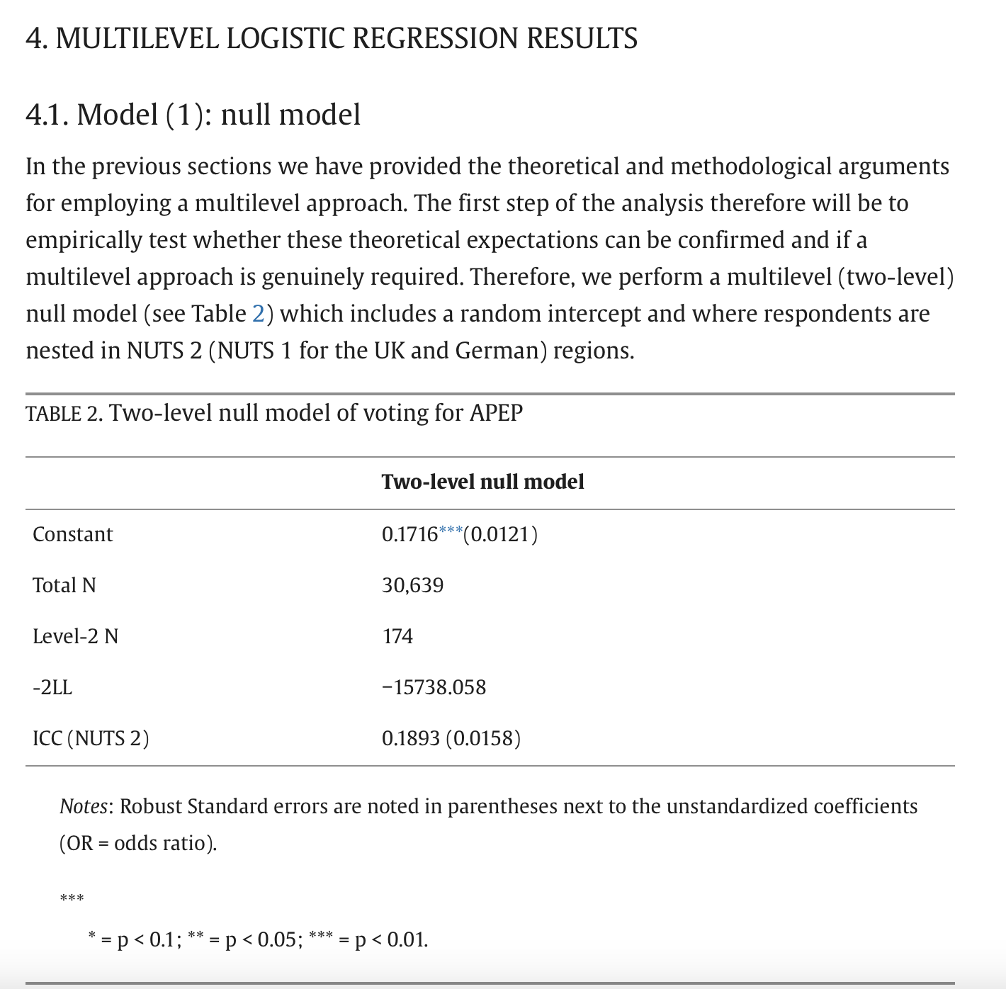

Slide 28
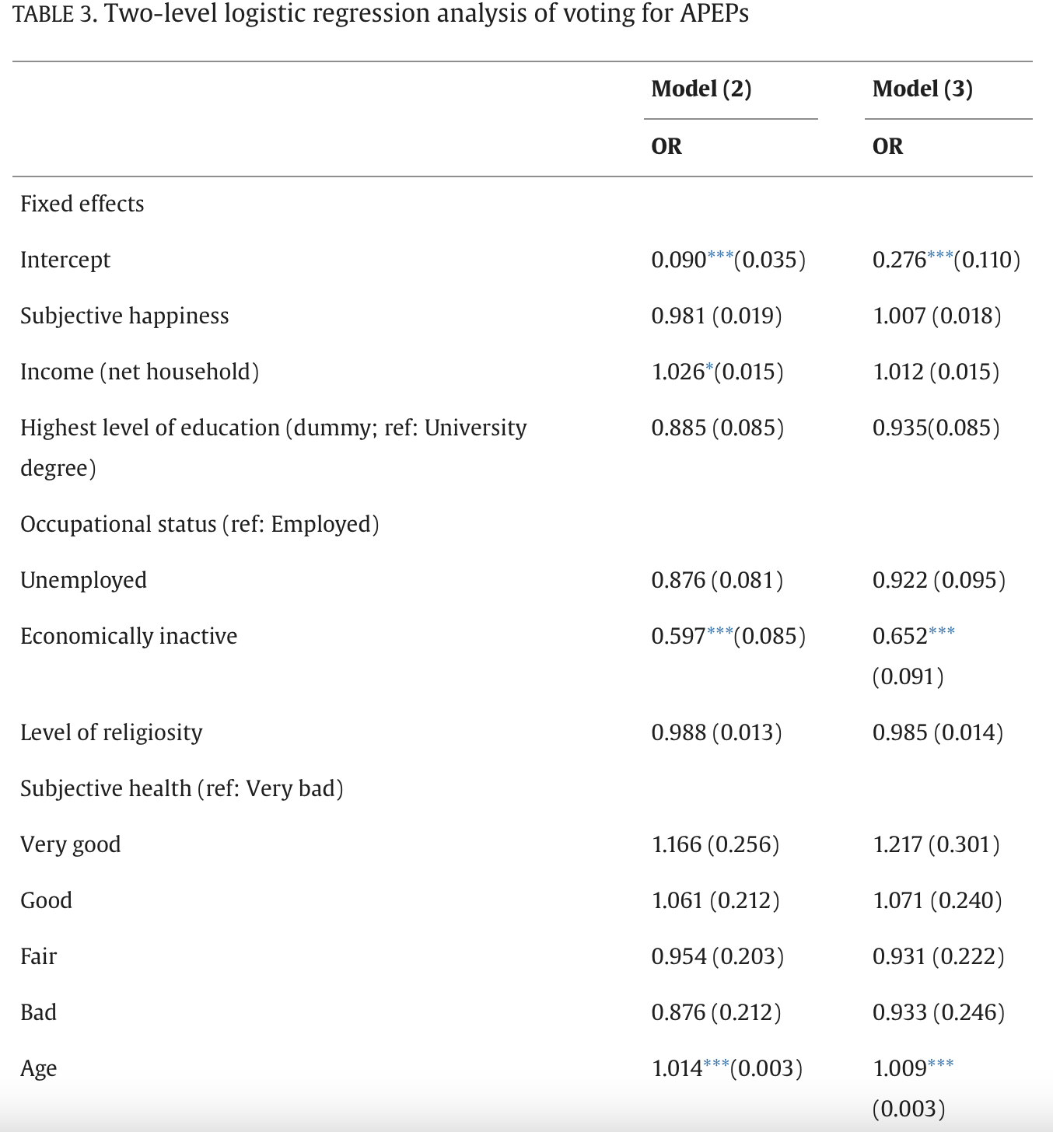

Slide 29
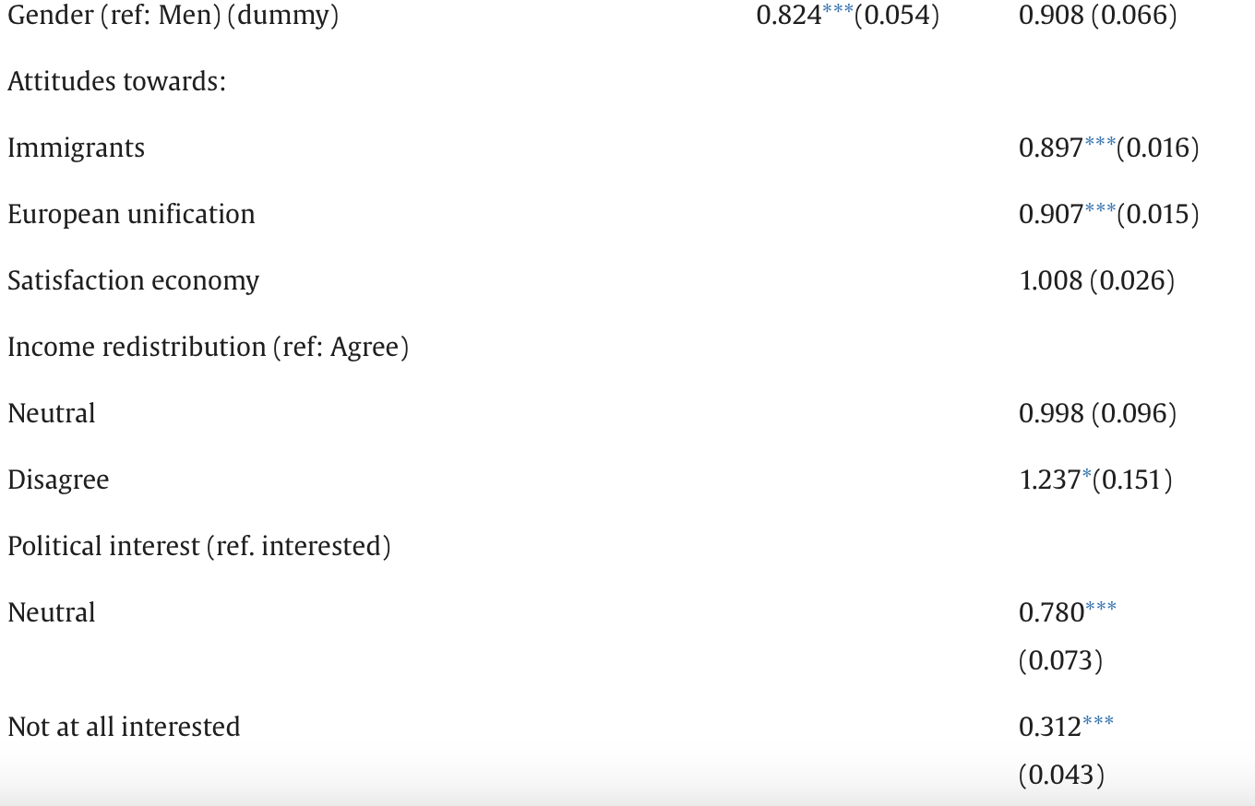

Slide 30
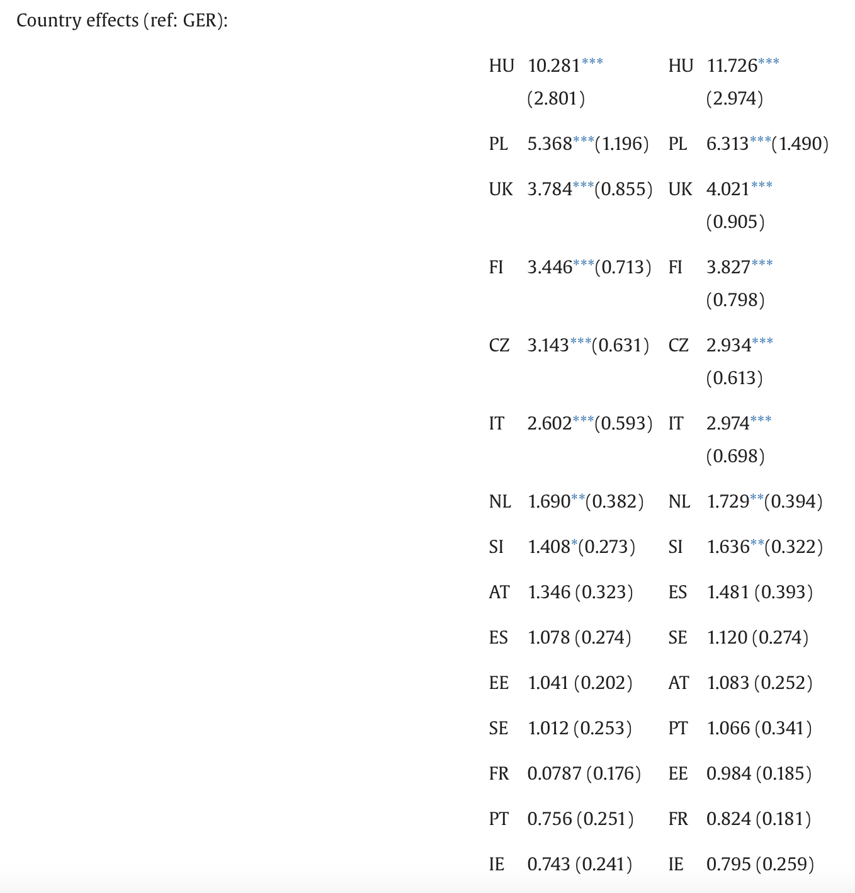

Slide 31
Opportunities for Further Research
Potential to consider additional contextual factors pertaining to the geography of discontent and relevant media and political discourse as well as possible interactions between levels.
Engage further with the highly relevant literature on the geographies of discontent and the revenge of the ‘places that don’t matter’
Potential engage with themes in cultural geography pertaining to intergenerational social justice and place attachment.
Inequalities, European Social Values and identity
Implications for democracy in Europe

Slide 32
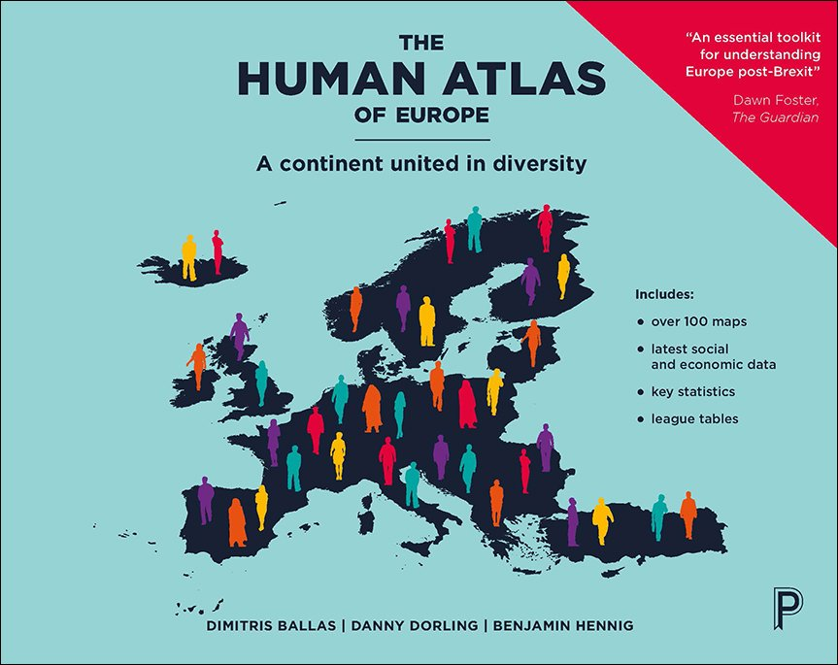

Slide 33
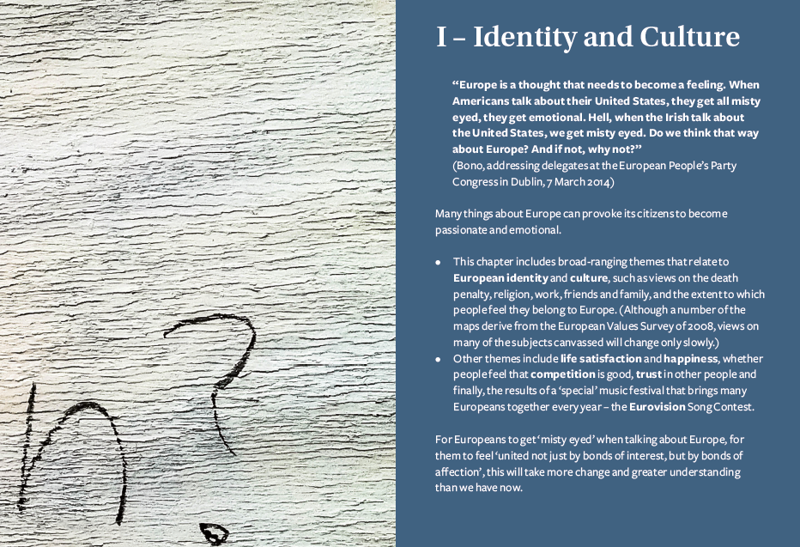

Slide 34

Article 2 Right to life
1. Everyone has the right to life.
2. No one shall be condemned to the death penalty, or executed.
Charter of Fundamental Rights of the European Union, 2007/C 303/01

Slide 35
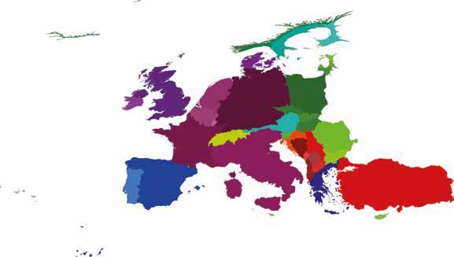
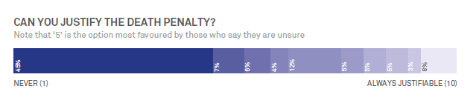
Can the death penalty be justified? Never

Slide 36
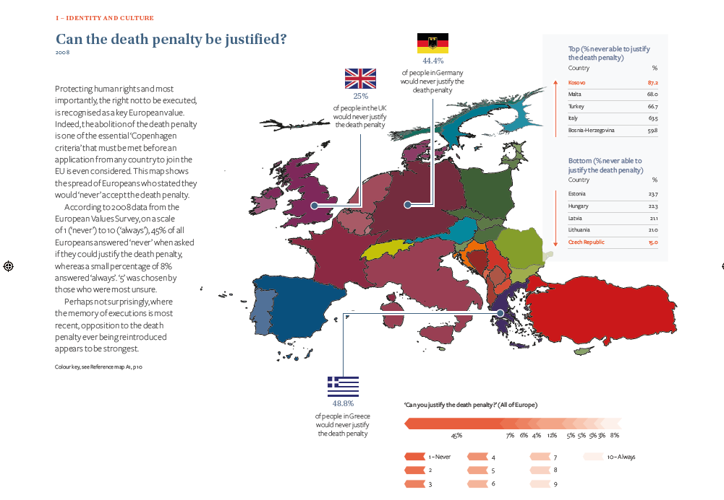

Slide 37
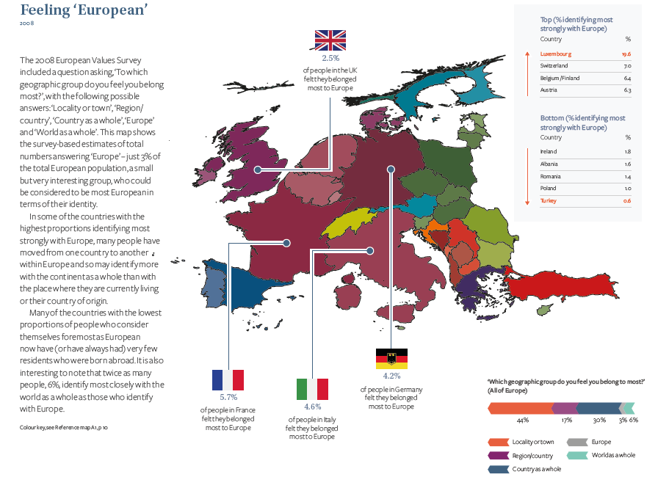

Slide 38
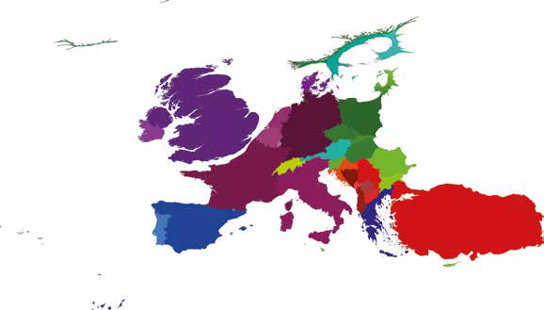
ARE YOU AFRAID OF LOSING YOUR NATIONAL IDENTITY/CULTURE? Distribution of people who feel ‘very much afraid’ of losing their national identity/culture

Slide 39
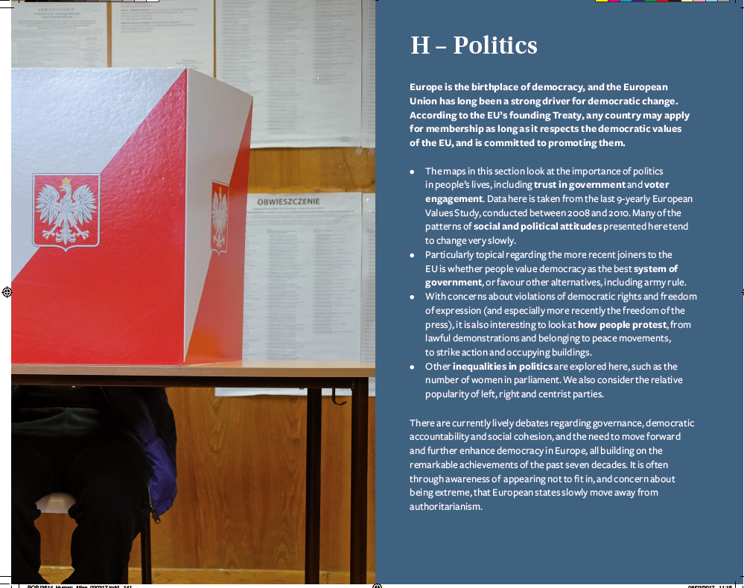

Slide 40
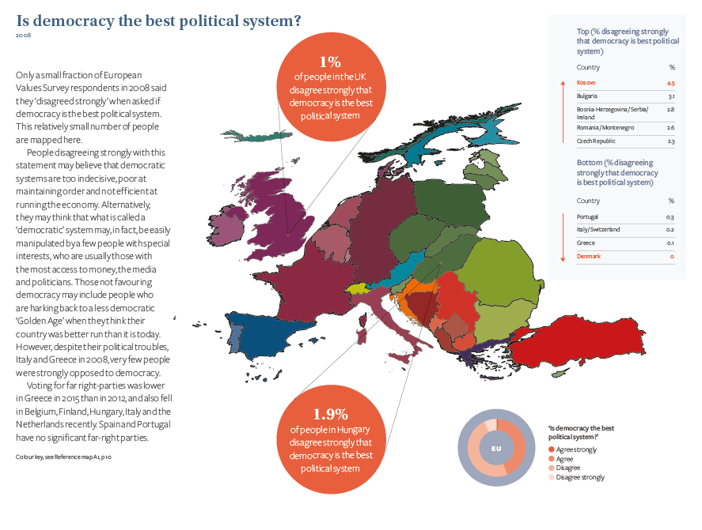

Slide 41
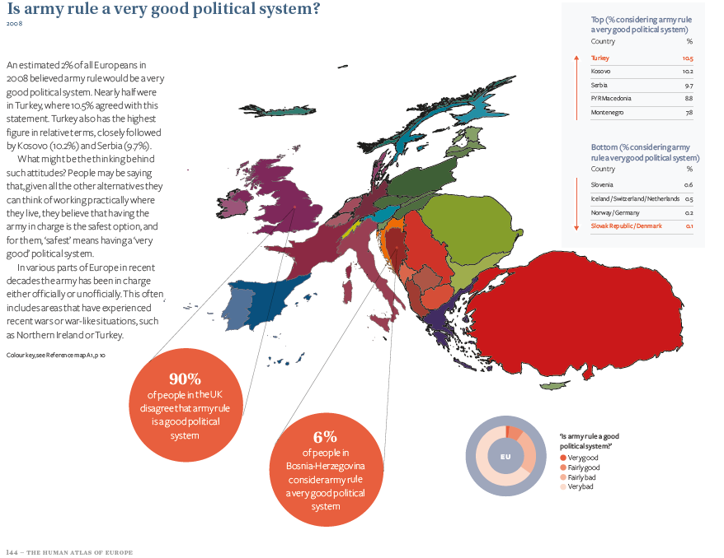

Slide 42
At 57, the thrice-married mother of-three has long been a ubiquitous presence on the political landscape of Greece, a defining figure who began as the iconic ‘voice of the Polytechnic’ during the 1973 students’ revolt against the military dictatorship … Damanaki, who would spend seven months in prison after the regime crushed the rebellion, still bears the scars of that time. Memories of days spent in solitary confinement in a darkened cell at Athens’s notorious military police headquarters return to haunt her.
Smith, 2010, on Maria Damanaki, European Commissioner for Maritime Affairs and Fisheries

Slide 43
Maria Damanaki voice
https://www.youtube.com/watch?v=xl3biKzs9kg
Educational video for Greek School pupils
https://www.youtube.com/watch?v=qjMJEJaxYsw&t=4s
Greek TV mini doc: https://www.youtube.com/watch?v=mQ3x0s_HMy4
DW report on 1967-1974
https://www.youtube.com/watch?v=dhodCIbKYOQ
Mikis Theodorakis
https://www.theguardian.com/music/2021/sep/02/mikis-theodorakis-obituary
Mikis Theodorakis Stadio Karaiskaki 1974
https://www.youtube.com/watch?v=hRyZbGHBuHg
https://www.youtube.com/watch?v=IdhyFdgY3dU
Maria Farantouri - 1974
https://www.youtube.com/watch?v=NLgerQJo7zM
Maria Farantouri and Mikis Theodorakis – Herodion, Athens September 2013
https://www.youtube.com/watch?v=b9yNgNsSTfQ
Athens 13 May 2024 https://en.wikipedia.org/wiki/Giorgos_Seferis
German Television report on the 1974 concert:
https://www.youtube.com/watch?v=m7ODvjf13bI

Slide 44
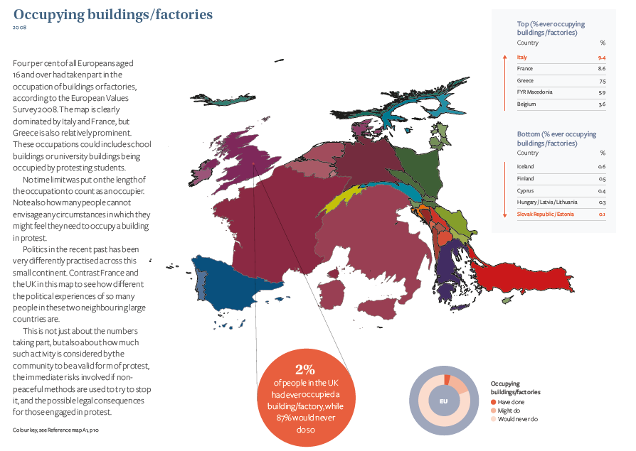

Slide 45
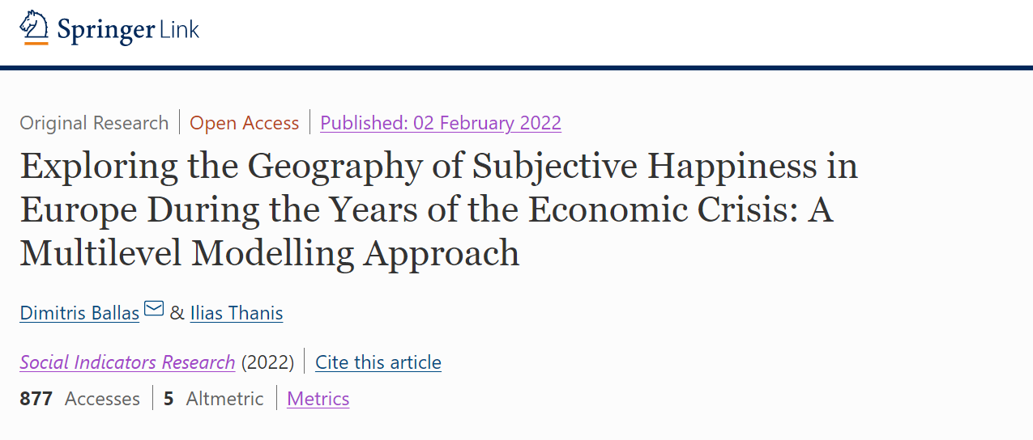
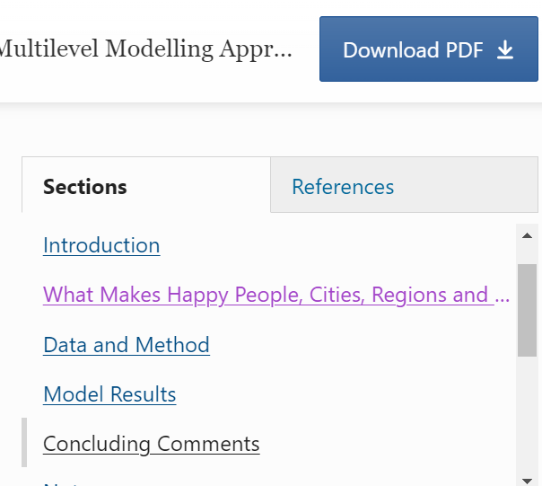

Slide 46


‘The Spirit Level’ & ‘The Inner Level’
by Richard Wilkinson and Kate Pickett
(2009 & 2018)
“Politics was once seen as a way of improving people’s social and emotional well-being by changing their economic circumstances. But over the last few decades the bigger picture has been lost. People are now more likely to see psychosocial well-being as dependent on what can be done at the individual level, using cognitive behavioural therapy – one person at a time – or on providing support in early childhood, or on the reassertion of religious or family values. However, it is now clear that income distribution provides policy makers with a way of improving the psychosocial wellbeing of whole populations. Politicians have an opportunity to do genuine good.”
(Wilkinson and Pickett, 2009: 233; my emphasis)

Slide 47
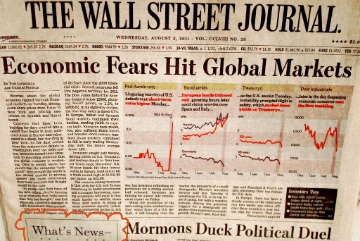
Happiness and the Great Recession of 2008
The 10 countries with the largest declines in average life evaluations typically suffered some combination of economic, political and social stresses. Three of the countries (Greece, Italy and Spain) were among the four hard-hit Eurozone countries whose post-crisis experience was analyzed in detail in the World Happiness Report 2013. The losses were seen to be greater than could be explained directly by macroeconomic factors, even when explicit account was taken of the substantial consequences of higher unemployment.
(Helliwell et al., 2015: 33; my emphasis).

Slide 48
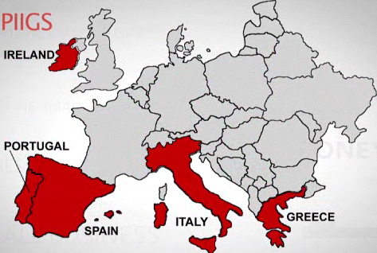
Media discourse in Europe relating to the economic crisis of 2008: “northern saints and southern sinners” (Matthijs & McNamara, 2015) & PIIGS

Slide 49
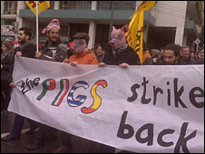

Slide 50
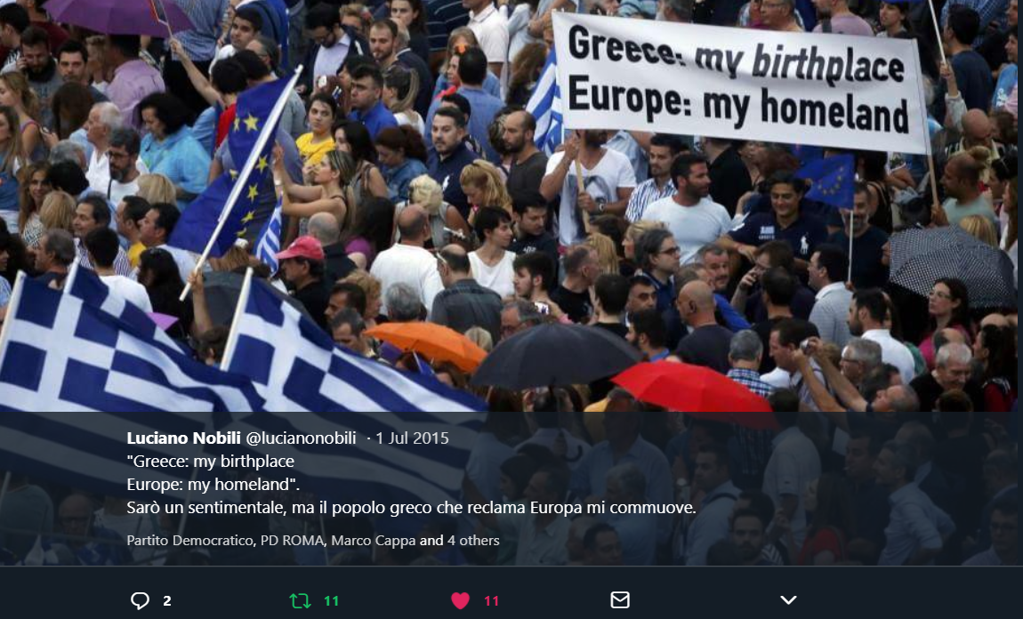

Slide 51
Data and Method
European Social Survey (2008, 2010, 2012, 2014 and 2016)
Multilevel modelling of happiness (how happy are you ? 0-10)
Explanatory variables:
Regional level: GDP (log) GDP growth, Regional Human Development Index, Inequality (Gini), Euro currency
PIIGS
EuroVoc regions: Central and Eastern Europe (BG, HR, CZ, HU, PL, RO, SK, SI), Northern Europe (DK, FI, IS, NO, SE), Baltic States (EE, LV, LT), Southern Europe (CY, GR, IT, ES, PT), Western Europe (AT, BE, FR, DE, IE, NL, CH, GB)
Individual level: Gender, Education, Income, Living comfortably or coping on present income, Cohabiting with husband/wife/partner, Meeting socially several times a week or every day with friends, relatives or work colleagues, Health, Born in the country, Victim of a burglary or assault in the past five years, Employment status, Trust in other people and institutions

Slide 52




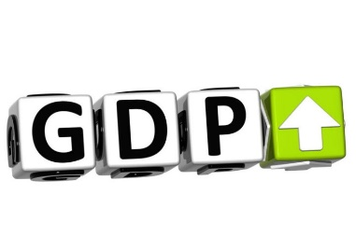



Correlates of happiness
Born Abroad
2014
Source of pictures: Microsoft Powerpoint online pictures Creative Commons database

Slide 53
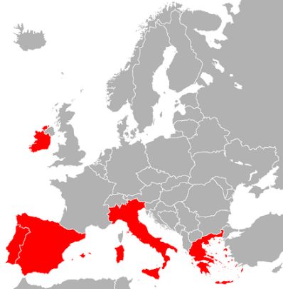


Correlates of happiness
2016
When compared to
Central and Eastern
Europe
2014 & 2016
When compared to
the Baltic States
2014
2014
When compared to
Northern Europe
Source of pictures: Microsoft Powerpoint online pictures Creative Commons database

Slide 54
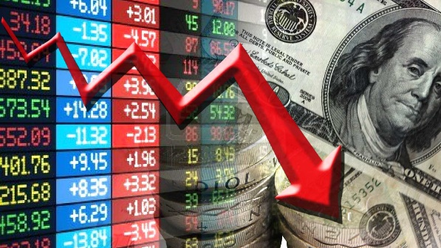
Happiness, unhappiness and discontent
Throughout the crisis years there has been an on-going ‘blame game’ and ‘scapegoating’ between what were seen as creditor and debtor countries contentious political rhetoric referring to “northern saints and southern sinners” (Matthijs & McNamara, 2015) as well as negative media portrayals of southern countries in European media with associated tensions and scapegoating.
Negative portrayal of countries and regions may have a detrimental impact on the reported happiness levels of the inhabitants of these countries (in addition to the real economic impacts).
PIIGS (and similar acronyms) can act as signals that guide and shape market perceptions (Brazys and Hardiman (2014) present an analysis of how this applied to Ireland). There may be similar processes with regards to perceptions and feelings (including subjective happiness) and labels that have negative connotations.

Slide 55
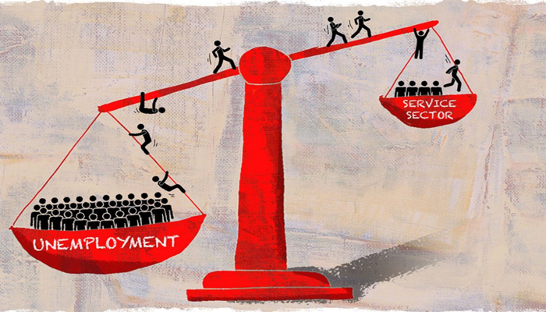
Happiness, unhappiness and discontent
After the outbreak of the economic crisis there has been a collective feeling of gloom and pessimism across Europe, especially for younger people (Dudel et al., 2016; Holleran, 2019) and in this context those born in the country may be more likely (compared to those born abroad) to consider their (and the country and regional) circumstances in relation to remembered or perceived better times in the past.
The lower reported happiness of those born in the country is consistent with tendencies for out-migration and brain drain, especially in the regions that were most negatively affected by the crisis (Cavallini et al., 2018). It is also relevant to note that the massive instability experienced in European labour markets (and especially in the European periphery) and the proliferation of what were described as “junk jobs”, diverse forms of concealed underemployment and the low salaries (also contrasting to the sharp increase in the cost of housing in the 2000s) in countries like Spain (Antentas, 2015) may have been particularly detrimental to ‘natives’ who remembered better times (or for the younger, there may have been a comparison to actual or perceived times in relation to previous generations).(Helliwell et al., 2015: 33; my emphasis).

Slide 56
Happiness and the Great Recession of 2008
After the outbreak of the economic crisis there has been a collective feeling of gloom and pessimism across Europe, especially for younger people (Dudel et al., 2016; Holleran, 2019) and in this context those born in the country may be more likely (compared to those born abroad) to consider their (and the country and regional) circumstances in relation to remembered or perceived better times in the past.
The lower reported happiness of those born in the country is consistent with tendencies for out-migration and brain drain, especially in the regions that were most negatively affected by the crisis (Cavallini et al., 2018). It is also relevant to note that the massive instability experienced in European labour markets (and especially in the European periphery) and the proliferation of what were described as “junk jobs”, diverse forms of concealed underemployment and the low salaries (also contrasting to the sharp increase in the cost of housing in the 2000s) in countries like Spain (Antentas, 2015) may have been particularly detrimental to ‘natives’ who remembered better times (or for the younger, there may have been a comparison to actual or perceived times in relation to previous generations).(Helliwell et al., 2015: 33; my emphasis).

Slide 57
Conclusions
Social and spatial context matters
Some area level variation in happiness does exist, even after accounting for individual and social context
Policy implications:
- income and wealth inequality and happiness
- regional/area-based policies vs. national social policies
- analysis of local policy outcomes
- inform local debates on issues such as green-spaces and the geographical allocation and extent of geographical features that may be affecting happiness and local well-being.
- Twin Transition – geographies of happiness and discontent
Next steps and future possibilities:
  Multilevel analysis of larger sample sizes
  Longitudinal analysis
  Further analysis for finer geographical scales (spatial microsimulation)
  Spatial econometrics
  Big Data

