Slide 1
Sustainability and Islands
ISLAS Summer School

Slide 2
Sustainable Development
Sustainable development is a development that meets the needs of the present without compromising the ability of future generations to meet their own needs.
2 concepts :
The concept of 'needs’. But whose needs? And how can we know future needs?
The idea of limitations to meet present and future needs:
  technology and the role of technology
  social organization.

Slide 3
SD talk: useful or utopian?
What is “transferrable” in natural capital?
What is an ideal society?
What is viable economic growth?
What is conservation?

Slide 4
Process
In June 1992, Earth Summit in Rio de Janeiro, Brazil, more than 178 countries adopted Agenda 21.
September 2000, UN Headquarters eight Millennium Development Goals (MDGs) to reduce extreme poverty by 2015
2002, Johannesburg Declaration on Sustainable Development and the Plan of Implementation.
2012, Rio+20 in Rio de Janeiro, Brazil, document "The Future We Want".
In 2013, 30-member Open Working Group to develop a proposal on the SDGs.
2015 a landmark year :
  Sendai Framework for Disaster Risk Reduction (March 2015)
  Addis Ababa Action Agenda on Financing for Development (July 2015)
  Transforming our world: the 2030 Agenda for Sustainable Development with its 17 SDGs was adopted at the UN Sustainable Development Summit in New York in September 2015.
  Paris Agreement on Climate Change (December 2015)

Slide 5
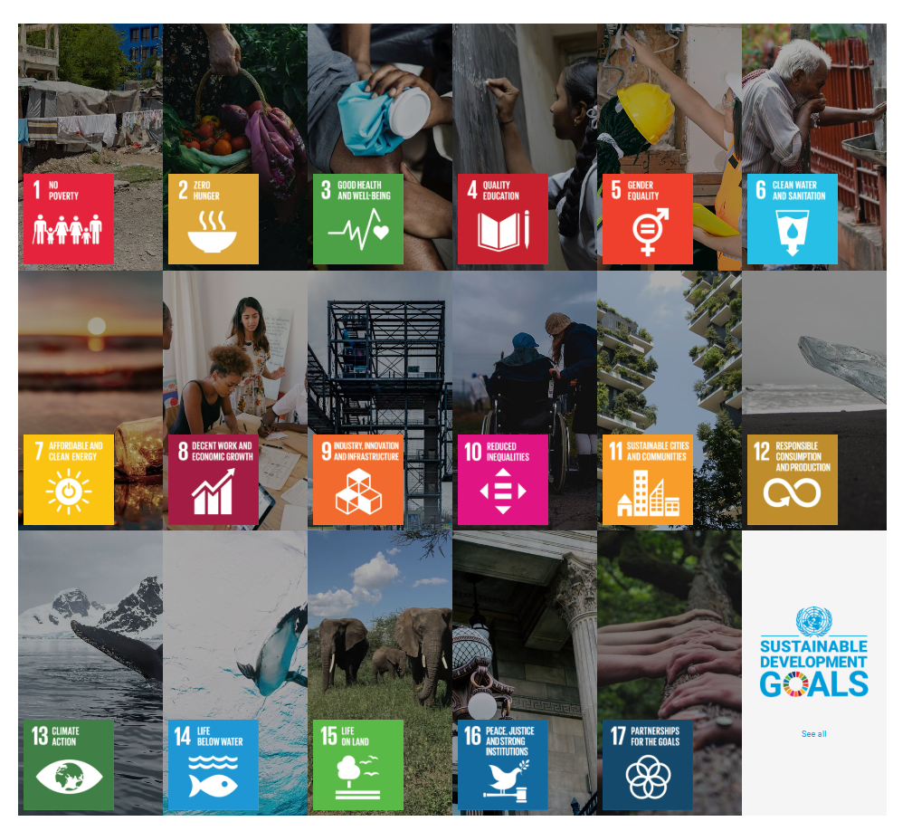
SDGs 2015 for 2030

Slide 6
Sustainability
UNESCO formulated a distinction between the two concepts as follows: "Sustainability is often thought of as a long-term goal (i.e. a more sustainable world), while sustainable development refers to the many processes and pathways to achieve it.“
I disagree:
SD the overall goal
Sustainability a glimpse of where we are and priorities to do better

Slide 7
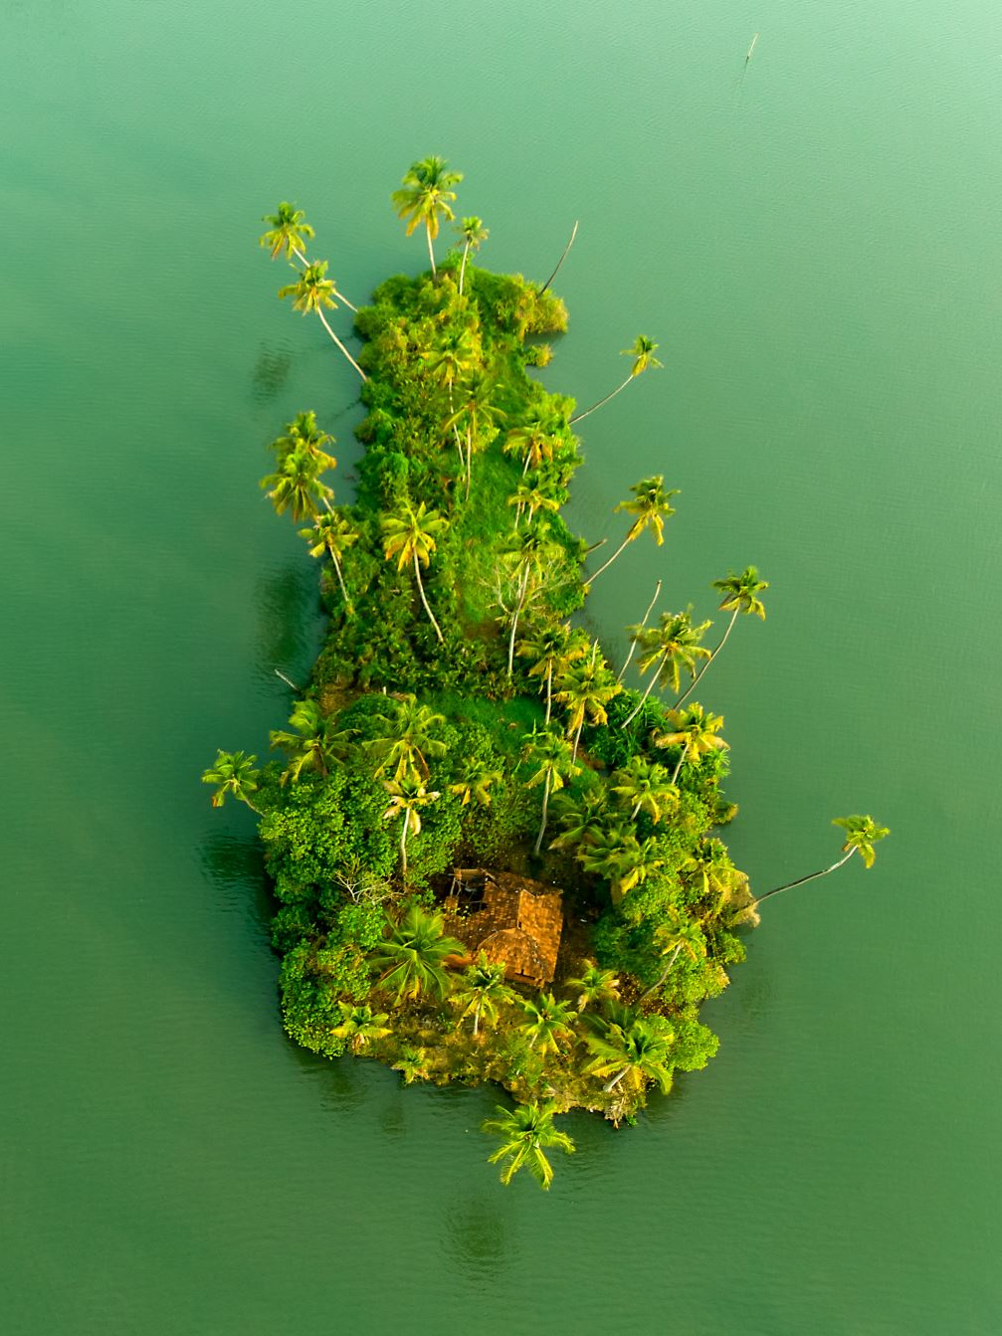
Islands and Islanders
Real meaning and real islands
Symbolic meaning: islands as metaphors

Slide 8
Islands? Yes Islands…
“Upper” limit: continents vs. islands: Is Australia an island? Is Greenland an island?
“Lower” limit: islets and rocks vs islands.
Suitable for human habitation: what does that mean?
How many?
5,675 islands 10-1,000,000 km2
8.8 mil. Islands/islets 0.001-10 km2
672 mil. Islets 1m2 – 0,001 km2

Slide 9
Table 1. A characterisation of the global occurrences of landmasses from an analysis of a 30 m spatial resolution, 2014 Landsat imagery-derived global shoreline vector (GSV).
Landmass type | Number of polygons | Area (km²) | Length of coastline (km)
Continental mainlands | 5 | 125,129,046 | 813,467
Islands > 1 km² | 21,818 | 9,938,964 | 1,304,762
Islands ≤ 1 km² | 318,868 | 20,589 | 321,774

Slide 10
Sustainability on islands vs sustainability FOR islands?
Islands have long been celebrated as places of novelty and the bounded nature, distinctiveness, manageable size, and controllable flows render islands as "ideal laboratories" for implementing novel sustainability programs and ideas.
However, this framing comes at a cost, usually paid by the local communities.
The non islander gaze perceives islands as tabulae rasa, places ready to welcome any external idea designed for their alleged benefit. Grydehøj and Kelman (2017) call this "conspicuous sustainability" - initiatives with little real impact, based on symbolism – that may result in "eco-island traps".

Slide 11
Sustainability on islands vs sustainability FOR islands?
We need to revisit the ‘island sustainability’ approach from a residents' perspective
Redefine what island sustainability means for islanders beyond “green growth” and “ecomodernism” by weaving together environments, economics, society, and aesthetics/ symbols

Slide 14
Laboratories for Sustainability or Laboratory Rats?
Discuss…

