Slide 1
Planning for Sustainability for/on Island(er)s

Slide 2
Definitions
Spatial planning is the management of space and resources through the creation and implementation of a plan restricting how space can be used and developed. Spatial planning is normally undertaken by state actors—at either the national, regional or local levels—but is sometimes undertaken by private sector actors as well. In achieving set policy aims, it usually tries to balance the competing demands upon land as a resource, mediating between the demands of the state, market, and local community.^{[1]}
In so doing, three different mechanisms—of involving stakeholders, integrating sectoral policies and promoting development projects—mark the three schools of transformative strategy formulation, innovation action and performance in spatial planning.^{[2]}

Slide 3
More definitions
Early definition from the European Regional/Spatial Planning Charter (1983, CEMAT): "Regional/spatial planning gives geographical expression to the economic, social, cultural and ecological policies of society. It is at the same time a scientific discipline, an administrative technique and a policy developed as an interdisciplinary and comprehensive approach directed towards a balanced regional development and the physical organization of space according to an overall strategy.“
3 different mechanisms, 3 schools of transformative strategy formulation, innovation action and performance
  involving stakeholders,
  integrating sectoral policies and
  promoting development projects.

Slide 4
Even more definitions
From spatial to territorial planning and development: from abstract “space” to specific territories, a territoralization that seeks to differentiate approaches and tools (and stakeholder involvement)
In line with landscape planning and more local or multilevel planning
«Sustainable Development» integrated into planning going for territorial management

Slide 5
The five principles of planning
Redistribution
Creation
Restoration
Protection
Negotiation

Slide 6
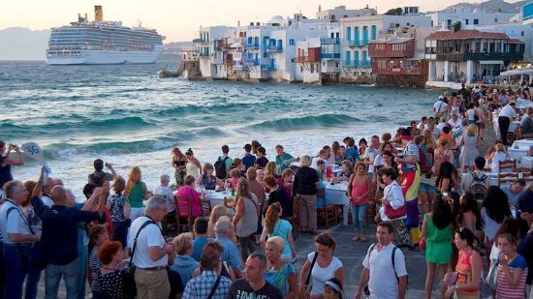
But what do they mean?
Redistribution:
In any given time, there is a certain amount/ stock or wealth and capitals (economic, environmental, social, cultural, etc.) that can be distributed in space.
Creation
There is a number of mechanisms, local condition and resources that allow to create or ignite development for a specific area and in a specific moment in time. Different mechanisms and tools used to create/ ignite development (e.g. clusters, poles, etc.)

Slide 7
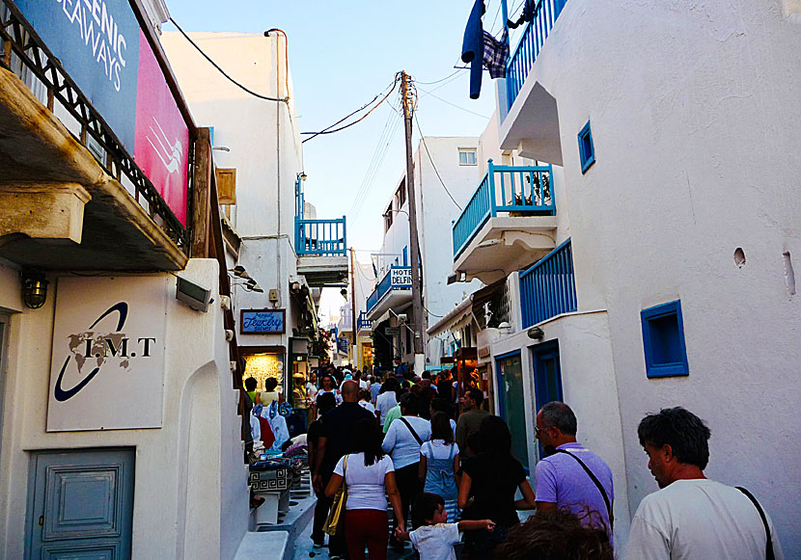
But what do they mean? II
Restoration:
There are imbalances and mechanisms that have created “harm” and we need to find tools, mechanisms and approaches that can restore. These can result from historical factors or other types of processes.
Protection:
We choose and select what is worth protecting. This can change and has changed and will change in the future.

Slide 8
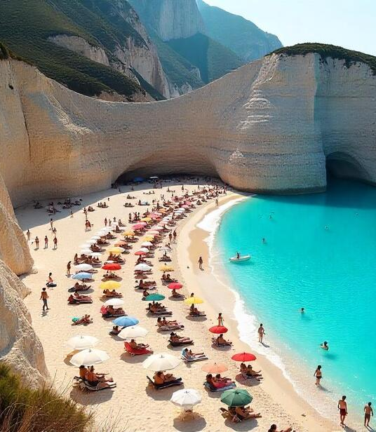
But what do they mean? III
Negotiation:
The most important principle of planning.
Planning is always a negotiation between actors, principles, ideas, symbols.
There are three issues here:
  Who are the actors
  How can we get meaningful inputs from them
  How we can integrate their opinions in multilevel plans (issues of governance).

Slide 9
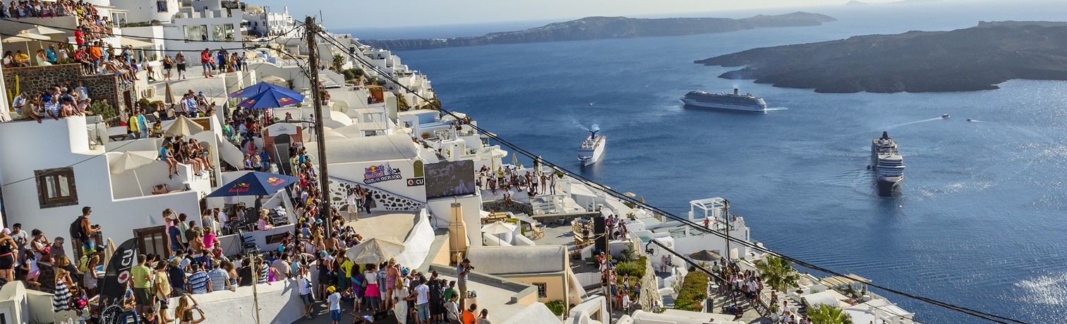
Tools and approaches
Administration and governance
Planning processes, scale and actor involvement
Large scale infrastructure programming
European, national concerns vs regional and local approaches
Financial, tax and other control mechanisms

Slide 10
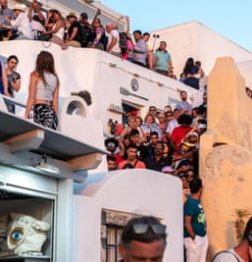
A (burning) example: managing tourism flows on islands
Seasonality
Mass differences in population and pop density
Different needs for infrastructure: what about care????
Should there be limits? Who will set the limits?
How can we manage local views of they are “unsustainable”?
Who has a right to say?

Slide 11




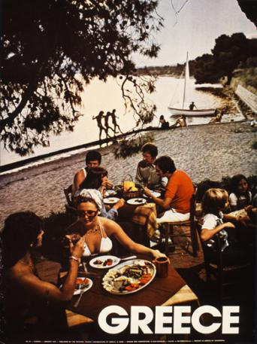


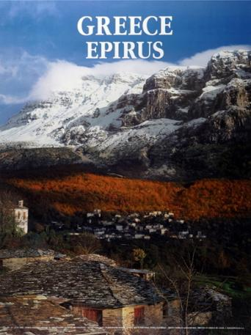
Return

Slide 12
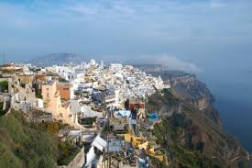
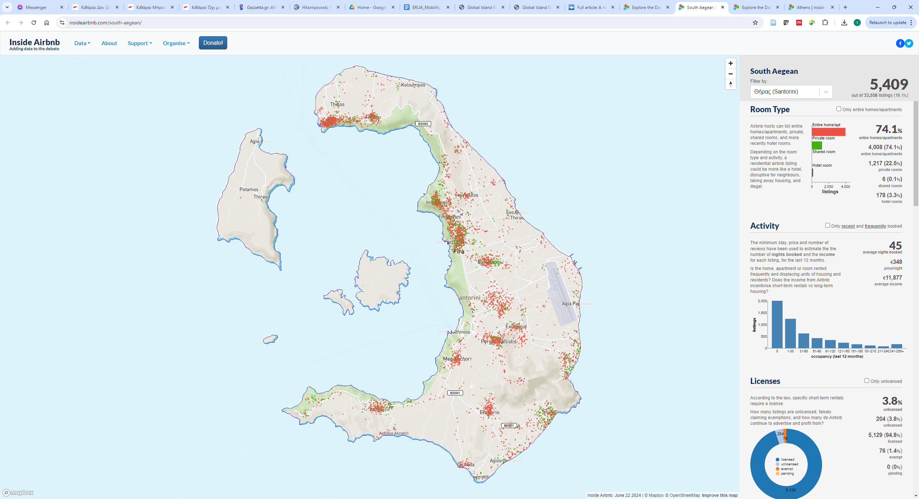
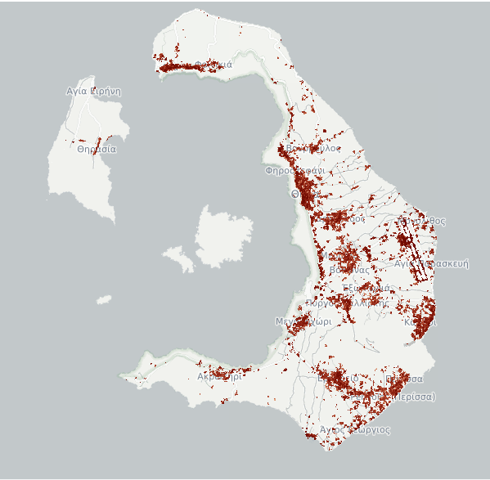
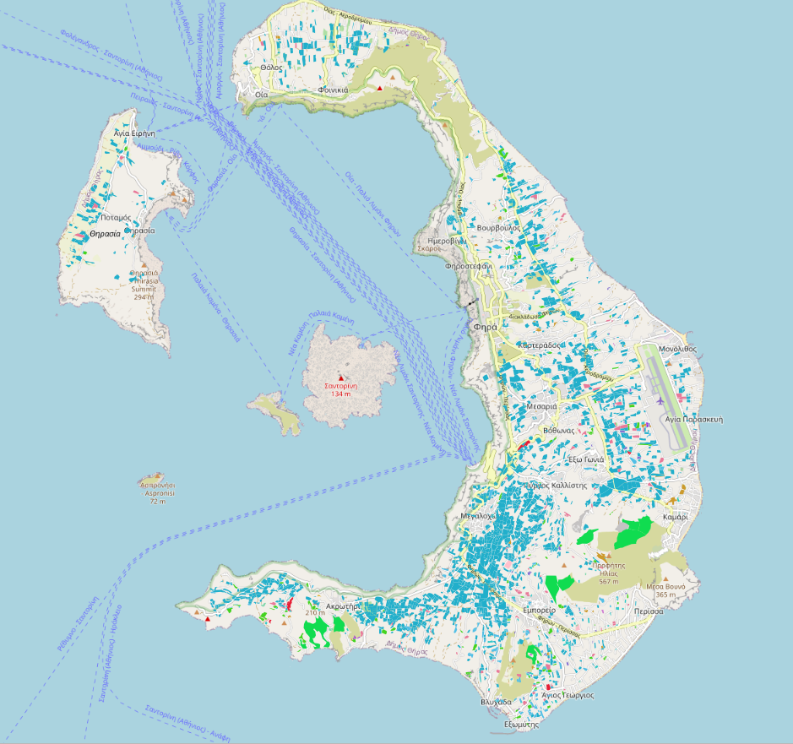
AirBnB
Santorini: a struggling wine industry with suffocating tourism intensity
Soil sealed areas
Vineyards (and Grazing lands) for subsidies

Slide 13
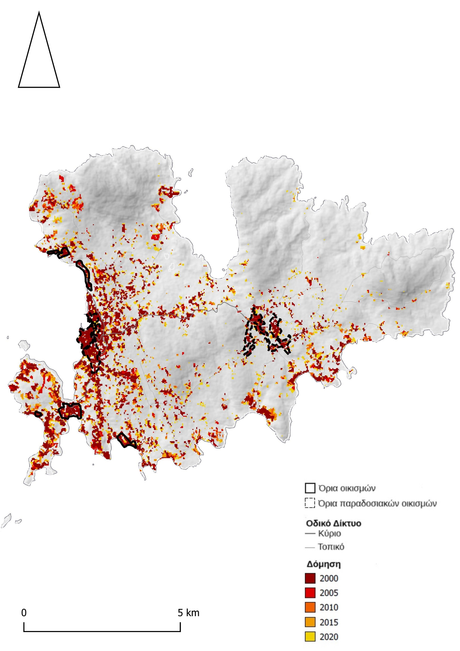
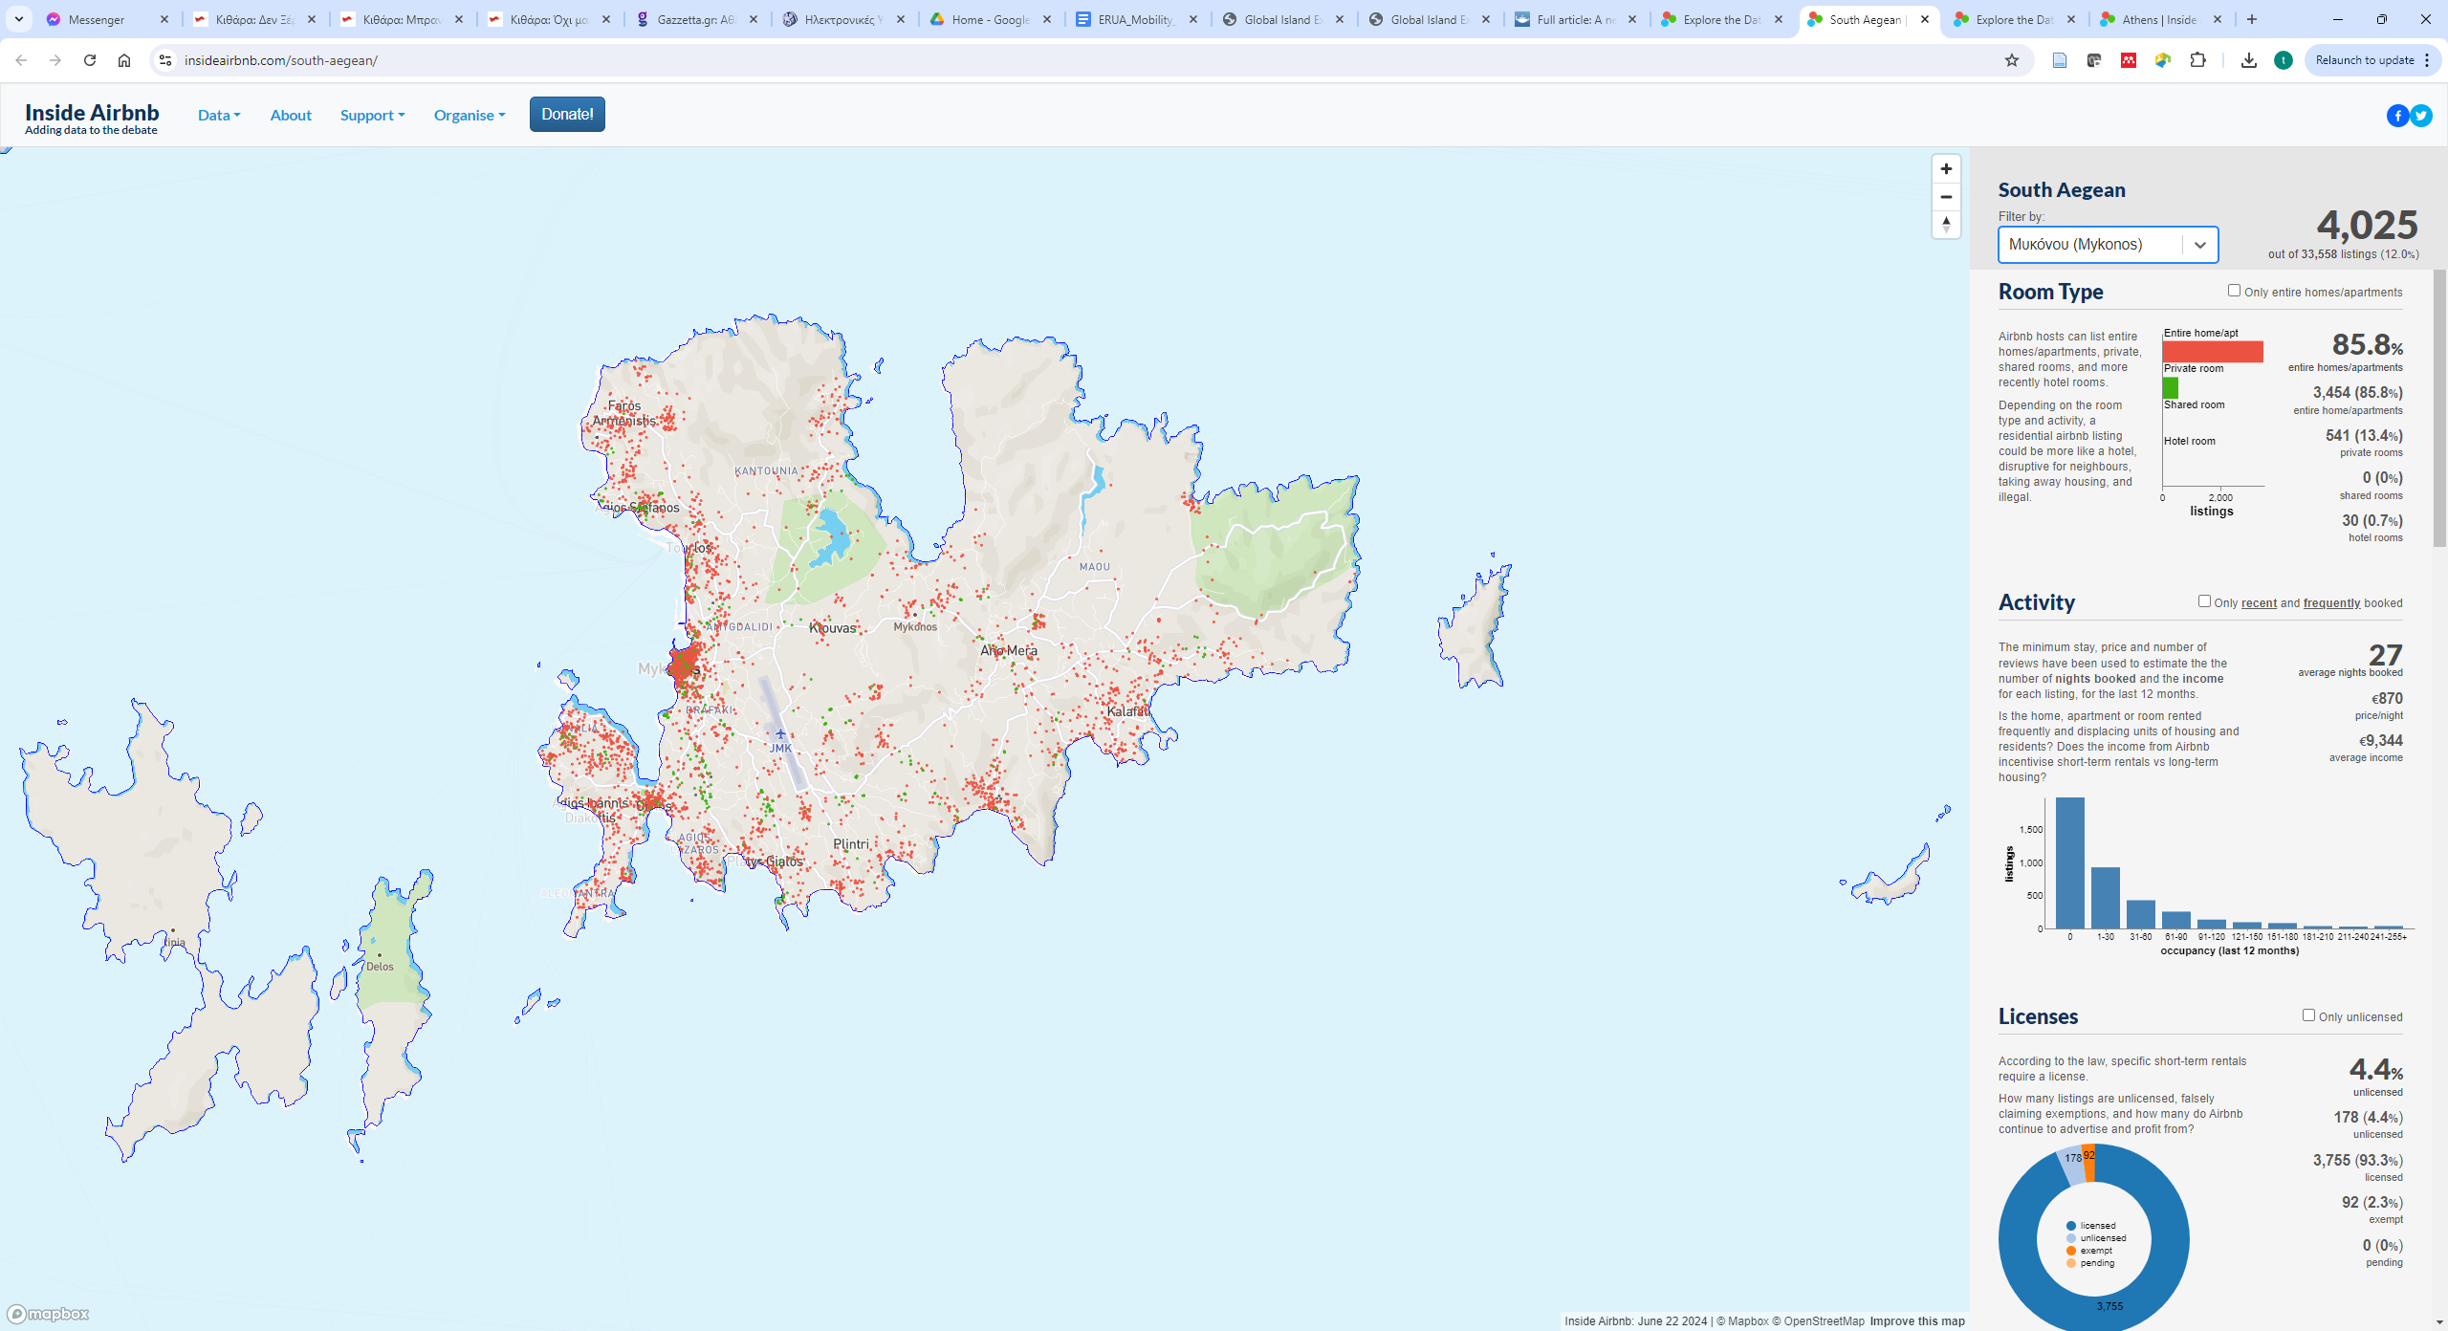
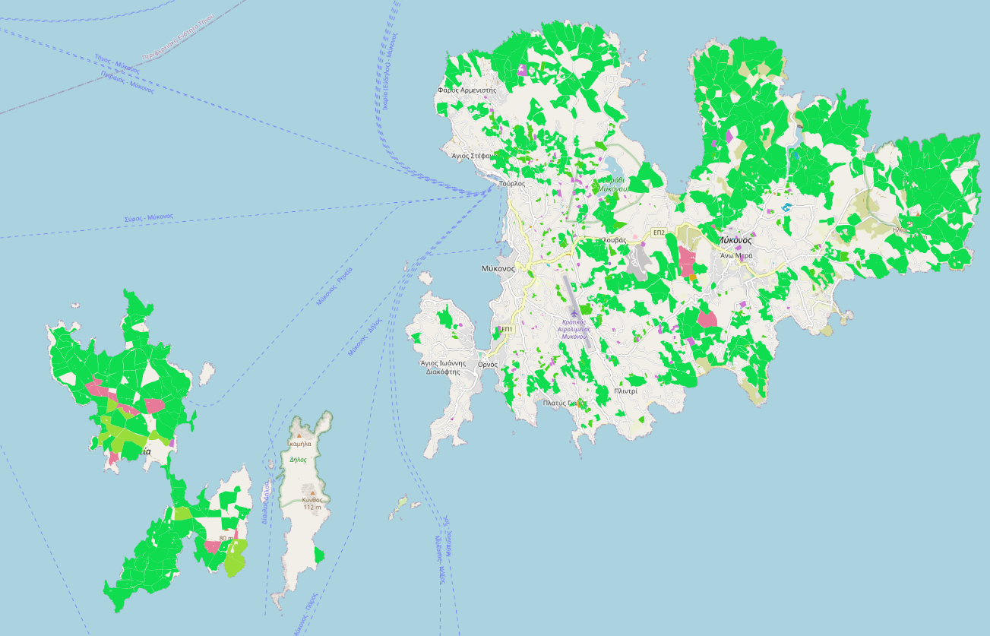
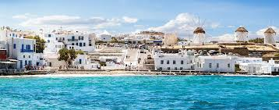
New RurUrbanities

Slide 14
Planning for sustainability for island(er)s
Need to define what “sustainability” is and what is the ‘vision’.
[Not all will agree on that vision]
Need to decide on the tools and check what is available at EU, national levels
[Not all will agree on the tools/ approaches]
My take: need to talk about islanders and focus on social and care issues for them
[Not all will agree on this…]

