Slide 1
Πανεπιστήμιο Αιγαίου

Slide 2
Άδειες Χρήσης
Το παρόν εκπαιδευτικό υλικό υπόκειται σε άδειες χρήσης Creative Commons.
Για εκπαιδευτικό υλικό, όπως εικόνες, που υπόκειται σε άλλου τύπου άδειας χρήσης, η άδεια χρήσης αναφέρεται ρητώς.

Slide 3
Χρηματοδότηση
Το παρόν εκπαιδευτικό υλικό έχει αναπτυχθεί στα πλαίσια του εκπαιδευτικού έργου του διδάσκοντα.
Το έργο «Ανοικτά Ακαδημαϊκά Μαθήματα στο Πανεπιστήμιο Αιγαίου» έχει χρηματοδοτήσει μόνο τη αναδιαμόρφωση του εκπαιδευτικού υλικού.
Το έργο υλοποιείται στο πλαίσιο του Επιχειρησιακού Προγράμματος «Εκπαίδευση και Δια Βίου Μάθηση» και συγχρηματοδοτείται από την Ευρωπαϊκή Ένωση (Ευρωπαϊκό Κοινωνικό Ταμείο) και από εθνικούς πόρους.

Slide 4
Ecological Risk Asssessment

Slide 5
Definition and Uses
Environmental Risk assessment – the probability of an effect occurring on an ecological system
ERA’s are designed to provide information on
Risk? (Risk = hazard * exposure)
Magnitude?
Ecological significance?

Slide 6
Uses of an ERA
Protect environmental and/or humans
Guide risk managers in making decisions regarding exposure
Compare costs to benefits
Determine how risks can be reduced or eliminated

Slide 7
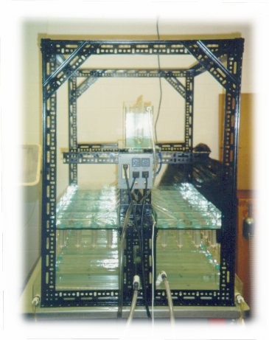
Components of an ERA
Since risk is hazard x exposure, to perform ERA one must develop an
Estimation of hazard due to a stressor (often based on LC₅₀, chronic test, ecosystem level test, case study if available)
Estimation of exposure due to a stressor (stressor poses no risk unless there is exposure)

Slide 8
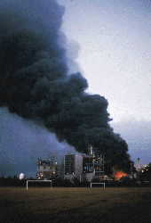
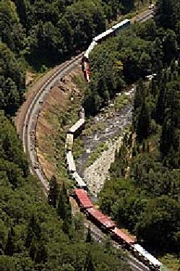
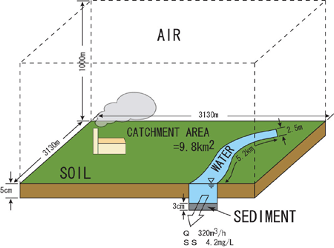
Components of an ERA
Stressor – any substance, circumstance or energy field that causes a negative impact on a biological system
chemical
radiation
temperature
turbidity
haze
another organism
etc.
Hazard – potential of a stressor to cause a particular effect upon a biological system
Exposure – measure of the concentrations or persistence of a stressor within a defined system

Slide 9
Framework for Environmental Risk Assessment
Environmental risks in the sea
Previously risk assessment seen only as hazard assessment and fate → but not easily separated in ecological systems (when release chemical starts to change ecosystem while ecosystem is changing chemicals)

Slide 10
Hazard Assessment vs. Ecological Risk Assessment
Characteristic | Hazard assessment | Risk Assessment
Probabilistic result | No | Yes
Scales of Results | Dichotomous (it is or it ain’t) | Continuous
Basis for regulation | Scientific judgment | Risk management
Assessment endpoints | Not explicit | Explicit
Expression of contam. | Concentration | Exposure
Tiered assessment | Necessary | Unnecessary
Decision criteria | Judgment | Formal criteria
Use of models | Deterministic fate | Probabilistic exposure and fate

Slide 11
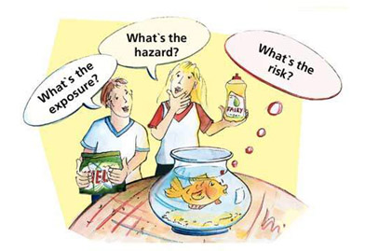
Not all segments of society are interested in all parts of an environmental risk assessment

Slide 12
current framework developed by the EPA in 1992

Slide 13
Biggest challenge today: identifying activities that are obviously causing high risk
Deformed frog Reduction in human sperm count

