Slide 1
Tutorial για το Animation
STUDIO 2B

Slide 2
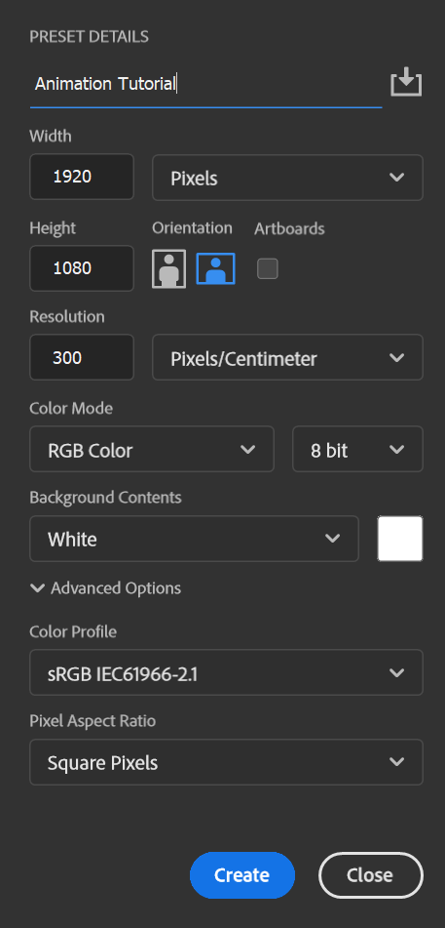
ΑΝΟΙΓΟΥΜΕ ΝΈΟ Project

Slide 3
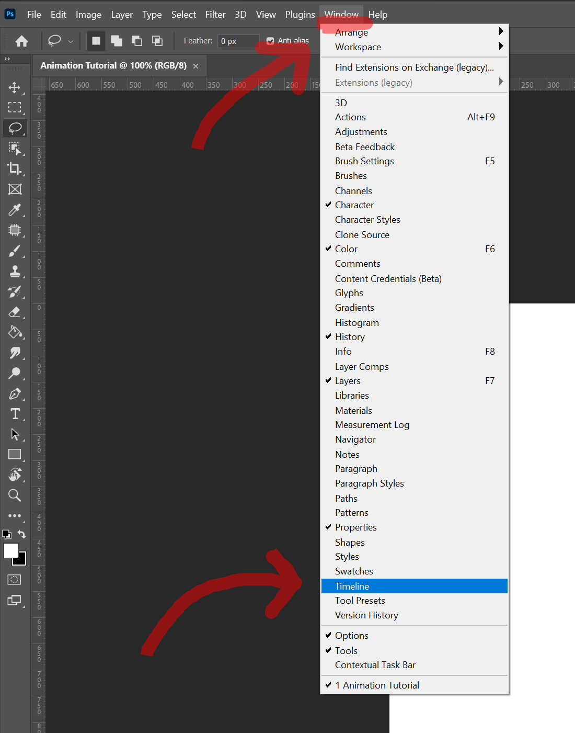
ΑΝΟΙΓΟΥΜΕ ΤΟ TIMELINE

Slide 4
CREATE VIDEO ANIMATION

Slide 5
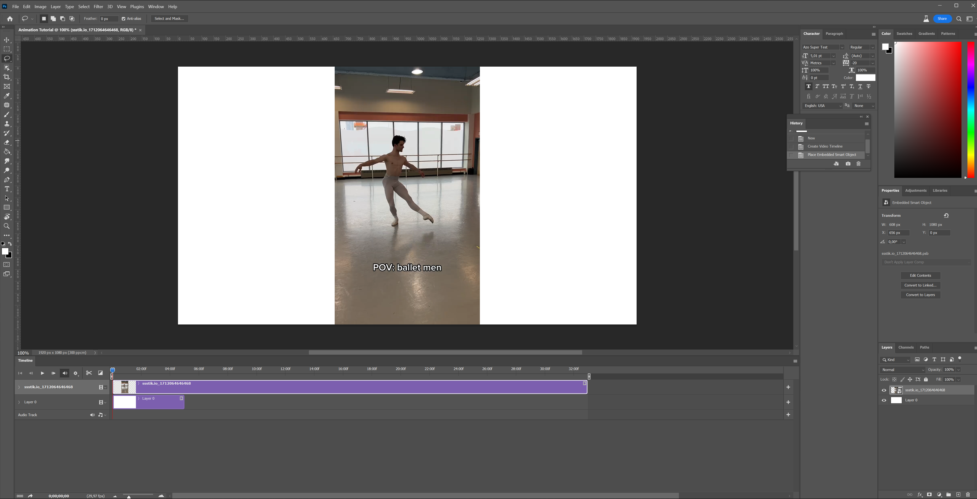
DRAG n DROP The Video Of Your Choice

Slide 6
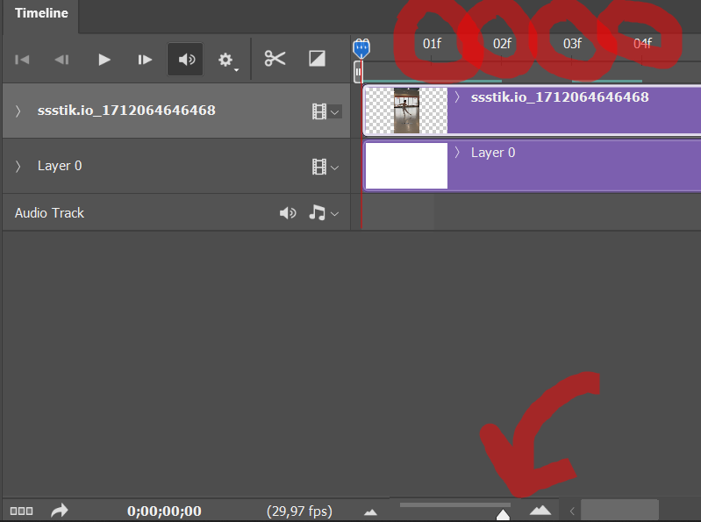
ZOOM in & out using the scale tool
(zoom in
till you get to
see each
frame)

Slide 7
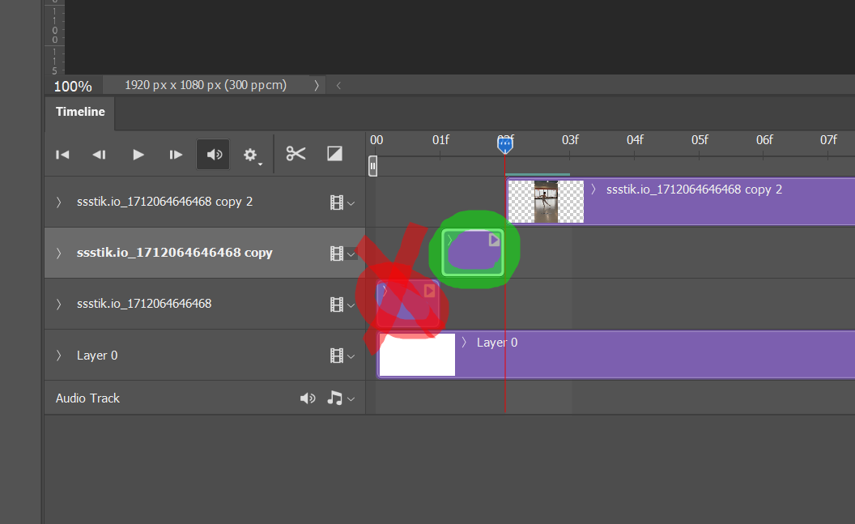
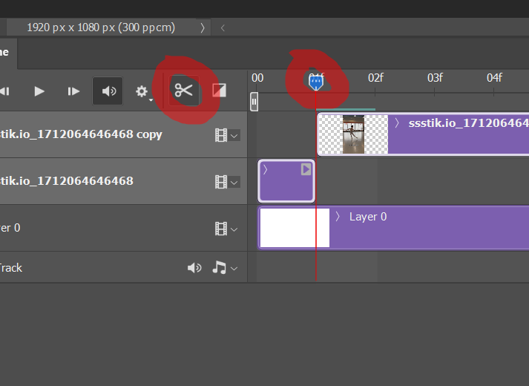
FRAME creation
1.Cut ONE frame at a time.
2.Delete the in between unused footage.
3.Drag your frame in the beginning.
4.Follow these steps and place your frames in order.
(Using the scissors)

Slide 8
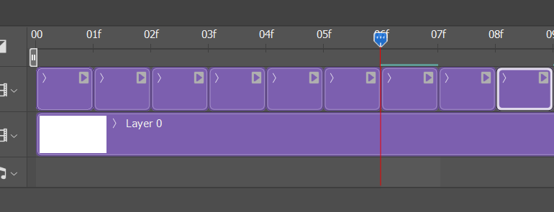
FRAME TIMELINE creation
If you followed the steps correctly,
Now your timeline should look like this.
(Using the scissors)

Slide 9
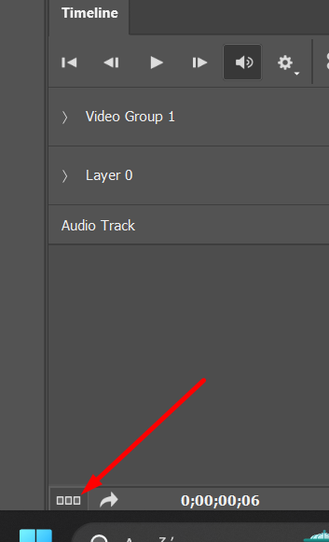
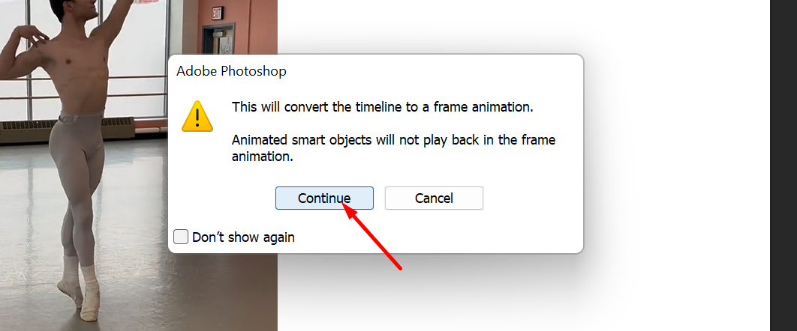
TIMELINE convertion

Slide 10
TIMELINE analisys
FRAMES
Delete that :)
Change it to
"Forever"
Create new Frame
Delete
Frame
Frame Duration Time

Slide 11
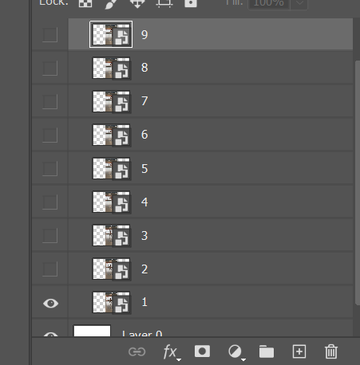
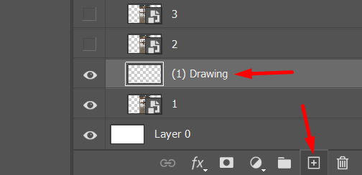
Add YOUR Flavor
Every single FRAME creates its own LAYER.
Create a new layer every time you work on a new frame.
Now you can draw on that new layer
And when you are done, just close the opacity of the reference layer you created at the beginning.

Slide 12
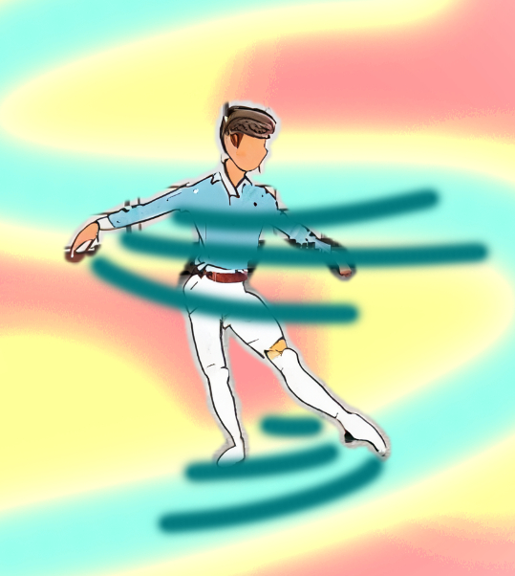
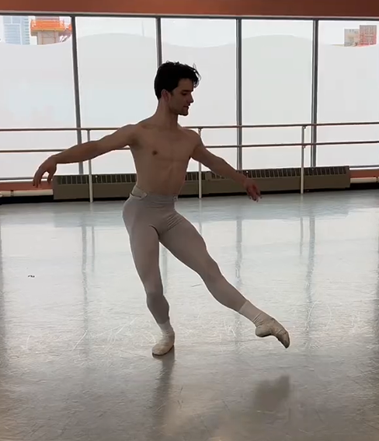
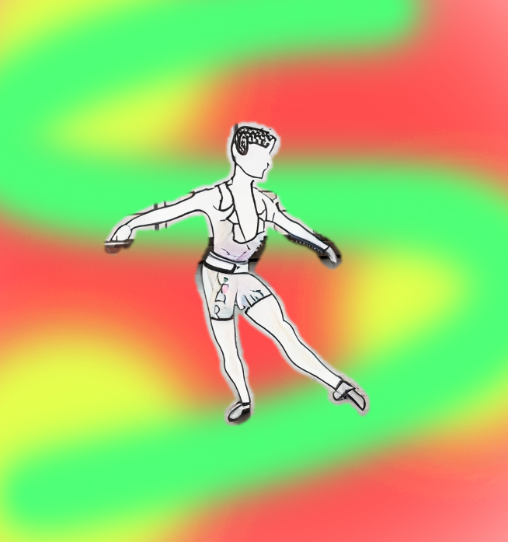
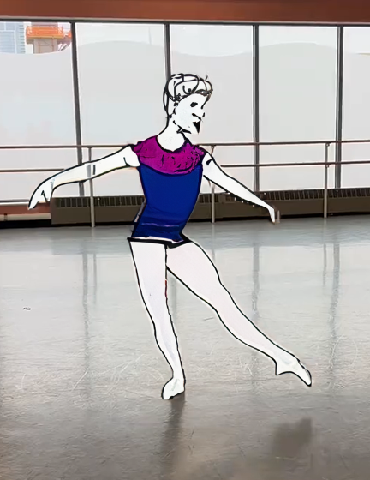
Reference

Slide 13
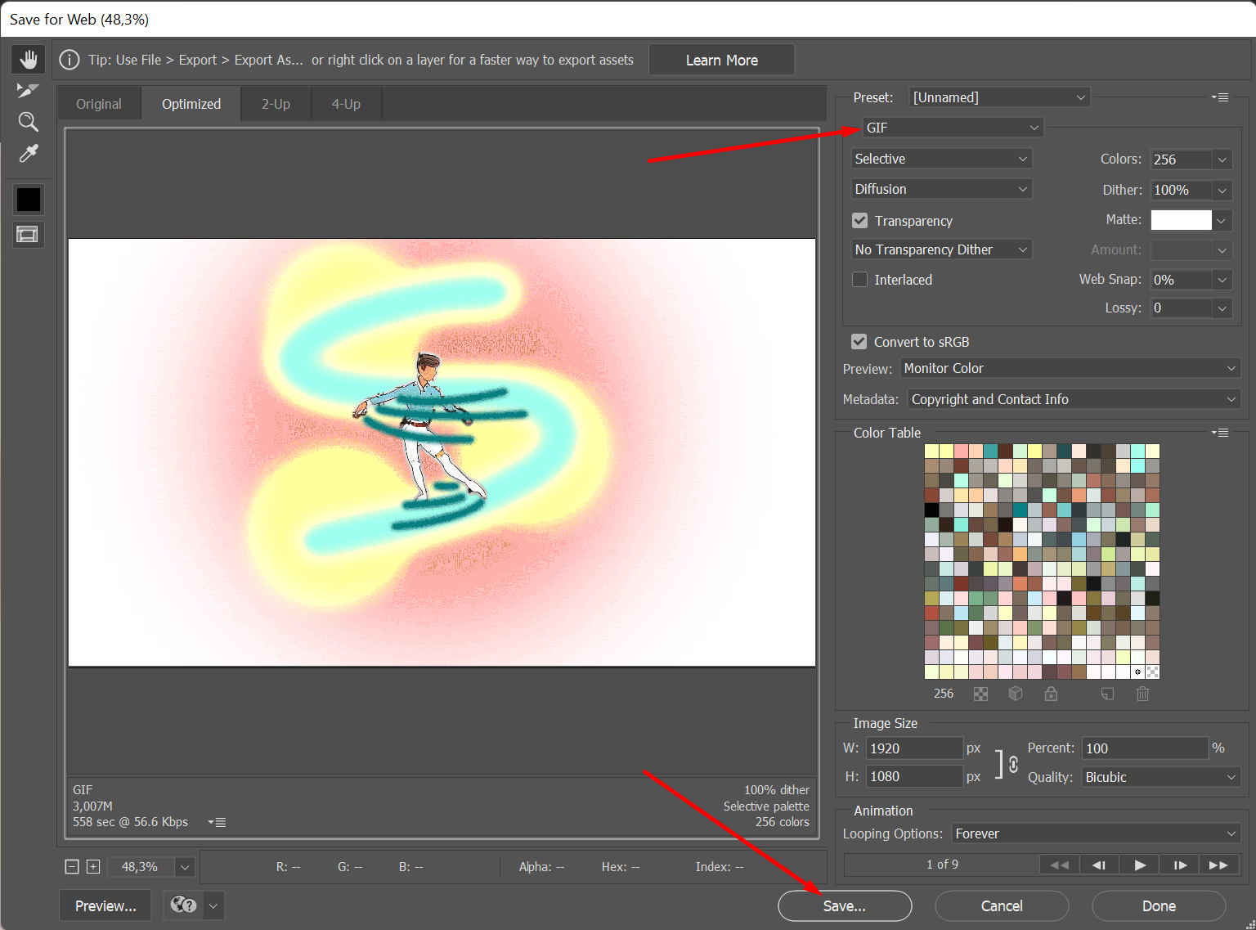
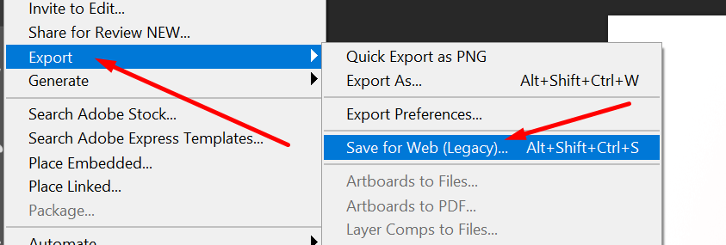
Finalize
Check that the box under the Preset [Unnamed] says "GIF".
And then click "Save" to save the GIF on your Computer.
When the entire timeline is ready,
Just hit "Space" on your keyboard!
You should be able to see your character move smoothly!
Now just hit "Space" again
Then go to "File > Export > Save for Web (Legacy)"

Slide 14
Tips :
Change your frame duration to create the feel of slow or fast motion.
You can use more than one LAYERS on each frame so be creative.
Feel free to search for more video tutorials on the internet.
This tutorial is just ONE way to complete this exercise,
Feel free to follow any other tutorials.
There is no limitation on how many frames or layers you should use on your GIF.
MORE = BETTER & SMOOTHER
https://youtu.be/9b0_3U4olW8?si=W2LIpItBMFVpgrcA
https://youtu.be/PH7vcZjTSLA?si=tEJoQhXV1b838uPN
https://youtu.be/1ovaAasCKp0?si=emVL5iEn9xmNElW3
https://youtu.be/E-sF_1FgpJw?si=H324jRDOKrUpqpEn

Slide 15
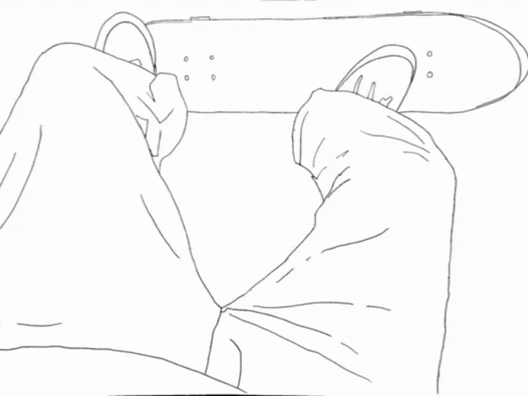
THE END
Tony Gavridakis

